Slide 1
Ising Model Hysteresis

Slide 2
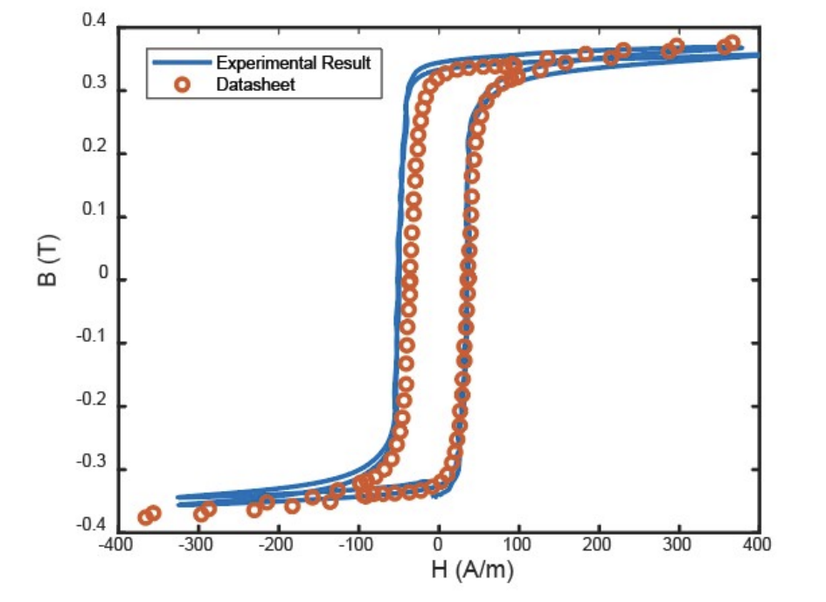
To benchmark the Ising model we need to first tune it with some known results
We know the hysteresis loop of the magnetic core we are using we experimentally verify the result as well

Slide 3
Simulation try 1
Nx=25;
Ny=25;
Nz=70;
T = 0.2; %tempreture why??
k = 1;
J = 0.5;
mu_0 = 4*pi*1e-7;
%time definition and switching speed need to be defined
Time = 0.5e-5; %0.5e-4
dt = 0.2e-7; %e-7
dt1 = 2e-7; %e-7
n = floor(Time/dt);
sw_speed = 100e7; %1e7
mc_steps = sw_speed*dt ; %number of switches in iteration
%core properties
NuT = 10;
Lc = 0.01;
A = 1e-6;
R = 1; %1e-2 %R serise
%scaling
Hc = 1e3;
Mc = 1e5;

Slide 4
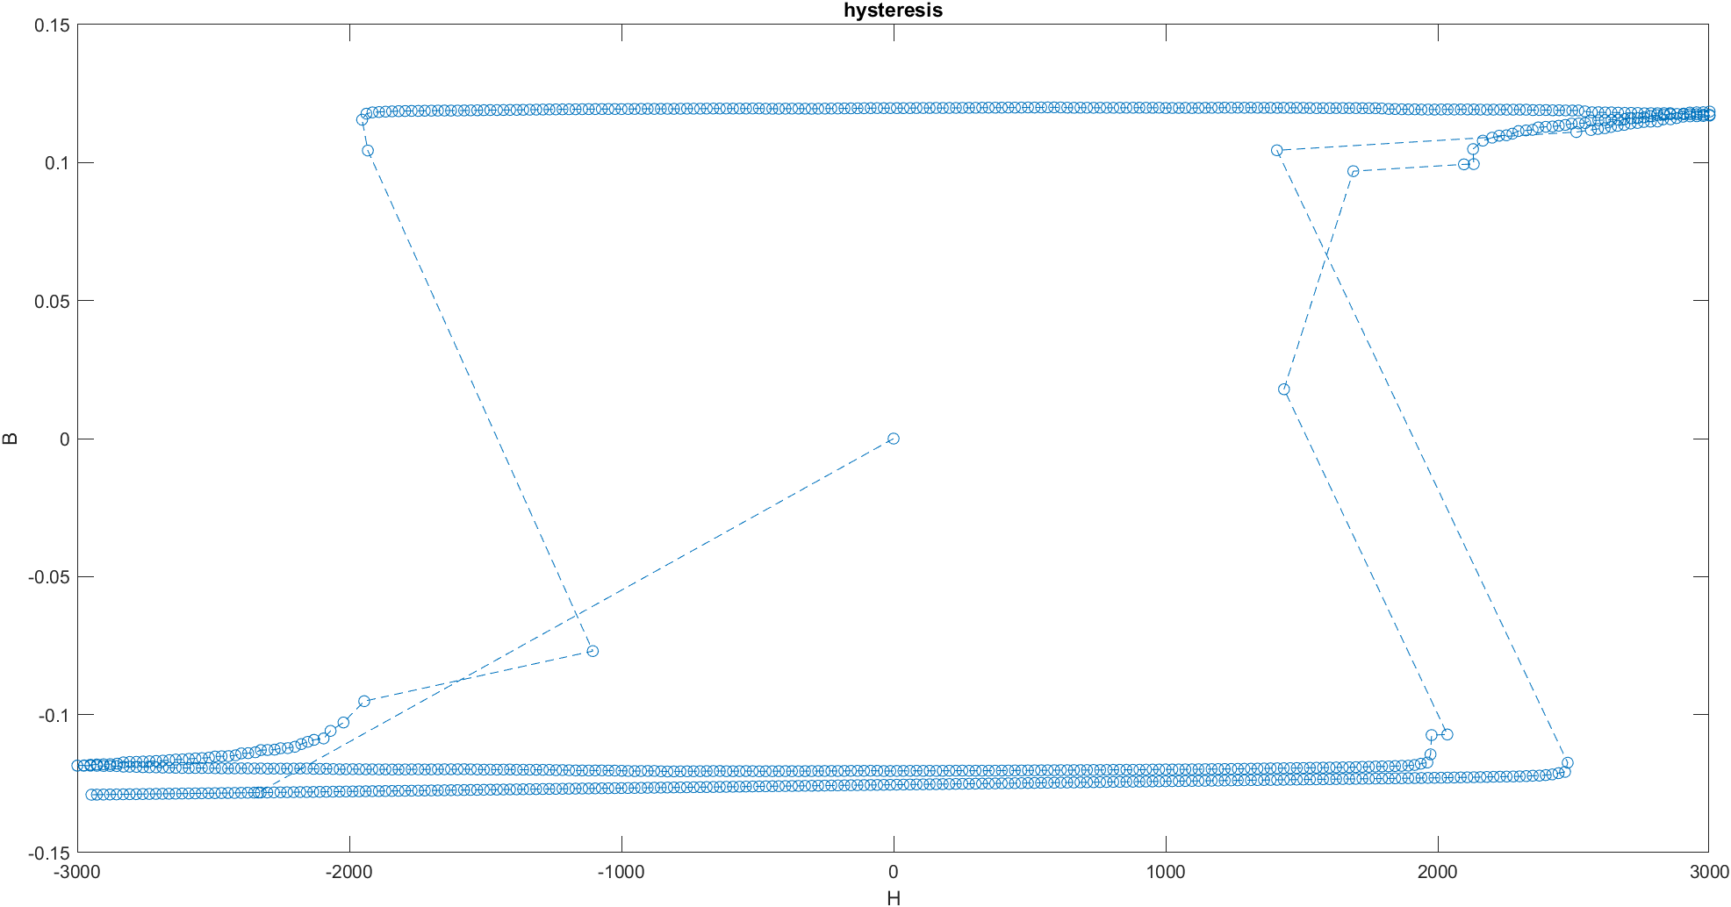
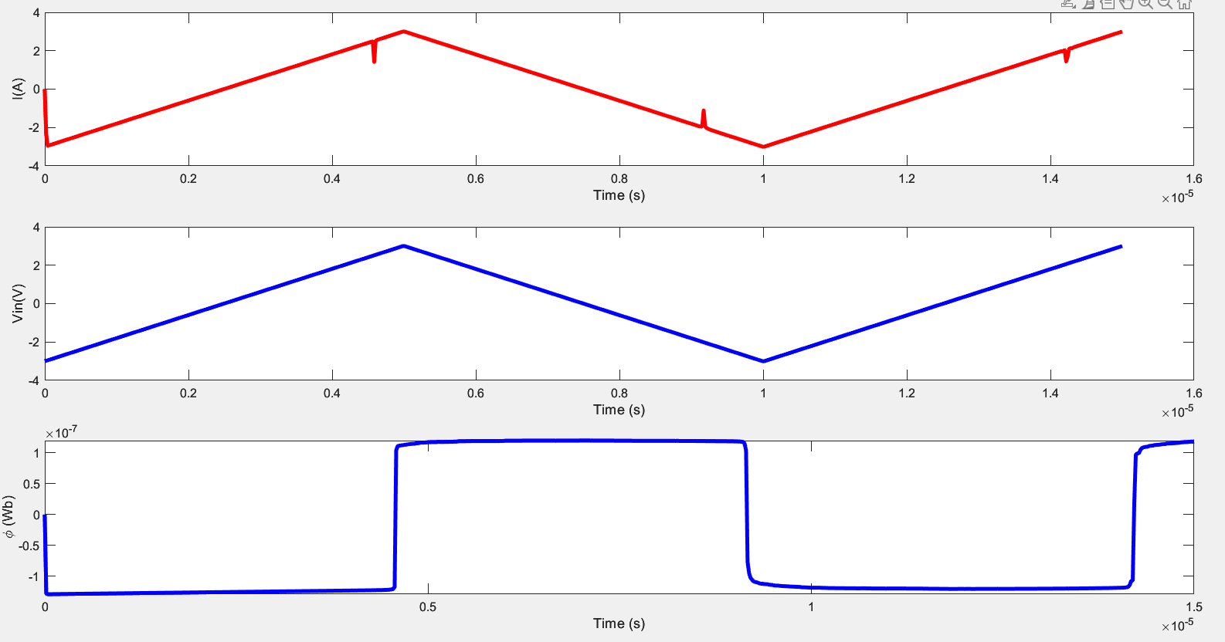
Simulation try 1

Slide 5
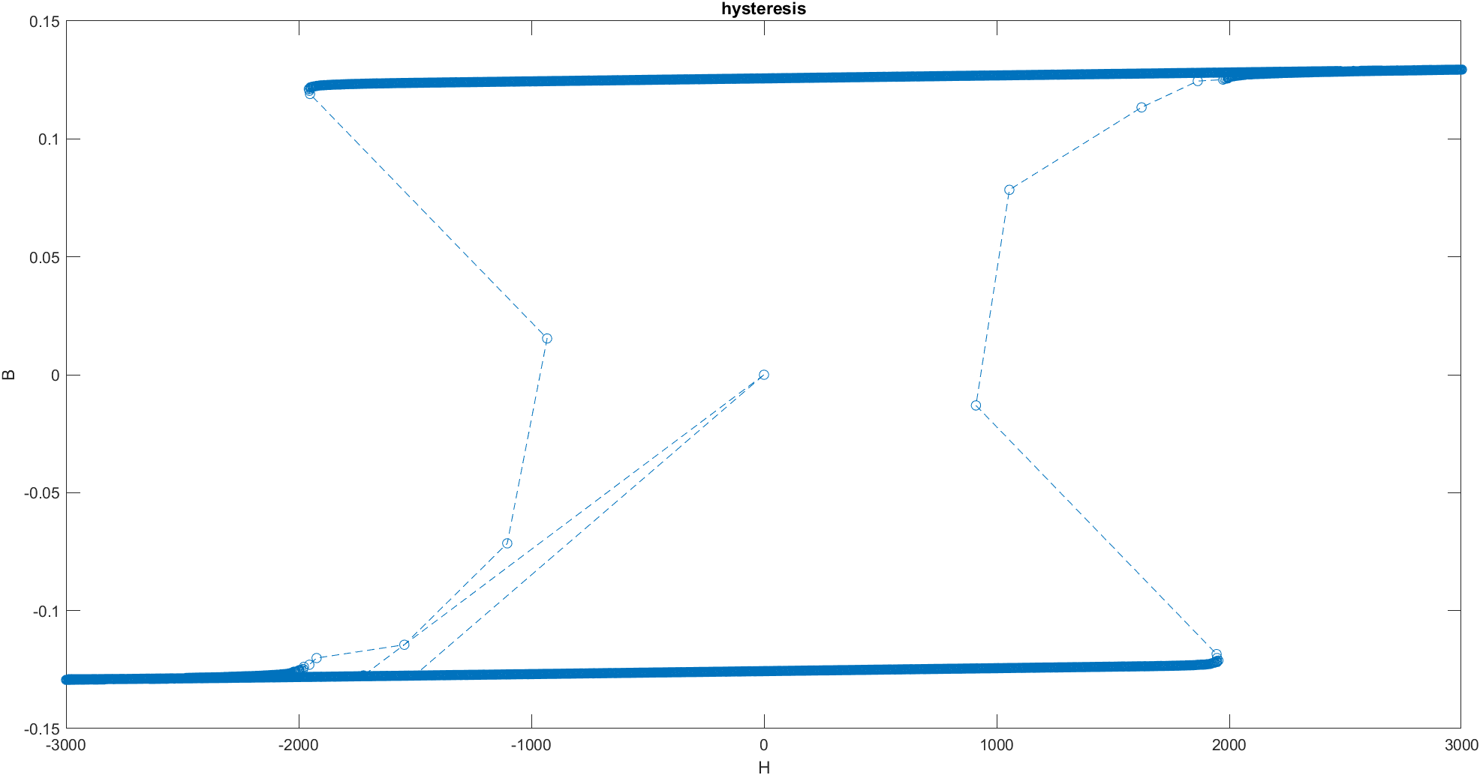
Simulation try 2
Time = 170e-6; %0.5e-4
dt = 1e-7; %e-7
dt1 = 1e-7; %2e-7
n = floor(Time/dt);
In order to match with the experiment measurement setup

Slide 6
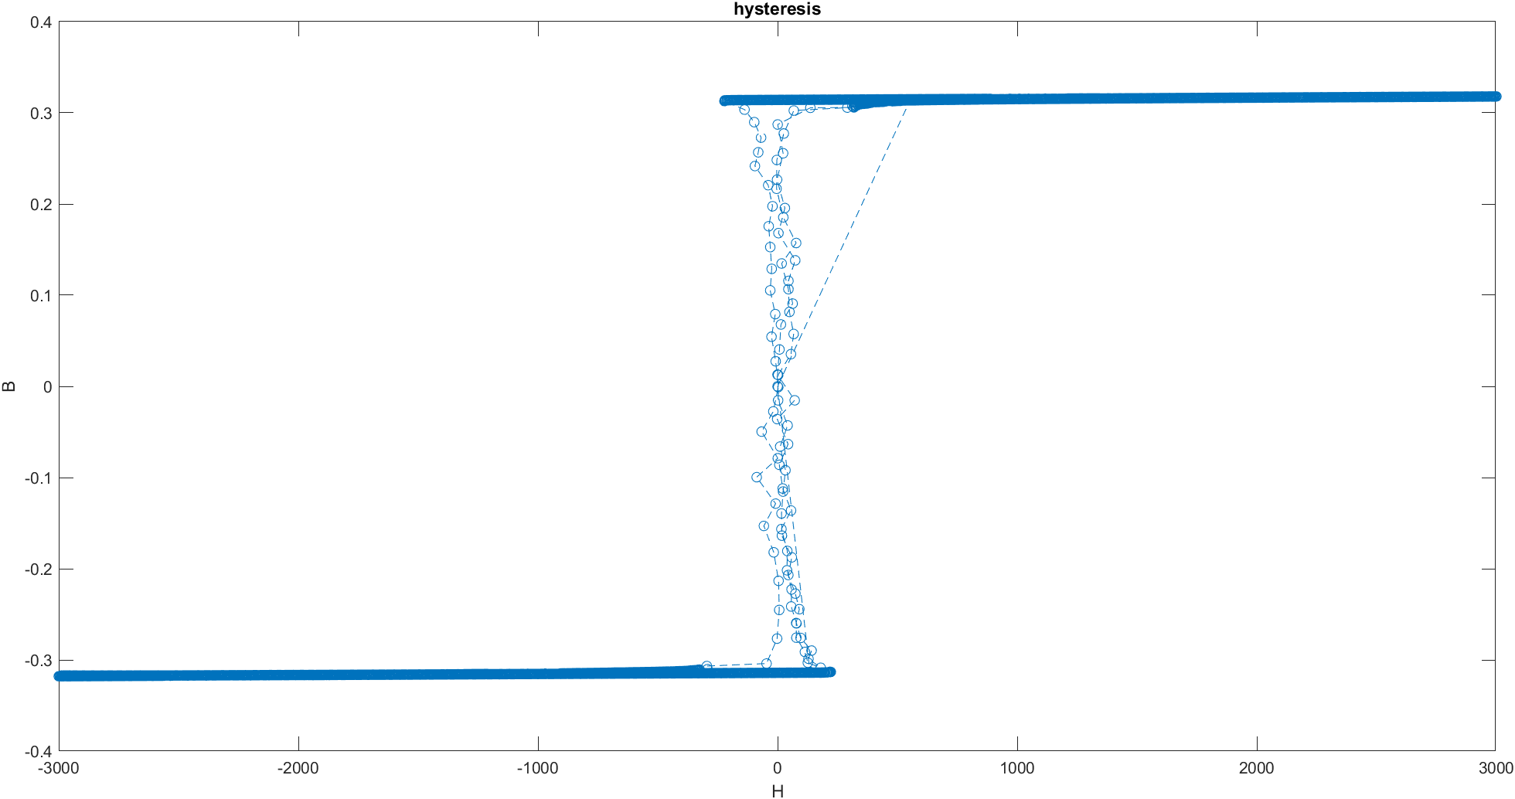
Simulation try 3
%scaling
Hc = 1e3/10; %1e3
Mc = 1e5*2.5; %1e5
In order to match with the experiment result

Slide 7
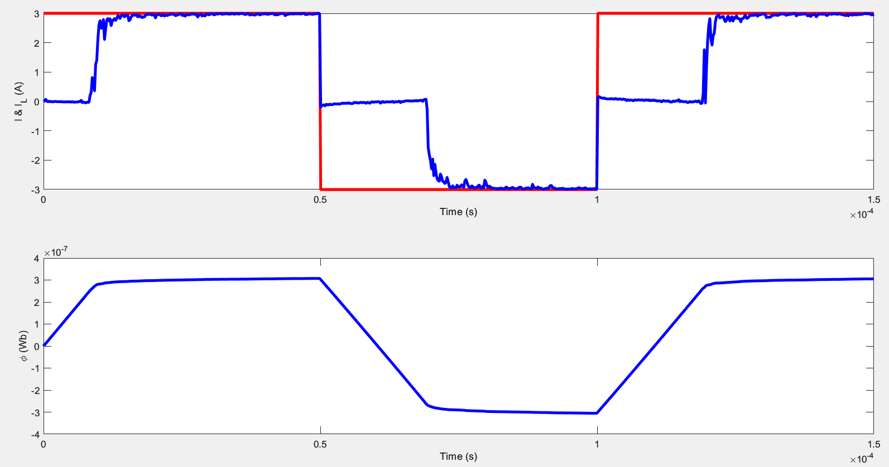
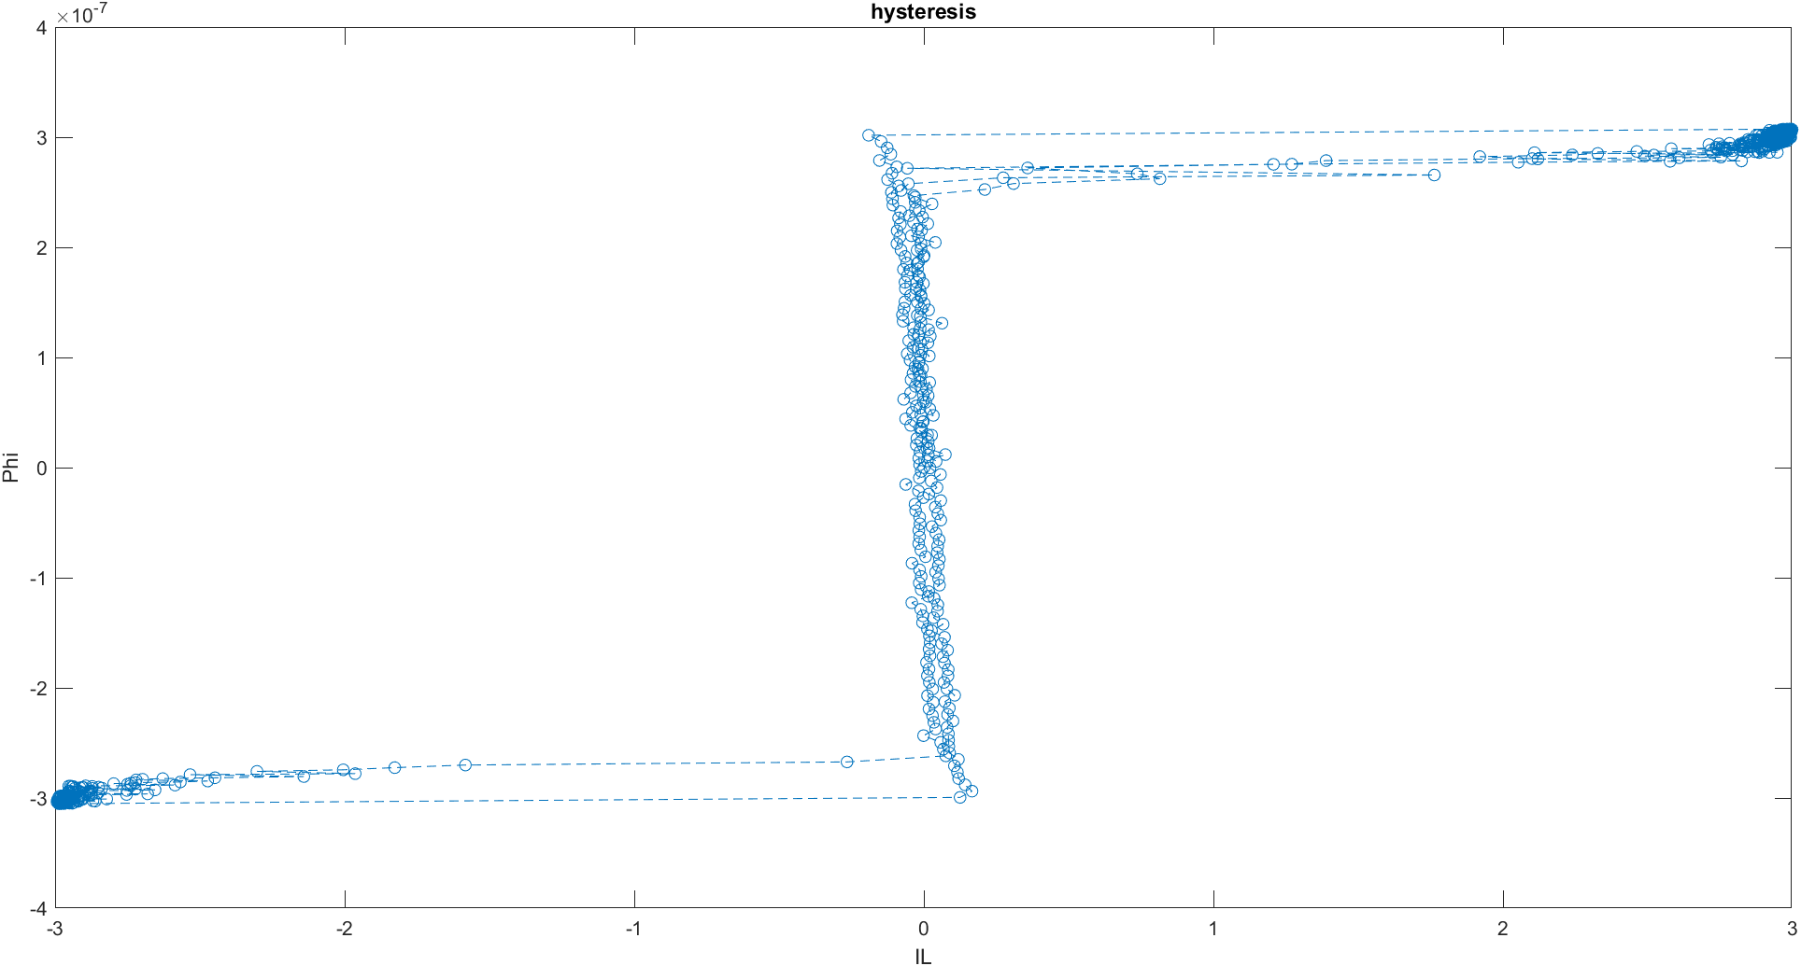
Now NI Ising model with the previous result parameters, Rp = 0.01

Slide 8
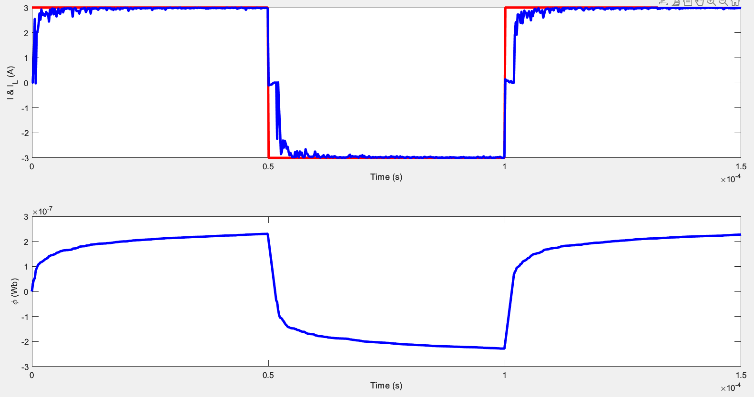
Now NI Ising model with the previous result parameters, Rp = 0.05

