Slide 1












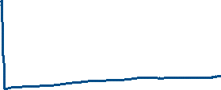

From units

Slide 2
http://hyperphysics.phy-astr.gsu.edu/hbase/magnetic/magfield.html

Slide 3
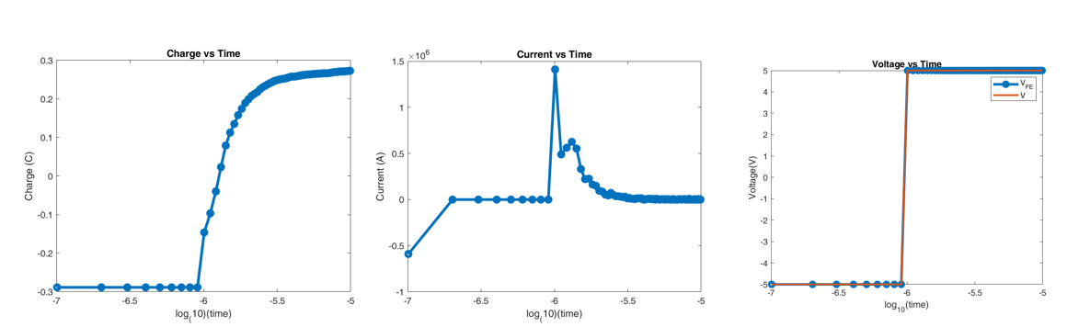















Expected curves

