Slide 1
RESULTS
OELP MEASURING NEGATIVE INDUCTANCE

Slide 2
LANDAU MODEL
HOW alpha, beta, rho

Slide 3
ISING MODEL
J, kT, Hc, Mc, sw_speed -> finalize

Slide 4
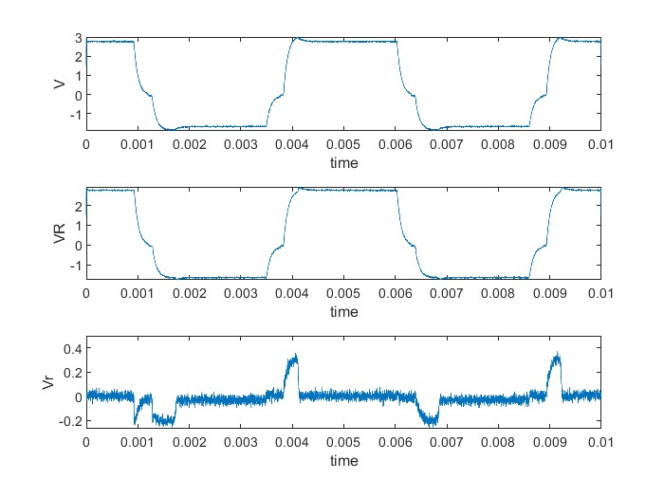
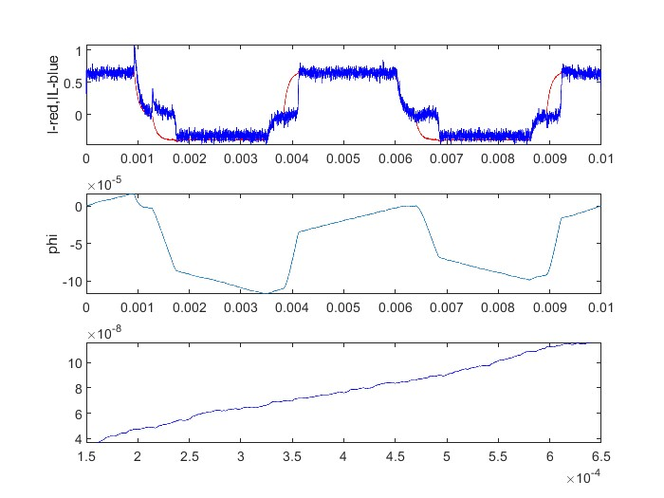
I = 0.5 A, Rp = 0.5, t = 4e-3, samp = 1, N = 20
(output_1.csv)

Slide 5
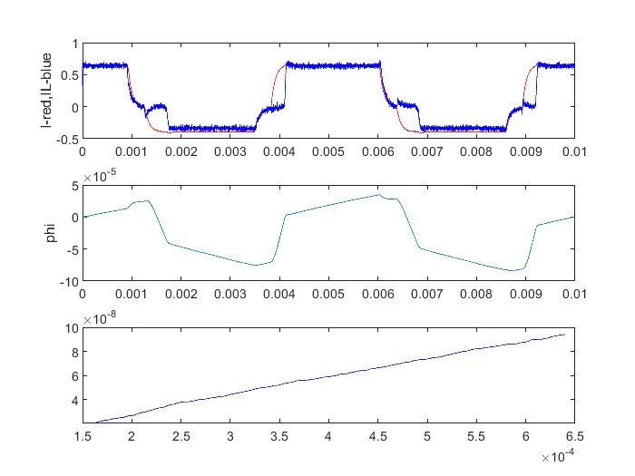
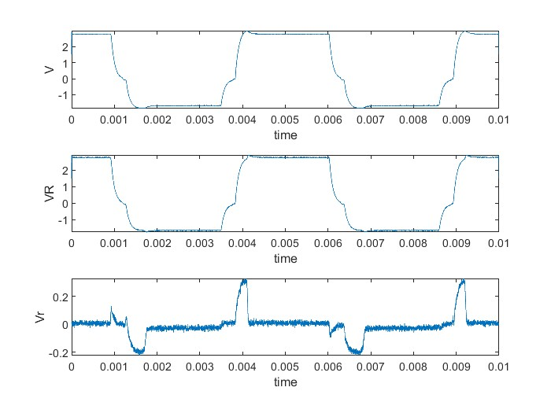
I = 0.5 A, Rp = 0.5, t = 4e-3, samp = 5, N = 20
(output_2.csv)

Slide 6
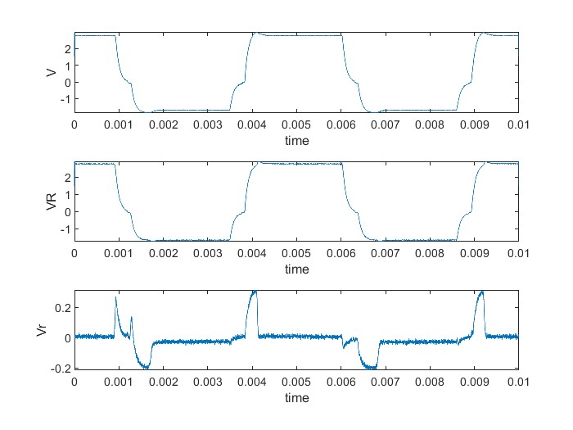
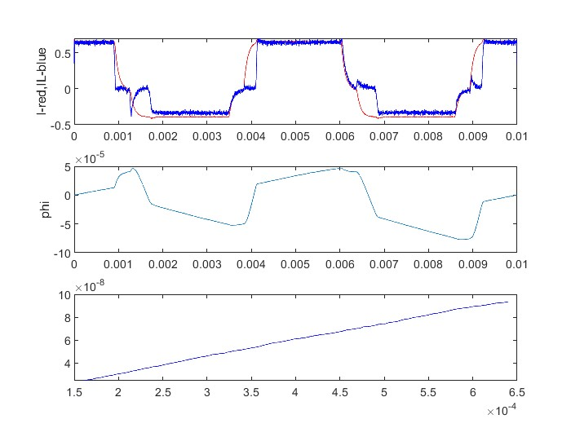
I = 0.5 A, Rp = 0.5, t = 4e-3, samp = 10, N = 20
(output_3.csv)

Slide 7
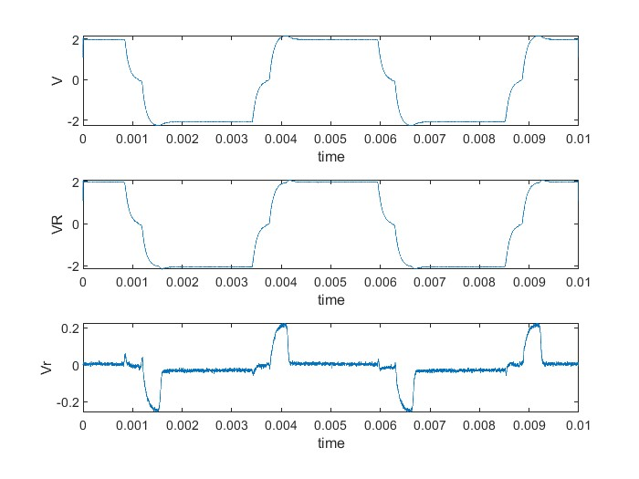
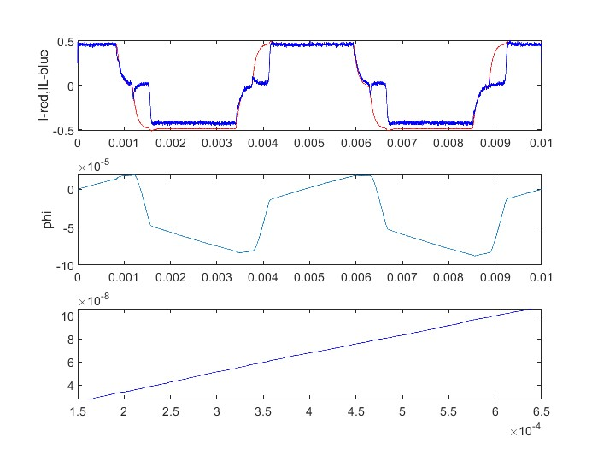
I = 0.5 A, Rp = 0.5, t = 4e-3, samp = 20, N = 20
(output_4.csv)

Slide 8
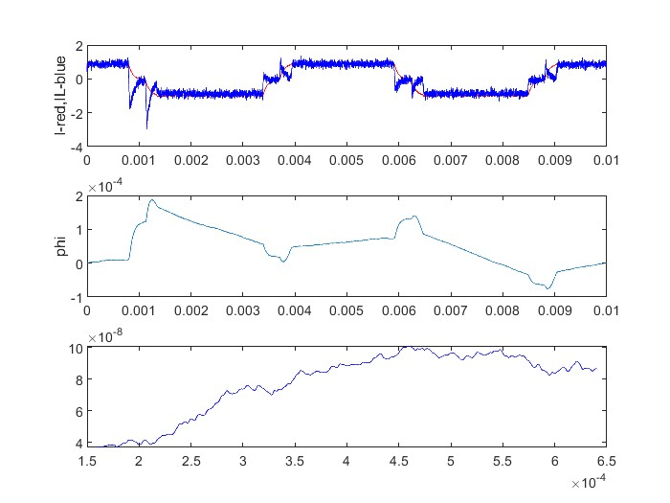
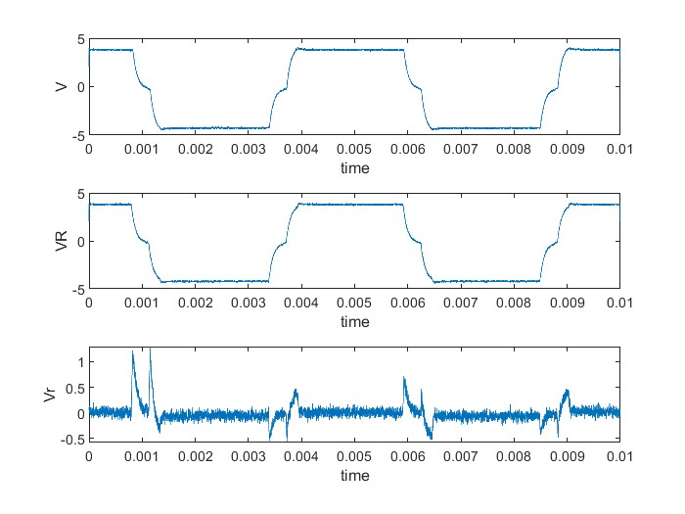
I = 1 A, Rp = 0.5, t = 4e-3, samp = 1, N = 20
(output_5.csv)

Slide 9
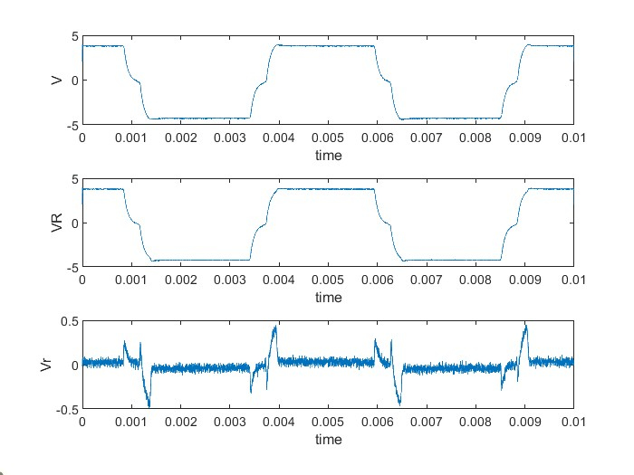
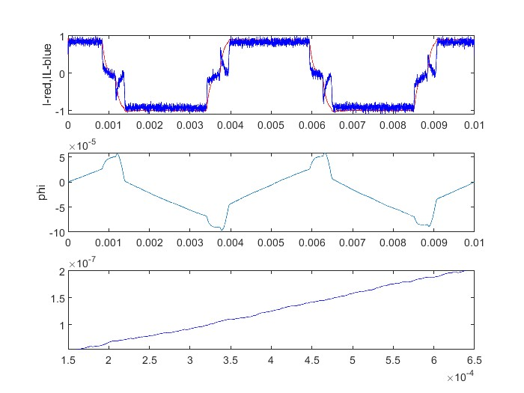
I = 1 A, Rp = 0.5, t = 4e-3, samp = 5, N = 20
(output_6.csv)

Slide 10
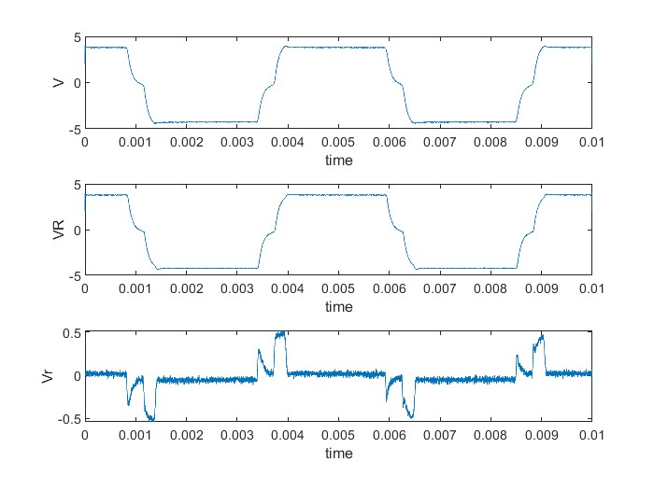
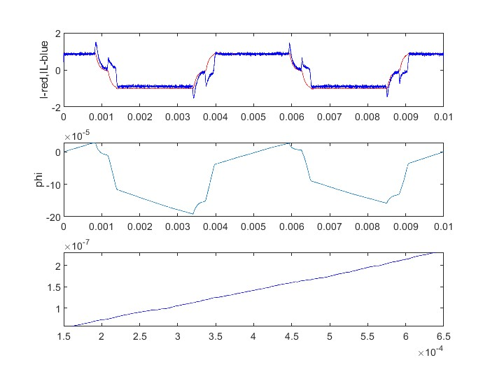
I = 1 A, Rp = 0.5, t = 4e-3, samp = 10, N = 20
(output_7.csv)

Slide 11
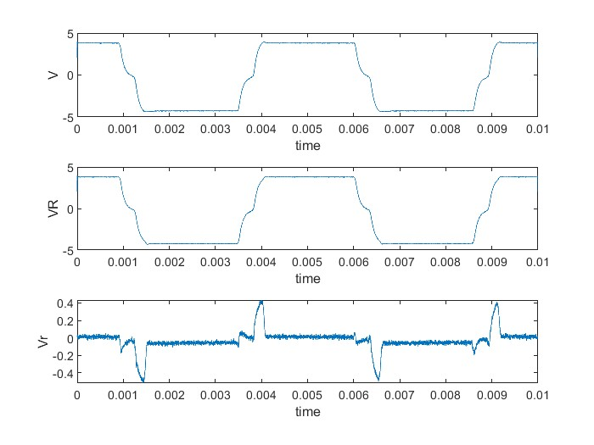
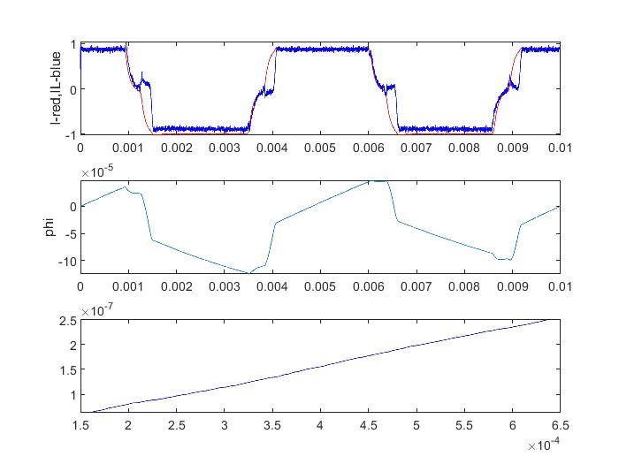
I = 1 A, Rp = 0.5, t = 4e-3, samp = 20, N = 20
(output_8.csv)

Slide 12
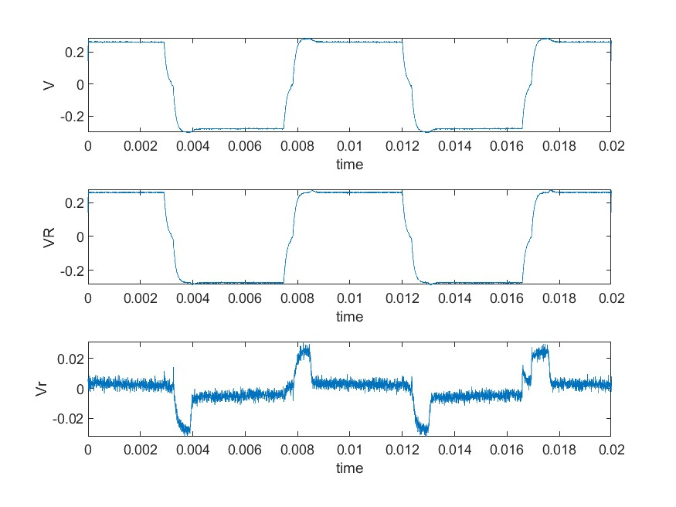
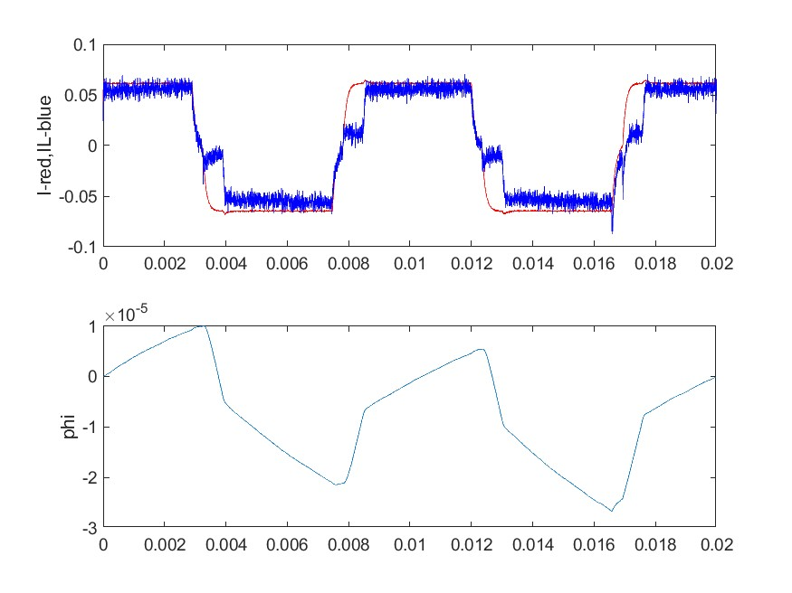
I = 0.5 A, Rp = 0.5, t = 4e-3, samp = 1, N = 40
(output_9.csv)
Resistance used to calculate is wrong!!!
It is 5.5ohm but used 4.2 in calculation….
But the resistance also fluctuating at the test setup

Slide 13
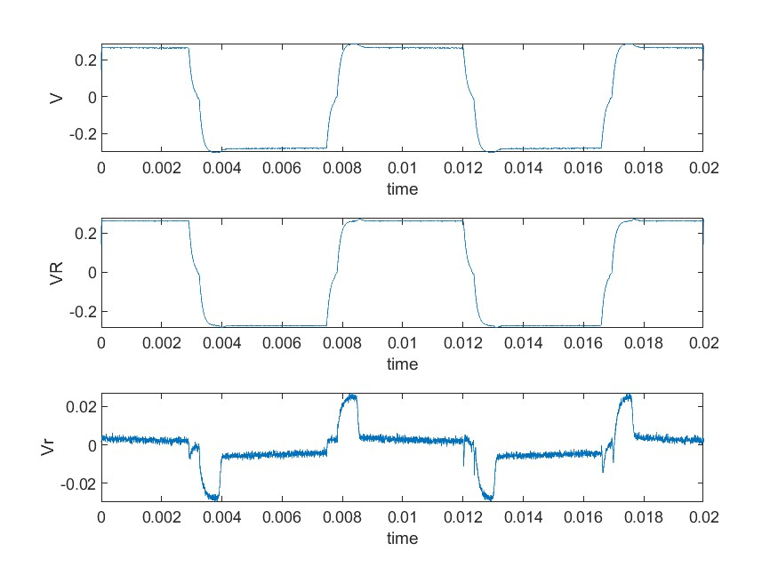
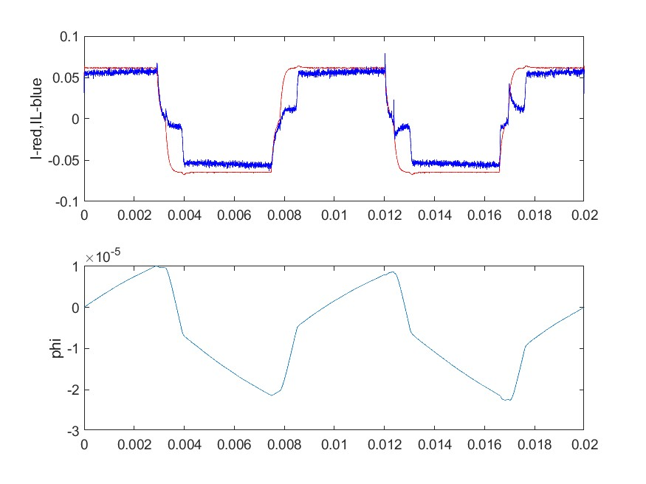
I = 0.5 A, Rp = 0.5, t = 4e-3, samp = 5, N = 40
(output_10.csv)
Resistance used to calculate is wrong!!!
It is 5.5ohm but used 4.2 in calculation….
But the resistance also fluctuating at the test setup

Slide 14
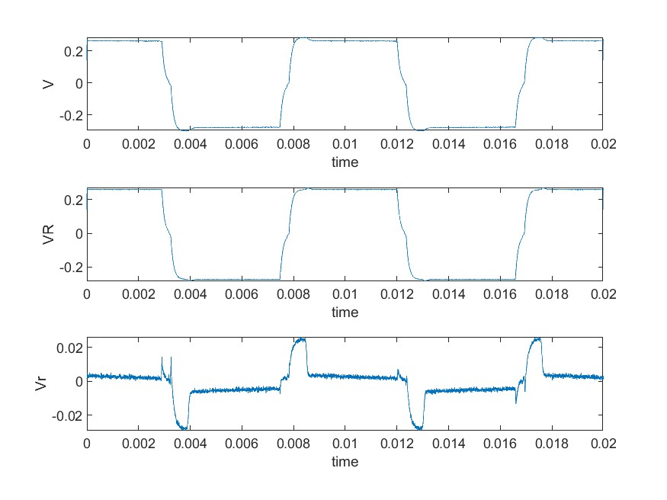
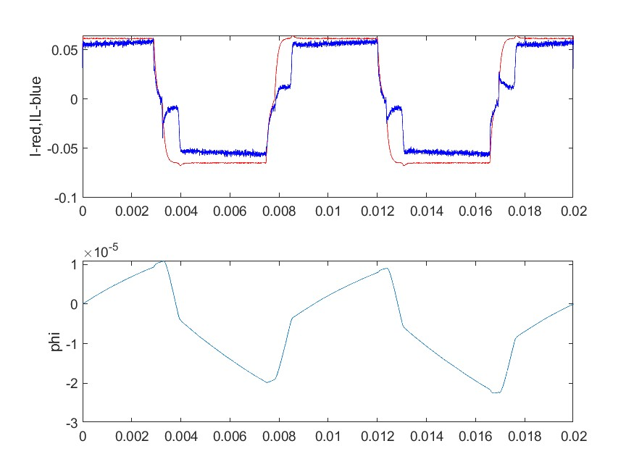
I = 0.5 A, Rp = 0.5, t = 4e-3, samp = 10, N = 40
(output_11.csv)
Resistance used to calculate is wrong!!!
It is 5.5ohm but used 4.2 in calculation….
But the resistance also fluctuating at the test setup

Slide 15
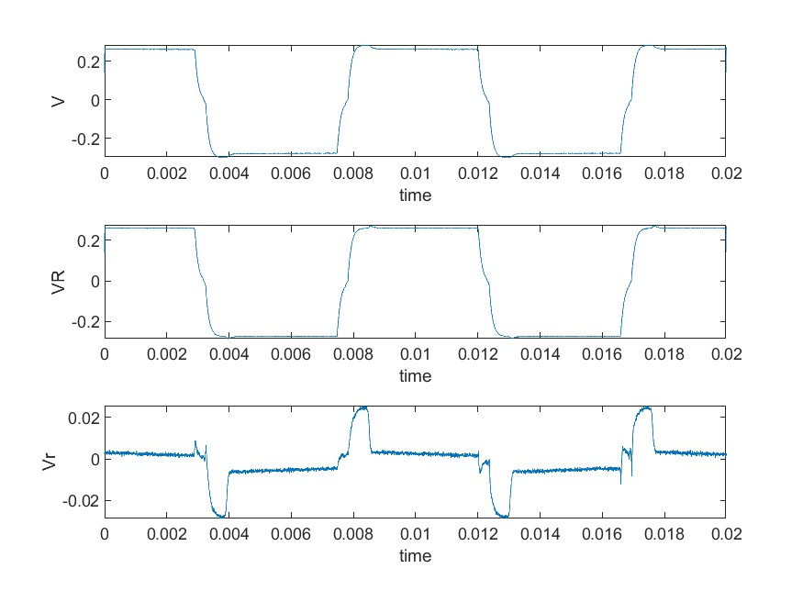
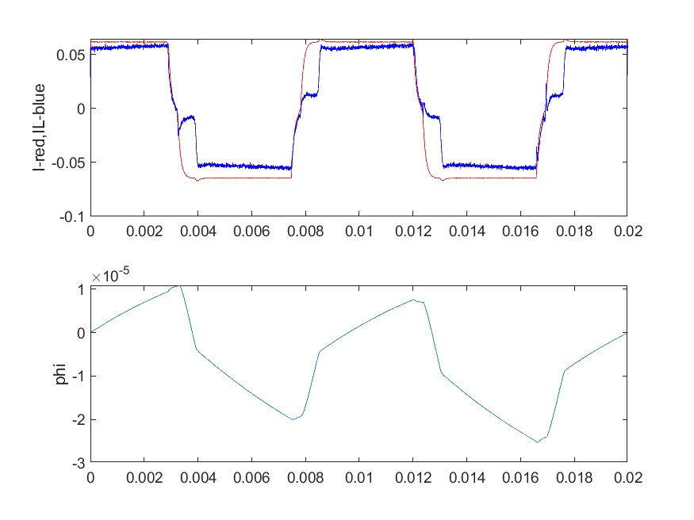
I = 0.5 A, Rp = 0.5, t = 4e-3, samp = 20, N = 40
(output_12.csv)
Resistance used to calculate is wrong!!!
It is 5.5ohm but used 4.2 in calculation….
But the resistance also fluctuating at the test setup

Slide 16
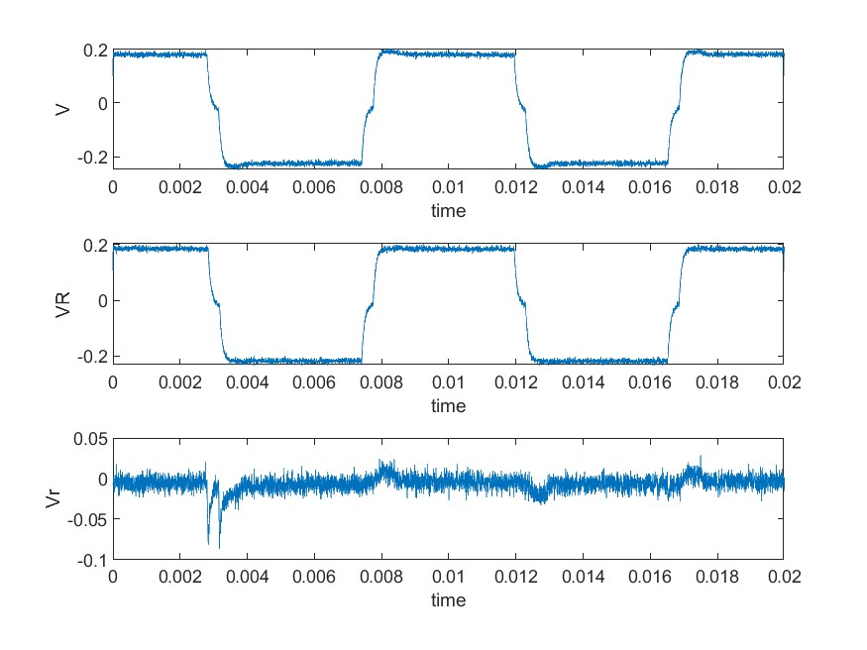
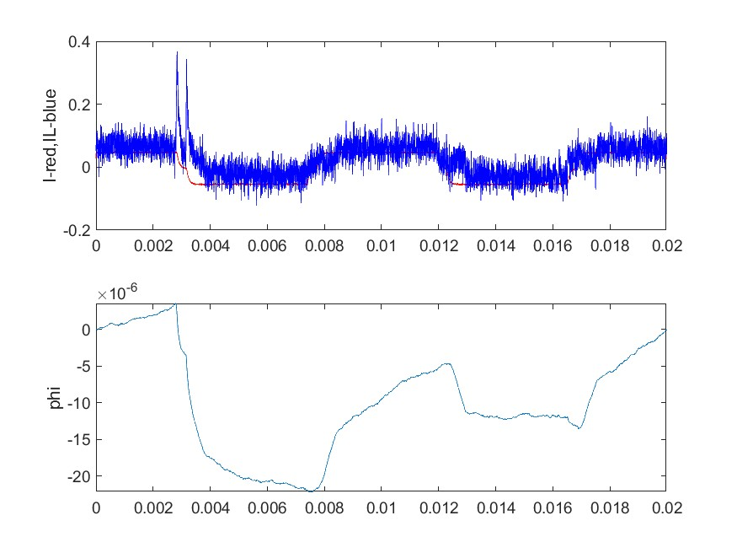
I = 0.5 A, Rp = 0.25, t = 4e-3, samp = 1, N = 20
(output_17.csv)

Slide 17
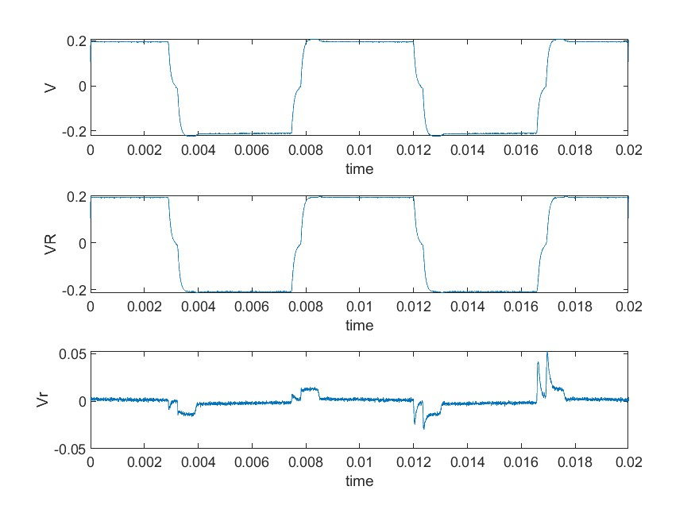
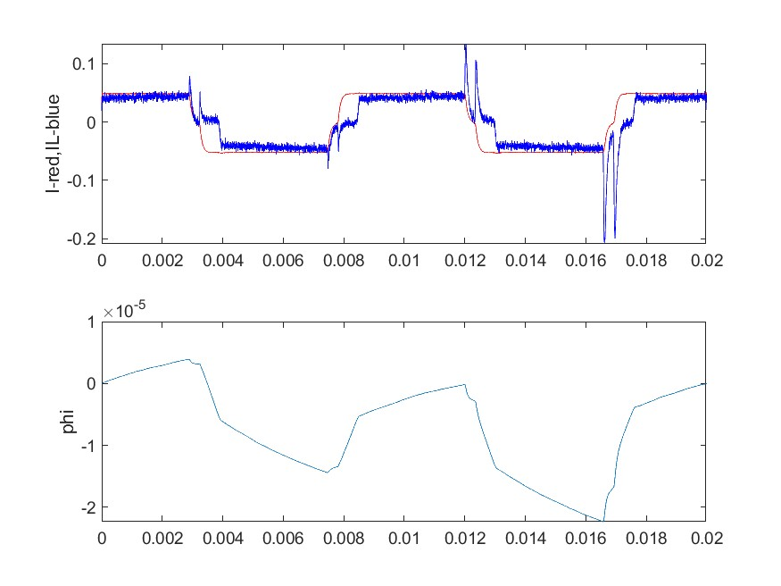
I = 0.5 A, Rp = 0.25, t = 4e-3, samp = 5, N = 20
(output_18.csv)

Slide 18
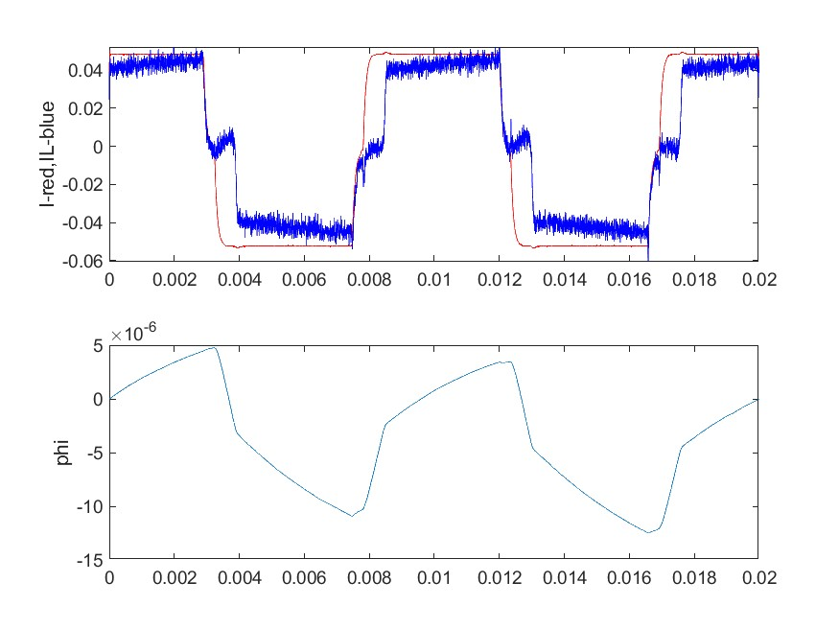
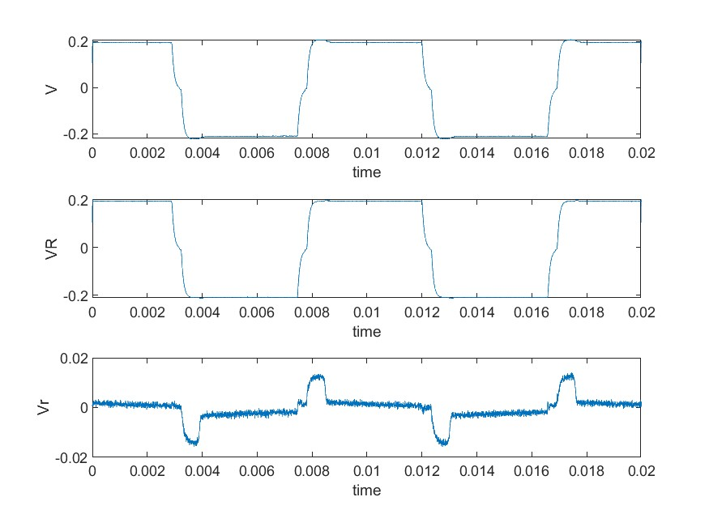
I = 0.5 A, Rp = 0.25, t = 4e-3, samp = 10, N = 20
(output_19.csv)

Slide 19
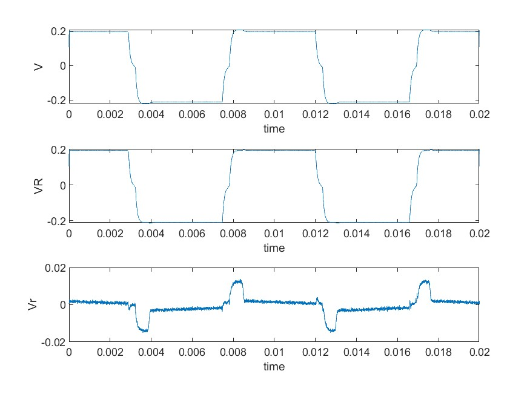
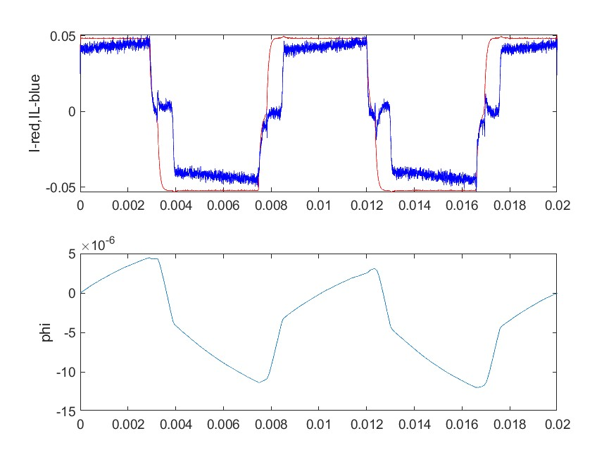
I = 0.5 A, Rp = 0.25, t = 4e-3, samp = 20, N = 20
(output_20.csv)

Slide 20
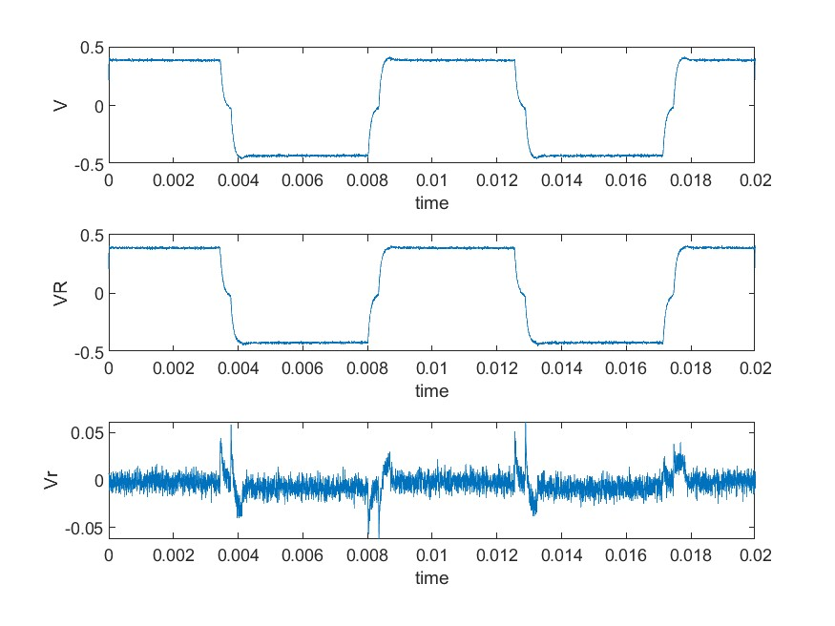
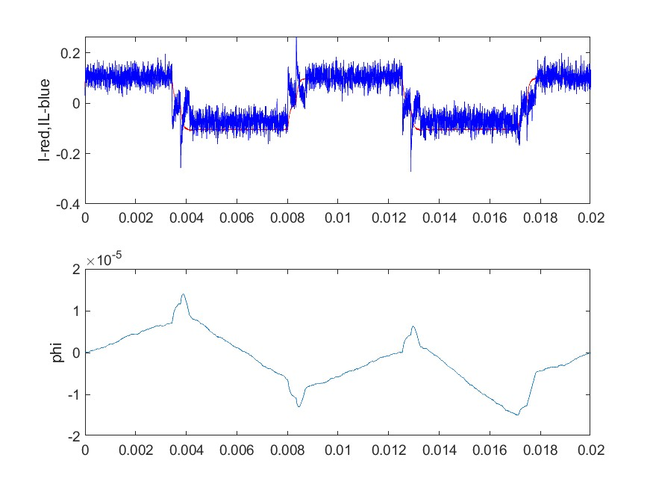
I = 1 A, Rp = 0.25, t = 4e-3, samp = 1, N = 20
(output_21.csv)

Slide 21
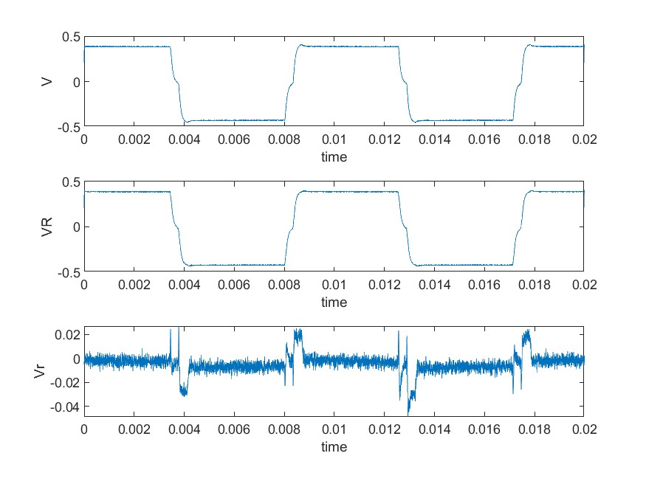
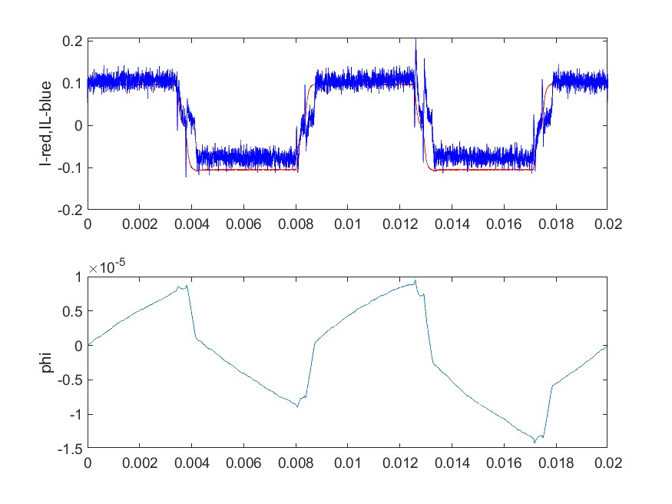
I = 1 A, Rp = 0.25, t = 4e-3, samp = 5, N = 20
(output_22.csv)

Slide 22
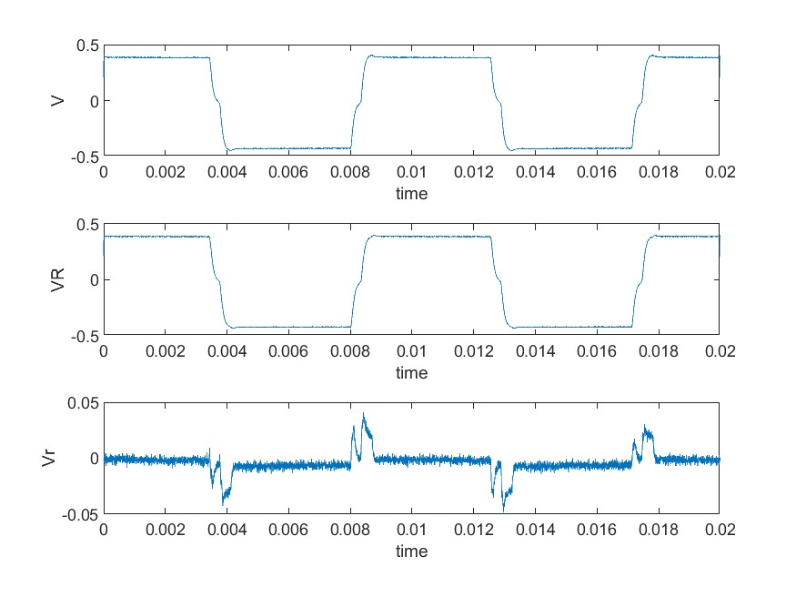
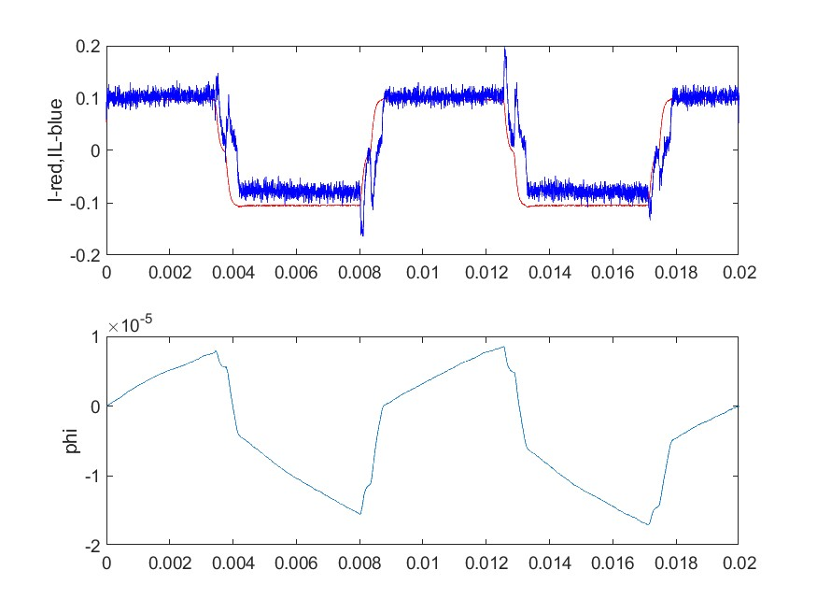
I = 1 A, Rp = 0.25, t = 4e-3, samp = 10, N = 20
(output_23.csv)

Slide 23
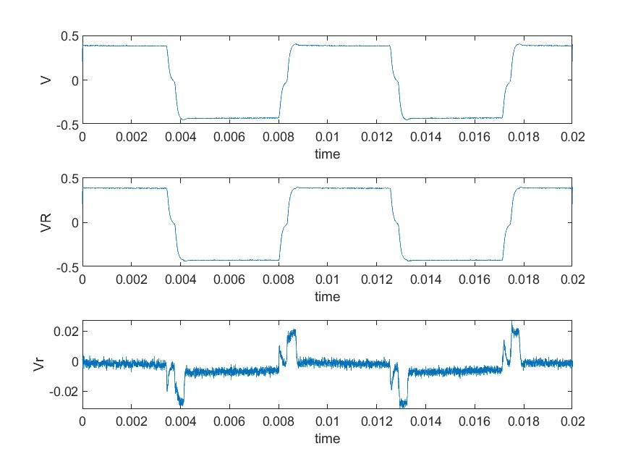
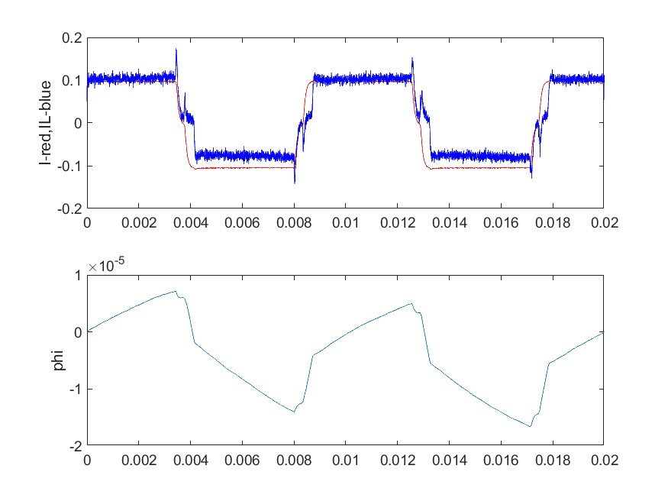
I = 1 A, Rp = 0.25, t = 4e-3, samp = 20, N = 20
(output_24.csv)

Slide 24
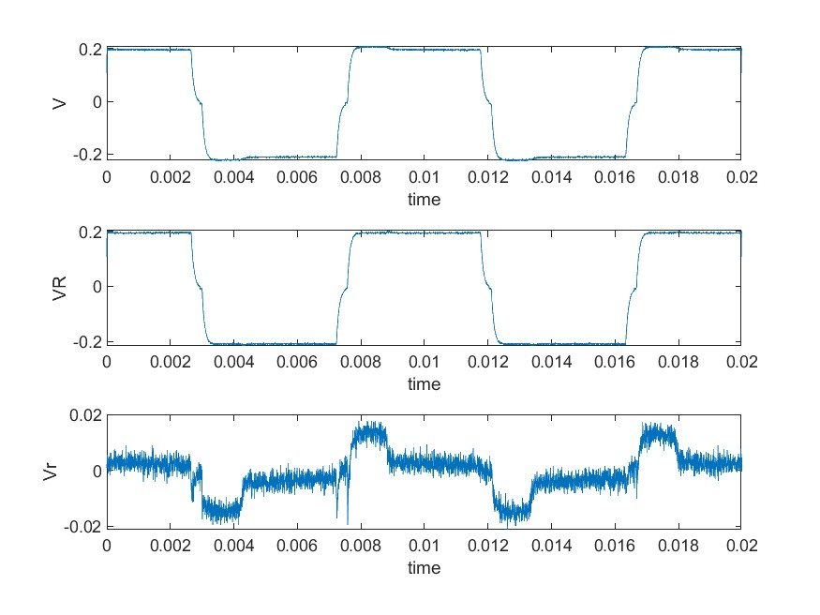
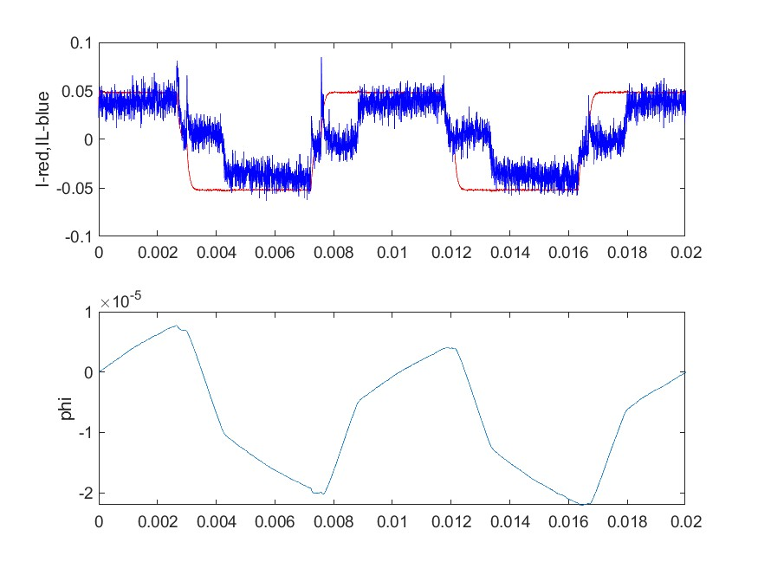
I = 0.5 A, Rp = 0.25, t = 4e-3, samp = 1, N = 40
(output_25.csv)

Slide 25
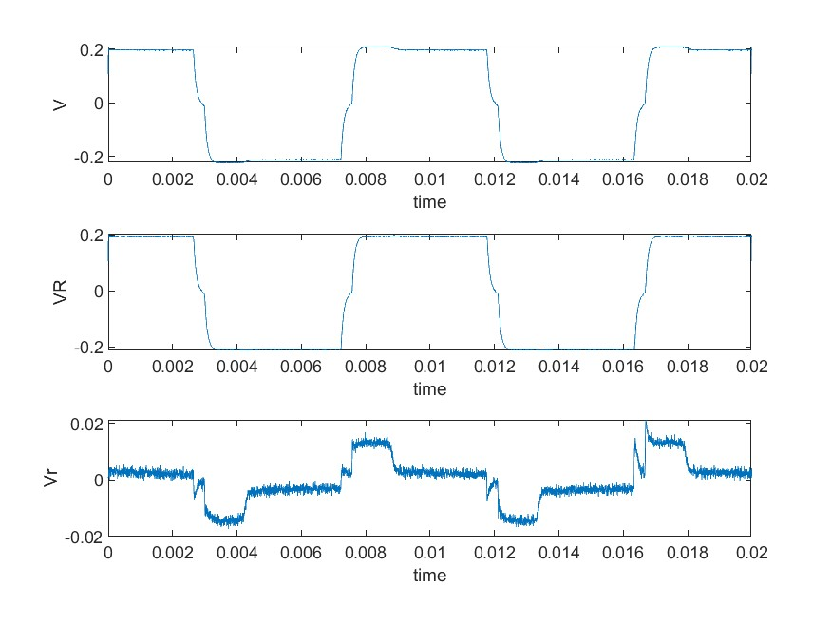
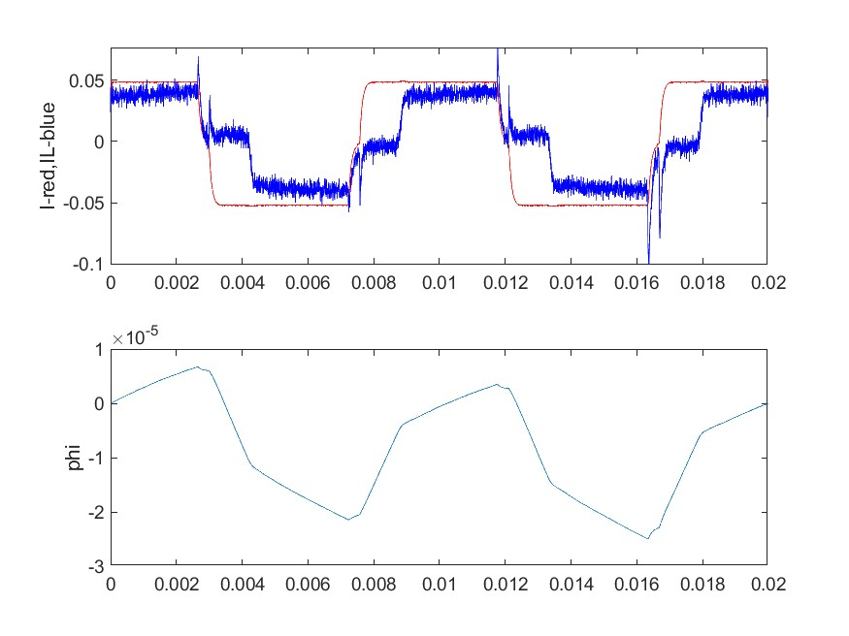
I = 0.5 A, Rp = 0.25, t = 4e-3, samp = 5, N = 40
(output_26.csv)

Slide 26
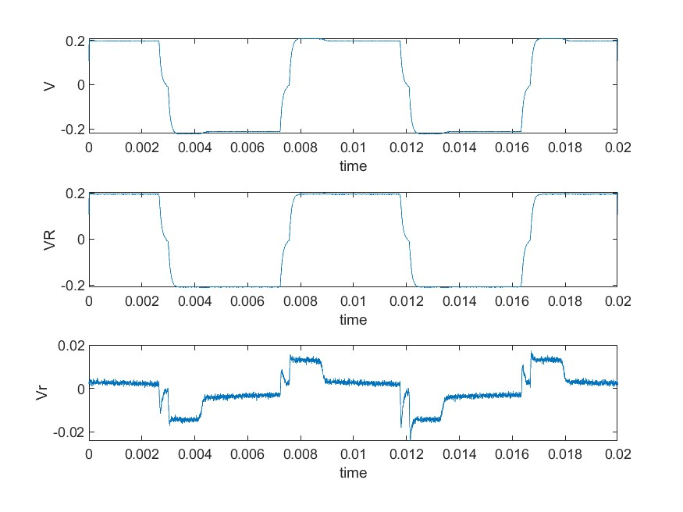
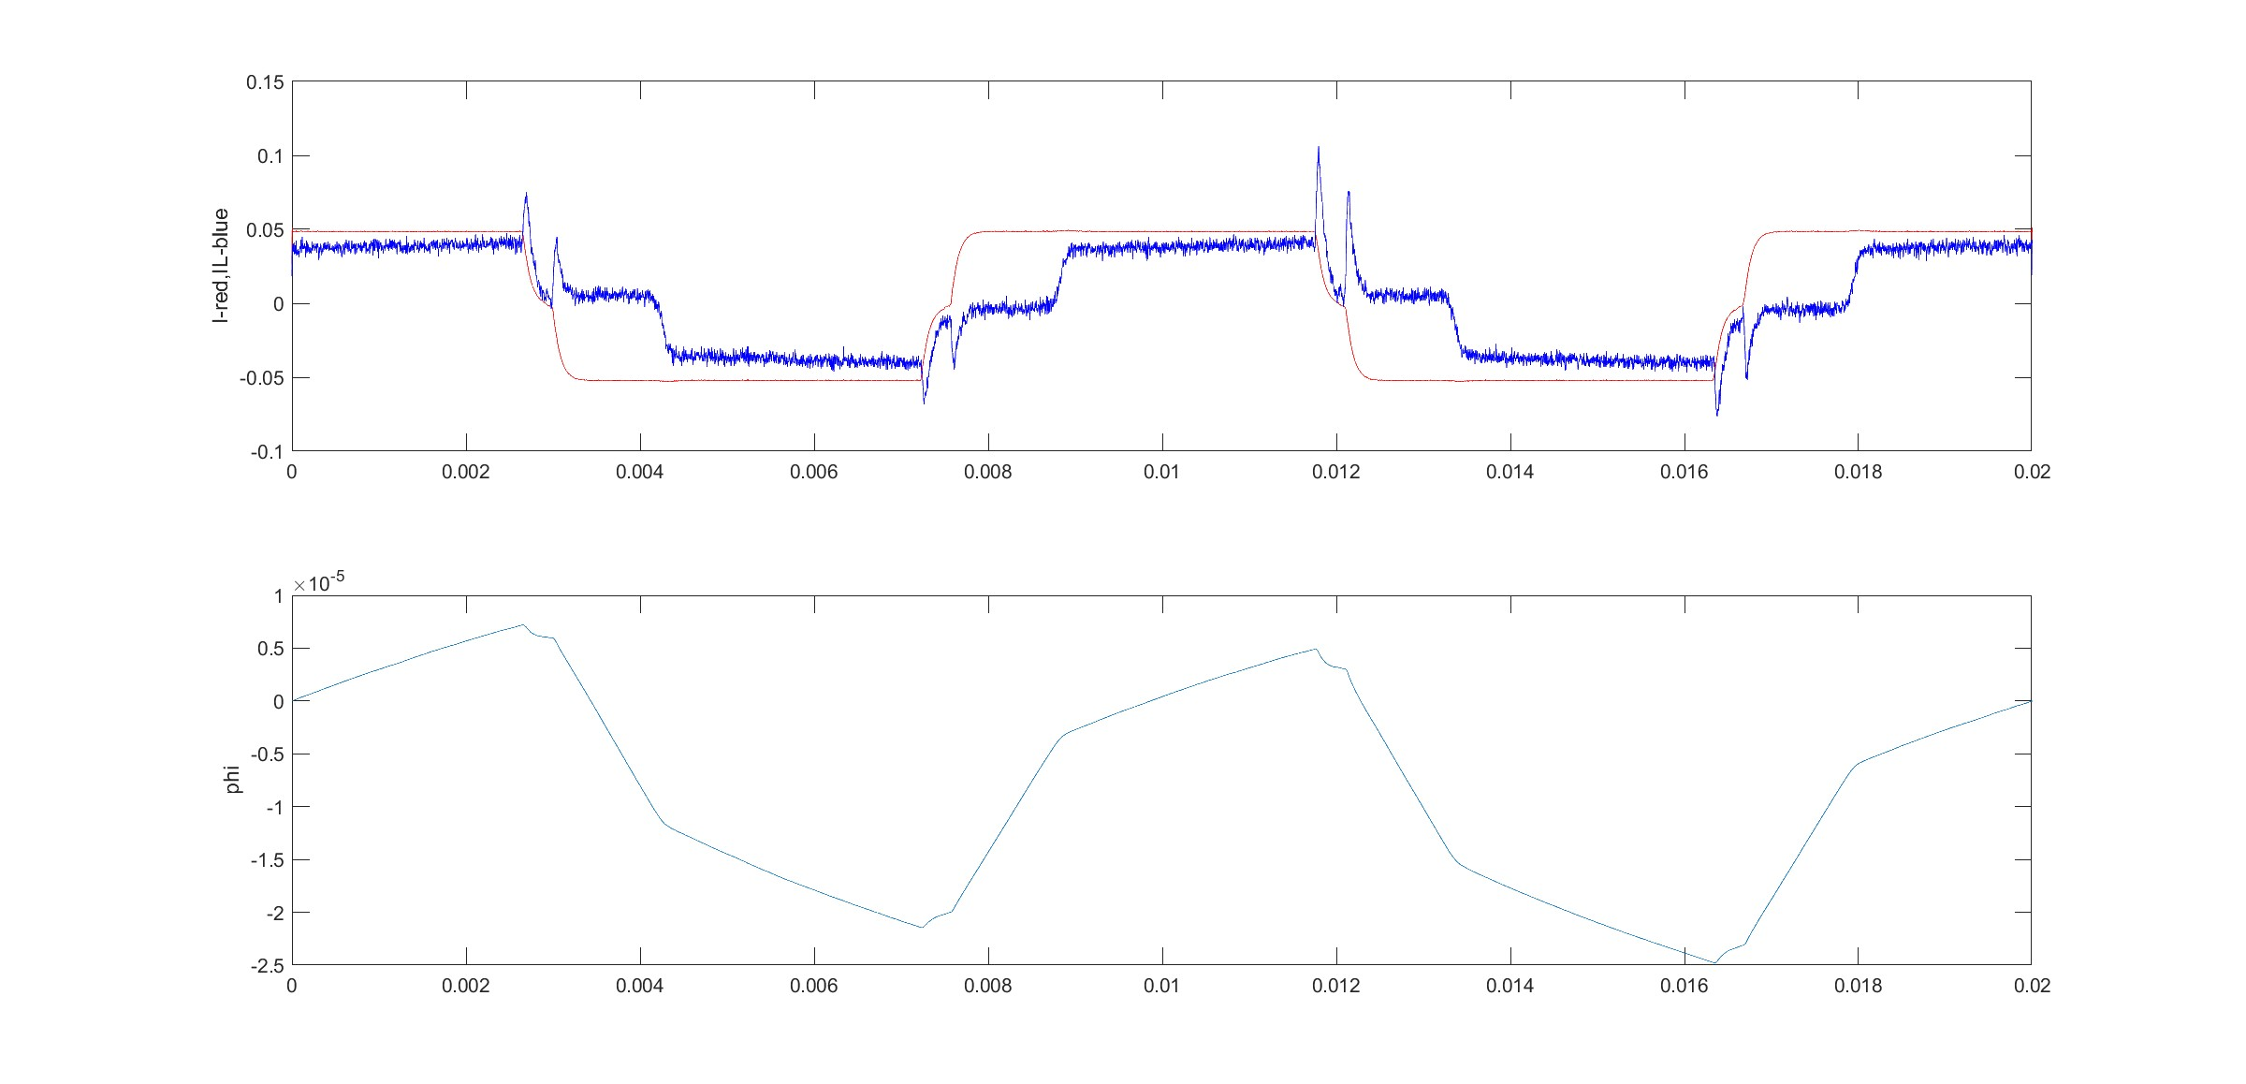
I = 0.5 A, Rp = 0.25, t = 4e-3, samp = 10, N = 40
(output_27.csv)

Slide 27
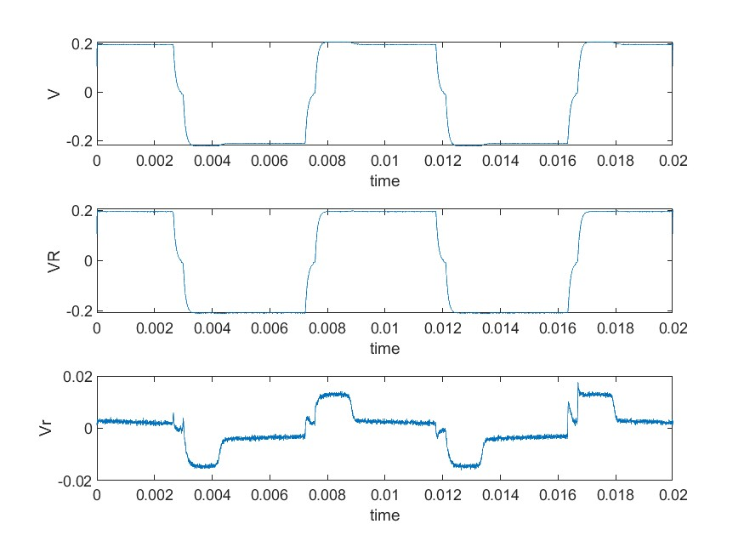
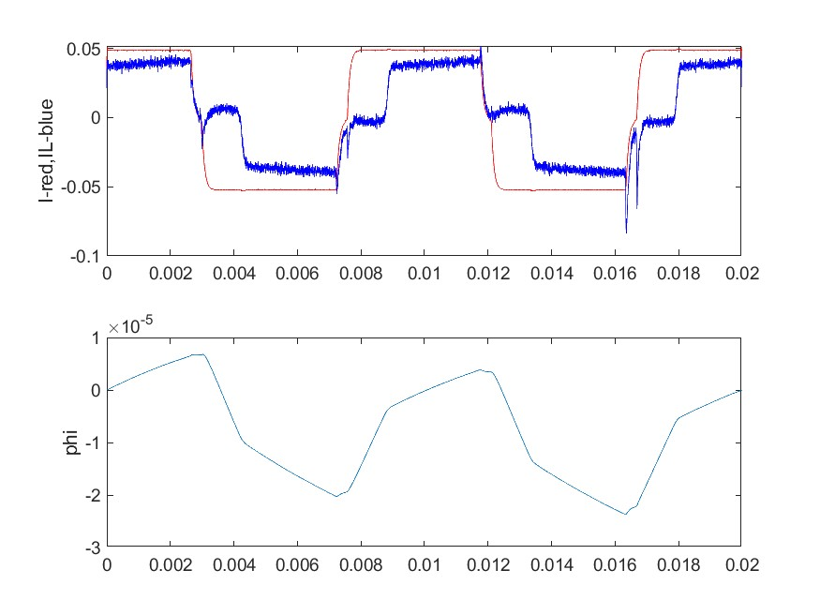
I = 0.5 A, Rp = 0.25, t = 4e-3, samp = 20, N = 40
(output_28.csv)

Slide 28
I = 0.5 A, Rp = 0.25, t = 4e-3, samp = 20, N = 40
(output_28.csv)

Slide 29
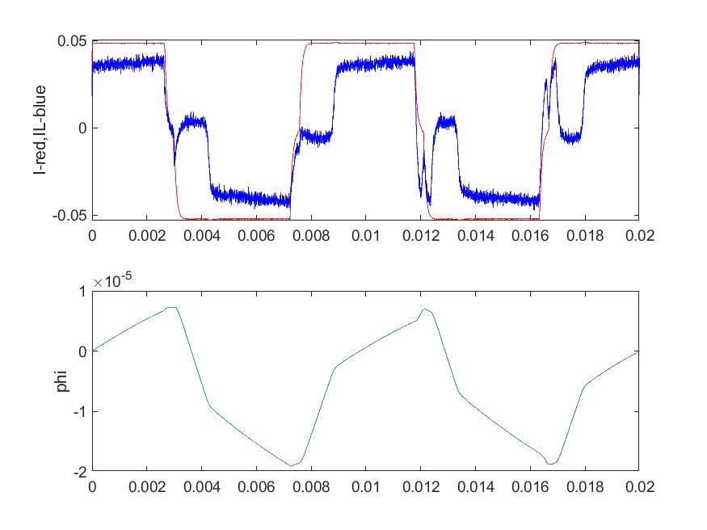
One of the best results we got

