Slide 1
MICROSOFT AZURE
2400032235
K. Manikanta Sai
Sec: 56i
Azure NAT Gateway
for Predictable Outbound Connectivity
Team: T239
Private VM • Predictable SNAT • Controlled Egress
01
PROJECT CODE
02
DOMAIN
03
PLATFORM
24CC3046-P035
Cloud Networking
Microsoft Azure
24CC3046-P035 • Azure NAT Gateway • 1

Slide 2
Problem Statement & Objectives
Why predictable outbound connectivity is needed
!
THE PROBLEM
✓
PROJECT OBJECTIVES
Private workloads need Internet access without exposing each VM with a public IP.
Key challenges:
• Unpredictable outbound source addresses
• Public IP exposure of workloads
• Uncontrolled outbound destinations
• High volumes of outbound connections
• SNAT port utilization concerns
1. Provide predictable outbound Internet access.
2. Keep the VM private with no VM-level public IP.
3. Perform SNAT through Azure NAT Gateway.
4. Use a stable public IP for outbound traffic.
5. Control outbound destinations with an NSG.
6. Reduce the risk of SNAT port exhaustion.
24CC3046-P035 • Azure NAT Gateway • 2

Slide 3
Solution Architecture
Private workload → NSG → NAT Gateway → Internet
UBUNTU VM
NSG
NAT GATEWAY
PUBLIC IP
INTERNET
vm-nat-test
Private IP: 10.0.1.4
5 approved IPs
Other Internet → DENY
natgw-project
Standard SKU
4.224.18.198
pip-nat-project
External
services
Outbound flow
PRIVATE SOURCE
NSG FILTER
SNAT
PUBLIC SOURCE
10.0.1.4 → NSG → NAT Gateway → 4.224.18.198 → Internet
24CC3046-P035 • Azure NAT Gateway • 3

Slide 4
Azure Resource Configuration
Actual resources used in the implementation
Resource Group
Virtual Network
Subnet
rg-nat-project
Organizes project resources
vnet-nat-project
10.0.0.0/16
default
10.0.1.0/24
Virtual Machine
NAT Gateway
Public IP
vm-nat-test
Ubuntu 24.04 • 10.0.1.4
natgw-project
Standard • Central India
pip-nat-project
4.224.18.198 • Standard
NSG
vm-nat-test-nsg
Outbound allowlist + deny
24CC3046-P035 • Azure NAT Gateway • 4

Slide 5
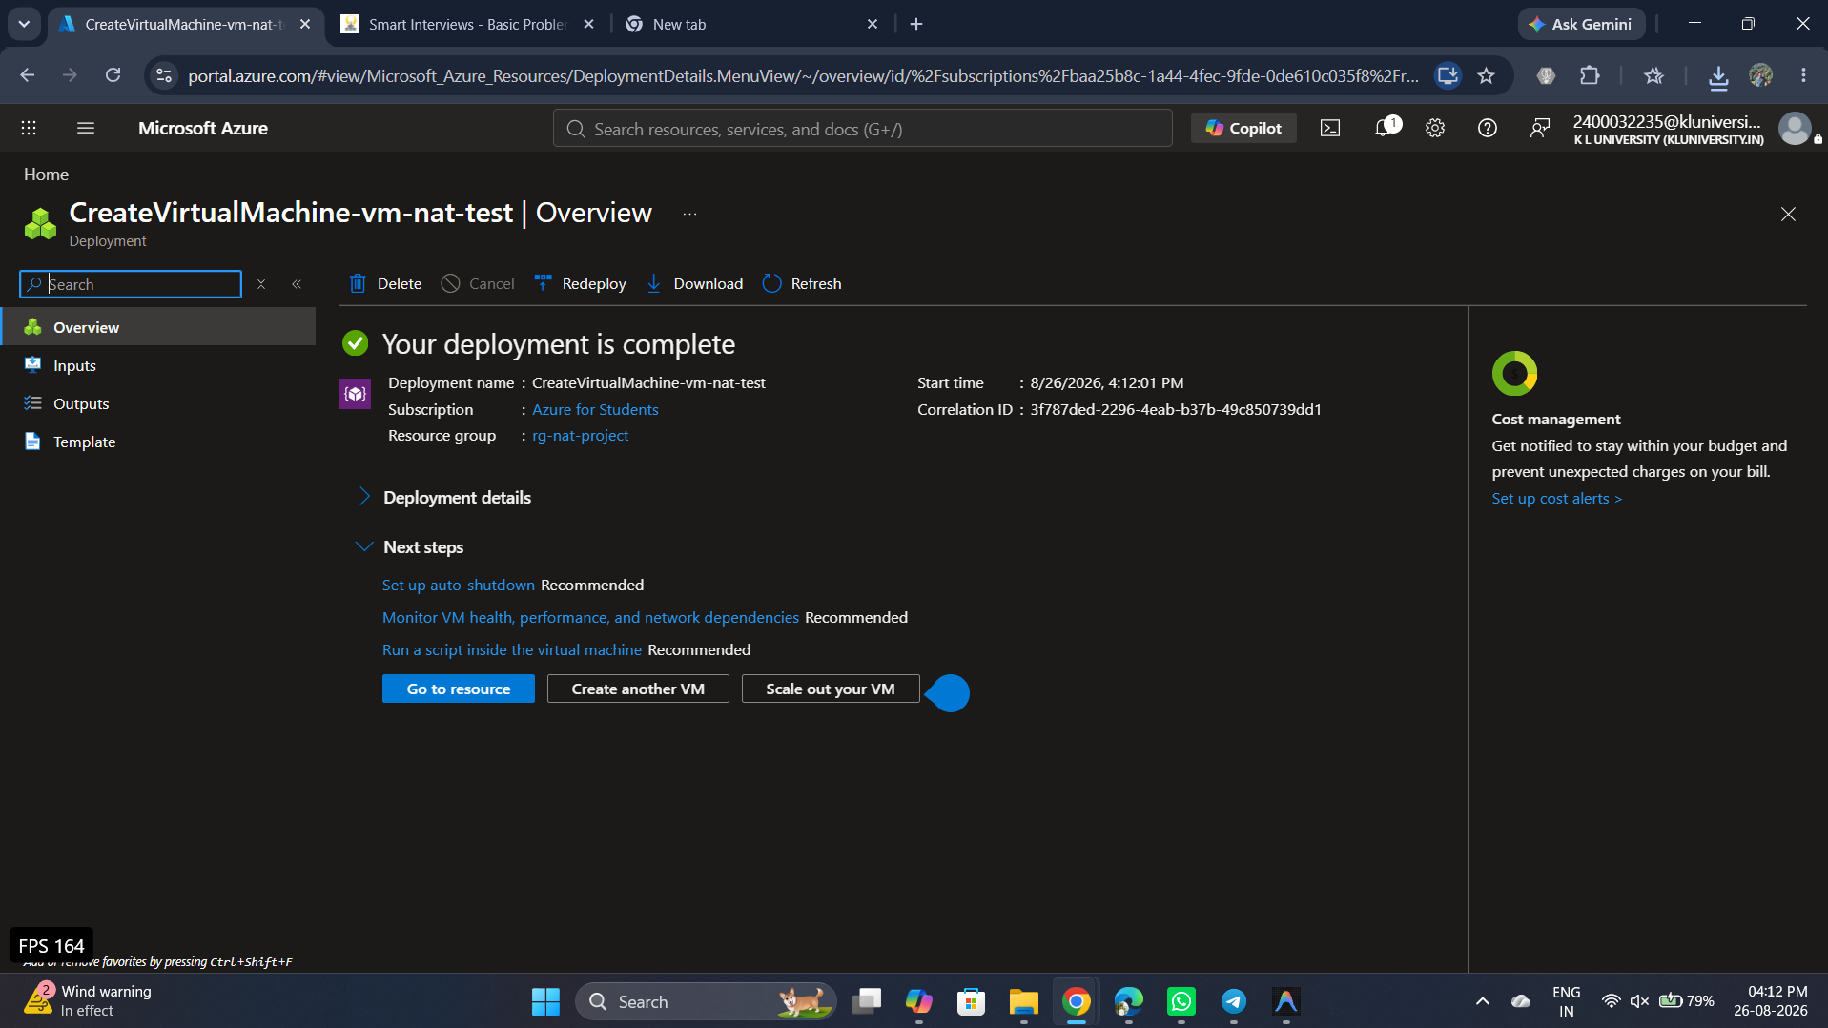
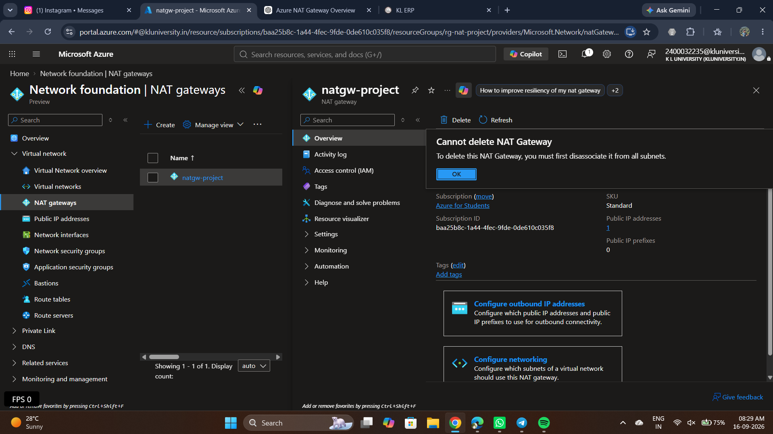
NAT Gateway Implementation
Configuration evidence from Azure Portal
N
NAT GATEWAY
P
OUTBOUND IP
S
SUBNET ASSOCIATION
Standard SKU
Central India
TCP idle timeout: 4 min
pip-nat-project
4.224.18.198
vnet-nat-project/default
Private subnet
24CC3046-P035 • Azure NAT Gateway • 5

Slide 6
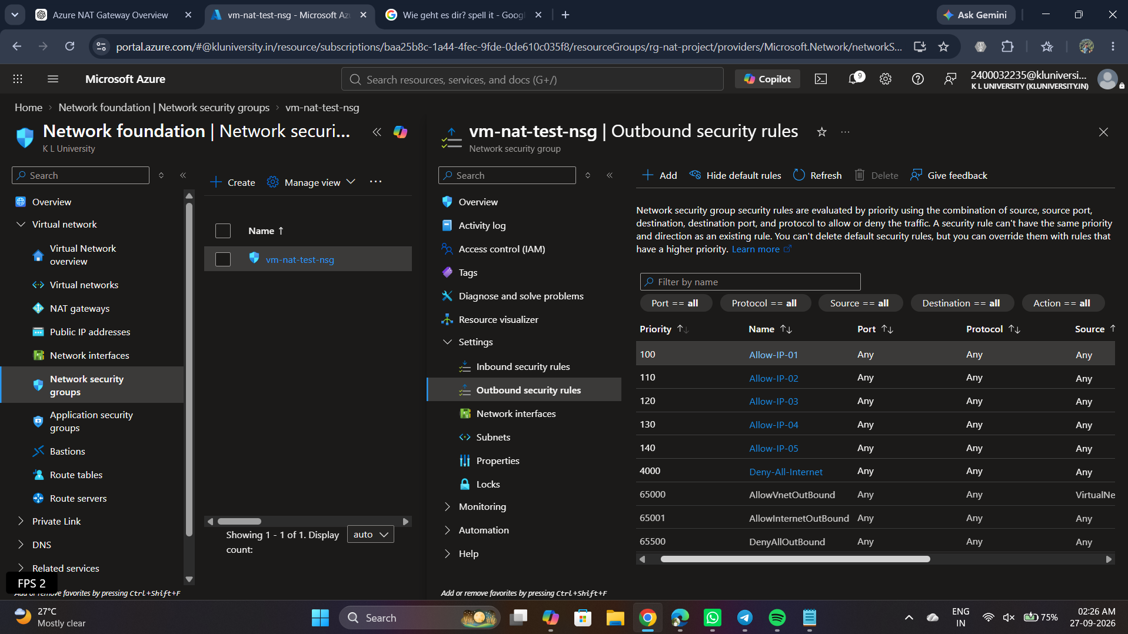
Outbound Security: NSG Allowlist
Approved destinations are evaluated before the deny rule
✓
ALLOWLIST
5 approved destination IPs
1.1.1.1
8.8.8.8
1.0.0.1
8.8.4.4
9.9.9.9
!
DEFAULT BEHAVIOR
Priority 4000: Deny-All-Internet
24CC3046-P035 • Azure NAT Gateway • 6

Slide 7
How SNAT Works
Private source address is translated to the NAT public IP
1
BEFORE SNAT
2
AFTER SNAT
Source IP
10.0.1.4
Destination
External Internet Service
Source IP
4.224.18.198
Destination
External Internet Service
SOURCE ADDRESS TRANSLATION
The Internet sees 4.224.18.198 — not the private VM address 10.0.1.4.
24CC3046-P035 • Azure NAT Gateway • 7

Slide 8
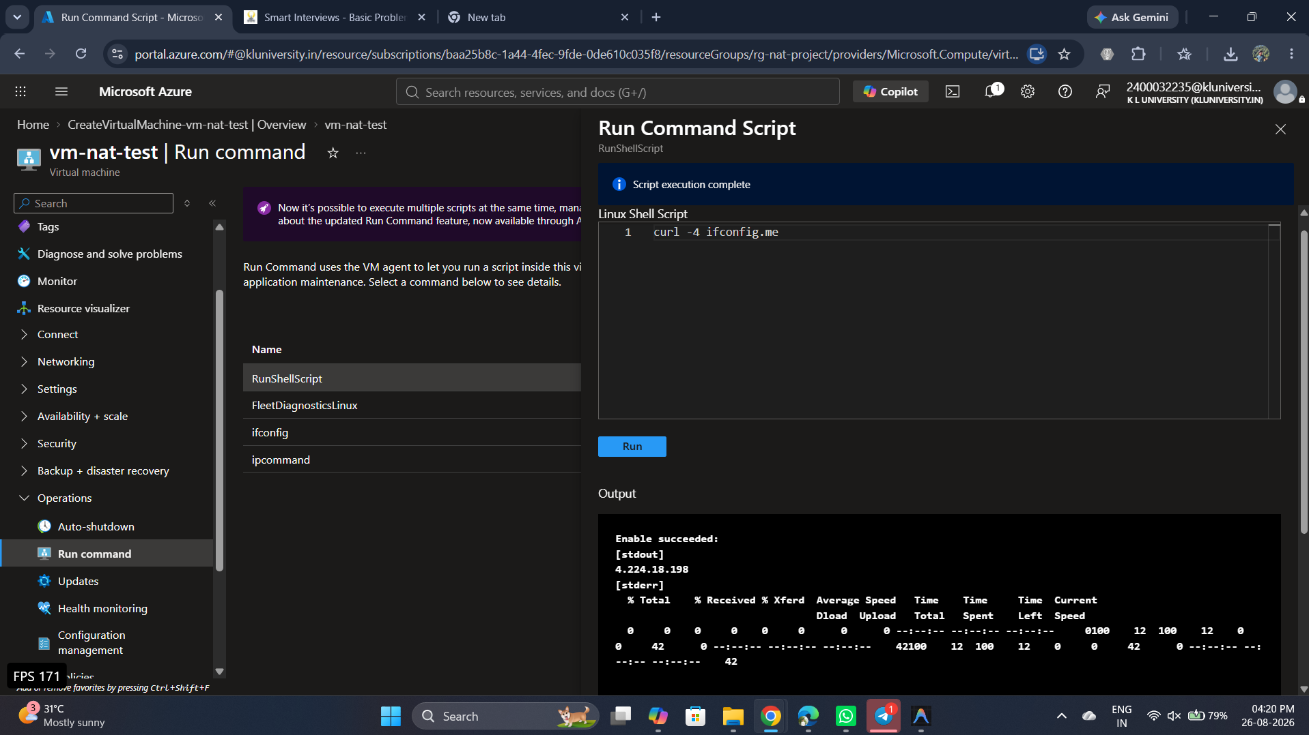
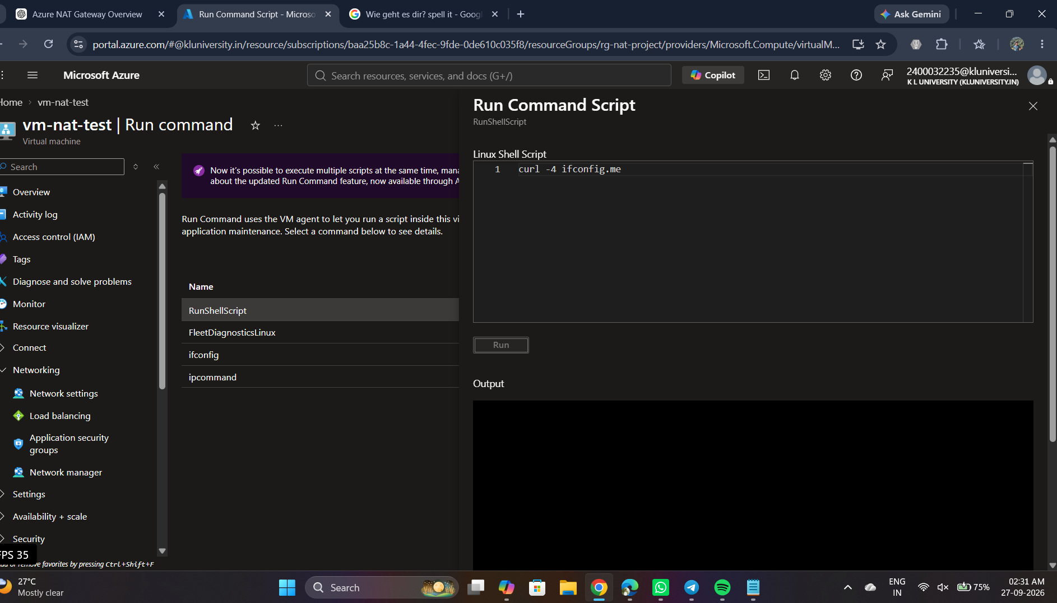
Implementation Verification
Commands used to prove the network behavior
01
1 • PRIVATE IP
02
2 • ROUTING
03
3 • INTERNET
ip a
Expected: 10.0.1.4
ip route
Default route available
curl -I https://www.google.com
HTTP/2 200 before restrictive filtering
Key evidence: curl -4 ifconfig.me returned 4.224.18.198 before the strict outbound allowlist.
24CC3046-P035 • Azure NAT Gateway • 8

Slide 9
Controlled Egress: Allow vs Deny
The NSG adds a second layer to the NAT architecture
✓
APPROVED DESTINATION
!
UNAPPROVED DESTINATION
Destination matches one of the five allow rules.
NSG → ALLOW ✓
Traffic continues to NAT Gateway.
NAT Gateway performs SNAT using 4.224.18.198.
Destination does not match an allow rule.
NSG → DENY ✕
The connection is blocked before it can use the Internet path.
ALLOW → NAT → INTERNET
DENY → BLOCKED
24CC3046-P035 • Azure NAT Gateway • 9

Slide 10
SNAT Scalability & Connection Testing
NAT Gateway provides scalable SNAT capacity
01
CONCURRENT TEST
02
WHAT NAT GATEWAY PROVIDES
A controlled test generated multiple outbound requests:
for i in {1..200}; do
curl -s --max-time 20 https://httpbin.org/delay/10 > /dev/null &
done
The test demonstrates concurrent outbound traffic generation. A point-in-time socket count is not proof that exactly 200 TCP connections were simultaneously established.
• Managed outbound SNAT
• Scalable source-port capacity
• Predictable public source IP
• Centralized subnet-level egress
Project conclusion:
NAT Gateway reduces the risk of SNAT port exhaustion; it does not mean port exhaustion is mathematically impossible.
24CC3046-P035 • Azure NAT Gateway • 10

Slide 11
Benefits, Limitations & Cost Awareness
Practical takeaways from the implementation
✓
BENEFITS
!
LIMITATIONS
$
COST CONTROL
✓ Predictable outbound IP
✓ Private VM without public IP
✓ Centralized outbound connectivity
✓ Controlled egress with NSG
✓ Scalable SNAT architecture
✓ Easier external IP allowlisting
• IP allowlists can be hard to maintain
• Internet services may use many IPs
• NAT Gateway is outbound-focused
• NSG filtering is destination/IP based
• A single Google IP is not a reliable full-service allowlist
• Deallocate VM when idle
• Delete NAT Gateway when finished
• Retain public IP if reuse is needed
• Monitor Azure for Students credit
• Remove unused resources
24CC3046-P035 • Azure NAT Gateway • 11

Slide 12
CONCLUSION
Private workload. Predictable egress. Controlled destinations.
The project demonstrates how Azure NAT Gateway provides predictable outbound connectivity for a private VM, while an NSG controls which Internet destinations are permitted.
VM
PRIVATE VM
IP
NAT PUBLIC IP
NSG
EGRESS CONTROL
10.0.1.4
4.224.18.198
5 allow + deny
Thank You
Questions & Discussion
24CC3046-P035 • Azure NAT Gateway • 12

