Slide 1
McMILLAN WOODS WORLDWIDE
E-Invoice Cloud
Paperless invoicing for every domain — payroll, logistics, manufacturing, trading and SCM — on Amazon Web Services
TAX · AUDIT · ADVISORY · Professionalism at the Forefront
Architecture and delivery plan · 90 / 180 / 270–360 days Prepared from mcmillanwoods.com · 5 September 2026
Global association of independent firms · 77+ countries · 250+ offices · 3,200+ staff

Slide 2
McM Invoice Cloud
TAX · AUDIT · ADVISORY
How long will this take?
Direct answer — this is not a few-day build. AWS is ready; tax-authority clearance is the bottleneck.
90 days
180 days
270–360 days
Go-live #1
Multi-domain
Network GA
One country (India GST or Malaysia MyInvois). One domain (trading B2B). Thousands of invoices per day. Three named pilot clients.
Payroll-adjacent, logistics, manufacturing, trading, SCM. Lakhs of invoices per day. Ops search and tracking.
250+ member firms as tenants. Two countries live. Crore-scale aggregate analytics. SOC 2 and disaster recovery.
McMillan Woods | Confidential | E-Invoice Cloud | September 2026
2 / 16

Slide 3


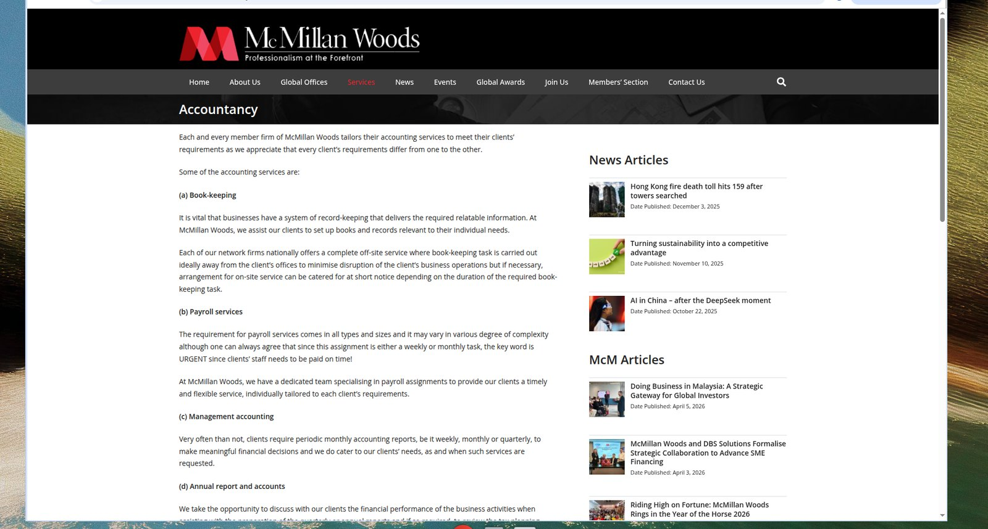

McM Invoice Cloud
TAX · AUDIT · ADVISORY
What the website tells us
Synced to live pages on mcmillanwoods.com — Home, About Us, Accountancy, and the Malaysia e-invoice seminar.
1 · Home
2 · About Us
Audit, Tax & Advisory · Founder President Dato’ Seri Dr. Raymond Liew · Chairman Tan Sri Datuk Wira Dr. Hj. Mohd Shukor
Global association of independent, qualified firms · red / maroon / white / black identity · not a software vendor
3 · Accountancy
4 · Events · YGL-World
Book-keeping · Payroll (urgent weekly/monthly) · Management accounts · Annual reports
Beyond e-Invoice Compliance in Malaysia · 26 Jun 2024 · four speakers: Raymond Liew, Yeap Kong Chean, Tay Hoay Leng, Yong Cheng Yew
McMillan Woods | Confidential | E-Invoice Cloud | September 2026
3 / 16

Slide 4
McM Invoice Cloud
TAX · AUDIT · ADVISORY
Product positioning
Member firms keep the client relationship. The platform is the engine.
McMillan Woods E-Invoice Cloud is the shared compliance fabric: ingest from payroll, ERP, WMS and TMS → validate → clear with the tax authority → store IRN / UIN / QR → track every document at thousands-to-lakhs scale → feed books, GST/VAT returns and audit.
ASP (McM platform)
GSP / MyInvois partner
Taxpayer
Member firm
Application layer, portals, tracking, domain packs. This is what we build.
Licensed pipe to NIC IRP (India) and LHDN (Malaysia). Contract in week 1. YGL is the existing MY option.
Client legal entity (GSTIN / TIN / BRN). Onboarded by the member firm.
Tenant. Issues invoices as outsourced accountant. Owns the engagement letter.
McMillan Woods | Confidential | E-Invoice Cloud | September 2026
4 / 16

Slide 5
McM Invoice Cloud
TAX · AUDIT · ADVISORY
E-invoicing across all domains
Salary itself is not a GST / MyInvois supply. Adjacent documents are. Paper is already not a legal invoice.
Domain | What becomes an e-invoice | Volume pattern
Professional / McM AR | Fee invoices, retainers, disbursements | Hundreds–thousands / day per firm
Payroll-adjacent | Contractors, reimbursements, MY perquisites, employee-on-behalf expenses | Month-end spike
Trading | B2B tax invoices, credit/debit notes, MY B2C consolidated | Thousands–lakhs / day
Manufacturing | Finished goods, job-work, scrap, returns tied to original IRN | HSN-heavy thousands / day
Logistics / 3PL | Freight, warehouse, detention — gated on proof of delivery | Event-driven bursts
SCM / procurement | Self-billed imports, agents/dealers, individual sellers | Inbound spike
McMillan Woods | Confidential | E-Invoice Cloud | September 2026
5 / 16

Slide 6
McM Invoice Cloud
TAX · AUDIT · ADVISORY
Two clearance regimes first
Pick the market where the first paying clients sit. Second country in Phase 5 — not Day 90.
India · GST · NIC IRP
Malaysia · LHDN MyInvois
▸ Legal invoice = JSON registered on IRP
▸ Returns IRN (hash) + signed QR on the print copy
▸ Invoice, credit note, debit note; optional e-way bill by IRN
▸ Idempotent key: GSTIN + FY + doc type + number
▸ Duplicate IRN (error 2150) = treat as success
▸ McM is ASP on a licensed GSP — do not become a GSP in v1
▸ Auth token ~6 hours; per-GSTIN rate limit ~100–500/min
▸ Clearance-first: UIN + QR before the document is legal
▸ Invoice, CN, DN, refund, self-billed, consolidated
▸ Consolidated monthly, within 7 days after month-end
▸ From 1 Jan 2026: line over RM10,000 cannot be consolidated
▸ Phase 4 (RM1m–RM5m) live; penalties from 1 Jan 2028
▸ Reuse YGL-World / MDEC-accredited provider
▸ McM already trained member firms (June 2024 seminar)
McMillan Woods | Confidential | E-Invoice Cloud | September 2026
6 / 16

Slide 7
McM Invoice Cloud
TAX · AUDIT · ADVISORY
Architecture principle
One canonical invoice graph inside McM. Many domain ingest adapters and jurisdiction clearance adapters around it.
1. Ingest
2. Canonical
3. Clearance
4. Artefacts
5. Tracking
REST, SFTP, CSV, Tally, SAP, Xero, payroll, TMS, WMS
Invoice aggregate, tax engine, numbers, tenant isolation
Step Functions saga, GSP → NIC IRP, MyInvois / YGL
PDF/A + QR, IRN/UIN, S3 Object Lock (WORM), ERP write-back
OpenSearch ops, data lake, QuickSight, lakhs → crores view
→
→
→
→
Hard rule
Tally JSON or SAP IDoc must never call NIC or LHDN directly. Scale-out is per tax identity (one FIFO queue per GSTIN / TIN), not one giant pipe. Crore-scale is the network aggregate across thousands of clients — a single GSTIN cannot legally push crores of IRNs per day.
McMillan Woods | Confidential | E-Invoice Cloud | September 2026
7 / 16

Slide 8
McM Invoice Cloud
TAX · AUDIT · ADVISORY
AWS reference architecture
Regions: Mumbai (ap-south-1) for India clients · Singapore (ap-southeast-1) for Malaysia / ASEAN.
Layer | AWS services | Why
Edge | Route 53, CloudFront, WAF, Cognito | Member-firm login, DDoS, geo DNS
API / compute | API Gateway, EKS, Lambda | Ingest, tax, PDF workers, token refresh
Orchestration | SQS FIFO, EventBridge, Step Functions | Per-GSTIN pacing, retries, DLQ, saga
Data | Aurora PostgreSQL + RLS, DynamoDB, Redis | Canonical OLTP, idempotency, GSP tokens
Documents | S3 (SSE-KMS) + Object Lock | Signed JSON, QR, PDF/A, 7–10 year retention
Tracking | Kinesis, Glue, Athena, OpenSearch, QuickSight | Lakhs/crores analytics off the OLTP path
Security | KMS, Secrets Manager, GuardDuty, CloudTrail | Per-tenant keys, GSP certs, audit
McMillan Woods | Confidential | E-Invoice Cloud | September 2026
8 / 16

Slide 9
McM Invoice Cloud
TAX · AUDIT · ADVISORY
Capacity: thousands, lakhs, crores
AWS will scale. NIC IRP and MyInvois will not. Design per tax identity.
Ambition | Docs / day | Peak / sec | Feasible?
Single SME | 500 | 0.1 | Trivial
Busy trader | 10,000 | ~1 | Easy on AWS; watch IRP
Large 3PL / plant | 1 lakh | ~12 | AWS yes — many GSTINs + GSP contract
Network slice | 10 lakh | ~120 | Kinesis/MSK; IRP only if sharded
Network crore | 1 crore+ | 400+ | Data lake + sharded status. Not one IRP credential.
Indicative AWS: USD 1.5k–4k / month at pilot · USD 8k–25k at 1–5 lakh / day network · GSP per-document fees often exceed AWS. Retry storms can 10× cost and get the GSP suspended.
McMillan Woods | Confidential | E-Invoice Cloud | September 2026
9 / 16

Slide 10
McM Invoice Cloud
TAX · AUDIT · ADVISORY
First 90 days — go-live #1
Team of 8–10. Sandbox credentials must be in hand by Day 15 or the date slips by the same number of days.
Days | Engineering | Tax / partner | AWS / security
1–5 | Freeze architecture, repo, CI | Choose India vs Malaysia; 3 pilots | Org, IAM, billing alarms
6–15 | Tenant + Invoice API | Sign GSP / YGL; GSTIN/TIN list | VPC, EKS, Aurora, KMS
16–30 | CSV + Tally ingest | Sandbox credentials in hand | WAF, secrets, environments
31–50 | Mapper, validator, SQS workers | Schema field dictionary signed off | Step Functions, observability
51–70 | IRP / MyInvois adapter, PDF+QR | Sandbox pack + 20 error codes | Authorisation pen-test
71–85 | ERP write-back, ops console | UAT then first live invoices | Backup drill, Object Lock
86–90 | Hypercare dashboards | Rejection war-room | Cost and rate-limit review
McMillan Woods | Confidential | E-Invoice Cloud | September 2026
10 / 16

Slide 11
McM Invoice Cloud
TAX · AUDIT · ADVISORY
Phases after Day 90
Ship domain packs in volume order. Second country only after the first is boringly reliable.
P3 Days 50–150
P4 Days 90–180
P5–P6 150–360
Domain packs
Lakhs / day tracking
Network + harden
1. Trading B2B (needed for go-live) 2. Manufacturing (HSN, plants, job-work) 3. Logistics (POD gate, e-way bill) 4. Payroll-adjacent (month-end batch) 5. SCM self-billed (imports, agents) Connectors: Tally + CSV first, then Xero/QB, then SAP.
Load test 50k docs/hour, 200k peak. OpenSearch by IRN, GSTIN, consignment. QuickSight for firms and the network. DLQ replay, back-pressure, cost alarms. 48-hour soak. Zero cross-tenant leaks.
Stand up the other of India / Malaysia. Onboard 10 then 50 member firms. GSTR-1 / VAT extract for Advisory. SOC 2 Type I, DR (RPO 15 min). UAE Peppol / ZATCA only with a paying client.
McMillan Woods | Confidential | E-Invoice Cloud | September 2026
11 / 16

Slide 12
McM Invoice Cloud
TAX · AUDIT · ADVISORY
90-day squad and non-goals
One person with an AWS account cannot deliver legal e-invoices in days.
Role | Count | Notes
Product / domain (CA + GST/MyInvois) | 1 | Must sit with McM tax partners
Engineering lead | 1 | Owns architecture and cutover
Backend (invoice + adapters) | 3 | Canonical, clearance, ingest
Frontend (firm + ops portals) | 1–2 | McM maroon / red / white / black
Data / integration | 1 | Tally, SFTP, CSV
AWS / platform / security | 1 | Terraform, tenancy, KMS
QA (schema + load) | 1 | IRP error catalogue + soak
Out of scope for v1
▸ Becoming a GSTN GSP or MDEC Peppol SP
▸ Replacing YGL on the shop floor
▸ Full payroll engine (PF, ESI, payslips)
▸ ZATCA crypto-stamping in 90 days
▸ AI HSN coding as legal authority
▸ One shared DB without row-level security
▸ All 77 countries in the first release
McMillan Woods | Confidential | E-Invoice Cloud | September 2026
12 / 16

Slide 13
McM Invoice Cloud
TAX · AUDIT · ADVISORY
Risks that actually slip the date
Schedule risk #1 is sandbox credentials. Legal risk #1 is a cross-tenant leak.
Risk | Impact | Control
Sandbox / prod credentials delayed | Go-live slips 1:1 | Start paperwork Day 1; backup GSP
Building a GSP instead of an ASP | 6–12 month delay | Out of scope for v1
Duplicate IRN / lost write-back | Legally invalid invoices | Idempotency store + Get IRN fallback
Cross-tenant data leak | Network-ending event | RLS + automated isolation tests
IRP throttle / 1-hour ban | Business stop | Per-GSTIN FIFO, jitter, circuit breaker
Treating salary as e-invoice | Wrong law | Payroll adapter allow-list
MY consolidation after RM10k rule | Penalties | Hard stop in the validator
Scope: UAE + KSA + EU in v1 | Never ships | Two jurisdictions max in 180 days
McMillan Woods | Confidential | E-Invoice Cloud | September 2026
13 / 16

Slide 14
McM Invoice Cloud
TAX · AUDIT · ADVISORY
Five decisions needed in week 1
Until these are answered, engineering can only stand up an empty AWS landing zone — not legal e-invoices.
1
First jurisdiction — recommend Malaysia first
Secretariat is in Petaling Jaya and McM already ran the MyInvois seminar with YGL. India GST is go-live #2 unless a named Indian pilot is signed this week.
2
First domain
Trading B2B is the correct default. Payroll and logistics follow.
3
Named partners — answered from the site
Malaysia: YGL World is already on stage with McM (26 Jun 2024) — Yeap Kong Chean (CEO), Tay Hoay Leng (Tax Director), Yong Cheng Yew (Innovation Director), with Dato’ Seri Dr. Raymond Liew. India GSP still needs a signed contract.
4
Operating entity
Which McM legal entity owns the AWS org and customer contracts.
5
Three pilots
Named companies with live volume and a partner firm ready to operate them.
McMillan Woods | Confidential | E-Invoice Cloud | September 2026
14 / 16

Slide 15
McM Invoice Cloud
TAX · AUDIT · ADVISORY
Security and operating model
Assume a hostile cross-tenant world. Independent firms share a brand, not a ledger.
Encryption
Access
Compliance
KMS CMKs per tenant (or envelope per tenant). TLS 1.2+. S3 Object Lock on cleared artefacts for 7–10 years.
Partner staff see only their tenant. Global Secretariat sees aggregated ops metrics, not line items, unless an engagement letter authorises a review.
Malaysia PDPA, India DPDP, UK GDPR. SOC 2 Type I by Day 180, Type II by Day 360. ISO 27001 if pitching banks (DBS SME financing).
Legal pack
Secrets
Audit
Network SaaS master, Accession addendum per firm, DPA, client letter that the McM firm issues/clears as agent.
GSP client id/secret, MyInvois certificates, ERP tokens in Secrets Manager with rotation. Never store PAN / Aadhaar / NRIC unless legally required.
Every clearance request/response stored. CloudTrail organisation trail. Immutable event log on the invoice aggregate.
McMillan Woods | Confidential | E-Invoice Cloud | September 2026
15 / 16

Slide 16
RECOMMENDATION
Build McM Invoice Cloud as a multi-tenant ASP on AWS.
▸ Day 90 — real IRNs or UINs for three pilots, thousands per day, one country, one domain.
▸ Day 180 — five domain packs at lakhs per day, tracking that Advisory can actually use.
▸ Day 270–360 — network product for 250 offices, crore-scale aggregate analytics, SOC 2.
▸ Do not advertise this as a week of work because an AWS account exists. That produces PDFs. Under GST and MyInvois, a PDF is still paper.
mcmillanwoods.com · Full plan: docs/e-invoicing-architecture-and-delivery-plan.md

