Slide 1
Lending Club Case Study

Slide 2
Background – Lending Club Case Study
Background
Lending club is the largest peer-to-peer marketplace connecting borrowers with lenders. Borrowers apply
through an online platform where they are assigned an internal score. Lenders decide
1) whether to lend and
2) the terms of loan such as interest rate, monthly instalment, tenure etc.
Some popular products are credit card loans, debt consolidation loans, house loans, car loans etc.
Business Objective
To identify variables which are strong indicators of default and potentially use the insights in approval /
rejection decision making.

Slide 3
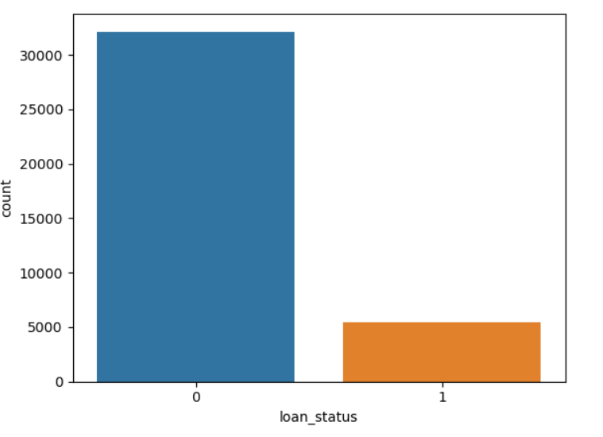
Overall default rate is 14%
85.62%
14.38%

Slide 4
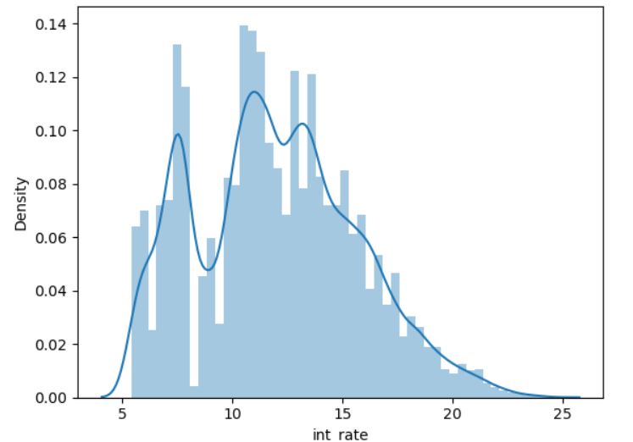
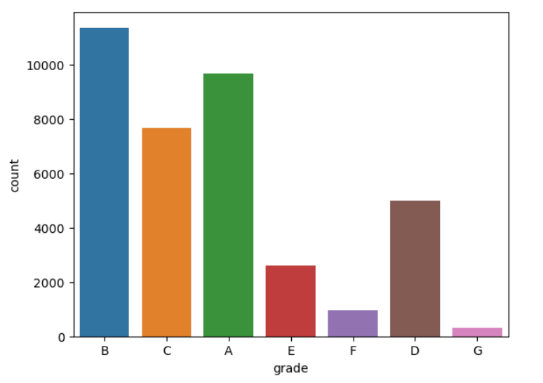
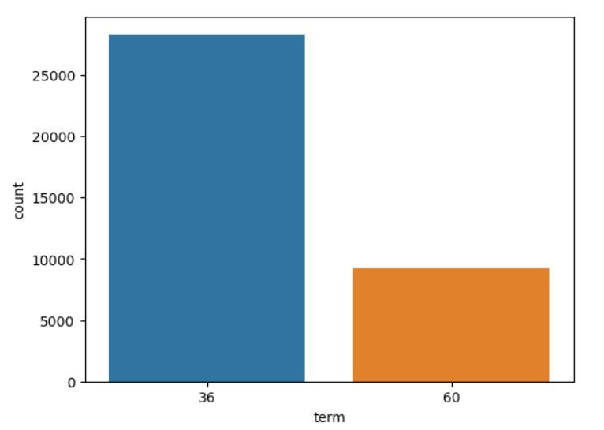
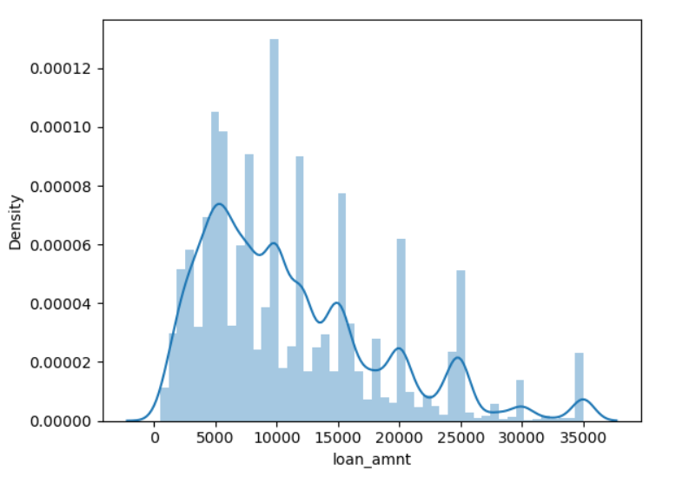
Important variables to determine higher default rates
Grade
Term
Annual Income
Loan Amount
Interest Rate

Slide 5
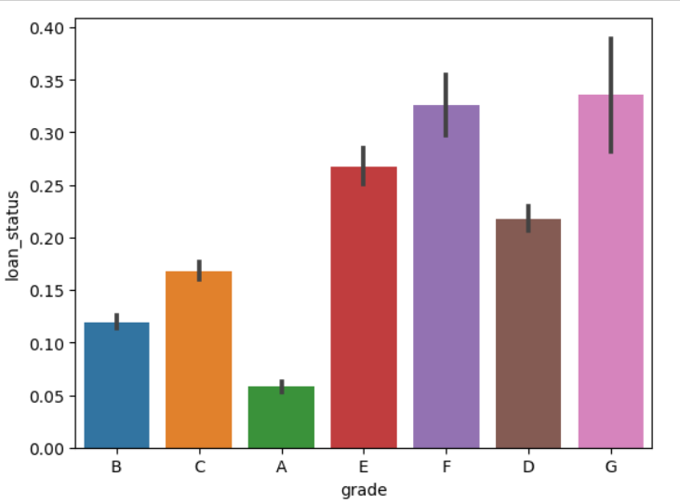
Grade
The shown graph offers a simple visual illustration that emphasizes the connection between loan default rates and the given grade.
There is a definite rising trend in the rate of loan default as the grade moves from A to G.
According to this, loans awarded higher letter grades (A being the lowest risk and G being the highest) tend to have a reduced likelihood of default, whilst loans given lower grades display a comparably larger risk of default.
This finding emphasizes how important the grade is in this dataset as a useful indication of the risk of loan payback.

Slide 6
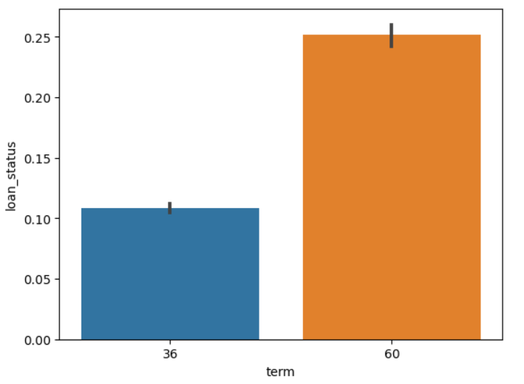
Term
The observed pattern shows that a rising loan term is associated with a higher default rate.
This research suggests that compared to loans with shorter terms, loans with longer terms have a larger probability for default.
This highlights the importance of loan term as a major factor in loan default, supporting the notion that lengthening the repayment period would raise the likelihood of default in the sample.

Slide 7
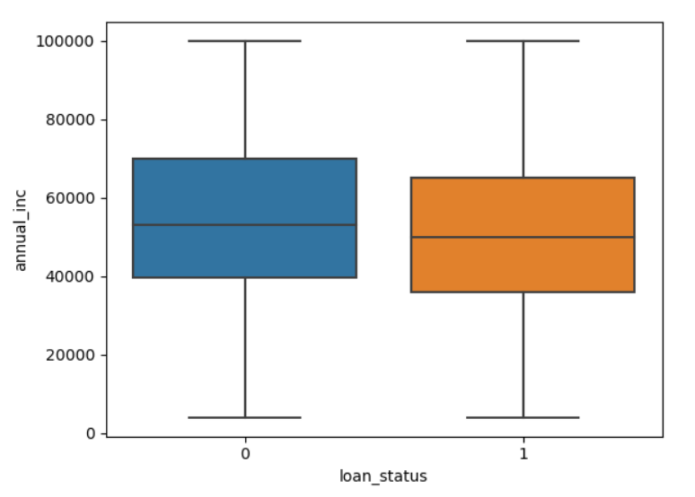
Annual Income
It is clear from the conclusions drawn from the box plot that there is a direct correlation between a person's annual income and the chance of loan default.
The likelihood of loan default increases noticeably when an employee's annual income drops.
This finding emphasizes the crucial role that annual income plays in predicting the likelihood of loan default.
It means that people with lower income levels could have more difficulty repaying their loans, which would raise the likelihood that they would default.

Slide 8
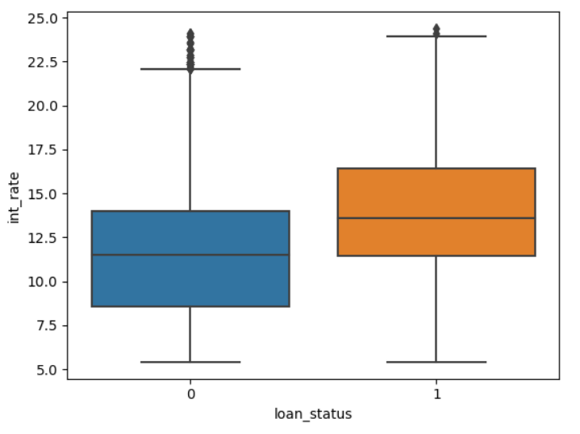
Interest Rate
A notable pattern is revealed by the insights gained from the box plot presented: defaulted loans typically have higher mean interest rates than non-defaulted loans.
This finding points to a strong correlation between interest rates and the likelihood of loan default. Particularly, loans with high interest rates are more likely to default.
This pattern emphasizes how important interest rates are in predicting the likelihood of loan default.
It means that borrowers who are subject to higher interest rates would experience greater financial strain, which could raise the risk that they will default on their debts.

Slide 9
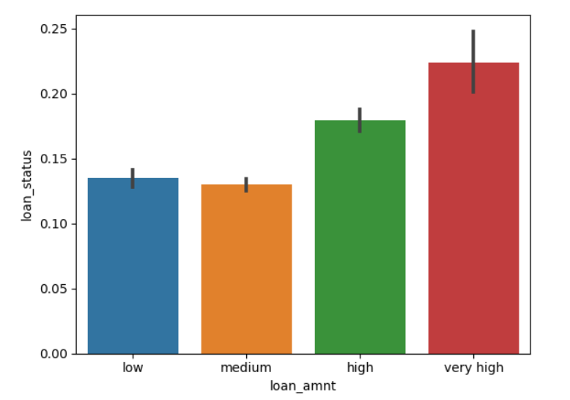
Loan Amount
A noteworthy trend emerges from the facts shown in the bar plot, namely that there is a positive link between the size of the loan and the chance of default.
The likelihood of default also shows an increase as the loan amount rises.
This pattern emphasizes the importance of loan amount as a determinant of loan default risk.
The inference is that people who borrow more money might have trouble repaying it, which would increase their risk of default.

