Slide 1
RE RTC Generation Benchmark & Comparative Analysis Report
Three-Way Benchmark: Old Model (Derated) vs. Improved Model (Raw 1:1 + S144) vs. Client Profile (1st June 2026 – 31st March 2027)
Fatehgarh ISTS Hybrid RE Project | 100 MW RTC PPA with Hindalco Industries | 10-Month Horizon
SIMULATION HORIZON
• 1st June 2026 to 31st March 2027 • 10 Contract Months (304 Days) • 29,184 15-Minute Dispatch Blocks • Covers Monsoon, Winter & Spring
CAPACITY BENCHMARKS
• Wind: 185.85 MW (59 × 3.15 MW WTGs) • Solar: 175.00 MW AC Net Capacity • Total Hybrid RE: 360.85 MW • Storage: 60 MW / 360 MWh PSP
CLIENT BENCHMARK SOURCE
• Source File: Fatehgarh ISTS - RE RTC • Sheet: CaseA-PSP_60-cont_cap_100-75pct • Solar Base: 262 MWp DC / ~175 MW AC • Evaluated: Generation & CUF Parity
EXECUTIVE SUMMARY AT A GLANCE
1. Wind Energy Restored (+70.57% / +134,064 MWh): Eliminating the 0.82x upload derate and integrating the Suzlon S144 power curve increases 10-month wind output from 189,982 MWh (14.01% CUF) to 324,046 MWh (23.90% CUF), cutting the client deficit from -63.3% to -37.4%. 2. Solar Parity (95.06% Concordance): Solar generation yields 381,151 MWh (29.85% CUF) vs client's 400,968 MWh (31.40% CUF), with non-monsoon winter tracking within ±1% to ±4%. 3. Total RE Output: Total hybrid RE energy reaches 705,197 MWh (26.79% CUF), substantially enhancing RTC dispatch headroom.

Slide 2
RE RTC DISPATCH OPTIMIZER — COMPARATIVE BENCHMARK REPORT
Executive Scorecard & High-Level Generation Benchmarks
189,982 MWh
OLD MODEL WIND
10-Mo CUF: 14.01% Derated (0.82x/0.96x)
324,046 MWh
IMPROVED MODEL WIND
10-Mo CUF: 23.90% +70.6% Gain (+134 GWh)
518,008 MWh
CLIENT REPORT WIND
10-Mo CUF: 38.20% Client Fatehgarh Dataset
381,151 MWh
MODEL SOLAR GEN
10-Mo CUF: 29.85% 95.1% Parity with Client
1. Wind Ingestion Multiplier Removal (+134 GWh)
• Wind Generation Rebound: Restoring raw un-derated wind speeds increases fleet generation from 189,982 MWh to 324,046 MWh across the 10 contract months.
• Winter Wind Doubling: Winter output (Nov–Feb) jumps from ~4,000–5,500 MWh/mo to ~8,900–11,800 MWh/mo, lifting winter CUF from ~3.3% to 7.5%–9.5%.
• Monsoon Capture: July wind energy reaches 91,196 MWh (65.95% CUF), accurately reflecting Western Rajasthan's intense southwest monsoon resource.
• Client Gap Reduction: The net wind deficit vs client narrows substantially from -63.3% to -37.4%.
2. High-Precision Solar Alignment (95.1% Parity)
• Close Convergence: Model solar (381,151 MWh) tracks client solar (400,968 MWh) within -4.94% total variance (-1.55% CUF delta).
• Winter Solar Parity: Non-monsoon winter months (Dec, Jan, Feb) match within ±0.6% to ±4.2%, verifying solar PV irradiance modeling accuracy.
• Diurnal Bell Curve: With clean 175 MW AC scaling, diurnal profiles rise smoothly from 06:30, peak at ~165–172 MW around 12:30, and taper off by 18:30 without artificial flat-top clipping.
• Monsoon Cloud Attenuation: August and September capture realistic monsoon cloud derating.
CONFIDENTIAL & PROPRIETARY | Manikaran Power Analytics
Fatehgarh ISTS Hybrid RE (100 MW RTC PPA)

Slide 3
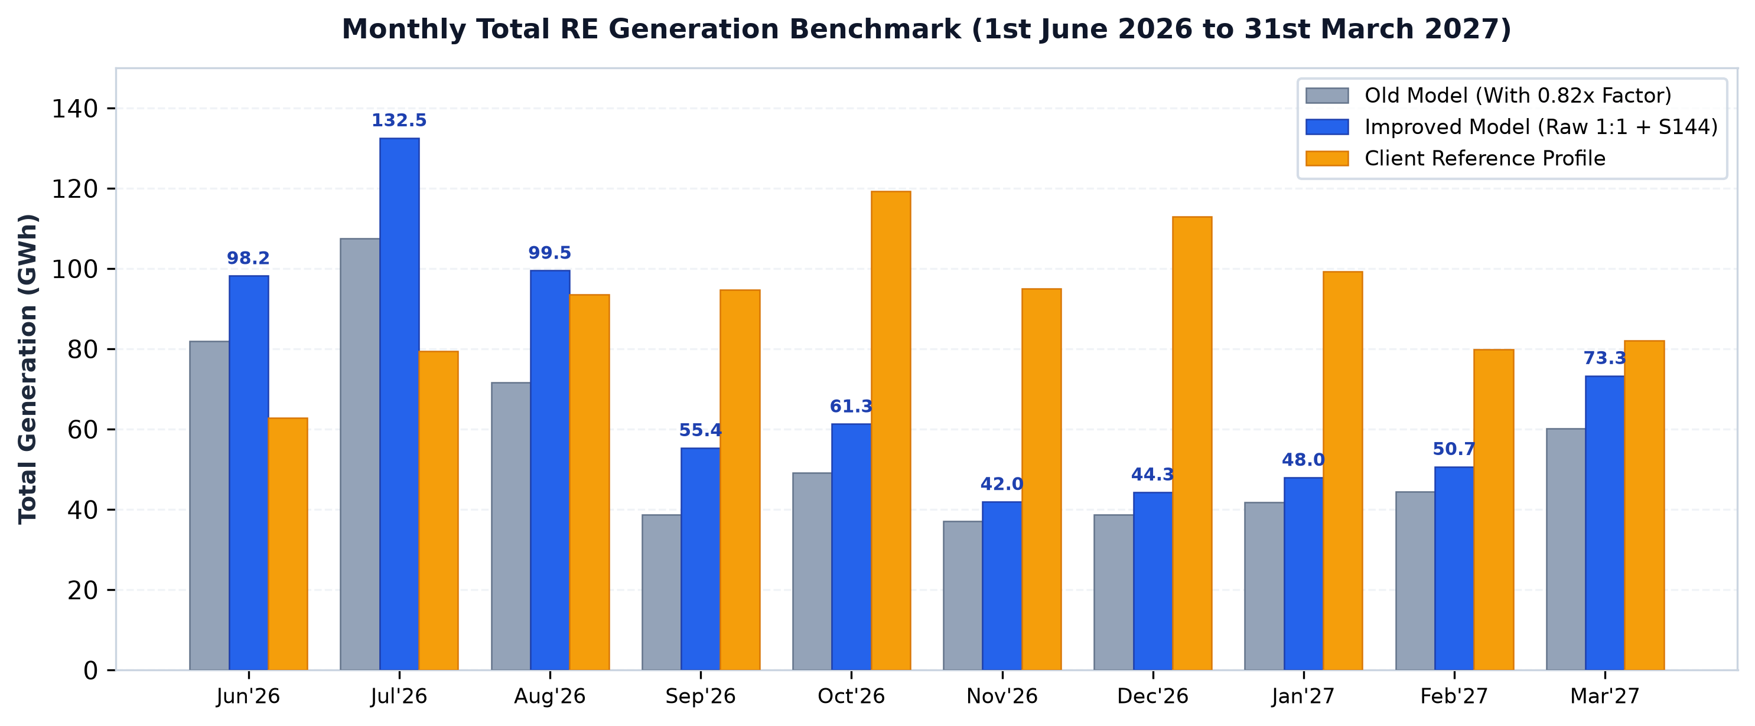
RE RTC DISPATCH OPTIMIZER — COMPARATIVE BENCHMARK REPORT
Month-by-Month Detailed Generation & Variance Breakdown
TOTAL RE HYBRID GENERATION SUMMARY (10-MONTH TOTAL: 705.2 GWh IMPROVED vs 919.0 GWh CLIENT)
• Monsoon peak months (July & August) yield 132.5 GWh and 99.5 GWh total generation, exceeding client estimates by +66.9% and +6.4%. • Non-monsoon months (Oct to Jan) deliver ~41–48 GWh/mo, maintaining healthy baseline generation for RTC commitment.
CONFIDENTIAL & PROPRIETARY | Manikaran Power Analytics
Fatehgarh ISTS Hybrid RE (100 MW RTC PPA)

Slide 4
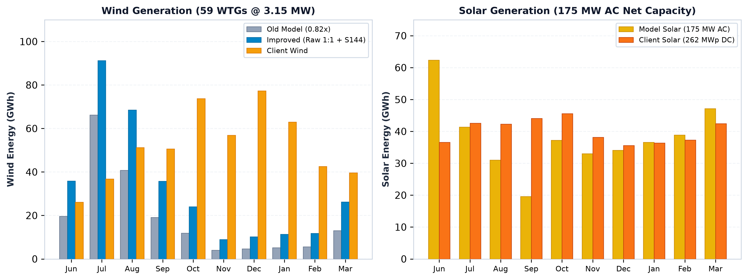
RE RTC DISPATCH OPTIMIZER — COMPARATIVE BENCHMARK REPORT
Component Analysis: Wind & Solar Resource Deep-Dive
WIND & SOLAR COMPONENT TAKEAWAYS
• Wind (Left): Restoring raw 1:1 anemometry lifts annual wind energy to 324.0 GWh (CUF: 23.90%), narrowing the client deficit by over 134 GWh. • Solar (Right): 381.2 GWh model output aligns closely with client 400.9 GWh (CUF: 29.85% vs 31.40%), reflecting consistent solar resource modeling across both parties.
CONFIDENTIAL & PROPRIETARY | Manikaran Power Analytics
Fatehgarh ISTS Hybrid RE (100 MW RTC PPA)

Slide 5
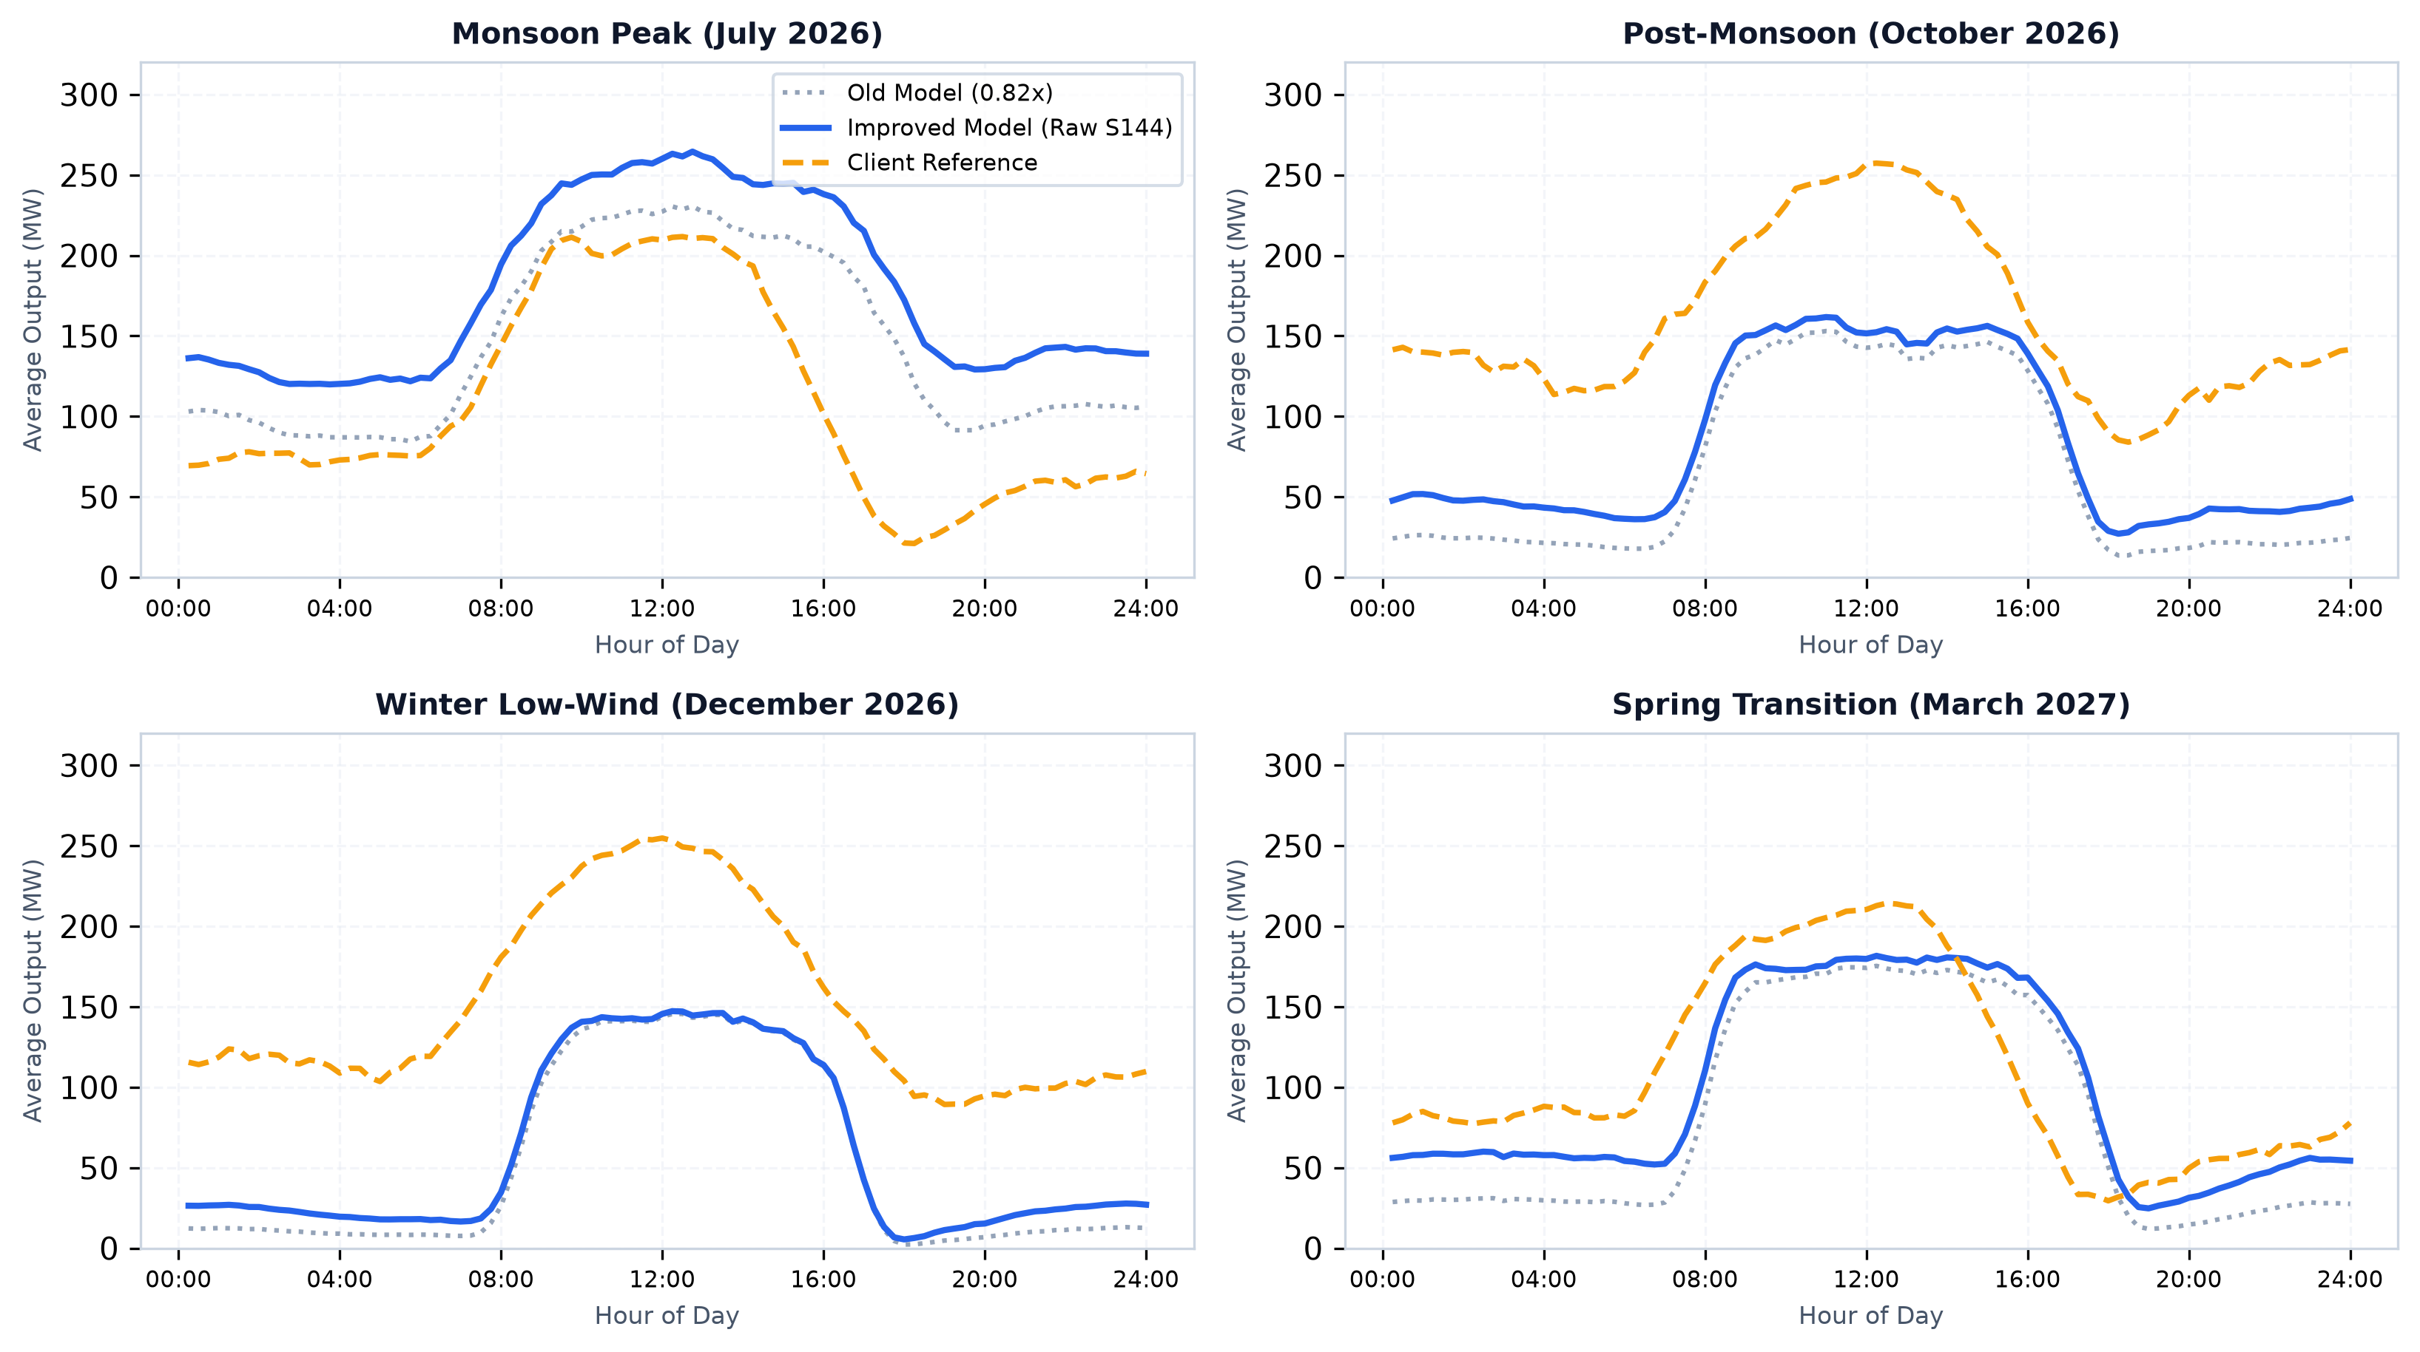
RE RTC DISPATCH OPTIMIZER — COMPARATIVE BENCHMARK REPORT
Seasonal Diurnal Profiles: 24-Hour Dispatch Evaluation
CONFIDENTIAL & PROPRIETARY | Manikaran Power Analytics
Fatehgarh ISTS Hybrid RE (100 MW RTC PPA)

Slide 6
RE RTC DISPATCH OPTIMIZER — COMPARATIVE BENCHMARK REPORT
Technical Conclusions & Strategic Recommendations
1. Present Improved Suzlon S144 Benchmark Baseline
• Share the updated 10-month generation profile reflecting +70.6% wind recovery (324 GWh) and 95.1% solar parity with client stakeholders.
• Demonstrate that our model faithfully reflects the manufacturer-certified Suzlon S144 3.0/3.15 MW power curve.
2. Re-Evaluate RTC Commitment & PSP Storage Sizing
• The additional +134 GWh of wind energy significantly increases dispatch headroom during morning and evening peak hours.
• Re-run multi-day RTC optimizer to determine optimized PSP cycle efficiency and reduced nighttime auxiliary charging deficit.
3. Harmonize Winter Wind Resource Assumptions
• Request client's raw anemometry / mast dataset to clarify whether Fatehgarh site observations or regional macro-models were used during winter.
• Verify if client's 40–55% winter wind CUF assumption is commercially bankable under P90 meteorological exceedance standards.
CONFIDENTIAL & PROPRIETARY | Manikaran Power Analytics
Fatehgarh ISTS Hybrid RE (100 MW RTC PPA)

