Slide 1

























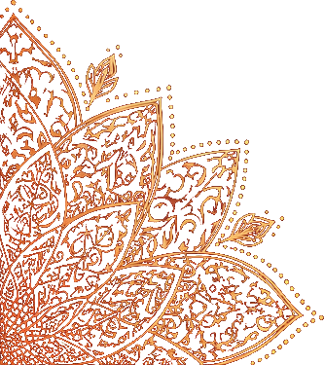
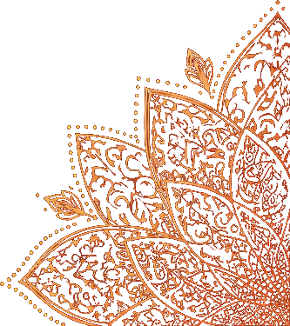
Navratri
NINE NIGHTS OF DIVINE POWER
Navratri is a Hindu festival dedicated to the worship of Goddess Durga. It symbolizes devotion, self-reflection, and the victory of good over evil.
The Nine Forms of Navadurga
1. Shailaputri
2. Brahmacharini
3. Chandraghanta
Stability
and strength
Devotion
and discipline
Courage
and fearlessness
4. Kushmanda
5. Skandamata
6. Katyayani
Creativity
and energy
Love
and protection
Righteousness
and justice
7. Kalaratri
8. Mahagauri
9. Siddhidatri
Destruction
of negativity
Purity
and peace
Wisdom
and fulfillment
How It Is Celebrated
Who Is Worshipped
What It Means
Prayer, fasting,
Garba and Dandiya, and
community gatherings
with joy and devotion.
Goddess Durga,
the Divine Mother, is
worshipped in her nine
forms (Navadurga).
Navratri reminds us to
overcome negativity,
cultivate inner strength,
and embrace new
beginnings.

