Slide 1
🏠 Melbourne Automated Valuation Model
Explainable, uncertainty-aware property pricing — the AVM class behind Zestimate, Redfin and lender valuation engines.
LightGBM + Optuna · Conformal prediction intervals · SHAP explainability · Streamlit
Manik Kaura — Data Science portfolio

Slide 2
The problem — valuation at scale
Banks, insurers, iBuyers and marketplaces must value millions of homes instantly.
• An Automated Valuation Model (AVM) prices a property from its attributes — no human appraiser per home.
• Accurate across a huge range: this market spans $85k to $9M.
• Honest about uncertainty: a single number is unsafe for underwriting — decisions need a calibrated range.
• Explainable: regulators and customers must see WHY a home was valued as it was.
Proptech
Mortgage risk
iBuying
Insurance

Slide 3
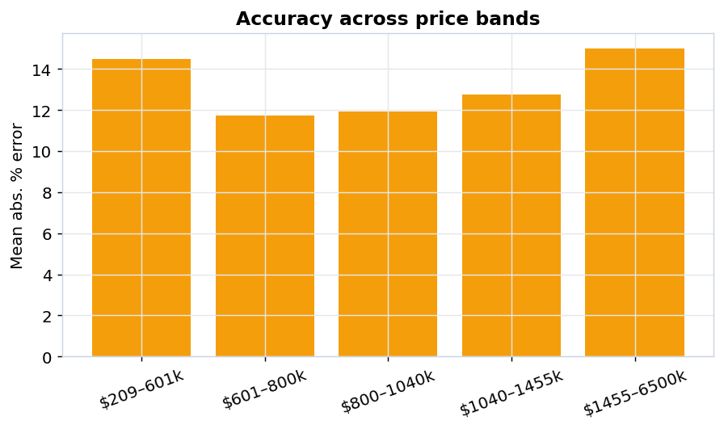
The data — and why it's hard
Melbourne housing: 13,580 sales × 21 fields. Exactly as messy as real estate data.
• BuildingArea 47% missing, YearBuilt 40%, CouncilArea 10%.
• Right-skewed target across two orders of magnitude.
• 314 suburbs & 200+ postcodes — strongest signal, but a leakage trap.
• Outliers & data-entry errors: 0 m² land, impossible build years.
• Must serve predictions from RAW inputs, not pre-baked arrays.

Slide 4
Approach & tech-stack logic
One scikit-learn pipeline: raw property row → dollars + interval + explanation.
raw row → ColumnTransformer → LightGBM (log-target) → TransformedTargetRegressor → $ + interval + SHAP
• log1p(Price) target — proportional error for a skewed, multiplicative quantity.
• Median impute + explicit missingness flags (a missing BuildingArea usually means a unit).
• One-hot for Type/Method/Region; cross-fitted TargetEncoder for Suburb/Postcode/Council (no leakage).
• LightGBM won a 5-model zoo (vs XGBoost, CatBoost, RandomForest, Ridge).
• Optuna TPE search — 40 trials over 8 hyperparameters, optimising CV MAE.
• Split-conformal intervals for distribution-free, verified-coverage uncertainty.

Slide 5
How each challenge was tackled
• Missingness → median impute + *_missing indicators (turn a gap into signal).
• Skew → log-target modelling; report both dollar and percentage error.
• Location leakage → TargetEncoder cross-fitting; all encoding lives inside the CV pipeline.
• Outliers → 0-values treated as missing; land/building capped at the 99.5th percentile.
• Train/serve skew → a single Pipeline does clean→encode→predict, identical in training and app.
• Trust → conformal range on every quote + SHAP explanation of every driver.

Slide 6
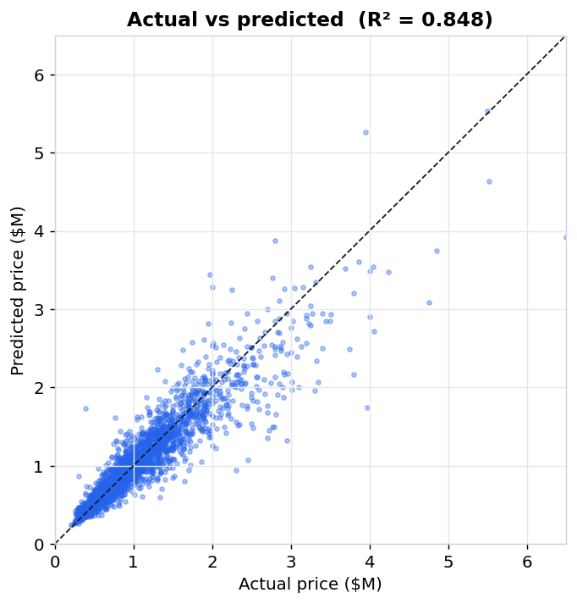
Results — held-out test set
Untouched 20% split; intervals calibrated on a separate fold.
R²
0.848
MAPE
13.2%
Median APE
9.9%
MAE
$148,216
90% PI coverage
90.2%

Slide 7
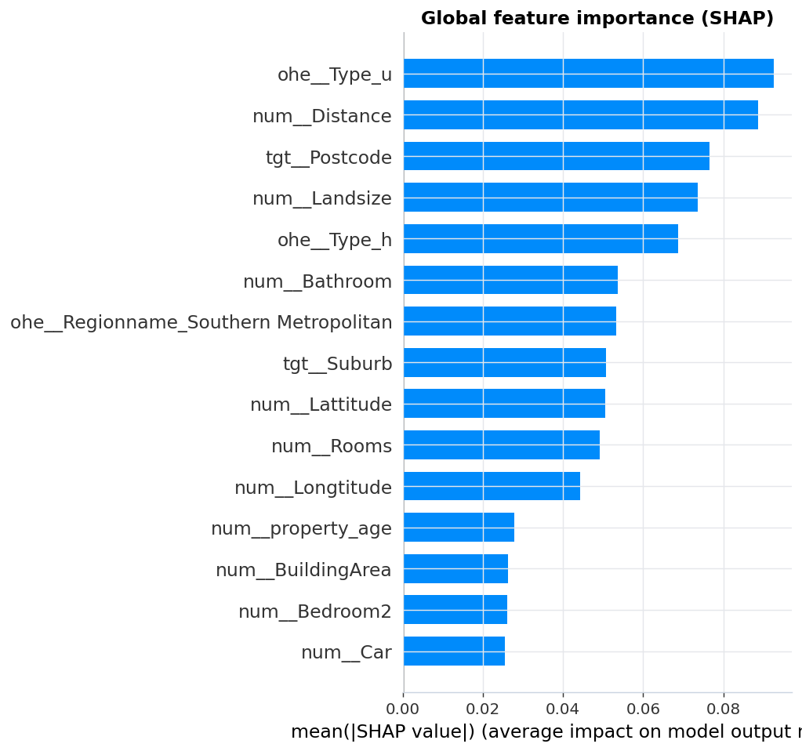
Explainability — SHAP
Global drivers and a per-property breakdown power the demo's 'why this valuation?'
• Type (house vs unit) and distance to the CBD dominate.
• Postcode & suburb encode fine-grained location value.
• Land size and bathrooms add property-level detail.
• Per-prediction: each factor shown as a ± % effect on that home's price.

Slide 8
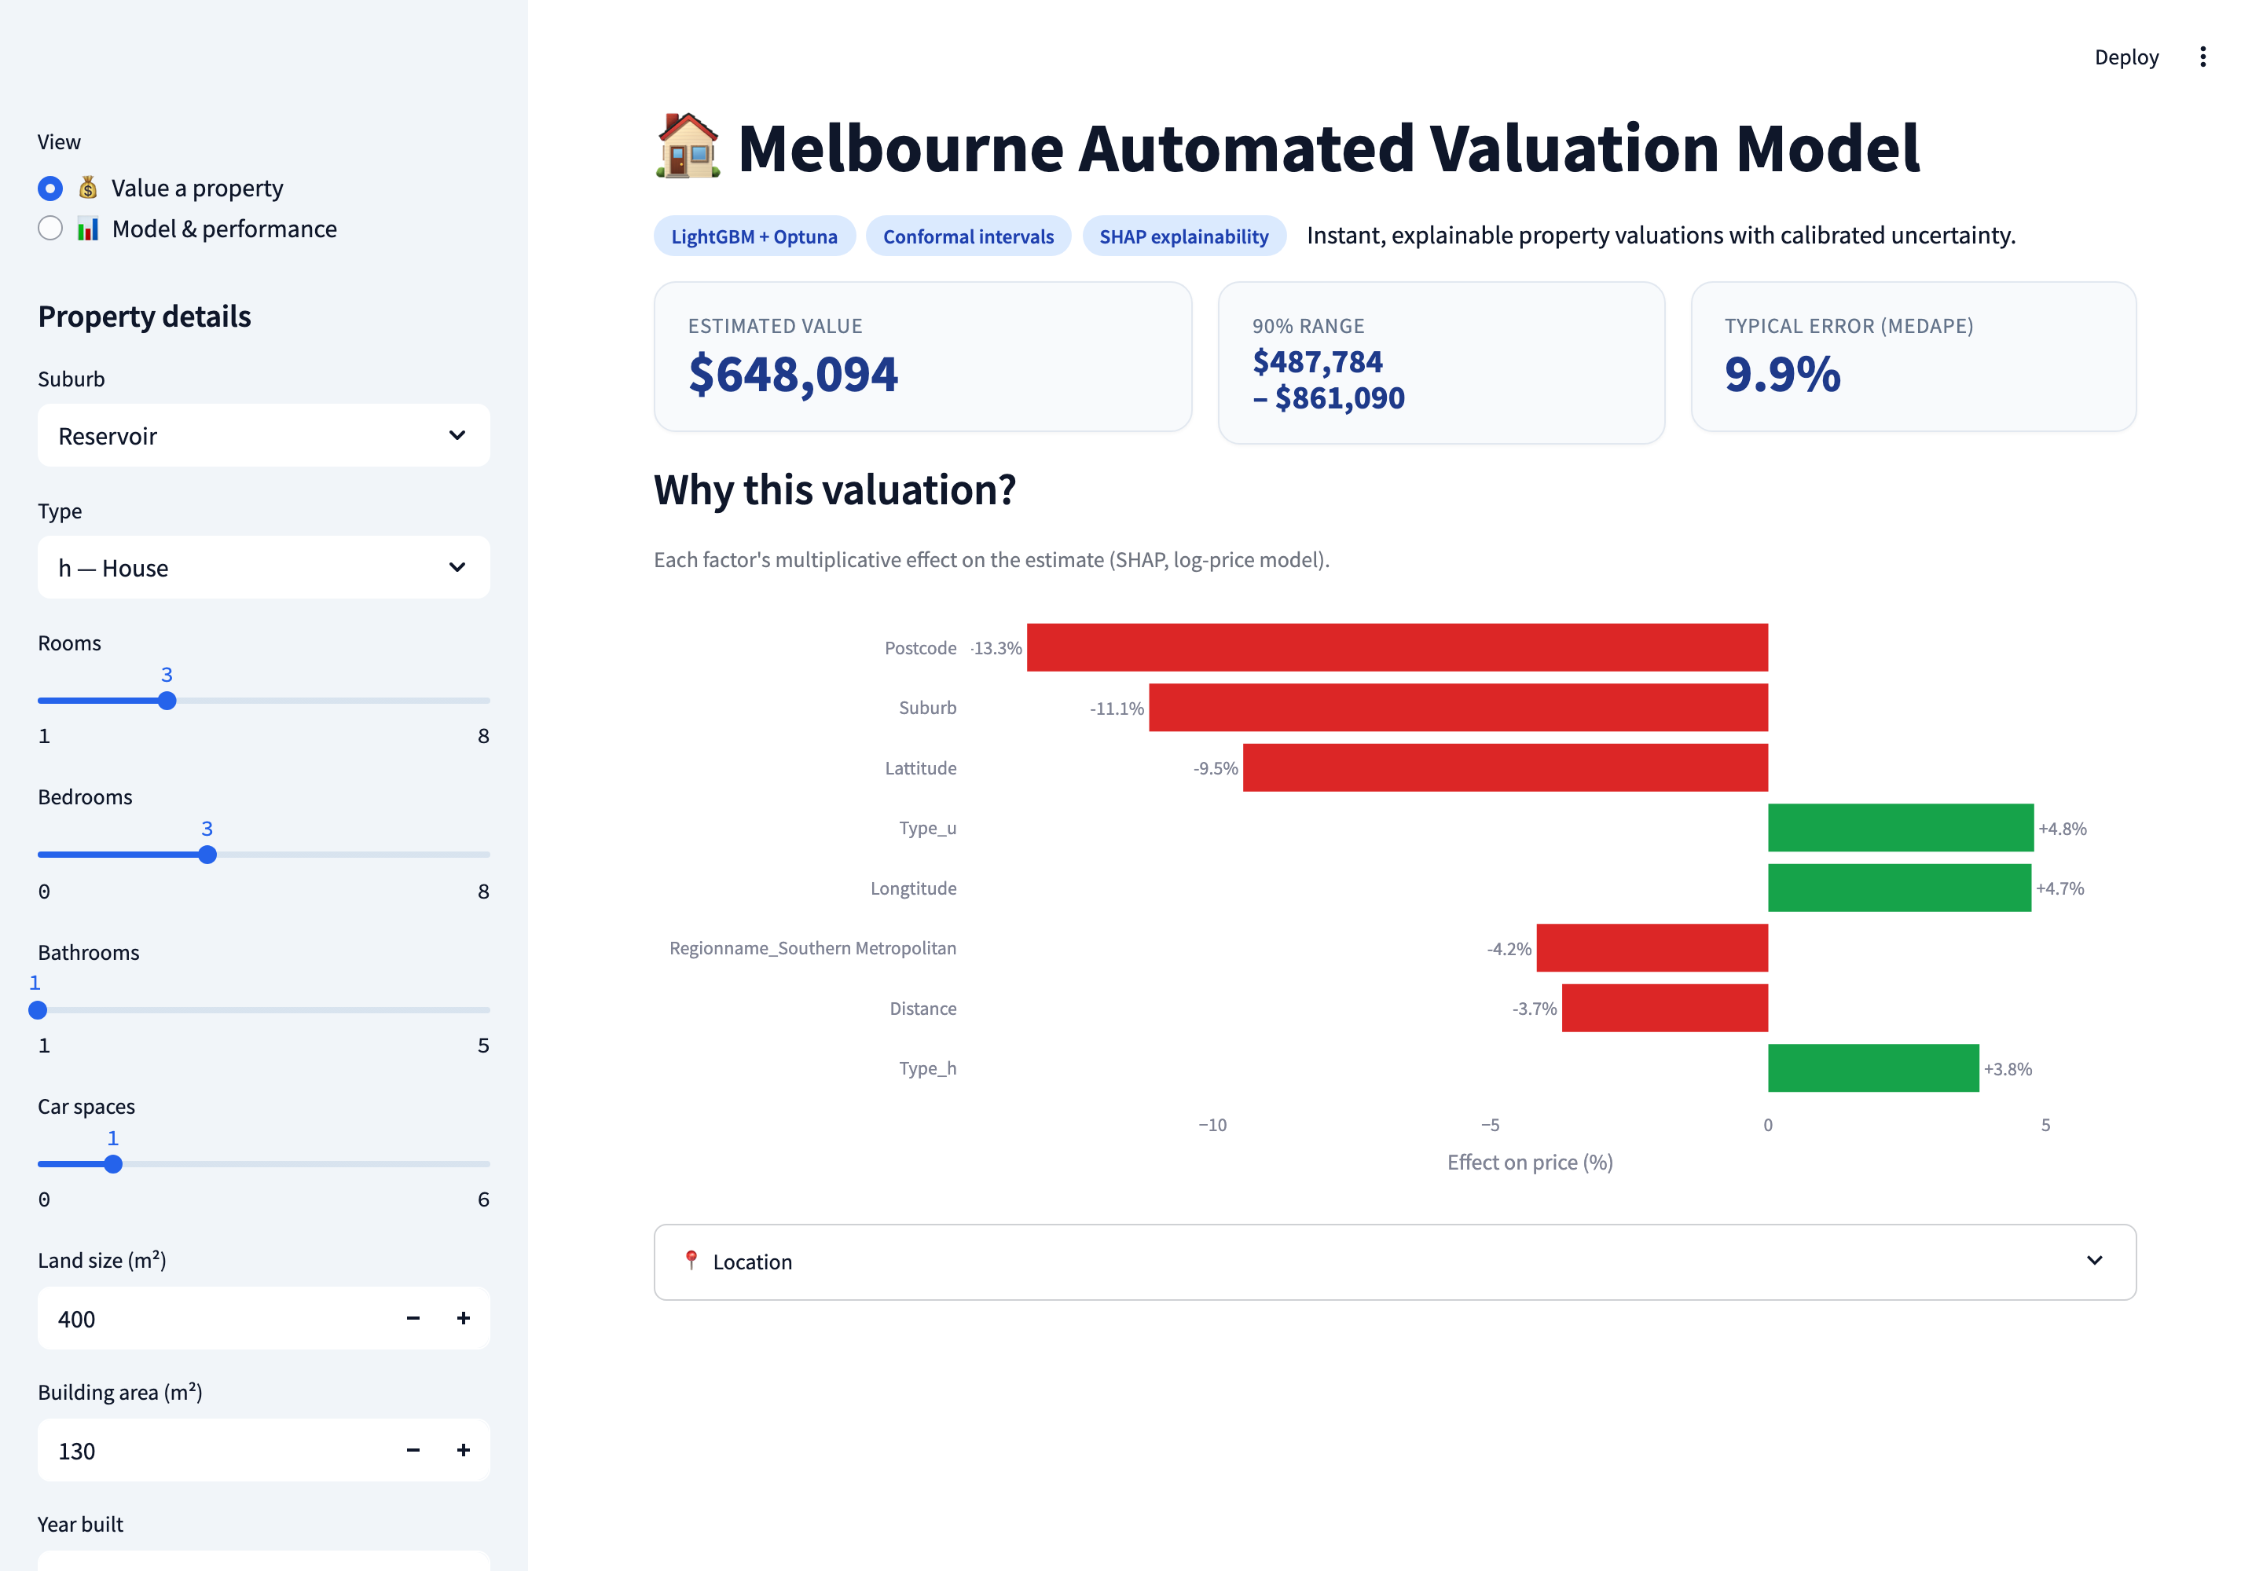
What we built
A bright, interactive Streamlit demo + a reproducible modelling pipeline.
• Enter a property → instant valuation.
• Calibrated 80/90% price range.
• 'Why this valuation?' SHAP drivers.
• Model-performance dashboard page.
• Modular src/ pipeline, one-command retrain.

