Slide 1

Fake News Detection System Leveraging Machine Learning, Natural language processing and Predictive analysis to Combat Misinformation and detecting the fake news.

Slide 2



Meet the team
Abiya Susan Varghese
Aakash Suryavanshi
Mani Krishna Kairoju

Slide 3

Executive Summary
Objective: Build a robust NLP-based model to classify news as "Fake" or "True."
Key Highlights:
Dataset: ~40,000 news articles.
Model Accuracy: 99.6%.
Techniques: TF-IDF vectorization and Logistic Regression*(best model with great accuracy).
Outcome: Reliable model, but improvements are needed for real-world applications.

Slide 4

Problem Statement
What is the Problem?
Fake news spreads misinformation, impacting public opinion and societal decisions.
Why NLP?
Text-based patterns can help distinguish fake news from credible sources.
Objective:
Automatically classify news as "Fake" or "True" with high accuracy.
Notes:
Core Problem-The inability of individuals to reliably distinguish between genuine and fabricated news articles

Slide 5
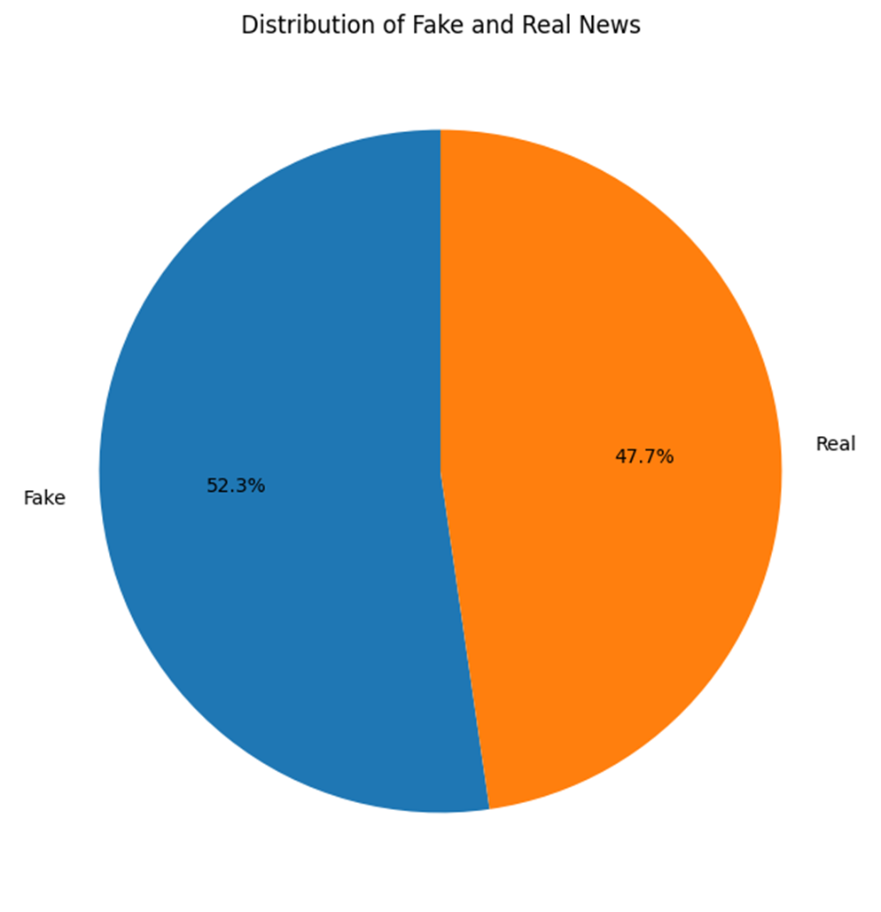

Dataset Overview
Dataset Details:
True.csv: Articles from Reuters (2018-2023).
Fake.csv: Fake articles from various sources.
Total Samples: ~40,000.
Features:
Title, Text, Subject, Date.
Labels: 1 = True, 0 = Fake.

Slide 6
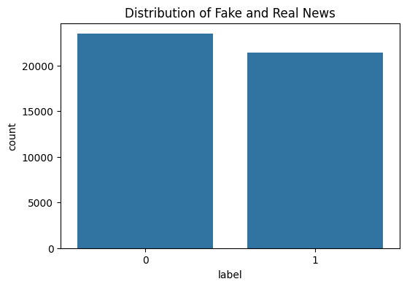
Distribution of Fake and Real News

Slide 7
Approach and Methodology
Steps Taken:
Data Collection and Exploration:
Kaggle’s Fake and Real News Dataset (or similar open-source dataset). This dataset contains thousands of labeled news articles
Data Preprocessing:
Text cleaning, stopword removal.
Feature Engineering:
TF-IDF vectorization.
Model Training:
Compare different deep learning architectures: CNN, RNN (LSTM/GRU), and Transformer-based models (BERT, RoBERTa)
Model Evaluation:
Metrics: Accuracy, Precision, Recall, F1 Score.

Slide 8
Workflow Diagram
Data Collection and Exploration
Data Preprocessing
Feature Engineering
Model Training
Model Evaluation

Slide 9
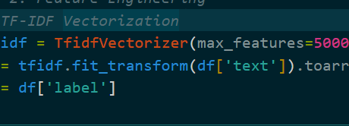

Data Preprocessing
Steps:
Combined True.csv and Fake.csv.
Removed StopWords and punctuation.
Lowercased all text.
Vectorized text using TF-ID

Slide 10

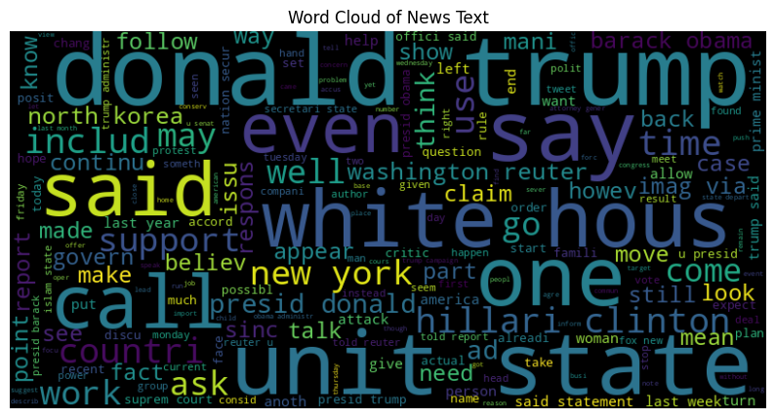
Feature Importance
WordCloud:

Slide 11
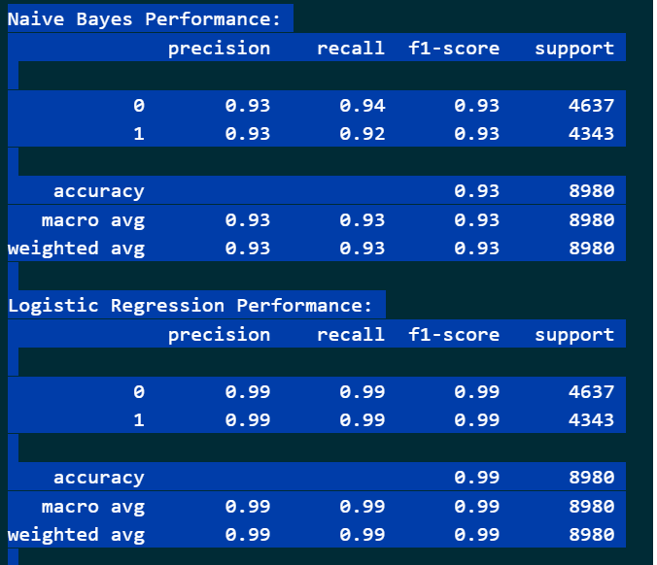
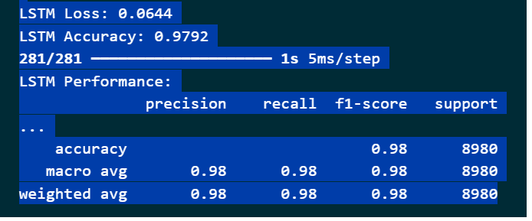
Model Training(Predictive)
Models Used:
Logistic Regression, Naïve Bayes

Slide 12
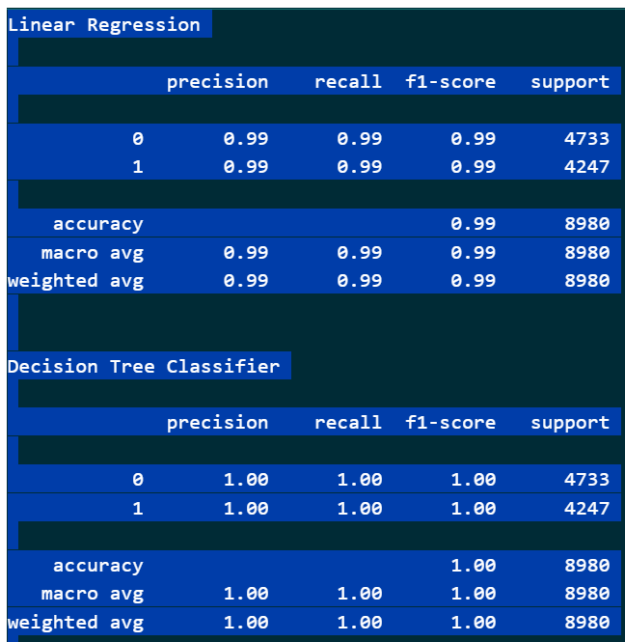
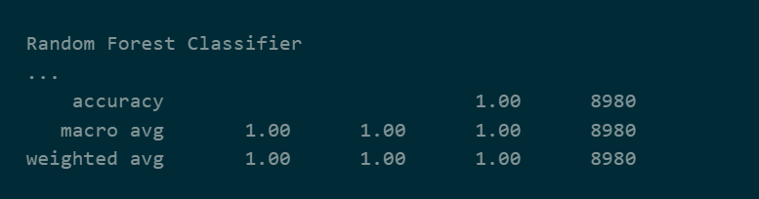
Model Training (NLP)
Model Used:
Logistic Regression, Decision Tree Classifier, Random Forest Classifier

Slide 13
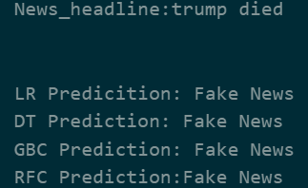
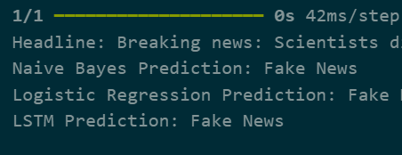
Manual Testing

Slide 14

Limitations
Current Challenges:
Dataset Bias:
"True" articles limited to Reuters, introducing potential bias.
Temporal Relevance:
Dataset (2019-2023) lacks modern terms (e.g., COVID-19).
Semantic Limitations:
TF-IDF ignores word order and deep context.
Class Imbalance:
Real-world fake news is rarer than in this dataset.
The model does not verify source credibility beyond text analysis.
It does not provide real-time fact-checking but predicts based on existing text patterns.

Slide 15

Future Improvements:
Advanced NLP Models
Transformers like BERT or RoBERTa.
Expand Dataset
Include articles from more publishers and modern topics ,web scraping from authentic resources
Address Bias
Adversarial debiasing techniques.
Real-World Testing
Deploy in a live environment for user feedback.

Slide 16
Conclusion
Summary
Model successfully detects fake news with ~98.6% accuracy.
Requires further development for real-world reliability.
Final Takeaway
A promising step toward automated misinformation detection.

Slide 17

References
Dataset: Kaggle Fake News Dataset.
Libraries: Scikit-learn, NLTK, pandas, etc.
Research Articles: Include articles on fake news detection using NLP.

Slide 18

ANY QUESTIONS ?

