Slide 1
Training and test split
Train
Test, scored once
2024
2025
489,223 requests
434,299 requests
The target is days from the open date to the close date. The regression fits log(1 + days) and converts predictions back to days.
Deadlines outside 0 to 120 days are dropped in both, so both scores use the same 923,522 requests.
Compared on MAE, RMSE, and R². The 2025 year is scored once and is not used to choose anything.
Notes:
Both models see the cleaned file, limited to deadlines from 0 through 120 days. The baseline does not use the deadline. The filter only keeps the scores on the same requests.
Fit on 2024 only. Score 2025 once. That is the plan's time split: earlier requests train, later requests test.
2024 median is 3.02 days and 2025 median is 2.97 days. The means are higher, 13.9 and 15.5 days, because of the long tail.
Raw days pile up near zero, which is why the regression uses log(1 + days). MAE and RMSE are always computed after converting back to days.

Slide 2
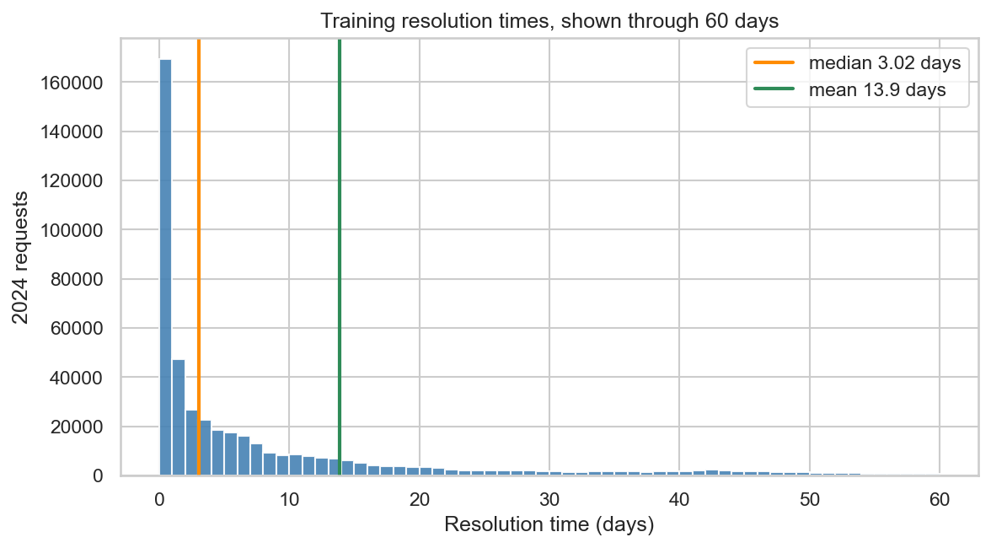
Distribution of resolution time
Histogram of 2024 resolution time through 60 days, with the median and the mean marked.
Most requests close in a few days, so the median is 3.02 days and the mean is 13.9 days.
Notes:
The constant that minimizes absolute error is the median. The constant that minimizes squared error is the mean.
On 2025, predicting the 2024 median has MAE 14.7 days. Predicting the 2024 mean has MAE 18.3 days.
The mean wins RMSE, 36.9 against 38.9. On the log scale its R² is −0.56, because 13.9 days sits far from a distribution whose middle is 3 days.
About 4.6% of 2024 requests take longer than 60 days and are outside this histogram.

Slide 3
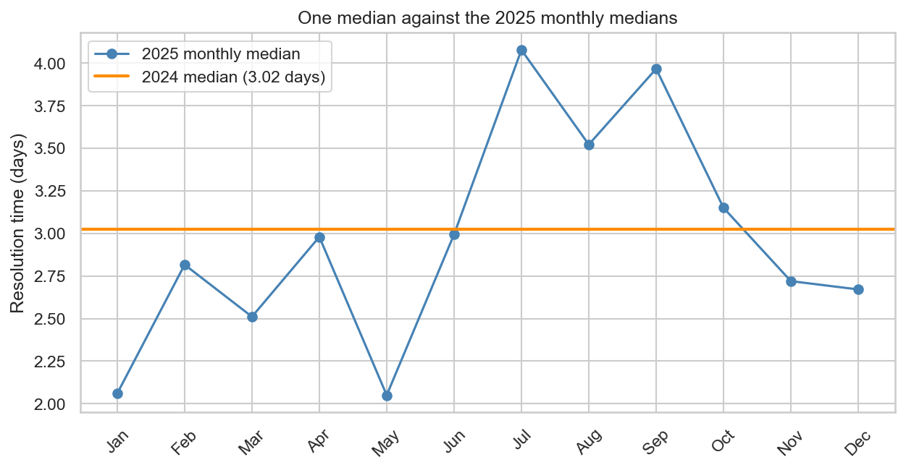
Monthly median resolution time, 2025
Each point is the median resolution time for requests filed in that month of 2025.
Monthly medians stay near the 2024 median of 3.02 days, so the center of the year barely moves.
Notes:
The orange line on the figure is the single 2024 median, 3.02 days.
Monthly medians in 2025 run from about 2.0 days, in January and May, to about 4.1 days in July.
April has only about 3,000 requests, against 30,000 to 50,000 in a full month. Its median is still about 3 days. Its mean is about 36 days.
The miss is inside each month. One number cannot cover requests that close in hours and requests that close in weeks.

Slide 4
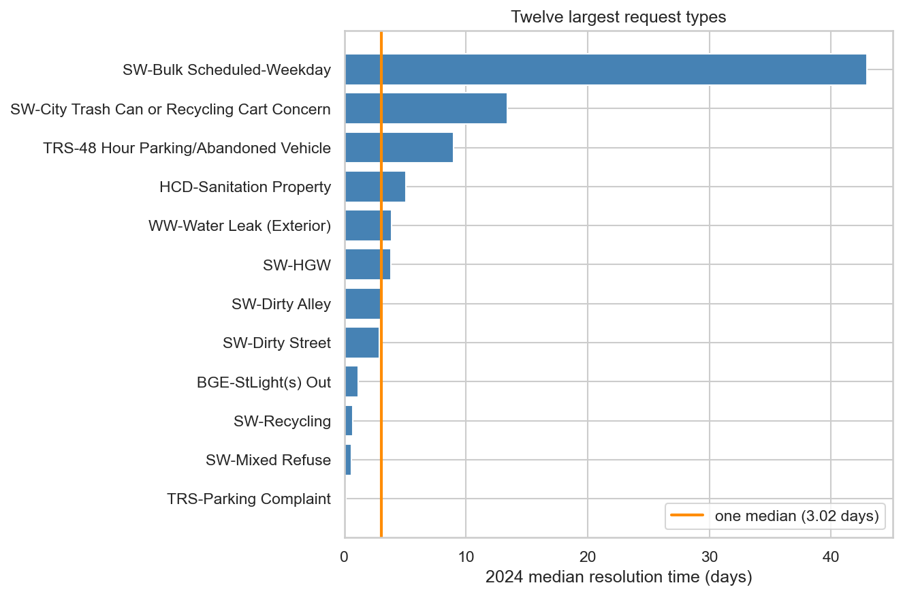
Median resolution time by request type
Each bar is the 2024 median for one of the twelve largest request types.
The medians run from under a day for parking to about 43 days for weekday bulk collection.
Notes:
The orange line is the single median of 3.02 days.
Only about 20% of 2024 requests belong to a type whose own median is within a day of 3.02.
Sanitation-property complaints, the most common type, sit near 5 days.
Types with fewer than 200 training requests share one Other median.
A few common types move in 2025: SW-HGW from 3.8 days to 1.2, dirty alley and dirty street from about 3 days to about 5.3, and 48-hour abandoned vehicles from 9.0 to 12.8.

Slide 5
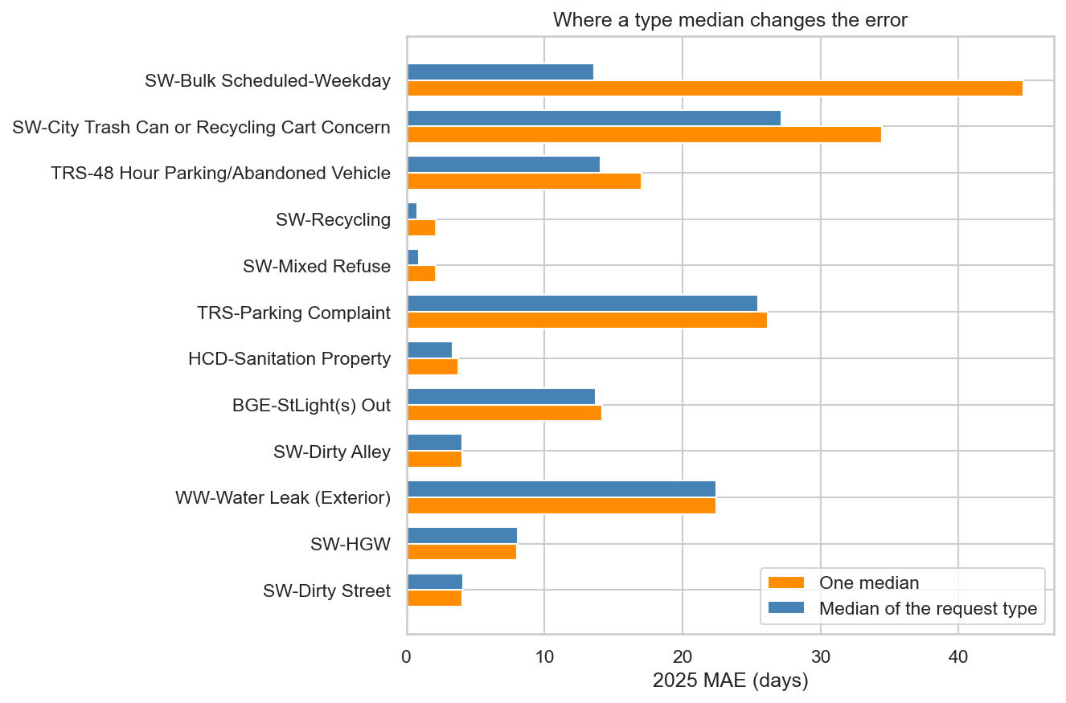
Test error by request type
Orange is the 2025 error from guessing 3.02 days; blue is the error from that type's own 2024 median.
The type median cuts error most for the slow types, especially weekday bulk collection.
Notes:
Overall MAE falls from 14.7 days to 11.9 days. RMSE falls from 38.9 to 36.0.
Weekday bulk collection falls from about 45 days of error to about 14. Trash-cart concerns drop by about 7 days of MAE.
Dirty-alley complaints do not move, because their 2024 median is already 3.02 days.
Parking complaints stay near 25 days of MAE either way, because a long tail keeps the average absolute error large.

Slide 6
Baseline results, 2025 test
Rule | MAE (days) | RMSE | R² (days) | R² (log)
2024 mean for every request | 18.30 | 36.86 | −0.002 | −0.563
2024 median for every request | 14.71 | 38.88 | −0.115 | −0.035
2024 median of each request type | 11.92 | 35.96 | 0.047 | 0.264
2025 scores for one mean, one median, and a median for each request type.
The type median is the baseline to beat: typical error falls from 14.7 days to 11.9.
Notes:
The mean is a check, not the baseline. It wins squared error and loses absolute error.
Day-scale R² stays near zero because a few requests take months.
R² (log) converts the day prediction with log(1 + days). For the type median that number is 0.26.
The highlighted row is the bar for the regression: 2025 MAE below 11.9 days.

Slide 7
Fitted equation
X = log(1 + days) = 1.557 + 0.0287 × deadline
+ type add-on + month add-on + weekday add-on + hour add-on
Predicted days = exp(X) − 1.
Same 10-day deadline, January, 10:00 | Plug into the equation | Predicted days
Sanitation property, Monday (all add-ons 0) | 1.557 + 0.0287 × 10 | 5.3
Same request, filed on Friday | 1.844 + 0.10 | 6.0
Pothole pickup instead of sanitation property | 1.844 − 1.62 | 0.26
Each row changes one term, holding the 10-day deadline, January, and 10:00 fixed.
Switching to a pothole changes the prediction by days; filing on Friday changes it by less than a day.
Notes:
A coefficient is one of the add-ons. The reference, where every add-on is zero, is HCD-Sanitation Property, filed on a Monday in January at 10:00.
Sanitation property with a 10-day deadline: 1.557 + 0.287 = 1.844, and exp(1.844) − 1 is about 5.3 days.
Friday adds 0.10, about 10 percent longer. The pothole add-on is −1.62, so the same deadline predicts about 0.26 days.
There are 180 fitted numbers: the starting value 1.557, the deadline slope 0.0287, and one add-on for each other request type, month, weekday, and hour.
Each extra deadline day multiplies (1 + days) by about 1.029, roughly 3 percent longer, after request type is already in the equation.

Slide 8
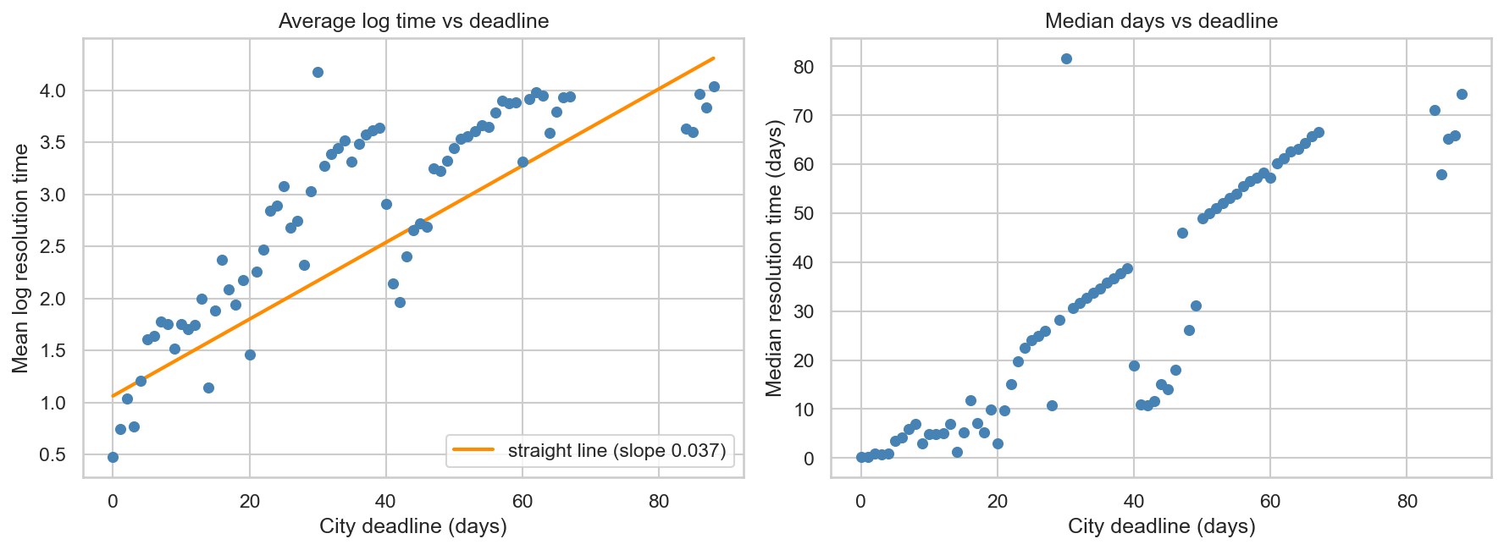
Resolution time by city deadline
Each dot groups requests with the same deadline: left is average log(1 + days), right is median days.
Longer deadlines go with longer closures, and many deadlines sit off one straight line.
Notes:
This plot ignores request type. The orange slope, 0.037, is the rough line before request type is held fixed. The equation's deadline slope is 0.0287.
On the left axis, 1.5 is about 3.5 days and 3 is about 19 days.
A 42-day deadline, mostly bulk collection, closes faster than a 30-day deadline. Those jumps are different kinds of work.

Slide 9
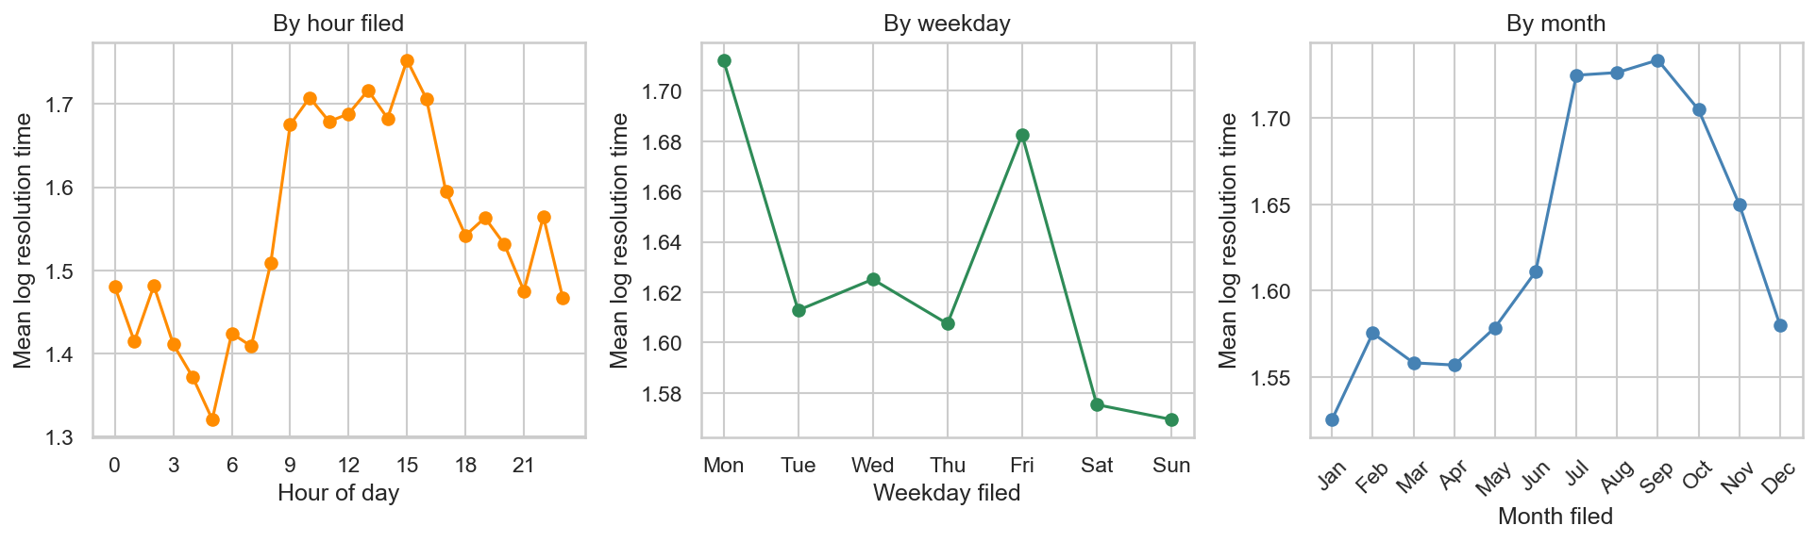
Resolution time by hour, weekday, and month
Each point is the average of log(1 + days) for that hour, weekday, or month.
The calendar bends, but the swing is small: 1.5 on this axis is about 3.5 days and 1.7 is about 4.5 days.
Notes:
Each hour pools every request filed at that hour, across all months and both years. Each weekday does the same. Nothing else is held fixed.
The shapes are not straight lines, so the equation uses a separate add-on for each hour, weekday, and month.
Request type, on its own, accounts for about 46 percent of the variation in log time. Hour, weekday, and month each account for well under 1 percent.

Slide 10
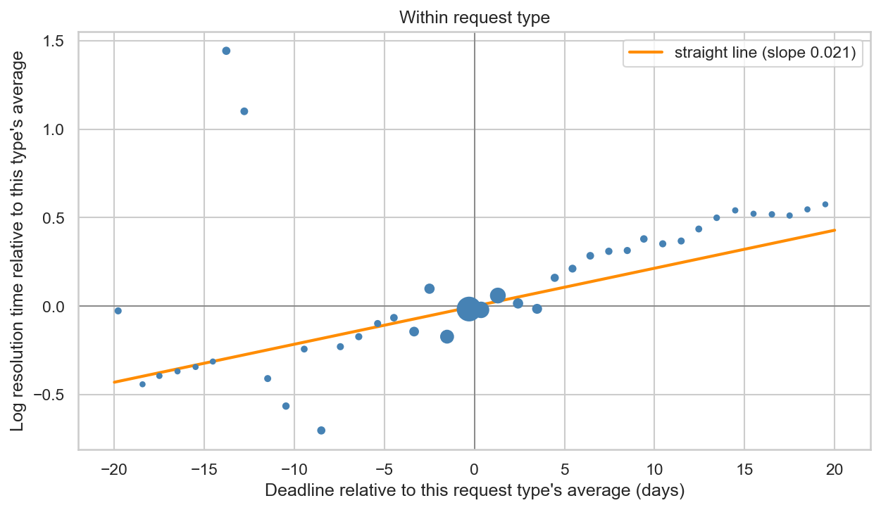
Deadline within request type
Both axes are the difference from the request type's own average; each dot is a bin of many requests.
Once the type is known, an extra deadline day adds little to resolution time.
Notes:
A dot is not one request type. Requests are grouped by how far their deadline sits from their own type's average, and the dot is the average of that bin. Point size is the number of requests.
The orange slope is 0.021, close to the 0.0287 in the equation.
73 percent of requests are within one day of the deadline their type usually gets.
Past about five extra deadline days the dots sit a little above the line. The two high dots near −12 to −14 days are mostly trash-cart complaints.

Slide 11
Linear regression results, 2025 test
Model | MAE (days) | RMSE | R² (days) | R² (log)
One median for every request | 14.71 | 38.88 | −0.115 | −0.035
Median of each request type | 11.92 | 35.96 | 0.047 | 0.264
Linear regression | 11.59 | 35.87 | 0.051 | 0.315
2025 test scores for the two median rules and the linear regression.
The regression beats the type median by about 0.3 days of MAE, from 11.9 to 11.6.
Notes:
The equation is fit on 2024 and scored once on 2025.
On the log scale, R² moves from 0.26 for the type median to 0.32.
In training, request type alone has log R² 0.53 and the full equation has 0.54.
Day-scale R² stays near 0.05 because a few requests take months. MAE, about 12 days, describes a typical request.

