Slide 1
NETWORKING WITH PYTHON
TEAM – 9
N. Vyshnavi
S. Sai Prasanna
P. Surya Narasimha
B. Pavithra
V. Manikumar
Mohammed Rafi Pathan

Slide 2
Use Cases
Make a Database connection.
Create Registration and Login portal page and display another page for successful login and error pop up for unsuccessfull login.
To get router packet details from Cisco iosxe router.
Ping for an IP address.
To know bandwidth utilized by the processes or network utilization in the system.
To find total number of ports open in a host.

Slide 3
Projects Requirements
Python(in-built) Modules:
Psutil,OS,Threading,Pandas,Time,Tkinter,mysql.connector,
sys,Netmiko,ncclient
MYSQL Workbench
Pycharm

Slide 4
TEAM WORK
Database Implementation - N. Vyshnavi
Router Packet Details - B. Pavithra
Ping Monitoring - S. Sai Prasanna
Bandwidth - V. Mani Kumar
Port Finding - Mohammed Rafi Pathan
Model Driven Programmability - Mohammed Rafi Pathan
Main Code - P. Surya Narasimha

Slide 5
Flow Chart:
Start
Database Connection
MODULES
Router Packet Details
Registration
Login
Ping Monitoring
Valid Credentials
Valid Credentials
No
No
Get Bandwidth
Port Finding
Yes
Yes
Registration Successful
Login Success
Model Driven Programmability
All fields are required
Invalid Credentials

Slide 6
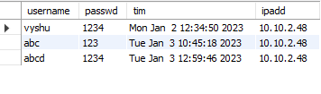
Creation of a database
create database info1;
use info1;
create table userinfo1
(username varchar(20),passwd varchar(20),tim varchar(40),ipadd varchar(40))
select * from userinfo1;

Slide 7
DB IMPLEMENTATION
from tkinter import * from tkinter import messagebox import mysql.connector import os import time import socket class DB_Access: status = False def __init__(self): # connecting to the database self.db = mysql.connector.connect(host='127.0.0.1', user="root", password="Lakshmi@1995", database="info1") self.mycur = self.db.cursor() # destroy() in the code base is used to destroy the window def error_destroy(self): err.destroy()

Slide 8
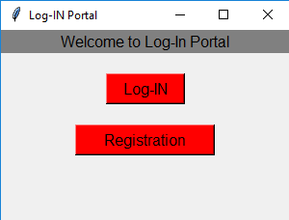
Main Screen
def main_screen(self): global root root = Tk() root.title("Log-IN Portal") root.geometry("300x300") Label(root, text="Welcome to Log-In Portal", font="bold", bg="grey", fg="black", width=300).pack() Label(root, text="").pack() Button(root, text="Log-IN", width="8", height="1", bg="red", font="bold", command=self.login).pack() Label(root, text="").pack() Button(root, text="Registration", height="1", width="15", bg="red", font="bold", command=self.registration).pack() Label(root, text="").pack() Label(root, text="").pack() root.mainloop() def return_status(self): return self.status

Slide 9
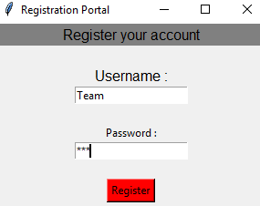
Registration:
def registration(self): global root1 root1 = Toplevel(root) root1.title("Registration Portal") root1.geometry("300x250") global username global password Label(root1, text="Register your account", bg="grey", fg="black", font="bold", width=300).pack() username = StringVar() password = StringVar() Label(root1, text="").pack() Label(root1, text="Username :", font="bold").pack() Entry(root1, textvariable=username).pack() Label(root1, text="").pack() Label(root1, text="Password :").pack() Entry(root1, textvariable=password, show="*").pack() Label(root1, text="").pack() Button(root1, text="Register", bg="red", command=self.register_user).pack()

Slide 10
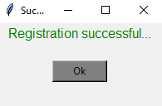
User Register:
def register_user(self): username_info = username.get() password_info = password.get() if username_info == "": error() elif password_info == "": error() else: Time = time.localtime() T = time.asctime(Time) ip=socket.gethostname() ipadd=socket.gethostbyname(ip) sql = "insert into userinfo1 values(%s,%s,%s,%s)" t = (username_info, password_info, T, ipadd) self.mycur.execute(sql, t) self.db.commit() Label(root1, text="").pack() time.sleep(0.50) self.success()

Slide 11
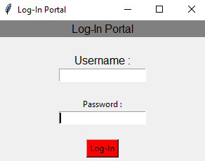
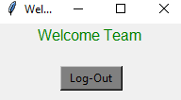
Login:
def login(self): global root2 root2 = Toplevel(root) root2.title("Log-In Portal") root2.geometry("300x300") global username_varify global password_varify Label(root2, text="Log-In Portal", bg="grey", fg="black", font="bold", width=300).pack() username_varify = StringVar() password_varify = StringVar() Label(root2, text="").pack() Label(root2, text="Username :", font="bold").pack() Entry(root2, textvariable=username_varify).pack() Label(root2, text="").pack() Label(root2, text="Password :").pack() Entry(root2, textvariable=password_varify, show="*").pack() Label(root2, text="").pack() Button(root2, text="Log-In", bg="red", command=self.login_varify).pack() Label(root2, text="")

Slide 12
ROUTER PACKET DETAILS
import psutil from netmiko import ConnectHandler from threading import Thread class Router_Packet_details: def get_packet_details(): router = { "device_type":"cisco_ios", "ip":"sandbox-iosxe-latest-1.cisco.com", "username":"developer", "password":"C1sco12345" } net_connect = ConnectHandler(**router) network_stats = psutil.net_io_counters(pernic = False,nowrap = True) print(network_stats)

Slide 13
bytes_sent = getattr(network_stats, 'bytes_sent') bytes_recv = getattr(network_stats,'bytes_recv') print("Bytes Sent = {0} | Bytes Received = {1}".format(bytes_sent,bytes_recv)) net_connect.disconnect() Route_details = Router_Packet_details Thread1 = Thread(target = Route_details.get_packet_details()) Thread2 = Thread(target = Route_details.get_packet_details()) Thread1.start() Thread2.start() Thread1.join() Thread2.join()

Slide 14
OUTPUT
C:\Users\user704\AppData\Local\Programs\Python\Python39\python.exe C:\Users\user704\PycharmProjects\Capstone\Router_Packet_Details.py
snetio(bytes_sent=267450533, bytes_recv=2501519764, packets_sent=1194520, packets_recv=12149450, errin=0, errout=0, dropin=17825, dropout=0)
Bytes Sent = 267450533 | Bytes Received = 2501519764
snetio(bytes_sent=267482221, bytes_recv=2501541941, packets_sent=1194628, packets_recv=12149680, errin=0, errout=0, dropin=17825, dropout=0)
Bytes Sent = 267482221 | Bytes Received = 2501541941

Slide 15
PING MONITORING
from netmiko import ConnectHandler import os
class Ping_test: def __init__(self): ip = input("Enter an IP address to ping : ") # ping for each ip in the file response = os.popen(f"ping {ip} ").read() # saving some ping output details to output file if ("Request timed out." or "unreachable") in response: print(response) f = open("ping_output.txt", "a") f.write(str(ip) + ' link is down' + '\n') f.close()
else: print(response) f = open("ping_output.txt", "a") f.write(str(ip) + ' is up ' + '\n') f.close() # print output file to screen
with open("ping_output.txt") as file: output = file.read() f.close() print(output)
Ping_test()

Slide 16
C:\Users\user704\AppData\Local\Programs\Python\Python39\python.exe C:\Users\user704\PycharmProjects\Capstone\Ping_monitoring.py
Enter an IP address to ping : facebook.co.in
Pinging facebook.co.in [162.215.226.7] with 32 bytes of data:
Reply from 162.215.226.7: bytes=32 time=258ms TTL=48
Reply from 162.215.226.7: bytes=32 time=259ms TTL=48
Reply from 162.215.226.7: bytes=32 time=258ms TTL=48
Reply from 162.215.226.7: bytes=32 time=259ms TTL=48
Ping statistics for 162.215.226.7:
Packets: Sent = 4, Received = 4, Lost = 0 (0% loss),
Approximate round trip times in milli-seconds:
Minimum = 258ms, Maximum = 259ms, Average = 258ms
facebook.co.in is up

Slide 17
BANDWIDTH
import tkinter as tk from psutil import net_io_counters KB = float(1024) MB = float(KB ** 2) GB = float(KB ** 3) TB = float(KB ** 4) def size(B): B = float(B) if B < KB: return f"{B} Bytes" elif KB <= B < MB: return f"{B / KB:.2f} KB" elif MB <= B < GB: return f"{B / MB:.2f} MB" elif GB <= B < TB: return f"{B / GB:.2f} GB" elif TB <= B: return f"{B / TB:.2f} TB" #WINDOW_RESIZEABLE = False REFRESH_DELAY = 1500
last_upload, last_download, upload_speed, down_speed = 0, 0 ,0 , 0 # initilizing window = tk.Tk()
WINDOW_SIZE =(400,400) window.title("Network Bandwidth Monitor") # setting window title window.geometry(f"{WINDOW_SIZE[0]}x{WINDOW_SIZE[1]}") # window size window.resizable(width=WINDOW_RESIZEABLE,height=WINDOW_RESIZEABLE) # look window label_total_upload_header = tk.Label(text="Total Upload:", font="Quicksand 12 bold") label_total_upload_header.pack() label_total_upload = tk.Label(text="Calculating...", font="Quicksand 12") label_total_upload.pack() label_total_download_header = tk.Label(text="Total Download:", font="Quicksand 12 bold") label_total_download_header.pack() label_total_download = tk.Label(text="Calculating...", font="Quicksand 12") label_total_download.pack() label_total_usage_header = tk.Label(text="Total Usage:", font="Quicksand 12 bold") label_total_usage_header.pack() label_total_usage = tk.Label(text="Calculating...", font="Quicksand 12") label_total_usage.pack()

Slide 18
label_upload_header = tk.Label(text="Upload Speed:", font="Quicksand 12 bold") label_upload_header.pack() label_upload= tk.Label(text="Calculating...", font="Quicksand 12") label_upload.pack() label_download_header = tk.Label(text="Download Speed:", font="Quicksand 12 bold") label_download_header.pack() label_download= tk.Label(text="Calculating...", font="Quicksand 12") label_download.pack()
def update(): global last_upload,last_download,upload_speed, down_speed counter = net_io_counters() upload = counter.bytes_sent download = counter.bytes_recv total = upload + download if last_upload > 0: if upload < last_upload: upload_speed = 0 else: upload_speed = upload - last_upload
if last_download > 0: if download < last_download: down_speed = 0 else: down_speed = download - last_download
last_upload = upload last_download = download label_total_upload["text"] = f"{size(upload)} ({upload} Bytes)" label_total_download["text"] = f"{size(download)} ({download} Bytes)" label_total_usage["text"] = f"{size(total)}\n" label_upload["text"] = size(upload_speed) label_download["text"] = size(down_speed) label_total_upload.pack() label_total_download.pack() label_total_usage.pack() label_upload.pack() label_download.pack() window.after(REFRESH_DELAY, update) update() window.mainloop()

Slide 19
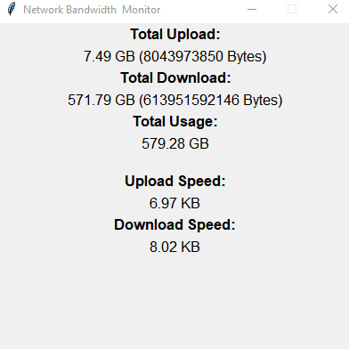
BANDWIDTH OUTPUT

Slide 20
PORT FINDING
from threading import Thread import socket host = str(input('host > ')) from_port = int(input('start scan from port > ')) to_port = int(input('finish scan to port > ')) counting_open = [] counting_close = [] threads = [] class Finding_unsedports: def scan(port): s = socket.socket() result = s.connect_ex((str(host),port)) if result == 0: counting_open.append(port) print((str(port))+' -> is open') peer = s.getpeername() print(peer) s.close()
else: counting_close.append(port) #print((str(port))+' -> is closed') s.close() for i in range(from_port, to_port+1): t = Thread(target=scan, args=(i,)) threads.append(t) t.start() [x.join() for x in threads] print(counting_open) Finding_unsedports()

Slide 21
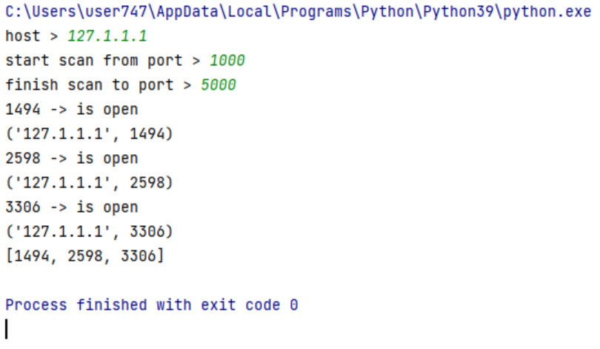
PORT FINDING OUTPUT

Slide 22
MODEL DRIVEN PROGRAMMABILITY
from ncclient import manager import re nexus = manager.connect( host='sandbox-iosxe-latest-1.cisco.com', username='developer', password='C1sco12345', allow_agent=False, look_for_keys=False, hostkey_verify=False, unknown_host_cb=True) for capability in nexus.server_capabilities: print (capability)

Slide 23
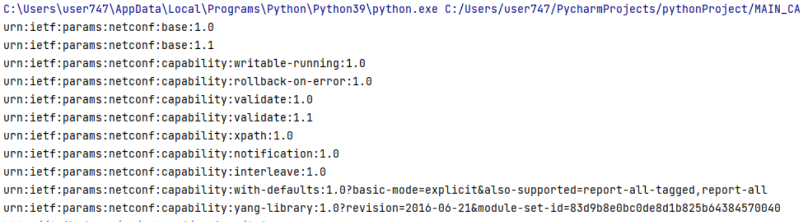
MODEL DRIVEN PROGRAMMABILITY OUTPUT

Slide 24
MAIN CODE (INTEGRATION)
import sys class Main: def run_db(self): import DB_connection def run_Router_Packet_Details(self): import Router_Packet_Details def run_Ping_monitoring(self): import Ping_monitoring def get_bandwidth(self): import Bandwidth def exitprogram(): sys.exit("system exiting") def printerror(): print("Invalid option entered") main = Main()

Slide 25
Continues..
def run(): menu={ 1:main.run_db, 2:main.run_Router_Packet_Details, 3:main.run_Ping_monitoring, 4:main.get_bandwidth, 5:exitprogram } while True: print("\n 1:Establish DataBase connection\n2:Get router packet details\n3:Ping Monitoring\n4:Get Bandwidth\n5:Exit Program\nEnter your choice?",end='') try : choice = int(input()) except ValueError: print("Please enter a valid input!") menu.get(choice,printerror)() run()

Slide 26
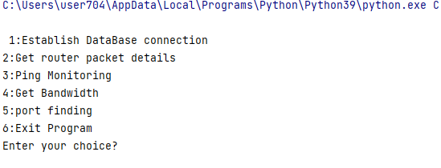
OUTPUT:

Slide 27
Thank You

