Slide 1
Bank Loan & Transaction Analysis Report
Performance Evaluation, Risk Assessment, and Dashboard Insights

Slide 2
Introduction
The Bank Loan & Transaction Analysis Report focuses on analyzing banking data to evaluate portfolio performance, transaction behavior, and risk exposure. The objective of this project is to transform raw banking data into meaningful insights that support data-driven decision-making.
This project covers two major analytical areas:
Loan Portfolio Analysis – assessing loan disbursement, repayment performance, risk indicators, product distribution, and demographic segmentation.
Debit & Credit Transaction Analysis – evaluating financial flow, transaction trends, branch performance, and high-risk transaction monitoring.
Using tools such as Excel, MySQL, Tableau, and Power BI, interactive dashboards were developed to visualize key performance indicators (KPIs) and provide actionable business insights.

Slide 3
DATA OVERVIEW
Two datasets used: • Bank Data Analystics.xlsx (Loan Portfolio Data) • Debit and Credit banking_data.xlsx (Transaction Data)
The Loan dataset contains customer demographics, loan details, disbursement records, repayment information, credit grades, verification status, and risk indicators.
The Transaction dataset includes customer accounts, transaction date, debit/credit type, amount, balance, branch, bank name, transaction method, and high-value transaction flags.
Data Period: Loan data covers multi-year disbursement records; Transaction data spans January–December (December partial).

Slide 4
Project Objectives
Analyse loan portfolio performance, including disbursement, repayment, and revenue generation.
Evaluate credit risk through default and delinquency analysis.
Examine geographic, demographic, and product-wise loan distribution.
Assess debit and credit transaction patterns and liquidity stability.
Monitor high-risk transactions to support fraud detection.
Develop interactive dashboards using Excel, MySQL, Tableau, and Power BI for data-driven insights.

Slide 5
process
Imported and cleaned raw loan and transaction datasets.
Handled missing values, standardized formats, and validated key fields.
Calculated KPIs including Total Loan Amount, Total Collection, Interest Revenue, Default Rate, Delinquency Rate, Total Credit, and Net Transaction Amount.
Created derived fields such as High-Value Transaction Flag (Amount ≥ 4750) and customer segmentation categories.
Developed interactive dashboards using Excel, MySQL, Tableau, and Power BI for performance and risk analysis.

Slide 6
Loan Portfolio Analysis
Performance, Risk and Distribution Overview

Slide 7
LOAN KPI OVERVIEW
₹732.7M funded across 65K+ loans reflects strong lending scale and market reach.
Total collection (₹808.3M) exceeding funded amount indicates healthy repayment performance.
₹155.29M in interest income shows strong revenue contribution from lending operations.
Average loan maturity of 43.2 months suggests a balanced medium-term portfolio structure.
Default rate (1.56%) is controlled; however, delinquency rate (10.84%) requires close monitoring.
16.9K non-verified loans indicate potential compliance and operational risk areas.

Slide 8
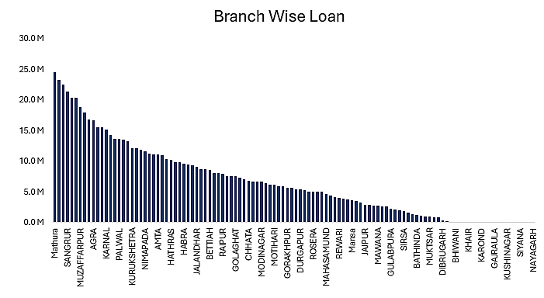
Branch-Wise Loan Distribution
Mathura leads in total loan disbursement, followed by Sangrur and Muzaffarpur.
The top branches contribute a significant share of the overall portfolio.
Lower-performing branches offer opportunities for portfolio growth and operational improvement.

Slide 9
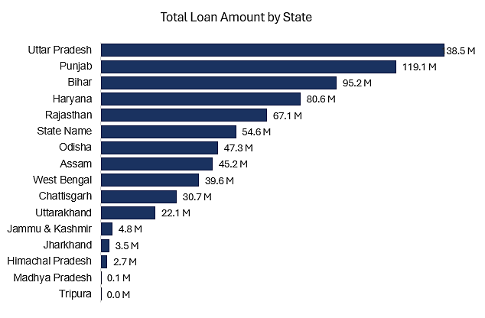
State-Wise Loan Distribution Analysis
Uttar Pradesh has the highest loan disbursement, followed by Punjab and Bihar.
Loan distribution is concentrated in a few major states.
Several states show low lending exposure, indicating potential growth opportunities.

Slide 10
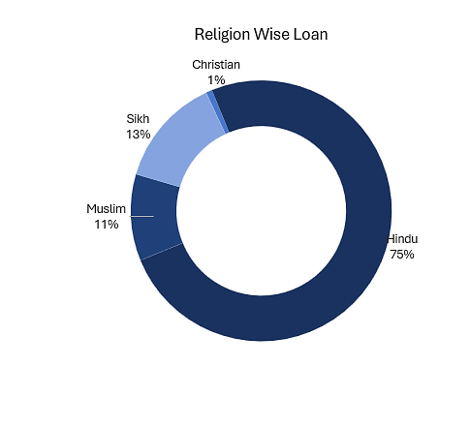
Religion-wise Loan Distribution
The majority of loans (75%) are issued to Hindu customers, indicating a strong concentration in this segment.
Sikh (13%) and Muslim (11%) borrowers represent moderate portions of the loan portfolio.
Christian customers account for only 1%, reflecting a very small share in comparison to other groups.

Slide 11
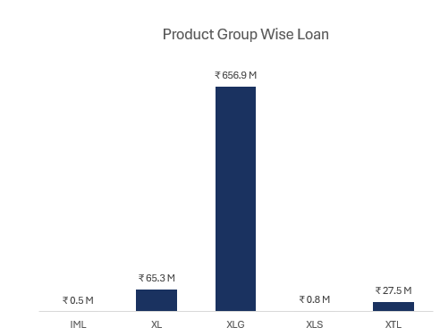
Product Group Wise Loan Distribution
The XLG product group dominates the portfolio, contributing approximately ₹656.9M, which is significantly higher than all other categories.
XL (₹65.3M) and XTL (₹27.5M) represent moderate contributions.
IML (₹0.5M) and XLS (₹0.8M) contribute a very minimal share.

Slide 12
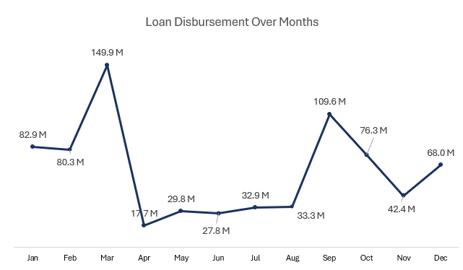
Loan Disbursement Over Months
Disbursement fluctuates significantly across the year.
March (₹149.9M) and September (₹109.6M) show peak lending activity.
A sharp drop is observed in April (₹17.7M) after the March spike.
Mid-year months remain relatively stable at lower levels, with slight recovery toward year-end.

Slide 13
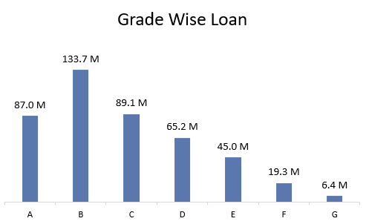
Grade Wise Loan
Grade B (₹133.7M) has the highest loan disbursement, followed by Grade C (₹89.1M) and Grade A (₹87.0M).
Loan amounts gradually decline from Grade D to Grade G, with Grade G (₹6.4M) being the lowest.

Slide 14
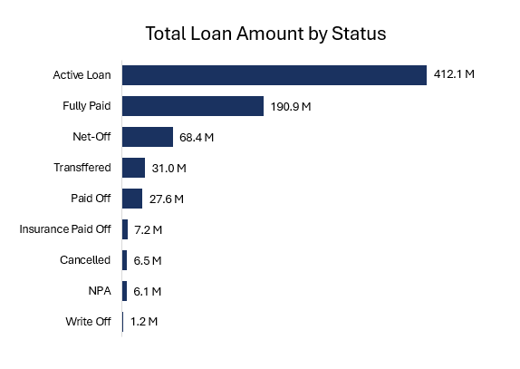
Loan Portfolio Distribution by Status
The majority of the portfolio is in Active Loans (₹412.1M), indicating strong ongoing lending exposure.
Fully Paid loans (₹190.9M) represent a significant portion, showing healthy repayment levels.
Net-Off (₹68.4M) is the largest stressed category, while NPA (₹6.1M) and Write-Off (₹1.2M) remain comparatively low.

Slide 15
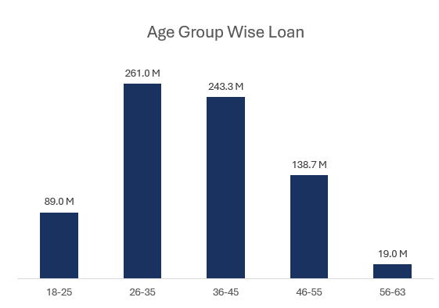
Age Group–Wise Loan Distribution
The highest loan disbursement is concentrated in the 26–35 age group (₹261.0M), followed closely by 36–45 (₹243.3M).
18–25 and 56–63 age groups have significantly lower loan amounts, indicating limited exposure.
Loan participation declines steadily after age 45.

Slide 16
Bank Debit & Credit Performance Analysis
Insights into Transaction Trends, Financial Flow, and Risk Performance

Slide 17
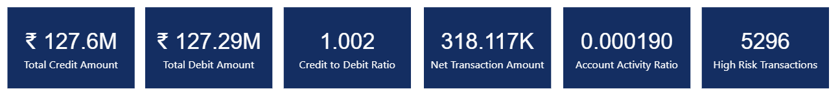
Debit & Credit KPI Overview
Credit (₹127.6M) and Debit (₹127.29M) amounts are nearly balanced, reflected in a Credit-to-Debit ratio of 1.002, indicating stable cash flow.
Net Transaction Amount stands at ₹318.1K, showing a marginal positive inflow.
Account Activity Ratio (0.000190) suggests relatively low active transaction intensity compared to total accounts.
5,296 High-Risk Transactions highlight the need for continuous fraud monitoring and risk control measures.

Slide 18
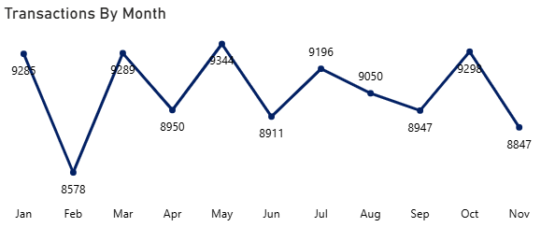
Monthly Transaction Analysis
Monthly transactions remain stable with periodic peaks in May and October.
February shows a temporary dip, followed by consistent recovery.
No major downward trend observed, indicating steady transaction activity.
December is excluded as data is available only until Dec 1.

Slide 19
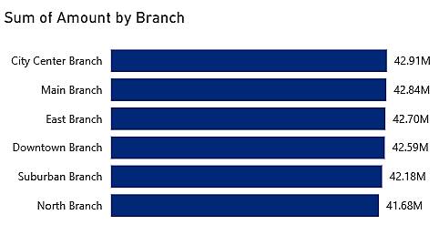
Branch-Wise Transaction Amount Analysis
Transaction amounts are evenly distributed across all branches, ranging between ₹41.68M and ₹42.91M.
City Center Branch leads slightly, followed closely by Main and East Branch.
The minimal variation indicates balanced operational performance across branches.
No single branch shows significant dominance or underperformance.

Slide 20
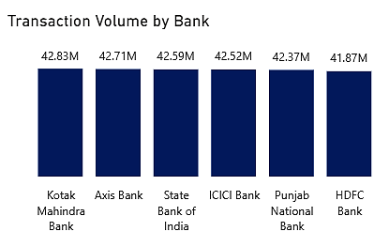
Transaction Volume by Bank Analysis
Transaction volumes are closely aligned across all banks, ranging from ₹41.87M to ₹42.83M.
Kotak Mahindra Bank leads marginally, followed by Axis Bank and State Bank of India.
The narrow variation indicates balanced transaction distribution across banking partners.
No single bank shows significant dominance, reflecting diversified banking activity.

Slide 21
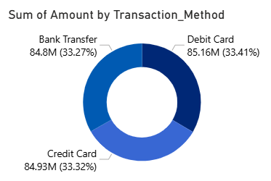
Transaction Amount by Payment Method
Transaction amounts are almost evenly distributed across Debit Card, Credit Card, and Bank Transfer.
Debit Card contributes the highest share (33.41%), closely followed by Credit Card (33.32%) and Bank Transfer (33.27%).
The minimal variation indicates balanced customer preference across payment methods.
No single transaction method dominates the overall volume.

Slide 22
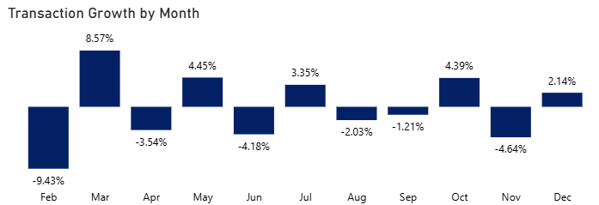
Monthly Transaction Growth Analysis
February shows the sharpest decline (-9.43%), followed by strong recovery in March (+8.57%).
Growth fluctuates throughout the year with moderate ups and downs.
Positive momentum appears in May, July, and October.
Overall trend indicates short-term volatility but stable performance overall.

Slide 23
Loan Portfolio – Strategic Insights
Portfolio shows strong financial health with collections exceeding disbursement and low default rate (1.56%).
However, delinquency rate (10.84%) signals early-stage repayment stress.
Loan exposure is concentrated in a few states and heavily dependent on the XLG product category.
Majority borrowers fall within the 26–45 age group, indicating limited demographic diversification.
Seasonal disbursement spikes suggest cyclical lending behavior.

Slide 24
Loan Portfolio - Recommendations
Implement proactive delinquency monitoring and early warning systems to reduce future NPAs.
Diversify product offerings to reduce reliance on XLG portfolio.
Expand lending in low-penetration states to mitigate geographic concentration risk.
Strengthen verification processes to reduce operational and compliance exposure.
Introduce targeted campaigns for underrepresented age groups to broaden portfolio base.

Slide 25
Debit & Credit Performance – Strategic Insights
Credit and debit volumes are well-balanced, ensuring liquidity stability.
Branches and banking partners show consistent performance with no major imbalance.
Payment methods are evenly distributed, reducing dependency on a single channel.
Monthly growth shows moderate volatility but no long-term decline trend.
High-risk transaction count (5,296) indicates ongoing fraud exposure.
Account activity ratio is relatively low, suggesting engagement improvement opportunity.

Slide 26
Debit & Credit Performance – Recommendations
Enhance fraud analytics and transaction monitoring systems.
Improve customer engagement strategies to increase transaction activity.
Leverage stable transaction trends for cross-selling and upselling initiatives.
Continue performance benchmarking across branches to maintain operational consistency.
Use seasonal transaction insights for better financial planning and campaign timing.

Slide 27
Conclusion
The bank demonstrates strong portfolio performance with healthy repayment and stable revenue generation.
Credit and debit transactions remain balanced, indicating financial stability and operational consistency.
While overall risk is controlled, delinquency levels and high-risk transactions require continuous monitoring.
Strategic diversification and proactive risk management can further strengthen long-term growth.

Slide 28
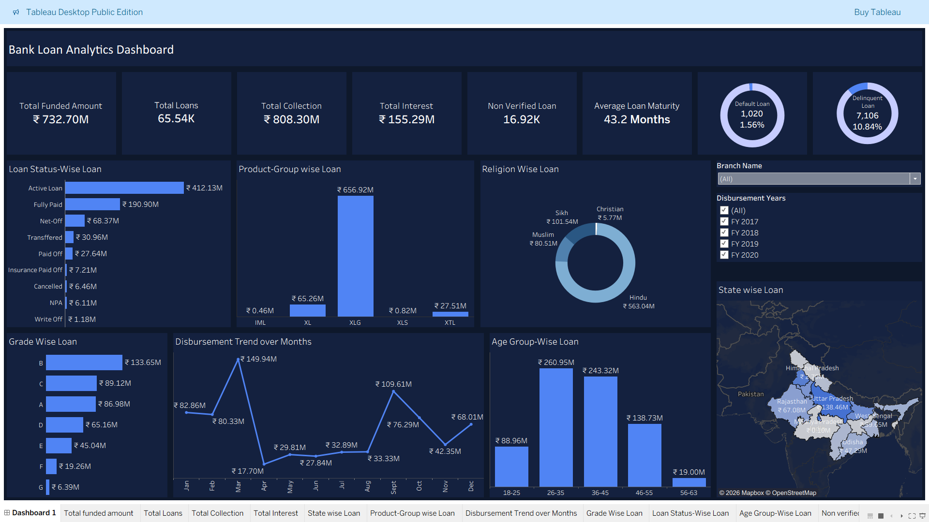
Bank loan Analytics dashboard

Slide 29
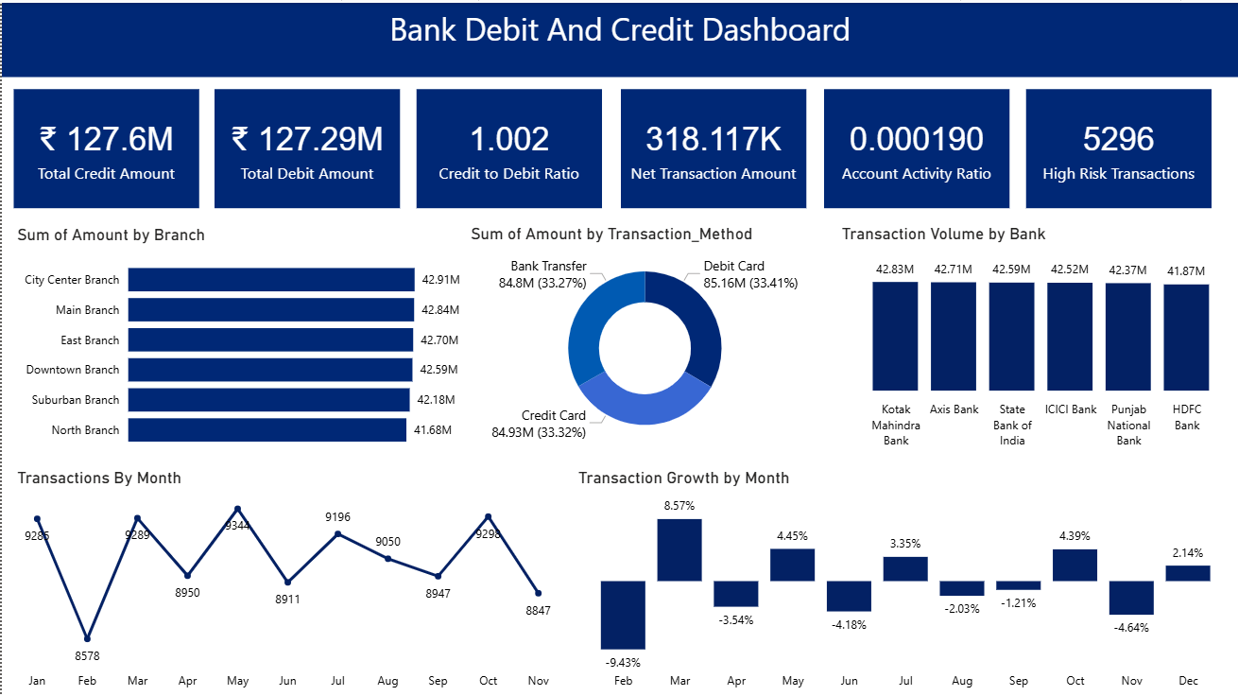
Bank debit and credit dashboard

