Slide 1
BIGMART SALES PREDICTION
Data analytics Project
Team Name: Covariance
Team members: Manikya Prakash Sarashetty(PES2201800301)
Ramyashree.J.R(PES2201800728)
Nandini.R.Sonth(PES2201800401)
Section:E

Slide 2
Aim of the project
“To find out what role certain properties of an item play and how they affect their sales .”
These days, every organization wants to uplift its revenue as well as profit. At the end of the day, one of the main objectives of any organization is to increase sales which will lead to increase in profit.
The dataset which we have used is bigmart sales prediction from kaggle source.
https://www.kaggle.com/devashish0507/big-mart-sales-prediction

Slide 3
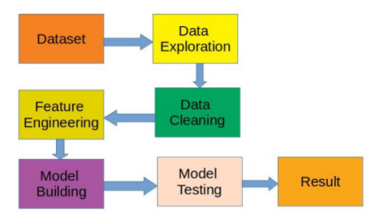
Working procedure of the project

Slide 4
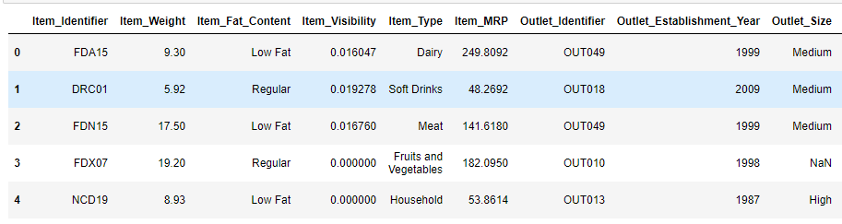
Peek at the data
Actually combining train and test data we have 13 columns

Slide 5
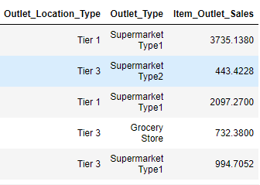

Slide 6
Literature survey
We went through many research papers of bigmart sales prediction in google scholar.
The insights we got from the papers are:
1) learnt about different models
2) Comaprision between models to get best

Slide 7
Data visualization
Actually this step in data analysis is very important because it is the easy way to understand the data through graphs ,charts.
In our project we decided to visualize the data before proceeding the analysation.
From Our Visualization we got to know that Item_Outlet_Sales is our target variable which we should focus on.

Slide 8
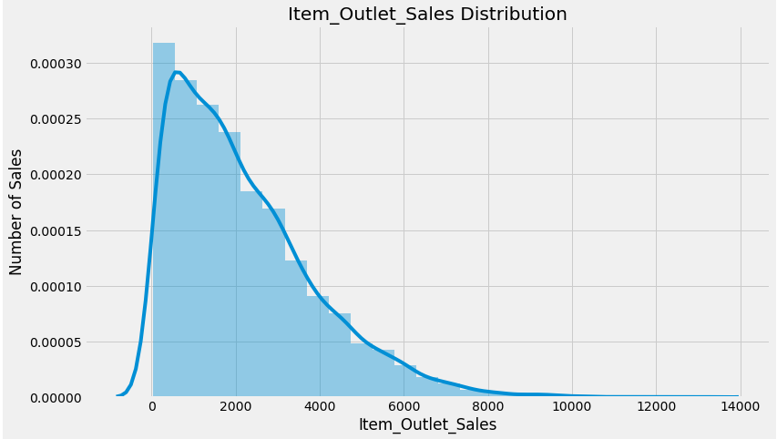
As you can see, it is a right skewd variable and would need some data transformation to treat its skewness.

Slide 9
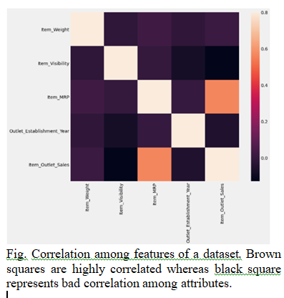

Slide 10
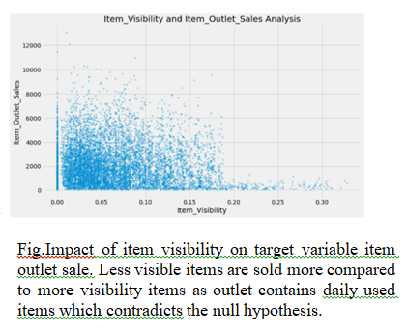

Slide 11
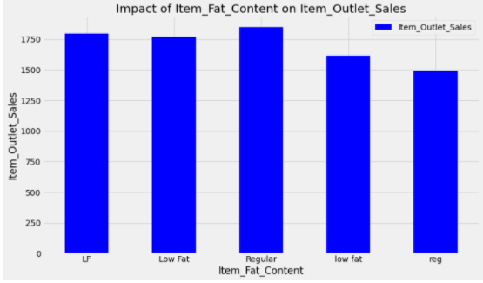
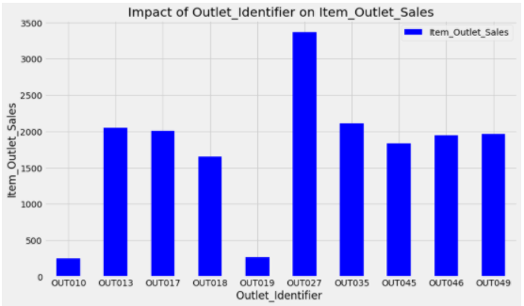
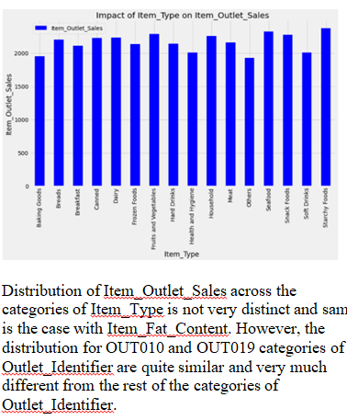

Slide 12
Data Cleaning
In the data preprocessing we came across some missing values.
We filled missing values according to the type of variable.

Slide 13
Proposed Model
After exploring and visualizing the data We started with implementing different models and came to the conclusion that XGBoost approach is the best to forecast the sales because of less RMSE.
RMSE
Linear regression model-1127
Decision Tree model-1095
Random Forest model-1062
XGBoost model-1031

Slide 14
Reason to choose XGBoost Model
Highest Accuracy
Least RMSE
Sparse Aware (that is the missing data values are automatic handled)

Slide 15
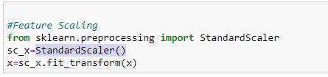
How does the model work
The idea behind StandardScaler is that it will transform your data such that its distribution will have a mean value 0 and standard deviation of 1.
The fit_transform() function performs both calculates the values of these parameters and applies the values of the parameters on the actual data and gives the normalized value.

Slide 16
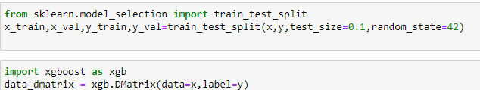
The train_test_ split technique is used to divide the dataset intosubsets.
DMatrix is an internal data structure that is used by XGBoost, which is optimized for both memory efficiency and training speed.

Slide 17
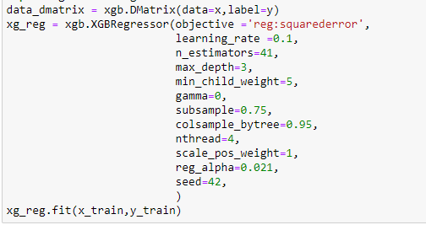
The XGBoost library implements the gradient boosting decision tree algorithm.

Slide 18
When Model can fail
One disadvantage of boosting is that it is sensitive to outliers since every classifier is obliged to fix the errors in the predecessors. Thus, the method is too dependent on outliers.
Another disadvantage is that the method is almost impossible to scale up. This is because every estimator bases its correctness on the previous predictors, thus making the procedure difficult to streamline.

Slide 19
conclusion
We started with making some hypothesis about the data without looking at it. Then we moved on to data exploration where we found out some nuances in the data which required remediation. Next, we performed data cleaning and feature engineering, where we imputed missing values and solved other irregularities, made new features and also made the data model-friendly by one-hot-coding. Finally we made linear regression, decision tree model ,random forest model and xgboost got a glimpse of how to tune them for better results

Slide 20
About Project
By working on this project we got to know about
1) how to scrape data
2)how to handle the data
3) the insights we see as consumers are the result of a great deal of work
4) problem solving skills
Contribution of each team member
Manikya Prakash Sarashetty- Data Description and Model Building
Ramyashree.J.R-Data Visualization and Model Building
Nandini.R.Sonth-Data Cleaning and Model Building

Slide 21
Github account and drive links
https://github.com/OurGithubAccount-03/Bigmart-Sales-Prediction
https://drive.google.com/drive/folders/10u44RrnV6NILRuafrbAHe-3haG9jHDa4

