Slide 1









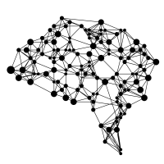

Load document(s)
...
Chunk up the text
Embeddings
ChromaDB
File(s)
be-bge-embeddings
Retrieve and Rank
Embeddings
Query
Get k nearest embeddings
(Default: k=30 & dist = cosine)
bge-reranker
be-bge-embeddings
Retrieve top M chunks
based on the ranks
Generate
Construct prompt with contextual
information and query
Block Entropy AI
Generated output along
with reference chunks

