Slide 1
Introduction to HTML ,CSS, JavaScript
Introduction to Web Programming
  HTML / CSS/ JS
Introduction to HTML5
New Features of HTML5
HTML5 Sematic Tags
  Laying out a Page with HTML5 Page Structure

Slide 2

K.Srivatsan
IT Trainer Since 1991
Conducting Java Training Since 2004
About 60+ Corporate Clients

Slide 3
World Wide Web
A kind of distributed document delivery system
Main presentation language is HTML
Uses a client-server model
Two processes
The client
    Sends requests to the server
    Blocks until reply is received
  The server
    Processes requests from clients
    Never blocks
    Can reply to several clients simultaneously

Slide 4
What is HTML
HyperText Markup Language.
Based on the Standard Generalized Markup Language (SGML)
  A Document-processing system.
Defines a set of common styles for web pages:
  headings, paragraphs, lists, and tables.
  defines character styles such as boldface
HTML element encompasses opening tag, closing tag and content

Slide 5
Evolution of HTML
Tim Berners-Lee made major contribution in Creating HTML in 1989
He Founded the W3C , refined and updated HTML with HTML4 in 1997.,
Growing need for richer Web content
  audio, video and interactivity ,Plug-in applications such as Flash
Web Hypertext Application Technology Working Group (WHATWG) in 2004,
  Created with the involvement of Apple, the Mozilla Foundation and Opera
In 2006 WHATWG developed the new standard named HTML5
  released in 2008, web browsers have increasingly incorporated the new standard

Slide 6
Web Browser
A software application for retrieving, presenting, and traversing information resources on the World Wide Web.
An information resource is identified by a Uniform Resource Identifier (URI) and may be a web page, image, video, or other piece of content.
They are primarily intended to access the World Wide Web, they can also be used to access information provided by Web servers in private networks or files in file systems.

Slide 7
Why Web Browser
Released by Tim Berners-Lee in in March, 1991.
  “Well, I found it frustrating that in those days, there was different information on different computers, but you had to log on to different computers to get at it.
  Also, sometimes you had to learn a different program on each computer.”
      Tim Berners-Lee.

Slide 8
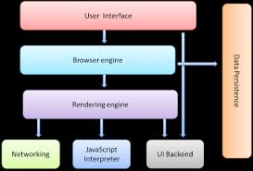
Browser Structure

Slide 9
Browser Structure
The user interface: this includes the address bar, back/forward button, bookmarking menu, etc.
The browser engine: marshals actions between the UI and the rendering engine.
The rendering engine : responsible for displaying requested content.
  requested content is HTML, the rendering engine parses HTML and CSS, and displays the parsed content on the screen.
Networking: for network calls such as HTTP requests, using different implementations for different platform behind a platform-independent interface.

Slide 10
Browser Structure
UI backend: used for drawing basic widgets like combo boxes and windows.
  This backend exposes a generic interface that is not platform specific.
  Underneath it uses operating system user interface methods.
JavaScript interpreter. Used to parse and execute JavaScript code.
Data storage. This is a persistence layer. The browser may need to save all sorts of data locally, such as cookies.
  Browsers also support storage mechanisms such as localStorage, IndexedDB, WebSQL and FileSystem.

Slide 11

Rendering Engine
By default display only HTML, XML and image.
Beyond above things, we need extension/Add-on/Plug-ins
Also called as Layout Engine
Rendering Engine
  Chrome and Opera : Blink
  Chrome (iPhone) & Safari : WebKit
  Firefox : Gecko
  IE : Trident

Slide 12
What is HTML5?
Latest standard for HTML.
Designed to replace both HTML 4, XHTML, HTML DOM Level 2.
Designed to deliver rich content without the need for additional plugins.
Animation to graphics, music to movies, and can also be used to build complicated web applications.
Cross-platform.
It is designed to work with PC, or a Tablet, a Smartphone, or a Smart TV.

Slide 13
Advantages of HTML 5
Easy to integrate multimedia and graphical content without using flash and third party plugins.
Semantic HTML tags Instead of “div” tags
Use of fancier forms with native validation.
Different type of text inputs and search
Instead of cookies usage of Local Storage.
Geo-location APIs make location directly available.
Worker Threads
Offline Storage and Query

Slide 14
Structuring HTML
HTML defines three tags that are used to describe the page's overall structure and provide some simple header information.
  <html>
  <head>
  <body>
These tags don't affect what the page looks like when it's displayed; they're only there to help tools that interpret or filter HTML files.
In the strict HTML definition, these tags are optional.

Slide 15
Creating a HTML Document
  Use an text editor to write the document.
  Save the file as filename.html
  Open any browser Off-Line
  Click on File, Open File and select the filename.html document that you just created.
  Your HTML page should now appear just like any other Web page in Netscape.

Slide 16
Basic HTML
  <!DOCTYPE html>
  <html>
  <head>
  <meta charset="UTF-8">
  <title>First Example</title>
  </head>
  <body>
  <header>
  <h1> HTML 5 and CSS 3</h1>
  <h2> HTML 5 Examples</h2>
  <h4> Chapter - 1</h4>
  </header>
  </body>
  </html>

Slide 17
What is a Tag
Tags are ;
surrounded with angle brackets
    <B> or <I>.
Most tags come in pairs
    exceptions: <P>, <br>, <li> tags …
The first tag turns the action on, and the second turns it off.
The second tag(off switch) starts with a forward slash.
    For example ,<B> text </B>
can be embedded
    <HEAD><TITLE> Your text </HEAD></TITLE> it won't work.
    The correct order is <HEAD><TITLE> Your text </TITLE></HEAD>
not case sensitive
Many tags have attributes.
    For example, <P ALIGN=CENTER> centers the paragraph following it.

Slide 18
The <html> Tag
The first page structure tag in every HTML page is the <html> tag.
It indicates that the content of this file is in the HTML language.
All the text and HTML elements in web page should be placed within the beginning and ending HTML tags

Slide 19
HTML Global Attributes
Global attributes may be specified on all HTML elements
Class
  Specifies one or more classnames for an element (refers to a class in a style sheet)
Id
  Specifies a unique id for an element
Style
  Specifies an inline CSS style for an element
Accesskey
  specifies a shortcut key to activate/focus an element
Tabindex
  Specifies the tabbing order of an element
Title
  Specifies extra information about an element

Slide 20
Html Global Attributes
Hidden
  Is a Boolean attribute indicates that the element is not yet, or is no longer, relevant.
  This attribute must not be used to hide content that could legitimately be shown.
Contenteditable
  indicating if the element should be editable by the user.
  True which indicates that the element must be editable;
  false, which indicates that the element must not be editable.

Slide 21
Html Global Attributes
data-*
  custom data attributes,
  Proprietary information to be exchanged between the HTML and its DOM
dir
  indicating the directionality of the element's text.
  ltr, which means left to right and is to be used for languages that are written from the left to the right (like English);
  rtl, which means right to left and is to be used for languages that are written from the right to the left (like Arabic);
  auto, which let the user agent decides.

Slide 22
Html Global Attributes
Spellcheck
  The spellcheck attribute specifies whether the element is to have its spelling and grammar checked or not.
  Text values in input elements (not password)
  Text in <textarea> elements
  Text in editable elements

Slide 23
Head - Tag
<HEAD>...</HEAD>
  contains information about the document
  specifies that the lines within the opening and closing tag are the prologue to the rest of the file.
  Generally, only a few tags go into the <head> portion of the page (most notably, the page title.
<TITLE>...</TITLE>--
  <title> tags are placed within the page header
  Each HTML page needs a title to indicate what the page describes.
  It appears in the title bar of the browser when viewed
  The title is stored in your browser's favorites (or bookmarks),
  also used by search engines when they index your pages.
.

Slide 24
Meta Data
Metadata within an HTML document:- information about data.
It will not be displayed on the page, but will be machine parsable.
Used to specify page description, keywords, author of the document, last modified, and other metadata.
Used by browsers to display content or reload page, search engines (keywords), or other web services.
<head>
<meta charset="UTF-8">
<meta name="description" content=“Training Materials">
<meta name="keywords" content="HTML,CSS,XML,JavaScript">
<meta name="author" content=“Ramesh">
</head>
_x000b_

Slide 25
Character Set
The UTF-8 Character Set
  UTF-8 is identical to ASCII for the values from 0 to 127.
  UTF-8 does not use the values from 128 to 159.
  UTF-8 is identical to both ANSI and 8859-1 for the values from 160 to 255.
  UTF-8 continues from the value 256 with more than 10 000 different characters.

Slide 26
Deprecated Tags in HTML5
<acronym> : Defines an acronym
<applet> : Defines an applet
<center> : Defines centered text
<font> : Defines text font, size, and color
<frame> : Defines a frame
<frameset> :Defines a set of frames

Slide 27
Body Tag
Defines the main content of the HTML document or the section of the HTML document that will be directly visible on web page.
This tag is also commonly referred to as the <body> element.
<body></body>
  <body>
    <h1>Heading</h1>
    <p>This is the content.</p>
  </body>

Slide 28
Headings
Headings are used to add titles to sections of a page
. HTML defines six levels of headings.
  <h1>Installing Your Safety Lock</h1>
The numbers indicate heading levels (H1 through H6).
They're displayed in larger or bolder text, are centered or underlined, or are capitalized so that they stand out from regular text.

Slide 29
Paragraphs
<p> tag was used to indicate the end of a paragraph and not the beginning.
Multiple <P>'s do not create blank lines
Use <BR> for blank line
Fully-specified text uses <P> and </P> ,but </P> is optional

Slide 30
Preformatted Text
Text in an HTML file is formatted based on the HTML tags used to mark up that text.
The preformatted text tag <pre>
This tag retains any white space that you put into text surrounded by the <pre> and </pre> tags is retained in the final output.
The spacing in the text in the HTML source is preserved when it's displayed on the page.
Used to align text by padding it with spaces, used in simple tables.

Slide 31
<PRE> Preformatted Text
  <PRE>
  if (a < b) {
  a++;
  b = c * d;
  }
  else {
  a--;
  b = (b-1)/2;
  }
  </PRE>

Slide 32
List Tags- Unordered List
List tags begin and end the entire list.
This will create a list with bullets next to the list items.
The is <ul> ... </ul>.
To set off each item in list, the <li> tag, followed by text, then close each list item with the </li> tag.
<ul type=“disc”>
<li>I am item one</li>
<li>I am item two</li>
</ul>
The type attribute to specify the type of bullets to be used in the list.
  disc, circle, square

Slide 33
List Tags- Ordered List
Ordered List
Created using <ol></ol>,
<ol>
<li>Item 1</li>
<li>Item 2</li>
<li>Item 3</li>
</ol>
Ordered List can also be specified with type , to use uppercase Roman numerals,
<ol type="I">
<li>Roman I</li>
<li>Roman II</li>
</ol>
“1” , “A”,”a”,”I” are the possible value for the type

Slide 34
Comments
Comments in HTML pages to describe the page itself or to provide some kind of indication of the status of the page.
Text in comments is ignored when the HTML file is parsed;
Comments don't ever show up on screen
  <!-- This is a comment -->

Slide 35
Creating Links
<a href="http://www.someplace.com">Display Text</a>
“a” stands for anchor, and the href="" is asking for a location to link to. The </a> is the closing tag.
The text between the tags is what will show up on your Web page as a link.
"local url".
  Any file for which the to create a local url link , the file should be in the same directory as the page you are editing.
  <a href="linking.htm">Linking to Other Pages</a>

Slide 36
Horizontal Rules & Line Break
The <hr> tag, which has no closing tag in HTML and no text associated with it, creates a horizontal line on the page.
Rule lines are used to visually separate sections of a web pagejust before headings,
  To separate body text from a list of items.
Line Break
The <br> tag breaks a line of text at the point where it appears.
When a web browser encounters a <br> tag, it restarts the text after the tag at the left margin

Slide 37
Physical Character Style
    <H1>Physical Character Styles</H1>
    <B>Bold</B><BR>
    <I>Italic</I><BR>
    <U>Underlined</U><BR>
    Subscripts: f<SUB>0</SUB> + f<SUB>1</SUB><BR>
    Superscripts: x<SUP>2</SUP> + y<SUP>2</SUP><BR>
    <SMALL>Smaller</SMALL><BR>
    <BIG>Bigger</BIG><BR>
    <STRIKE>Strike Through</STRIKE><BR>

Slide 38
Image
SRC is required
WIDTH, HEIGHT may be in units of pixels or percentage of page or frame
  WIDTH="357"
  HEIGHT="50%"
Images scale to fit the space allowed
Align=position
  Left : Image on left edge; text flows to right of image
  Right : Image on right edge; text flows to left
  Top : Image is left; words align with top of image
  Bottom : Image is left; words align with bottom of image
  Middle : Words align with middle of image

Slide 39
Inline Images in HTML: The <img> Tag
Inline images are placed in HTML documents using the <img> tag.
Attribute – “src “
  the URL of the image to include.
  <img src="image.gif" />
Adding Alternative Text to Images
When client cannot present then there is graceful degradation
<img src="myimage.gif" alt="[a picture of a cat]" />
  <img src=“next.jpg" />
<img src="next.jpg" align="left" />
  <h2>
  <img src="house.jpg" alt="House of Terror" />
  The Halloween House of Terror!!
  </h2>

Slide 40
Image SRC
<BODY>
<img src="dolphin.jpg" align="left" width="150" height="150" alt="dolphin jump!">
This is a very cute dolphin on the left!<br>
This is a very cute dolphin on the left!<br>
You can see text wrap around it<br>
</BODY>
</HTML>

Slide 41
Images and Links
Image can serve as a link
Add an <img> tag inside a link tag (<a>), that image serves as a link itself:
<a href="index.html"><img src="uparrow.gif" alt="Up" /></a>
Both an image and text in the link tag, they become links to the same page:
<a href="index.html">
  <img src="uparrow.gif" alt="Up" />Up to Index</a>

Slide 42
<A> Anchors (HyperLinks)
Link to an absolute URL:
  If you get spam, contact
  <A HREF="htttp:www.microsoft.com“>Microsoft </A> to report the problem.
Link to a relative URL:
  See these <A HREF="#references"> references </A>
  concerning our fine products.
Link to a section within a URL:
  Amazon provided a <A HREF="www.amazon.com/#reference">
  reference for our company. </A>

Slide 43
Naming a Section
You can link to another part of the same web page by adding an id attribute to almost any HTML tag, and then link to it by adding a pound sign (#) at the beginning of where the destination url goes
Clicking on the link will take you to the HTML element with that id.
<p id="part16">
Part 16
HTML Made Easy
</p>
<a href=“#part16”>software Required</a>

Slide 44
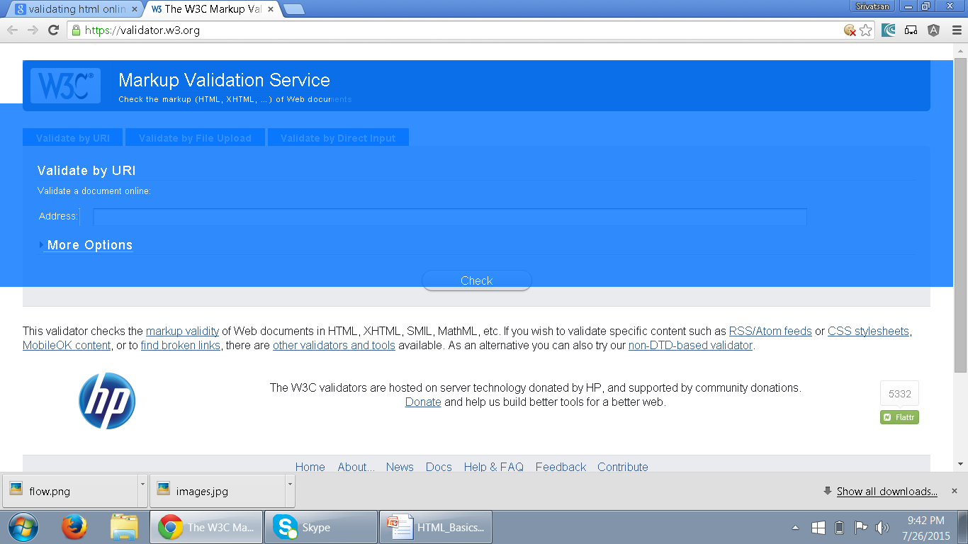
Validating HTML
The validator service checks the markup validity of Web documents in HTML, XHTML, SMIL, MathML, etc
https://validator.w3.org/
.

Slide 45
Cascading StyleSheets (CSS)
The main aim of HTML was to create content for a web page.
HTML tags when used for formatting the web pages, made websites cumbersome and expensive.
Hence, CSS was created by World Wide Web Consortium (W3C) in order to separate out formatting from content creation.
Cascading StyleSheets were introduced from HTML 4.0 where all formatting tags were moved to a separate external .css file.

Slide 46
CSS Usage
Specify point size and font of text;
Set margins within a web page;
Create a distinctive style for individual web pages or sets of web pages;
Format style to one element of a web page or to a numerous pages;
Control color of different elements of a web page;

Slide 47
Style Rule
A Style Rule is composed of two parts: a selector and a declaration.
TH {color: red;}.
The Selector indicates the element to which the rule is applied.
The Declaration determines the property values of a selector.
Selector
Declaration

Slide 48
Style Rule
The Property specifies a characteristic, such as color, font-family, position, and is followed by a colon (:).
The Value expresses specification of a property, such as red for color, arial for font family, 12 pt for font-size, and is followed by a semicolon (;).
        P {color: red;}
Value
Property

Slide 49
Using External Style Sheet
Style Rules can be expressed in an external Style Sheet - a text document that doesn’t contain any HTML code. There is no <STYLE> element in an external style sheet.
External Style Sheet has a .css extension.
h1, h2, h3
{
font-family: verdana, arial, 'sans serif';
color: #9933FF;
text-align: center;
}

Slide 50
Using the <STYLE> Element
The <STYLE> element is always positioned in the <HEAD> section of the document.
The <STYLE> element always contains <TYPE> attribute. The value “text/css” defines the style language as Cascading Style Sheets.
  <Head>
  <Style type=“text/css”>
  P {
  color:blue;
  font-size: 24pt;
  }
  </Style>
  </Head>

Slide 51
Cascading StyleSheets (CSS)
  Extenal StyleSheet
    can be applied to any number of pages in the website
    will not contain HTML tags
    <link> tag is used to link the Web page to an external style sheet.
    Href URL Specifies the location of the linked document
    Rel Specifies the relationship between the current document and the linked document
      Can be Author,bookmark,external, Help,search,sidebar,stylesheet,tag

Slide 52
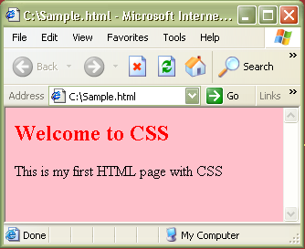
CSS – External StyleSheet Example
<html>
<link rel="stylesheet" type="text/css" href=“my_style.css" />
<h2> Welcome to CSS </h2>
<body> This is my first HTML page with CSS </body>
</html>
Sample.html
Path to the .css file
h2 {color:red}
body {background-color:pink}
my_style.css
Output:

Slide 53
CSS – Internal StyleSheet
  Internal StyleSheet
    can be applied to a particular page that needs a unique format.
    should be included in the head section of HTML page
    <style> tag is used to hold the values for formatting

Slide 54
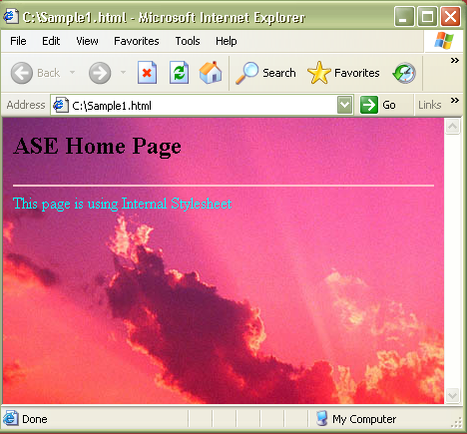
CSS – Internal StyleSheet Example
<html>
<head>
<style type="text/css">
hr{color:pink}
font {color:cyan}
body {background- image:url('c:\Sunset.jpg')}
</style>
<h2> ASE Home Page</h2>
</head>
<hr>
<body>
<font>
This page is using Internal Stylesheet
</font>
</body>
</html>
Output :

Slide 55
CSS – Inline StyleSheet
  Inline StyleSheet
    style attribute is used in the relevant tag.
    style attribute can contain any CSS property.
    For example:
    <html>
    <p style="color:blue">This is a example of inline stylesheet</p>
    </html>

Slide 56
Working with Tables

Slide 57
Table
  <BODY>
  <TABLE>
  <TR>
  <TD>Links</TD>
  <TD>Content</TD>
  </TR>
  </TABLE>
The cells within each row are created using one of two elements:
<th>...</th> elements are used for heading cells.
Generally, browsers center the contents of a <th> cell and render any text in the cell in boldface.
<td>...</td> elements are used for data cells.
TD stands for table data.

Slide 58
<colgroup>
  Specifies a group of one or more columns in a table for formatting.
  Useful for applying styles to entire columns, instead of repeating the styles for each cell, for each row.
  Must be a child of a <table> element, after any <caption> elements and before any <thead>, <tbody>, <tfoot>, and <tr> elements.

Slide 59
<caption>
Defines a table caption.
Inserted immediately after the <table> tag.
It will be center-aligned by default and above a table.
text-align and caption-side can be used to align and place the caption.
  caption-side: bottom; other value can be top

Slide 60
Semantic markup
HTML is oriented towards design
  element in it should have well-structured content.
Semantic markup :
  self-describing and uses the correct HTML elements for the correct job.
<div id="heading" style="font-size:300%; padding: 10px;">
My heading
</div>
Its not heading in terms of meaning or purpose.

Slide 61
Advantage of Semantic Markup
Search engine optimization
  keywords in headings have more weight,
Accessibility
  screen readers use heading elements as navigational signposts
Development
  it is a lot trickier to target elements with styles and scripts when you don't use proper semantic elements
Lightweight
  removing all those nested <divs> and other spaghetti code.
This makes file sizes smaller and coding easier.

Slide 62
Structural Elements
Elements that are replacements for the common ad hoc semantics applied using class and id attributes
Header
  Header content for a page or a section of page
Footer
  footer content for a page or a section of the page
Section
  A section in a web page
Article
  Independent article content
Aside
  Related content or pull quotes
nav
  Navigational aids

Slide 63
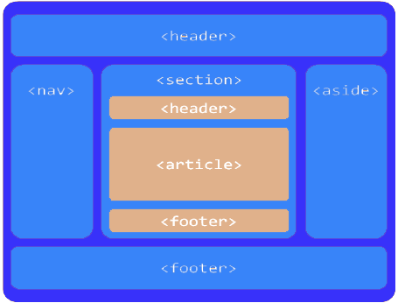
Page Layout

Slide 64
  a group of introductory or navigational aids.
  contains the section’s heading (an h1–h6 element or an hgroup element),
  but can also contain other content, such as a table of contents, a search form, or any relevant logos
Generally placed at the beginning of page.
Can be multiple headers, each of which will then become the for that section of the document
<header>
<h1>The most important heading on this page</h1>
<p>With some supplementary information</p>
</header>.

Slide 65
represents a footer for its nearest ancestor sectioning content or sectioning root element.
contains information about its section such as who wrote it, links to related documents, copyright data
  Can use multiple footers, each of which will then become footer for that section of the document
  <footer>
  <ul>
  <li>copyright</li>
  <li>sitemap</li>
  <li>contact</li>
  <li>to top</li>
  </ul>
  </footer>

Slide 66
Section
Used for sectioning, more or less like a <div> element.
  “The <section> element represents a generic section of a document or application.
  “When an element is needed only for styling purposes or as a convenience for scripting, authors are encouraged to use the div element instead
  A general rule is that the section element is appropriate only if the element’s contents would be listed explicitly
First, the section element is technically style-able, but it is suggested to instead use<div> when we are more likely to apply heavy styles or script to the element.
Secondly, similar to <li> element, the general idea of section element is to list content.

Slide 67
Section Element
the section element’s content should be “thematic,”
Some examples of acceptable uses for section elements include:
individual sections of a tabbed interface
segments of an “About” page; for example,
  a company’s “About” page might include sections on the company’s history, its mission statement, and its team
various sections of an online news site;
  articles could be grouped into sections covering sports, world affairs, and economic news

Slide 68
Example
  <footer>
  <section id="authors">
  <section id="copyright">copy Right 2014-2015</section>
  </section>
  </footer>
  </div>
  </body>

Slide 69
<article> Element
“A self-contained composition in a document, page, application, or site and that is, in principle, independently distributable or reusable,
Used exclusively for structuring article, common usage of article
  forum posts
  magazine or newspaper articles
  blog entries
  user-submitted comments
article elements can be nested inside other article elements.
You can also nest a section inside an article, and vice versa.

Slide 70
<aside> Element
Defines content which is stand alone from the page content
Used to define the text surrounded by its familiar content.
Used for creating some index related to the topic.
Can be used in sidebar of a page, whenever user clicks on the index, it redirects the user on the related content.
Can be used to represent some block quote content in an article

Slide 71
Example
  <div id="main">
  <div id="primary">
  <article>
  </article>
  </div>
  <div id="content">
  <article>
  <aside></aside>
  </article>
  </div>
  </div>

Slide 72
<nav> Element
The nav element stands for Navigation.
  “A section of a page that links to other pages or to parts within the page: a section with navigation links.”
Usage is not limited to only the primary navigation, typically at the top of the web page.
Can also be used on any part of the page that also acts as a navigator,

Slide 73
Example
  <body>
  <div id="wrapper">
  <header>
  <h1>HTML5 Document Structure Example</h1>
  <nav id="navigation">
  <ul id="nav-list">
  </ul>
  </nav>
  </header>

Slide 74
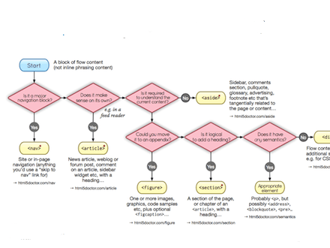
HTML5 Elements

