Slide 1
AUTOMATIC EVALUATION OF SHORT DESCRIPTIVE ANSWERS
Project Guide MANIMEGALA P
Dr. S . SENDHILKUMAR 2024178027 MCA(REG)
Professor
Department of IST,
Anna University

Slide 2
INTRODUCTION
Descriptive questions: measure conceptual understanding, reasoning & clarity
Online learning & large exams: manual evaluation of concept-rich answers is:
Time-consuming
Inconsistent
Non-scalable
Need: Automated evaluation for consistency, speed & instant feedback
Key success factor: must reliably judge conceptual depth & correctness, mirroring human expert standards

Slide 3
PROBLEM STATEMENT
In real classroom and online exam scenarios, teachers evaluate descriptive answers by checking key concepts, assigning partial credit, and providing feedback.
Existing automatic grading systems(Eg - e-raters, Gradescope)primarily use similarity or classification-based models, which:
Output only a final score - Do not identify missing or partially covered concepts
Provide no clear explanation for the assigned marks
Therefore, the problem is to design an automatic evaluation system that can analyze answers at the concept level, assign partial credit, and generate explainable, teacher-like feedback while remaining scalable which was missing in the existing system.

Slide 4
BASE PAPER
Paraphrase Generation and Supervised Learning for Improved ASAG (International Journal of Artificial Intelligence in Education – 2024,Volume -34,Issue - 1)
Domain - NLP-based Educational Assessment
Dataset Used - Quora (English), Al-Raisi (Arabic), Mohler ASAG
Approach - Paraphrase-augmented reference-based grading
Algorithms - GRU Encoder-Decoder with Attention, Ridge Regression
Challenges - Linguistic diversity, scalability, Arabic NLP limitations

Slide 5
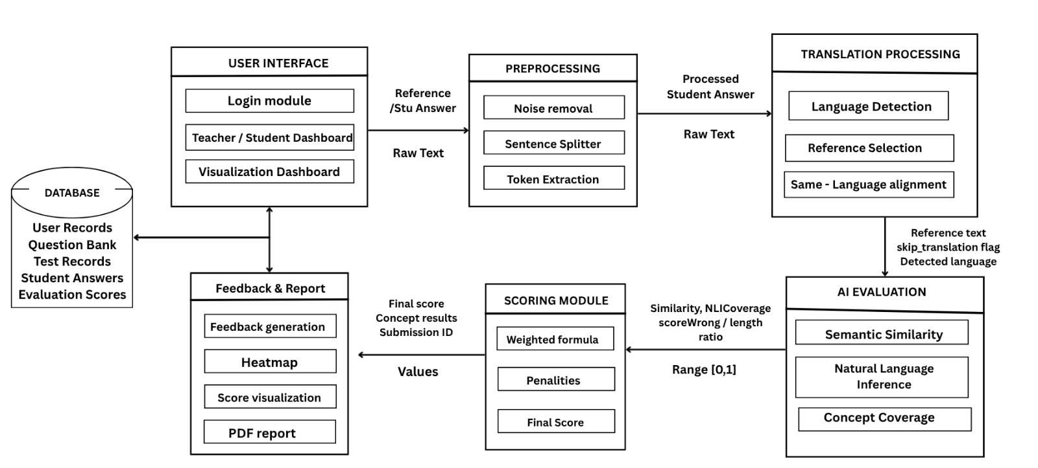

Slide 6
DATASET
Dataset Name: Custom Academic Short Answer Grading Dataset(ASAG-Concept)
Dataset Source: : AI-generated synthetic student answer dataset.
Input Features:
Question_Id , Answer_Id, Question, Model Answer , Student Answer, Human Score
Dataset Size : Number of Question – 40 to 50 Question
Answers per question – 20 to 30 Answers
Total Student answer - ~ 500+
Score range: 0 to 10
Dataset Format: CSV

Slide 7
USER INTERFACE MODULE
Input :
User Credentials
Questions & Answers
Maximum Marks
Output :
Displays final normalized score
Presents evaluation summaries and visual indicators
Process:
Displays login interface and identifies user role (Student / Teacher)
Redirects users to role-specific dashboards
Collects question, model answer, and grading parameters from teacher
Sends collected inputs to backend via Flask route handler
Waits for backend response containing score and feedback
Process:

Slide 8
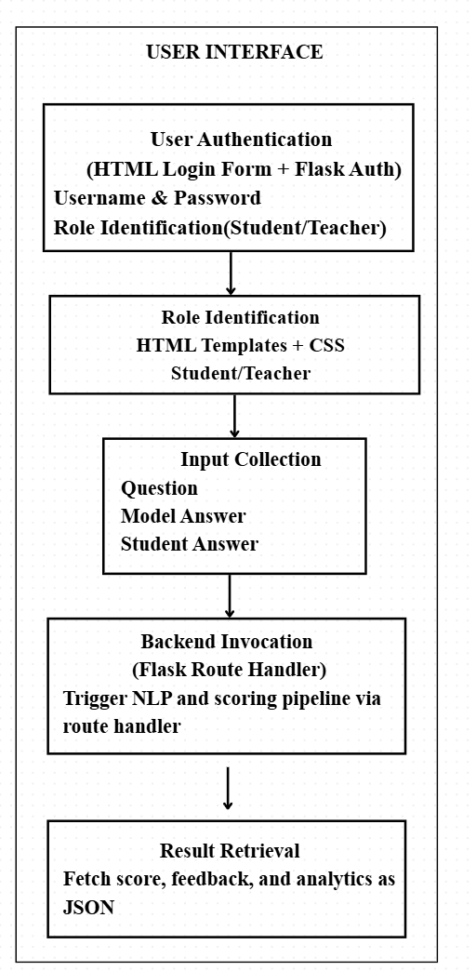

Slide 9
PREPROCESSING MODULE
PROCESS:
Converts all text to lowercase for uniform comparison
Removes noise such as special characters, extra spaces, and irrelevant symbols
Preserves important technical terms and programming symbols
Expands common abbreviations and corrects basic spelling and typographical errors
Applies regular expressions and dictionary-based corrections
Logs preprocessing steps, errors, and statistics for monitoring and debugging
Input:
Question ID
Raw model answer text
Raw student answer text
Input format: CSV / DataFrame
Output:
Output format: CSV / DataFrame with new columns
clean_model_answer
clean_student_answer

Slide 10
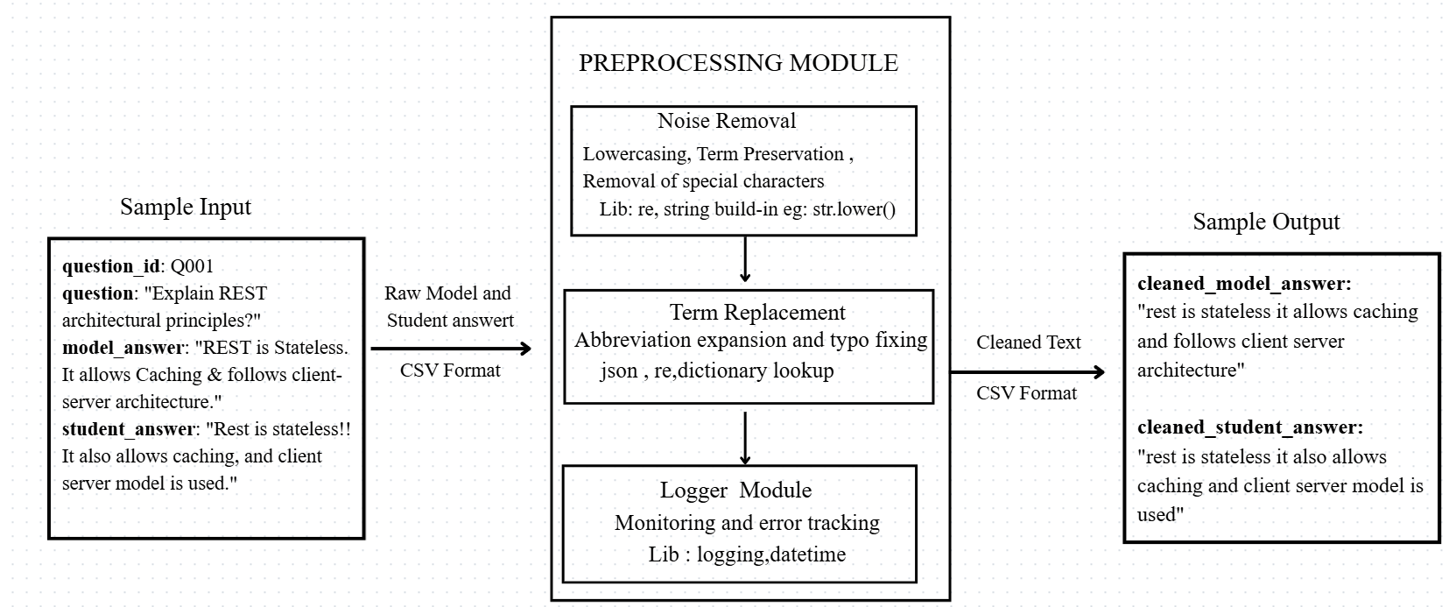

Slide 11
CONCEPT EXTRACTION MODULE
PROCESS:
Checks concept cache using Question ID
If concepts exist → retrieves from cache
Else extracts key concepts from model answer
Offline: Keyword and dictionary-based extraction
Online: LLM-based concept extraction(Ollama)
Normalizes extracted concepts (case, abbreviations, duplicates)
Stores concepts in cache for reuse
Input:
Question ID
Cleaned Model Answer
Concept Cache (JSON)
Output:
Normalized list of key concepts
Output format: JSON / Dictionary
Passed to concept–sentence matching module

Slide 12
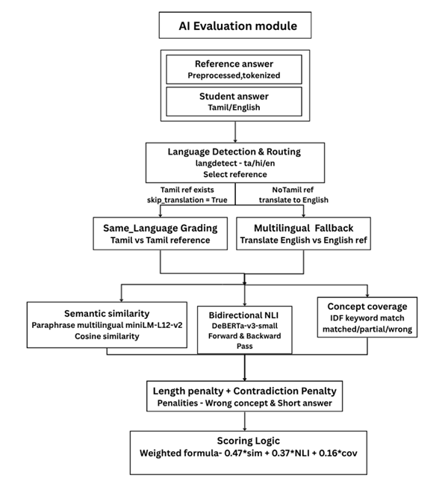

Slide 13
ANSWER SEGMENTATION MODULE
Input:
Cleaned student answer text
Question ID and Answer ID
Input format: JSON / DataFrame
Output:
Segmented student answer (JSON)
Each segment = one evaluable idea
PROCESS:
Sentence splitting (spaCy)
Clause splitting (spaCy)
Verb check for validity
Filters weak or irrelevant segments

Slide 14
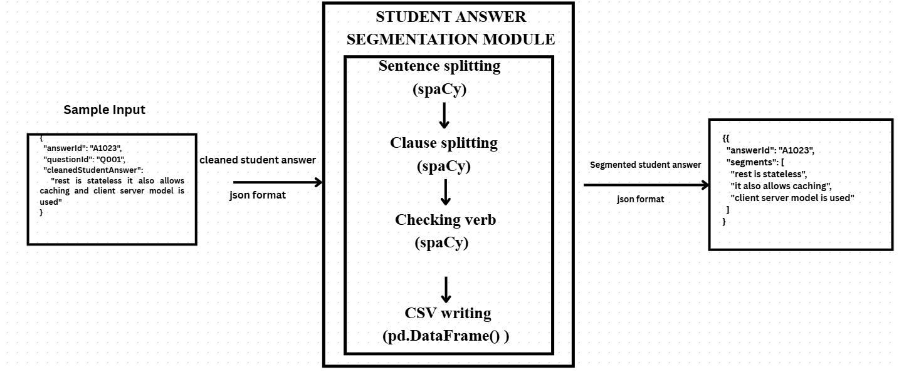

Slide 15
CONCEPT – SENTENCE MATCHING MODULE
Process
Generate embeddings using SBERT and MPNet
Compute cosine similarity for each concept–sentence pair
Compare semantic performance of both models
Select best-performing embedding model
Choose highest similarity match per concept
Input:
Extracted concepts (JSON)
Segmented student answer sentences
Output:
Concept-wise best matched sentence
Semantic similarity scores

Slide 16
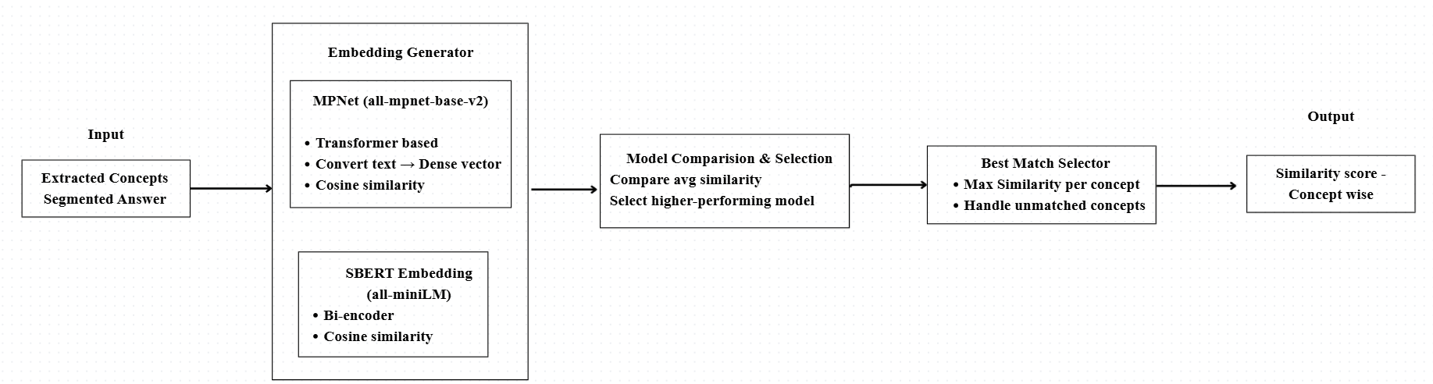

Slide 17
SCORING AND CALIBRATION MODULE
Input:
Concept-wise similarity
Question ID
Score scale (e.g., 0–10)
Output:
Final predicted score
PROCESS:
Aggregate similarity scores of all concepts
Generate fixed-length feature vector
Load trained regression (calibration) model
Predict raw score
Normalize score to defined scale

Slide 18
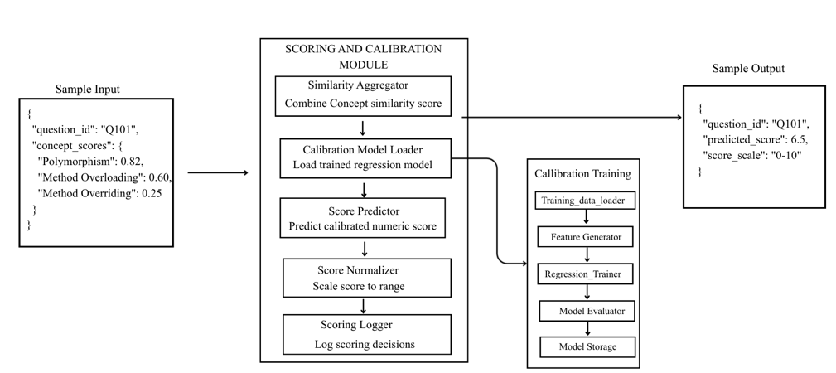
MODULE DESCRIPTION

Slide 19
FEEDBACK MODULE
Input:
Concept-wise similarity
Final predicted score
Extracted concepts & matched segments
Output:
Concept-wise feedback (Covered / Partial / Missing)
Overall qualitative feedback
PROCESS:
Classify each concept’s understanding level using similarity thresholds
Generate structured feedback using an LLM
Convert technical evaluation into human-readable English feedback

Slide 20
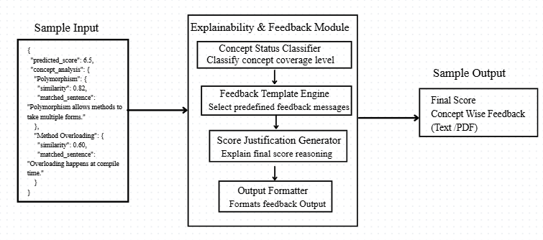
MODULE DESCRIPTION

Slide 21
EVALUATION METRICS
RMSE – Measures numerical grading accuracy.
MAE – Measures average grading error.
Pearson Correlation – Measures alignment with human grading.
Concept Coverage Accuracy – Measures correctness of concept extraction.
Average Semantic Similarity – Measures semantic match quality.
Explainability Coverage – Measures clarity of score justification.
System Response Time – Measures grading speed for LMS use

Slide 22
REFERENCES
Explainable ASAG (ACL BEA 2023): aclanthology.org/2023.bea-1.29.pdf ACL Anthology
ASAG with SBERT (EDM 2021): EDM21_paper_149.pdf educationaldatamining.org
BERT for ASAG (PMC article): pmc.ncbi.nlm.nih.gov/articles/PMC7334737 PMC
ASAG Survey (ERIC PDF): files.eric.ed.gov/fulltext/EJ1424258.pdf ERIC
Universal ASAG Model (JISEM 2024): jisem-journal.com/article/view/11686 JISEM Journal
ASAG + Feedback Dataset (ArXiv): arxiv.org/html/2407.12818v1 arXiv
BERT-based ASAG (ResearchGate): researchgate.net/publication/360734349 ResearchGate

