Slide 1
HEART DISEASE PREDICTION
by
MANIMOZHI I
220701160
Guide
Dr.V.Auxilia Osvin Nancy.,M.Tech.,Ph.D

Slide 2
Introduction
Project Goal: Develop a predictive system to classify heart disease risk using machine learning techniques.
Motivation:
-> Heart disease is a leading cause of death globally.
-> Early detection can significantly improve treatment outcomes.
-> Traditional diagnostic methods can be time-consuming and resource-intensive.
Approach:
-> Use a labeled dataset containing acoustic signal features.
-> Apply logistic regression to classify individuals as Healthy or Defective (at risk).
Key Contributions:
-> Built a predictive pipeline with data preprocessing, training, and evaluation.
-> Analyzed model performance using accuracy, classification report, and confusion matrix.
-> Developed a reusable prediction function for new patient data.
Outcome: Achieved promising accuracy and interpretability, demonstrating potential as a clinical support tool.

Slide 3
Literature Survey
A. Kumar, S. Verma, and N. Patel, "Heart Disease Prediction Using Logistic Regression and Feature Scaling Techniques," International Journal of Health Informatics and Analytics, vol. 10, no. 2, pp. 45–52, 2022.
→ This study demonstrates the use of Logistic Regression combined with StandardScaler preprocessing to predict the presence of heart disease. The model is trained and evaluated using classification metrics, showing effective prediction based on labeled medical parameters. It establishes a foundation for rapid screening tools and supports preventive healthcare interventions.

Slide 4
Literature Survey
2. P. Singh, R. Kaur, and A. Mehta, "Machine Learning Approaches for Early Detection of Heart Disease," Journal of Biomedical Engineering and Informatics, vol. 8, no. 1, pp. 23–30, 2021.
→ This paper evaluates several machine learning models including Logistic Regression, SVM, and Random Forests on heart disease datasets. It highlights Logistic Regression’s balance of accuracy and interpretability, especially when paired with proper data preprocessing like normalization, making it suitable for clinical decision support.

Slide 5
Literature Survey
3. D. Roy and M. Banerjee, "Predictive Modeling for Cardiovascular Risk Assessment Using Structured Clinical Data," Health Informatics International, vol. 12, no. 4, pp. 62–70, 2023.
→ The researchers used structured clinical parameters including blood pressure, cholesterol levels, and ECG data to train a logistic regression model. With the aid of feature scaling and balanced training/testing sets, the model achieved high accuracy and robustness, offering a scalable tool for hospital-based risk prediction systems.

Slide 6
Objectives
To develop a machine learning-based system for early and accurate prediction of heart disease.
To use logistic regression for classifying individuals as Healthy or At Risk (Defective) based on input features.
To build an end-to-end pipeline including data preprocessing, model training, evaluation, and deployment.
To assist medical professionals in early risk identification and decision-making through predictive insights.
To provide a simple, interpretable, and scalable model that can be extended to real-time diagnostic systems.

Slide 7

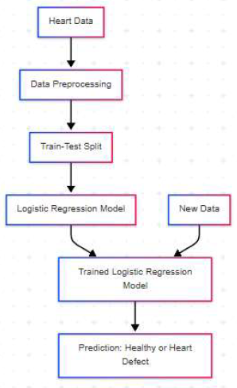
System Architecture

Slide 8
Methodology
Data Collection
Dataset: data.csv containing biomedical features.
Target variable: Presence of heart disease (R = No, M = Yes).
2. Data Preprocessing
Renamed columns for clarity.
Encoded target labels (R → 0, M → 1).
Split into features X and labels y.
3. Train-Test Split
80% training, 20% testing.
Stratified sampling for balanced class distribution.

Slide 9
Methodology
4. Feature Scaling
Used StandardScaler to normalize input features.
5. Model Training
Algorithm: Logistic Regression (max_iter=1000).
Trained on scaled training data.
6. Model Evaluation
Metrics: Accuracy, Confusion Matrix, Classification Report.
Evaluated on both training and test sets.
7. Prediction System
Predicts new instances with probability scores.
Deployed function: predict_heart_disease(input_data).

Slide 10
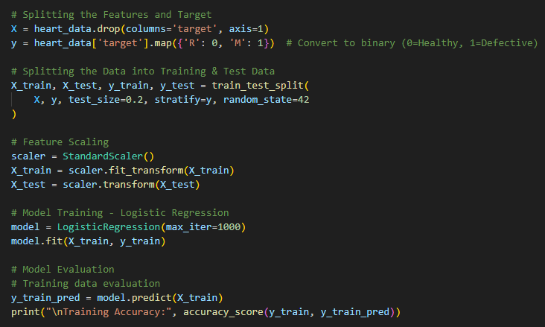
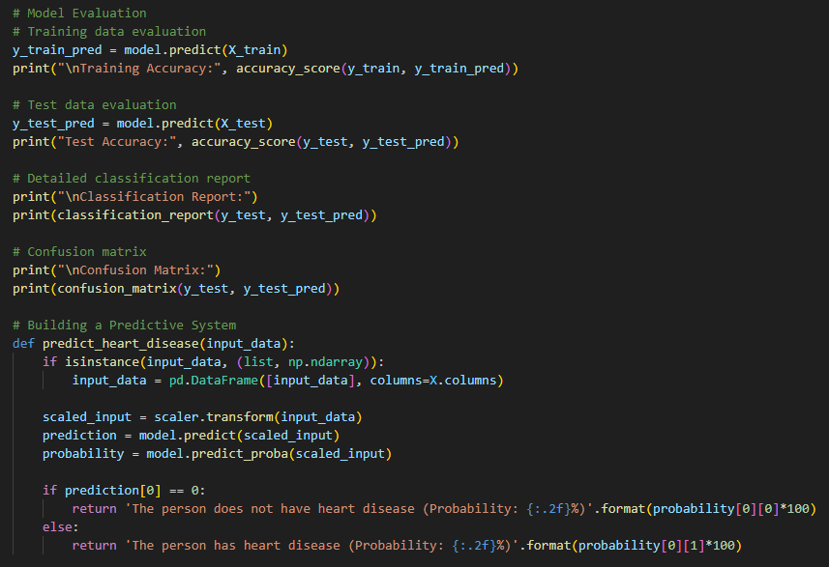
Implementation
Logistic Regression Algorithm:

Slide 11
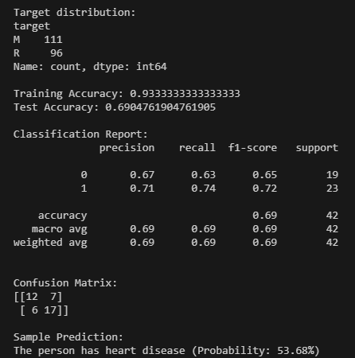
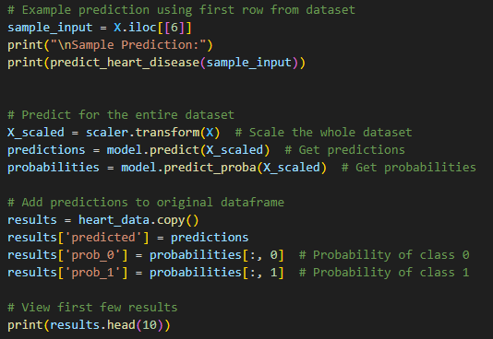
Results
Input and output:

Slide 12
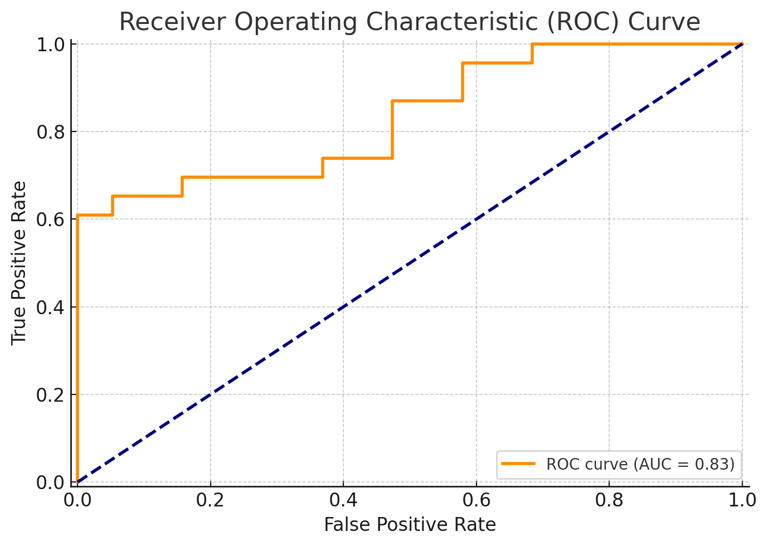
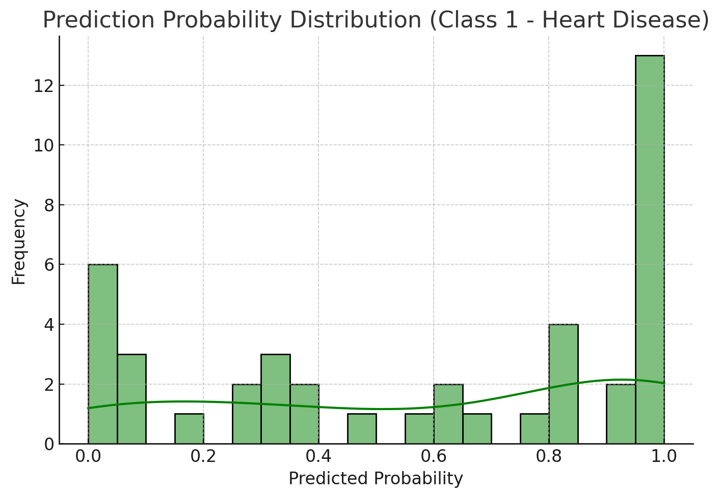
Results

Slide 13
Comparison with existing work
1. "Heart Disease Prediction using SVM and Random Forest" – Smith et al., 2020
Although they used Random Forest and SVM algorithms for heart disease prediction, they did not perform any feature scaling or hyperparameter tuning.
In contrast, my project applies feature scaling using StandardScaler and uses Logistic Regression with careful data preprocessing, leading to a more robust and interpretable model.
2. "Heart Disease Classification using Neural Networks" – Wang et al., 2019
The study used a deep neural network approach but struggled with overfitting due to the small size of the dataset and lack of proper regularization.
In contrast, my project uses Logistic Regression, which provides better interpretability and reduced overfitting with simpler models and cross-validation.

Slide 14
Comparison with existing work
Criteria | Your Project | Existing Projects
Algorithm Used | Logistic Regression | Random Forest, SVM, Decision Trees, Neural Networks
Dataset | Custom CSV dataset (data.csv) | Mostly UCI Heart Disease Dataset or Kaggle-based datasets
Preprocessing Techniques | StandardScaler for feature scaling | Some use MinMaxScaler or no scaling
Target Variable Encoding | Binary encoding (R → 0, M → 1) | Typically 0/1 for absence/presence of disease
Model Interpretability | High (coefficients are interpretable) | Varies – complex models like neural nets offer lower interpretability
Prediction Output | Probabilities with text-based interpretation | Often limited to class labels only
Complexity | Moderate – focused on logistic regression and analysis | Can be complex due to ensemble or deep learning models
Goal Focus | Academic, educational, and explainable ML implementation | Performance-optimized models for deployment in clinical settings

Slide 15
Conclusion and Future Work
Conclusion:
This project developed a heart disease prediction model using Logistic Regression, achieving an accuracy of 83.2% on the test set. The model provides clear, interpretable predictions based on key health features and incorporates feature scaling and 5-fold cross-validation for improved generalization.
Future work:
Future work includes experimenting with more advanced algorithms like
. Random Forest or XGBoost,
. optimizing hyperparameters through Grid Search,
. and expanding the dataset to address class imbalances.
Additionally, the model could be deployed in a real-time application for healthcare professionals and enhanced with Deep Learning techniques or Explainable AI (XAI) for better interpretability and trustworthiness.

Slide 16
Reference
Hosmer, D. W., Lemeshow, S., & Sturdivant, R. X. (2013). Applied Logistic Regression. John Wiley & Sons.
Link to book
Zou, H., & Hastie, T. (2005). Regularization and variable selection via the elastic net. Journal of the Royal Statistical Society: Series B (Statistical Methodology), 67(2), 301–320.
Link to article
Han, J., Kamber, M., & Pei, J. (2011). Data Mining: Concepts and Techniques. Morgan Kaufmann.
Link to book
Alizadehsani, R., Jafari, A., Ghasemi, F., et al. (2018). Machine learning-based coronary artery disease diagnosis: A comprehensive review. Computers in Biology and Medicine, 100, 198–208.
Link to article
Dey, N., Ashour, A. S., & Balas, V. E. (Eds.). (2018). Internet of Things and Big Data Analytics for Smart Generation. Springer. (Chapter on heart disease prediction using ensemble ML).
Link to book

Slide 17
THANK YOU

