Slide 1

Department of Electronics and Communication Engineering
Minor Project-2 Summer Semester-2024-25
Viva Voice
Title: Design of a miniaturized planar antenna with rectangular concave
structure for triple band applications
Domain: Communication
Date: 30-10-2024
Project Team Members
VTU 19769(J.Manindra)
VTU 20999(J.Eswara Venkata Sai)
VTU 21029(N.Yaswanth Sai)
Supervisor
Dr. Beulah Jackson M.E., Ph.D
PROFESSOR/ECE

Slide 2
ABSTRACT
In this project, a miniaturized triple band antenna is proposed.
The antenna will be designed using CST Microwave studio.
FR4 material is chosen as the dielectric substrate to construct the antenna.
This triple band antenna is composed of a rectangular ring, a concave ring and a rectangular branch.
By adjusting their shapes and sizes, three working frequency bands can be obtained.
The antenna operates at 2.4 GHz, 3.3 GHz and 5.9 GHz and it is suitable for wireless local area network (WLAN) applications, World Interoperability for Microwave Access (WIMAX) applications and Bluetooth services.

Slide 3
INTRODUCTION
Nowadays, wireless local area network (WLAN) is widely used.
With the popularization of smart devices and wireless network, people are paying more attentions to the multiband and miniaturized designs of antennas.
Antennas are designed with different properties, such as low cost, ease of fabrication, small size, light weight and multiple bands .
In order to obtain compact multi-band WLAN antennas, a lot of researches have been carried out and many researchers have proposed new design methods .
In this paper, a triple band antenna is proposed. It is composed of a rectangular ring, a concave ring and a rectangular branch.
By adjusting the shape and optimizing the parameters of the antenna, it operates in three frequency bands which are 2.4 GHz, 3.3 GHz and 5.9 GHz, respectively.
These frequency bands can be used for WLAN applications, WIMAX applications and Bluetooth services.

Slide 4
OBJECTIVE
A miniaturized planar antenna with a rectangular concave structure for triple band applications aims to achieve a compact design with high radiation efficiency, operating simultaneously across three distinct frequency bands. The objective is to reduce the antenna's physical size while maintaining acceptable performance, making it suitable for applications with limited space. Additionally, the design targets a large bandwidth in each operating band, high gain, and directivity, ensuring robust and reliable communication. The antenna's low profile, light weight, and ease of fabrication and integration are also key objectives, enabling seamless incorporation into modern communication systems and devices. By accomplishing these goals, the proposed antenna design seeks to provide a cost-effective, high-performance solution for various wireless communication applications, including wireless local area networks (WLAN), satellite communication, and internet of things (IoT) devices.

Slide 5
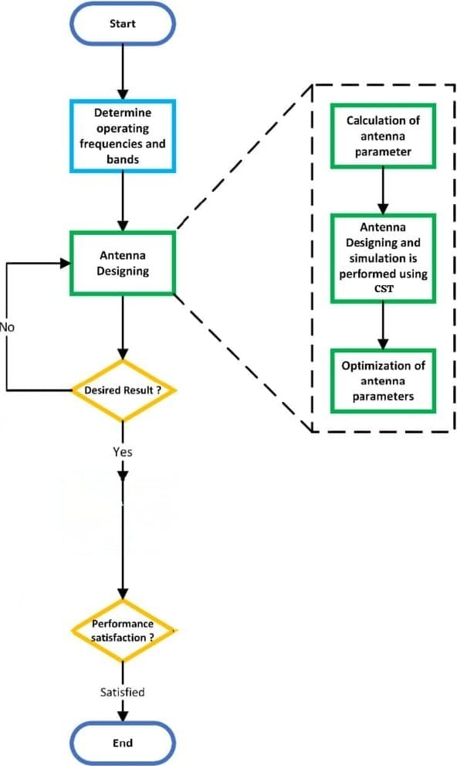
METHODOLOGY/TECHNIQUE

Slide 6
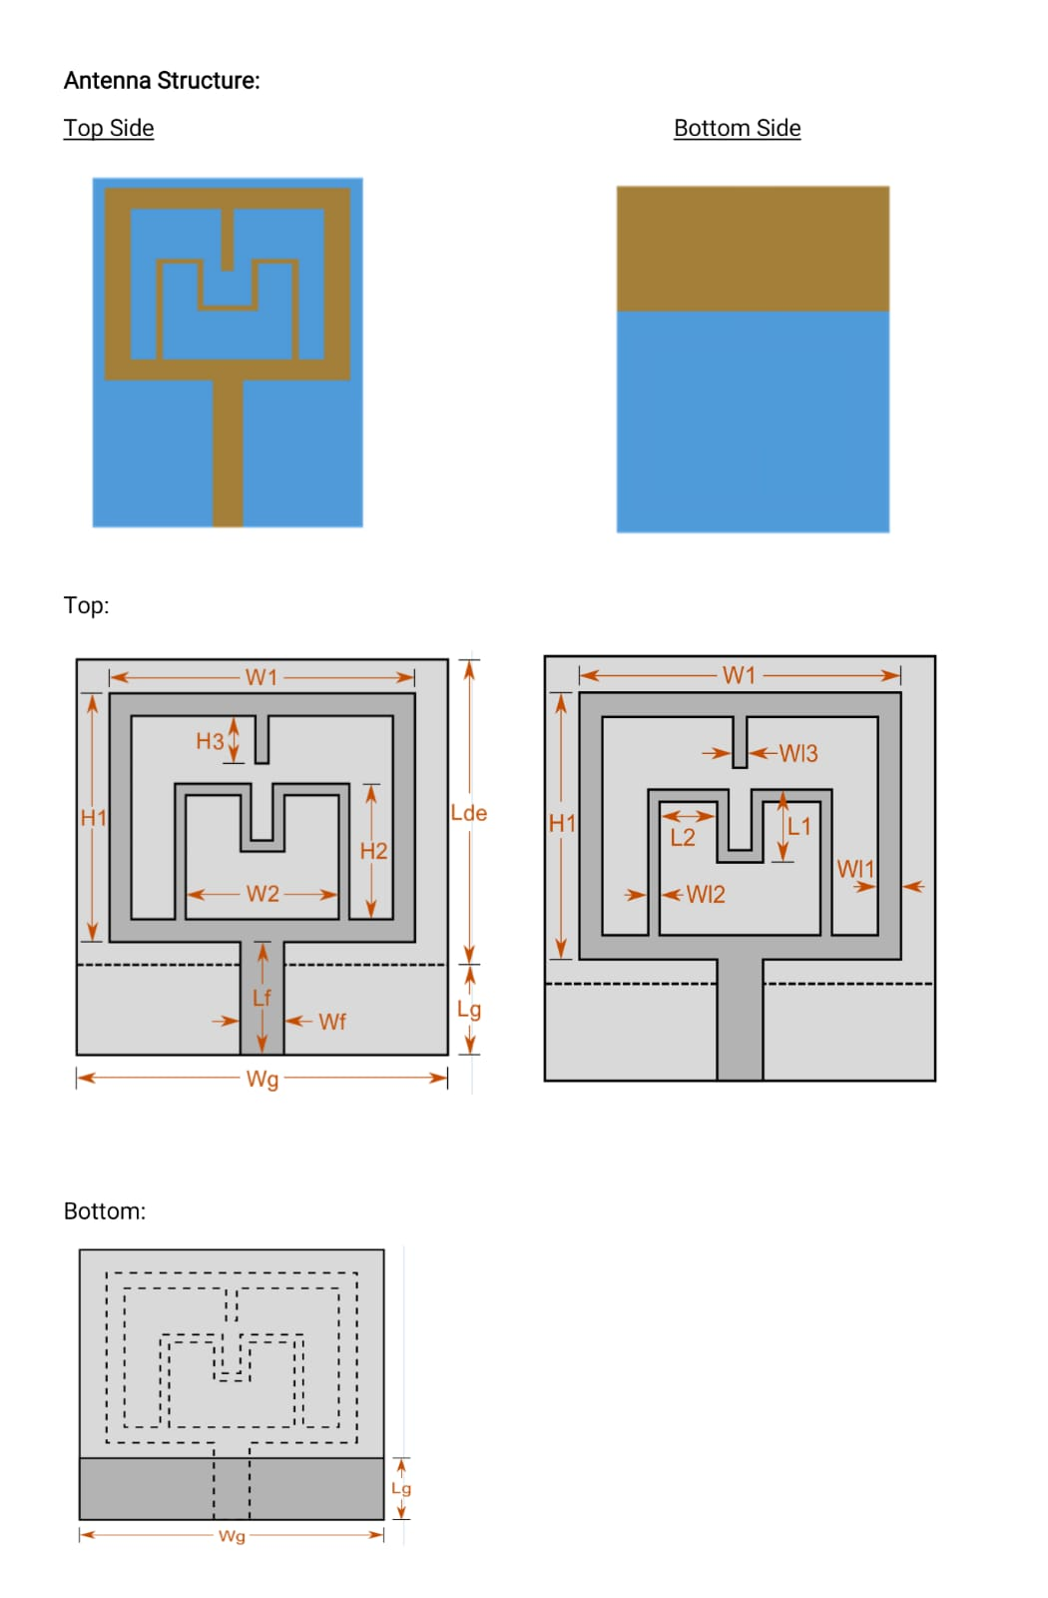
ANTENNA STRUCTURE

Slide 7
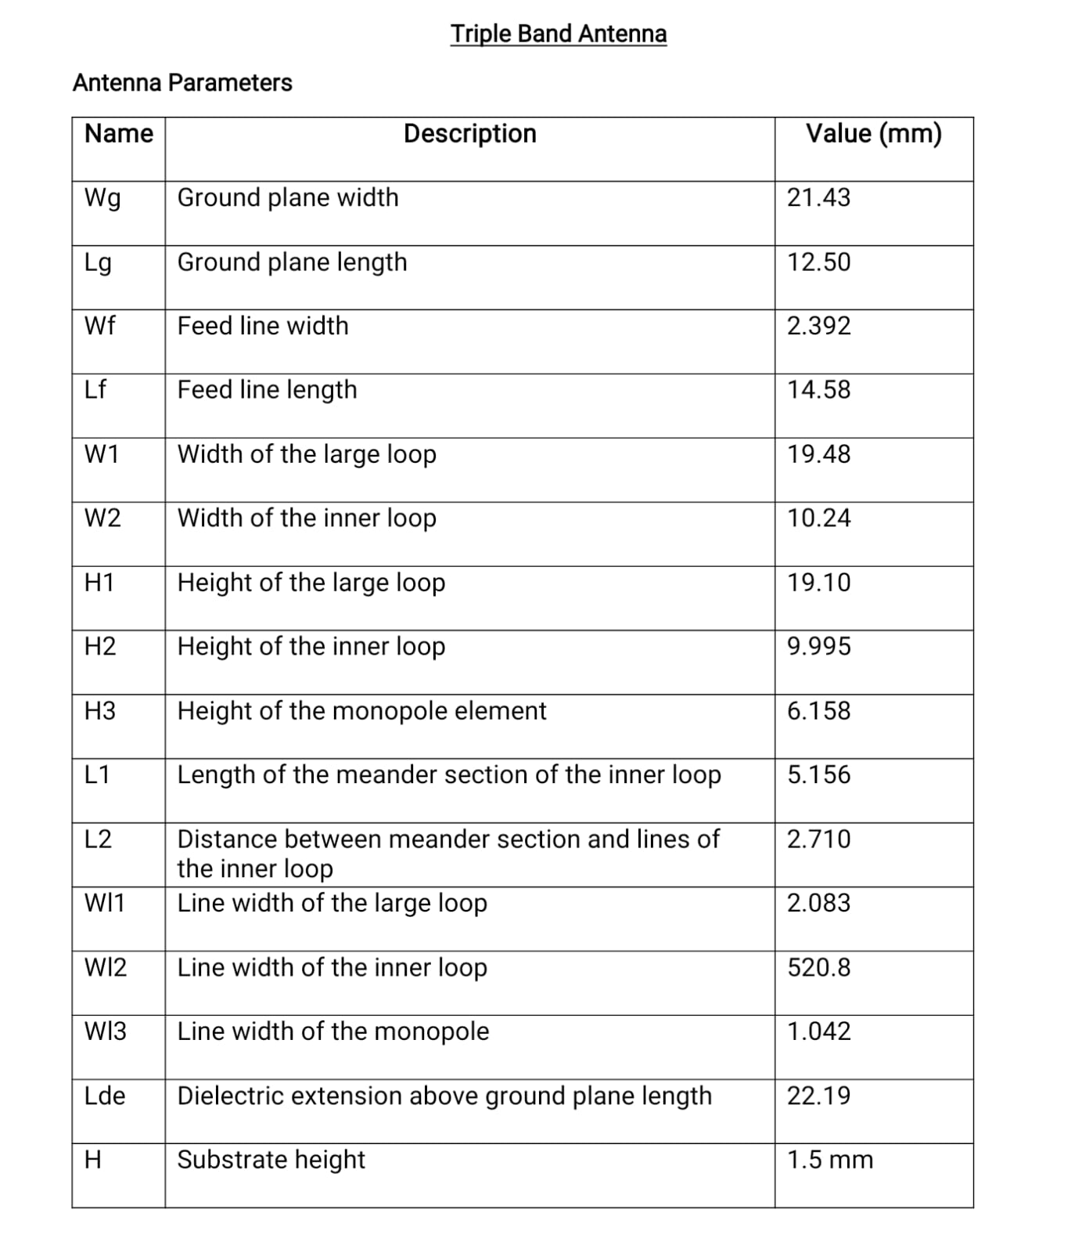
ANTENNA PARAMETERS

Slide 8
METHODOLOGY/TECHNIQUE
The structure of the proposed triple band antenna is presented in Fig.
The antenna is symmetrical. The material of the substrate is FR4 and its size is 35 mm × 21 mm × 1.5 mm.
The dielectric constant of FR4 material is 4.4 and its loss tangent is 0.02. From the top view, the antenna is composed of a feed line, a rectangular ring, a concave ring and a rectangular branch.
The triple band antenna is fed by the microstrip line. The 2.4 GHz WLAN band is obtained by the rectangular ring.
Loading the concave ring and the rectangular branch in the rectangular ring can provide the frequency bands of 3.5 GHz and 5.8 GHz, respectively.
A rectangular ground plane is on the bottom side and its size is 21 mm × 12 mm.

Slide 9
METHODOLOGY/TECHNIQUE
The performance of the antenna can be improved by optimizing its parameters in Fig.
After the optimization, the antenna’s specific parameters are shown
The width of the rectangular ring D1 is 2 mm and the width of the concave ring D2 is 0.5 mm.
The width of the microstrip feed line W1 is 2.8 mm and the width of the rectangular branch W5 is 1 mm.
This antenna is designed to operate in WLAN frequency bands.
The rectangular ring, the concave ring and the rectangular branch are used to achieve tri-band characteristics

Slide 10
TIMELINE PLAN
S.No | Project Activity | Description | Date of completion (or) Week number
 | Literature Survey | Undestanding and collecting the information | Week 1
2 | Design | Developing the prototype | Week 2&3
3 | Implementation | Getting ready with all required tools and implementation | Week 3,4 &5
4 | Analysis | Evaluate the perform of project | Week 5&6
5 | Results and discussion | Checking the result | Week 6 &7
6 | Documentation | Recording the key project details and producing the documentation that are required to implement it successfully | Week 8,9&10
7 | Paper publication | Identifying a journal/conference with aims& journal/conference | Week 11&12
Vel Tech Rangarajan Dr. Sagunthala R&D Institute of Science and Technology

Slide 11
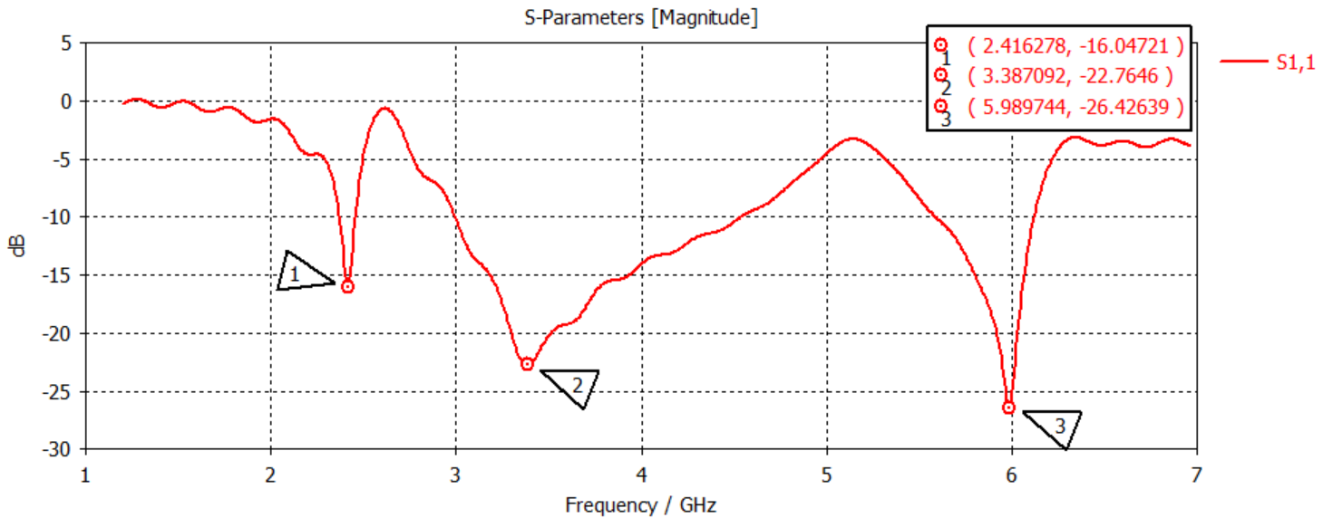
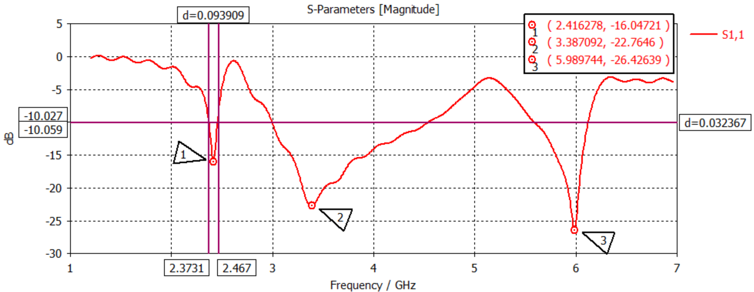
RESULTS
S Paremeter (S₁₁) or Return Loss
Bandwidth from S₁₁:At 2.4 GHz

Slide 12
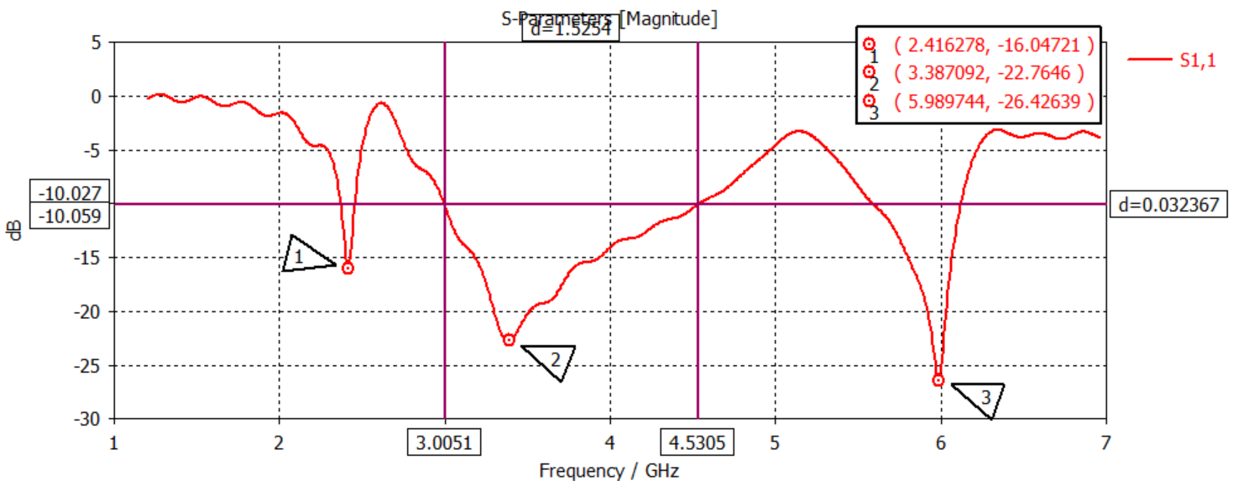
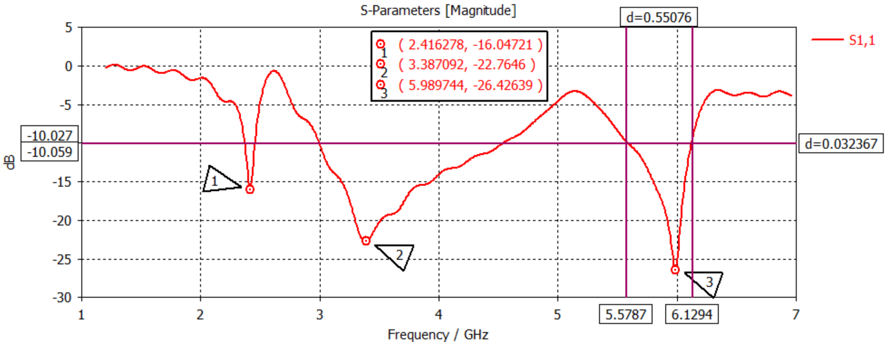
RESULTS
At 3.3 GHz
At 5.9 GHz

Slide 13
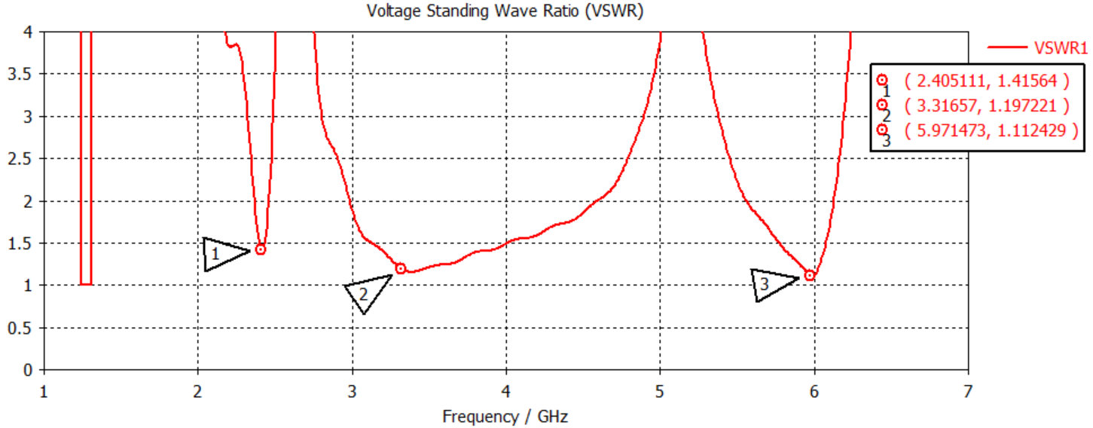
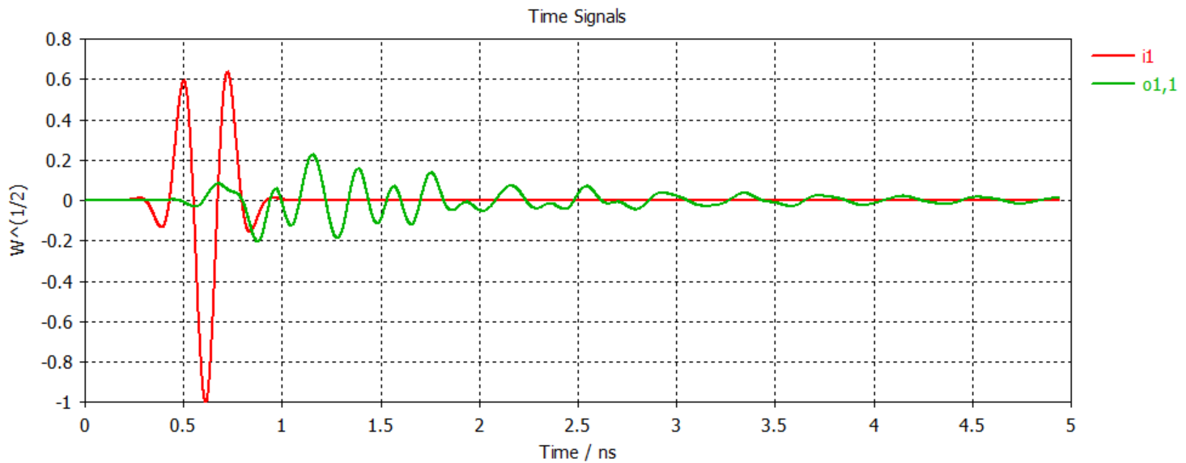
RESULTS
VSWR:
Port Signals:

Slide 14
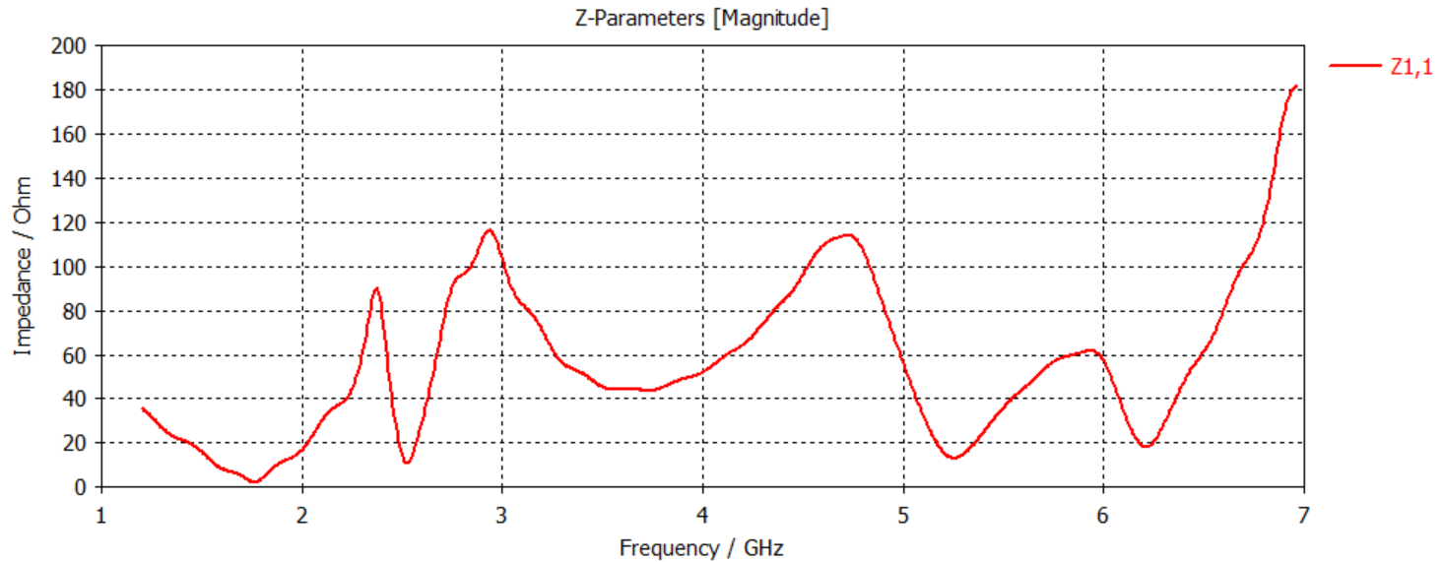
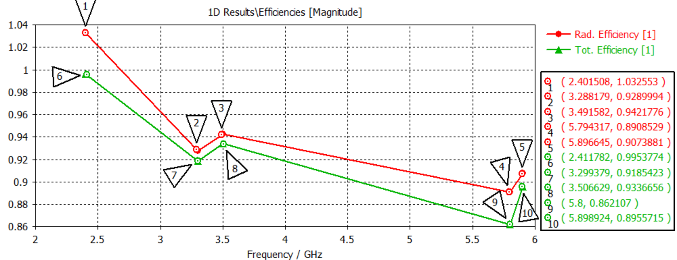
RESULTS
Z Parameters
Efficiencies:

Slide 15
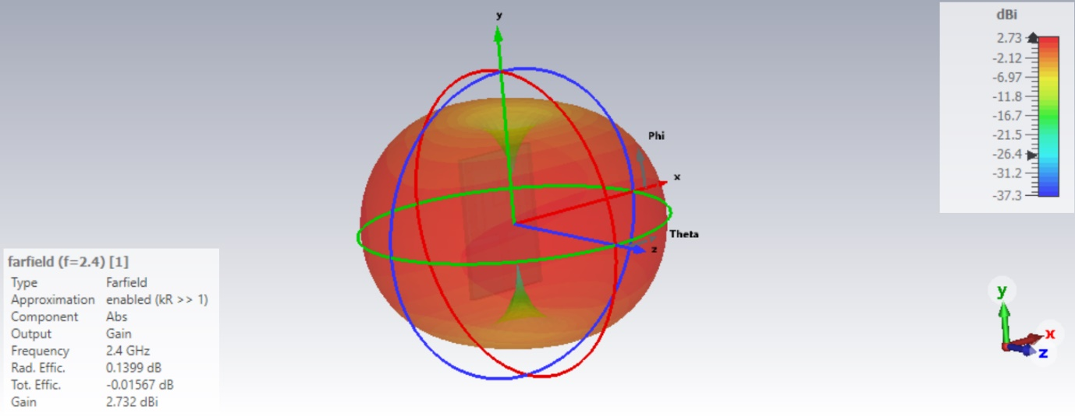
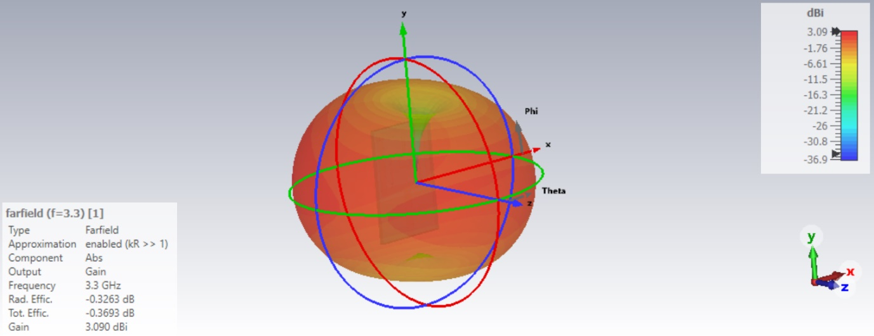
RESULTS
Far field:
3D Pattern & Gain At 2.4 GHz
3D Pattern & Gain At 3.3 GHz

Slide 16
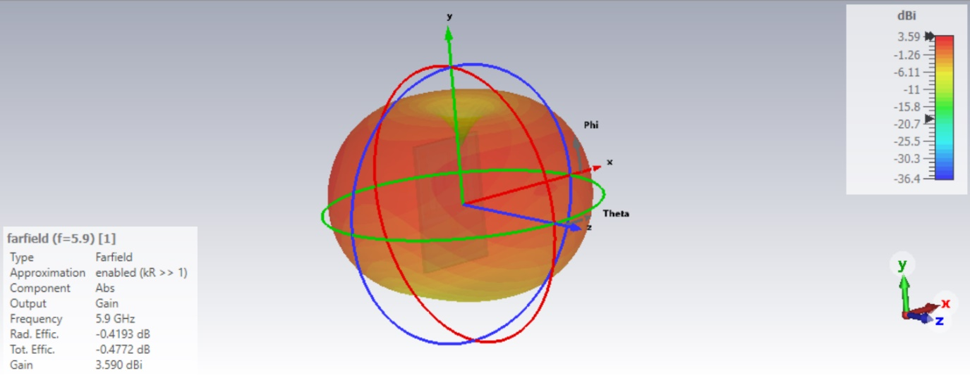
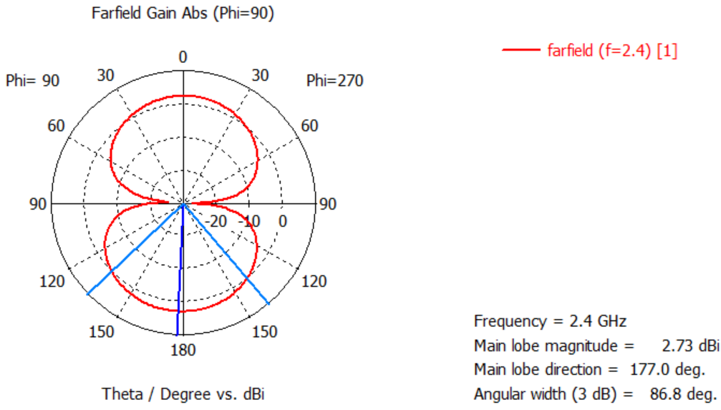
RESULTS
3D Pattern & Gain At 5.9 GHz
Polar Pattern & Gain At 2.4 GHz

Slide 17
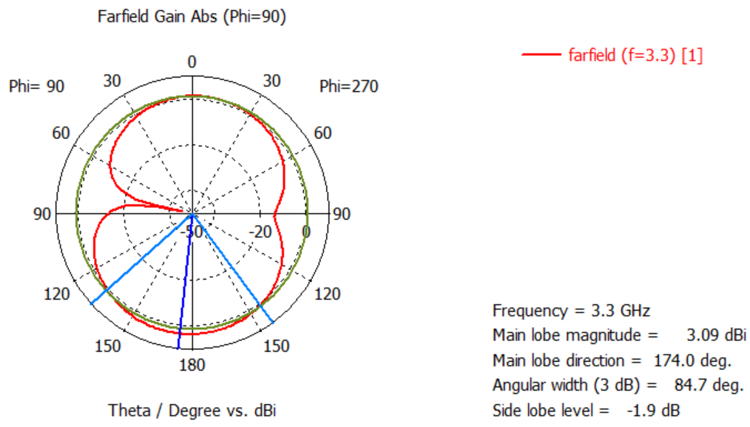
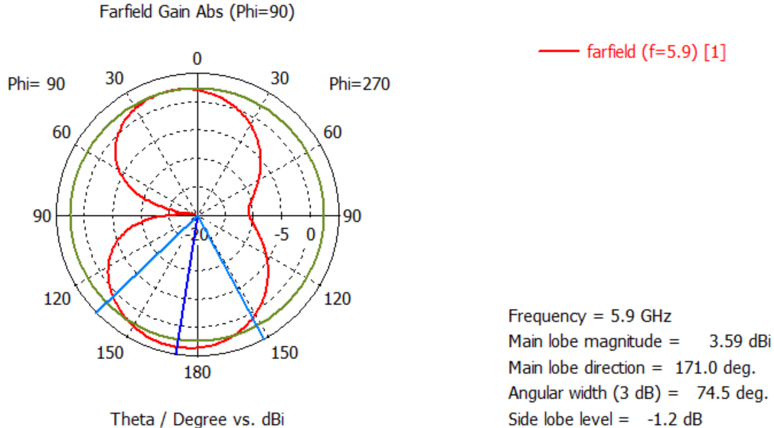
RESULTS
Polar Pattern & Gain At 3.3 GHz
Polar Pattern & Gain At 5.9 GHz

Slide 18
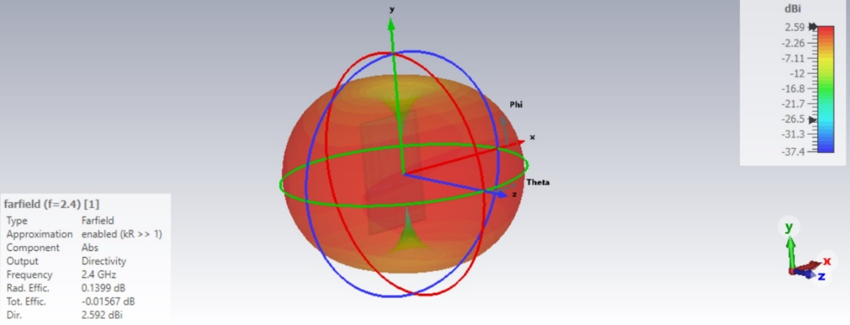
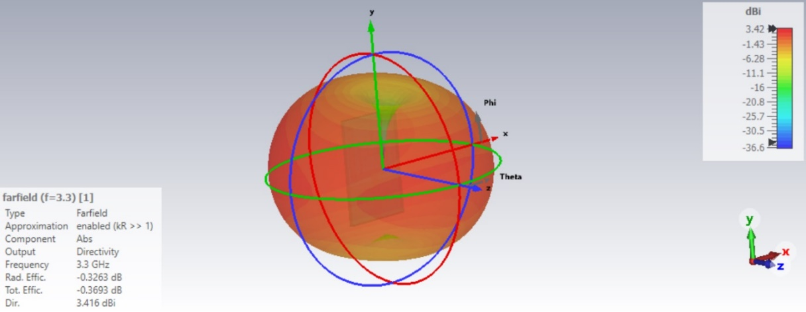
RESULTS
3D Pattern & Directivity At 2.4 GHz
3D Pattern & Directivity At 3.3 GHz

Slide 19
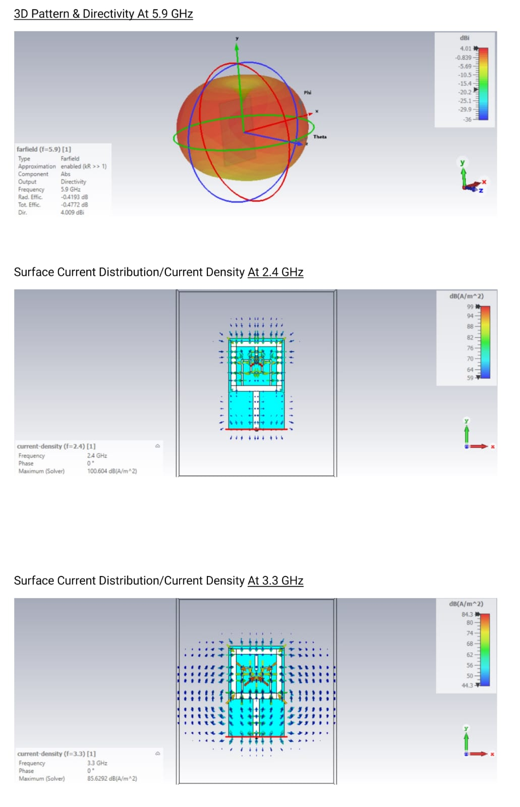
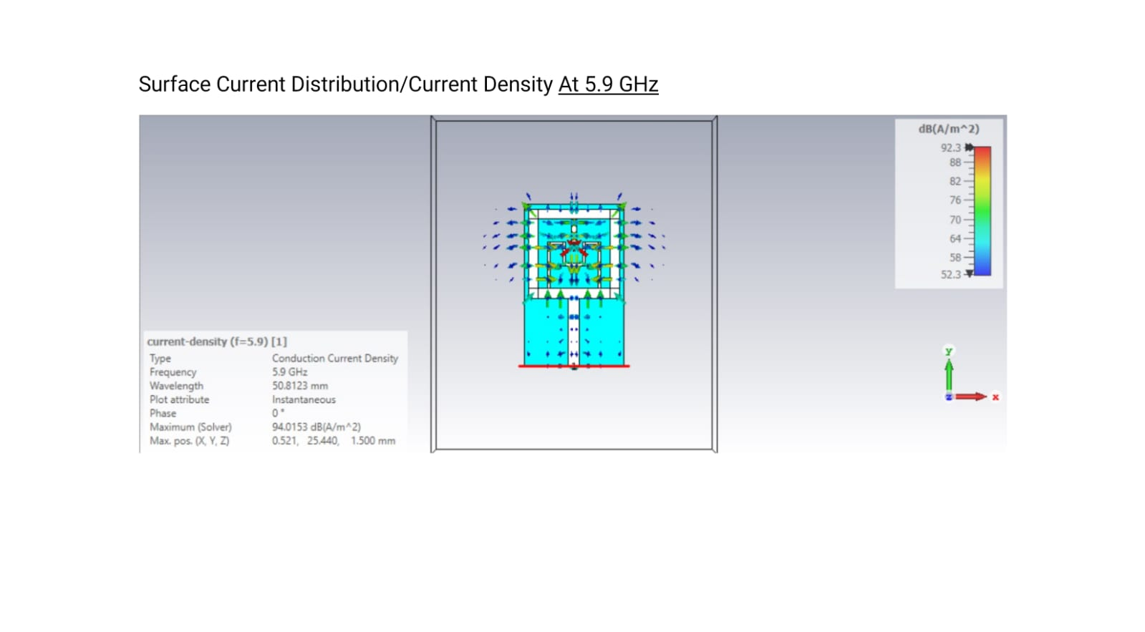
RESULTS

Slide 20
CONCLUSION
The proposed planar antenna with a rectangular concave structure designed for triple band applications has achieved a compact size, high radiation efficiency, and robust performance. Through parametric studies and optimization, the antenna's dimensions and parameters have been tailored to achieve triple-band operation, large bandwidth, and high gain. The rectangular concave structure has enhanced the antenna's bandwidth and gain, while the optimized patch and substrate dimensions have enabled miniaturization without compromising performance. With a reduced size of 30% compared to traditional designs, this antenna offers a promising solution for modern communication systems, including WLAN, satellite communication, and IoT devices, and demonstrates a significant advancement in miniaturized planar antenna technology.

Slide 21
REFERENCES
[1] J. R. Costa, C. R. Medeiros and C. A. Fernandes, ”Performance of a Crossed Exponentially Tapered Slot Antenna for UWB Systems,” in IEEE Transactions on Antennas and Propagation, vol. 57, no. 5, pp. 1345-1352, May 2009, doi: 10.1109/TAP.2009.2016727.
[2] D. Sarkar, K. V. Srivastava and K. Saurav, ”A Compact Microstrip-Fed Triple Band-Notched UWB Monopole Antenna,” in IEEE Antennas and Wireless Propagation Letters, vol. 13, pp. 396-399, 2014, doi: 10.1109/LAWP.2014.2306812.
[3] H. Zhai, Z. Ma, Y. Han and C. Liang, ”A Compact Printed Antenna for Triple-Band WLAN/WiMAX Applications,” in IEEE Antennas and Wireless Propagation Letters, vol. 12, pp. 65-68, 2013, doi: 10.1109/LAWP.2013.2238881.
[4] L. Li, X. Zhang, X. Yin and L. Zhou, ”A Compact Triple-Band Printed Monopole Antenna for WLAN/WiMAX Applications,” in IEEE Antennas and Wireless Propagation Letters, vol. 15, pp. 1853-1855, 2016, doi: 10.1109/LAWP.2016.2539358.
[5] W. Liu, C. Wu and Y. Dai, ”Design of Triple-Frequency Microstrip-Fed Monopole Antenna Using Defected Ground Structure,” in IEEE Transactions on Antennas and Propagation, vol. 59, no. 7, pp. 2457-2463, July 2011, doi: 10.1109/TAP.2011.2152315.

Slide 22


