Slide 1

A NOVEL MACHINE LEARNING METHOD FOR SOFTWARE DEFECT ESTIMATION
DEPARTMENT OF CSE
IV B.TECH CSE C-SECTION
Batch Details – C13
RAGHURAM-2110611024
MANINDRA-211061101143
VINAY-211061101145
GUIDE:
MR.ARUN

Slide 2
OUTLINE
Title
Abstract
Introduction
Literature Survey
Requirements specification
Problem Definition
Existing System
Proposed System
UML Diagram
Implementation
Conclusion
Reference

Slide 3
Abstract
Software engineering is a multifaceted field that necessitates effective communication between system stakeholders to deliver a developed system within specified time constraints and budget limits. Meeting customer requirements involves optimizing system performance by minimizing complexity.
Efficiently predicting system defects early in the project life cycle allows for better allocation of resources and effort for development and quality assurance.
This paper's primary goal is to assess the effectiveness of machine learning algorithms in predicting software defects.
As a branch of computer science, software engineering facilitates seamless communication between system software and user requirements.
One software have different versions but I want particular versions in that input data set will defect or not
EX: Python Versions(some input datasets defect in some versions
Using machine learning algorithm like SVM(support vector machines).

Slide 4
Introduction
Software defect prediction plays an important role in improving software quality and it help to reducing time and cost for software testing. Machine learning focuses on the development of computer programs that can teach themselves to grow and change when exposed to new data. The ability of a machine to improve its performance based on previous results. Machine learning improves efficiency of human learning, discover new things or structure that is unknown to humans and find important information in a document. For that purpose, different machine learning techniques are used to remove the unnecessary, erroneous data from the dataset. Software defect prediction is seen as a highly important ability when planning a software project and much greater effort is needed to solve this complex problem using a software metrics and defect dataset.
The process of software defect to find the defect in project is :Data collection, data preparation, model selection,Analyse and prediction

Slide 5
Literature Survey
A literature survey on software defect estimation explores various approaches, methods, and models used to predict or estimate the number of defects that may exist or appear in software systems.
Software defect estimation is a critical aspect of software quality assurance and helps organizations plan resources, reduce costs, and improve product reliability.
Accurate defect estimation enables project managers to anticipate potential issues, allocate resources effectively, and optimize testing and debugging efforts
Title: A Novel Approach to Improve Software Defect Prediction Accuracy Using Machine Learning

Slide 6
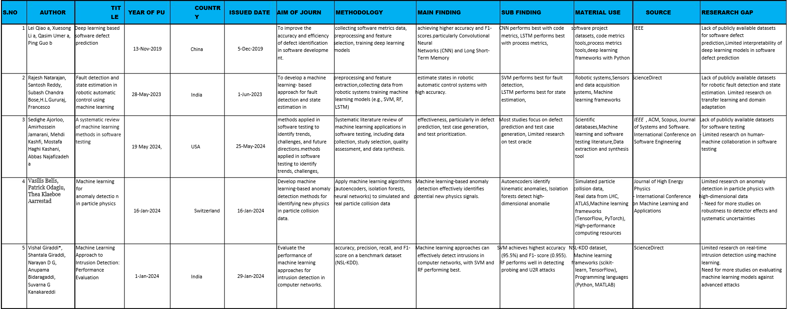

Slide 7
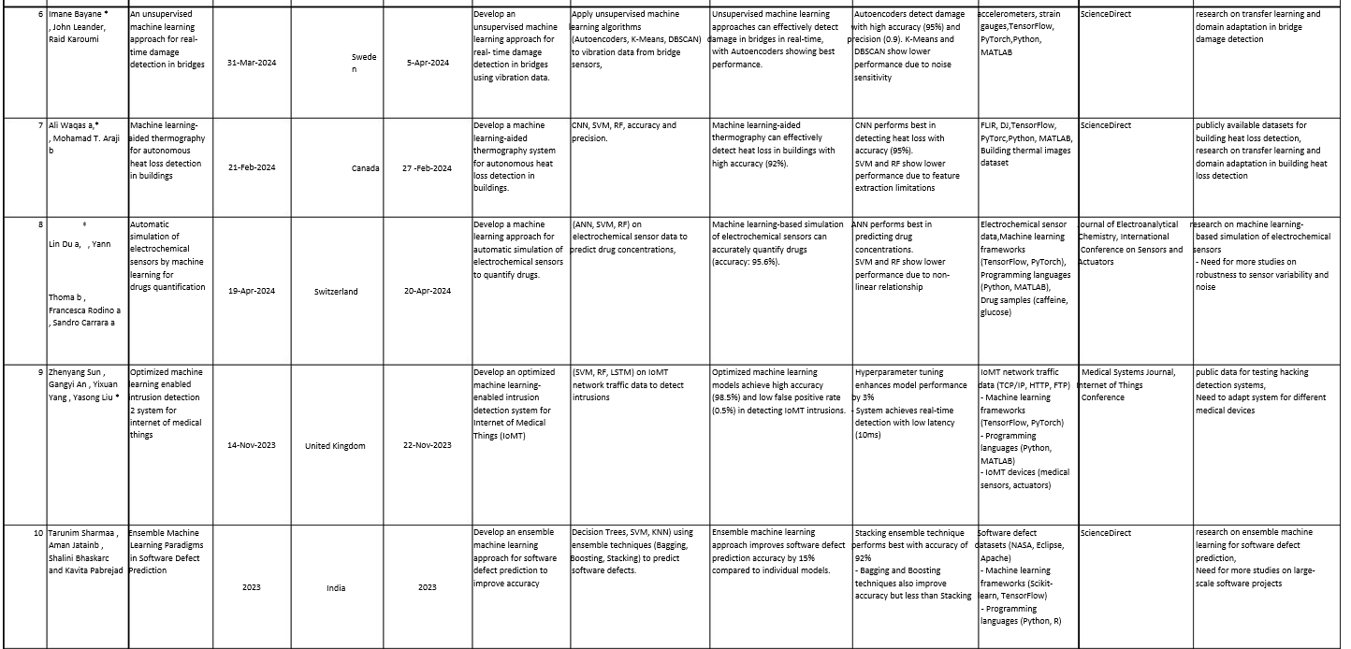

Slide 8
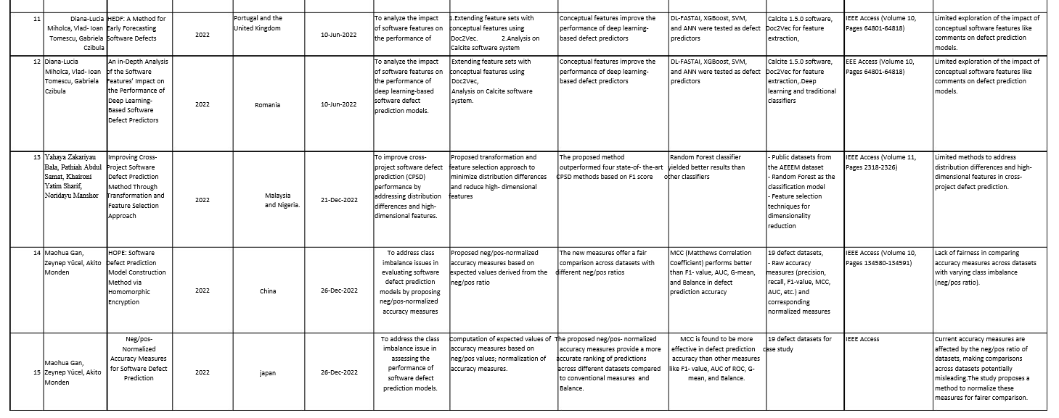

Slide 9
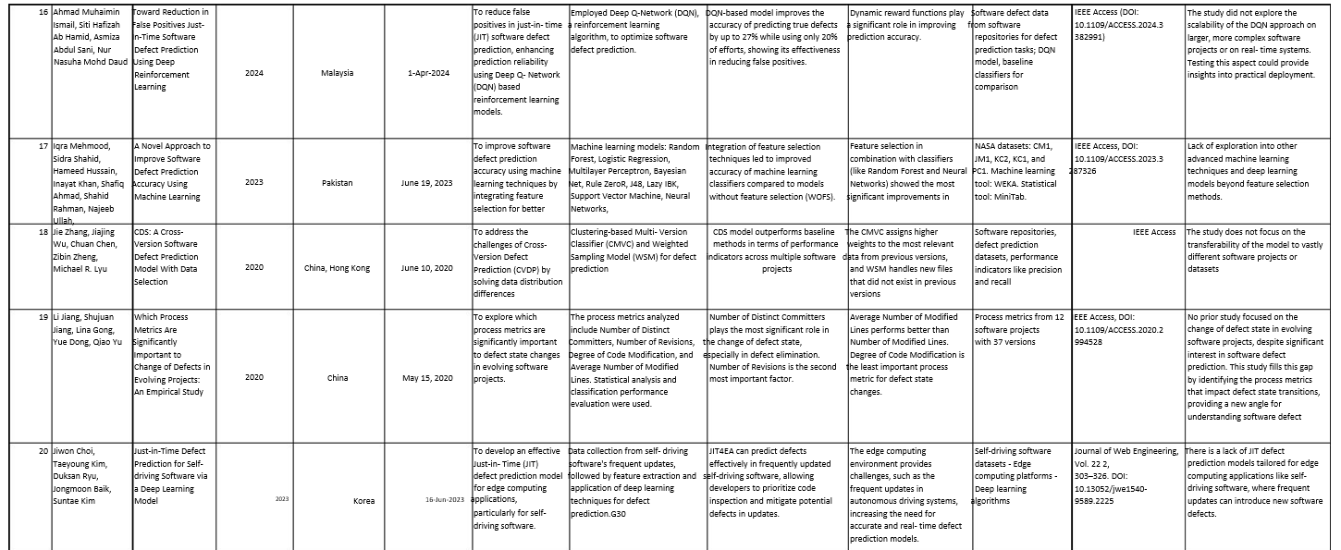

Slide 10
Requirements specification
HARDWARE REQUIREMENTS
System : Pentium Dual Core.
Hard Disk : 120 GB.
Monitor : 15”LED
Input Devices : Keyboard, Mouse
Ram : 1GB.
SOFTWARE REQUIREMENTS
Operating system : Windows 7.
Coding Language : Python

Slide 11
PROBLEM DEFINITION
Developing software systems today is a complex process that involves stages like planning, analysis, design, implementation, integration, and maintenace.
Using decision and KNN (K-nearest neighbors) algorithms in M.L Software engineers are tasked with delivering systems on time and within budget, often determined during the planning phase.
faults are categorized based on their severity, with corrective and preventive actions taken according to the defined severity levels.
Will using this process that we get dataset quality are very less and also it gets the accuracy rating it get less

Slide 12
Existing System
The existing system described, you would first need to establish the infrastructure for using the Adaptive Neuro-Fuzzy Inference System (ANFIS) for software fault prediction. The steps below outline a potential approach for implementation based on the provided description
Software defects is there but there is different algorithms in existing system
Like Naïve Bayes, and Decision Tree
When we using decision tree algorithm in that quality of data set less and Accuracy values are also defecting

Slide 13
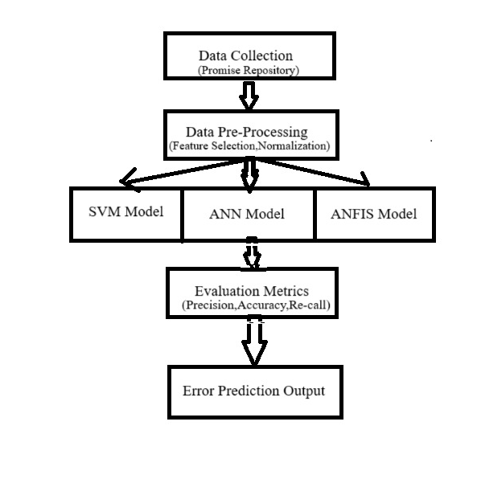
Fig: Existing System

Slide 14
PROPOSED SYSTEM
The major goal of Software Defect Prediction is to detect defects prone in the program by reduce the effort, time and cost involved to the minimum. This paper gives comprehensive review of all the techniques to approach defect prediction. The PROMISE repository which is a public software defect prediction dataset which is owned by the National Aeronautics and Space Administration (NASA) is used.
We are proposed SVM algorithm and data set Quality also very high when compare to the previous dataset
By the using of SVM weget the 90% accuracy

Slide 15
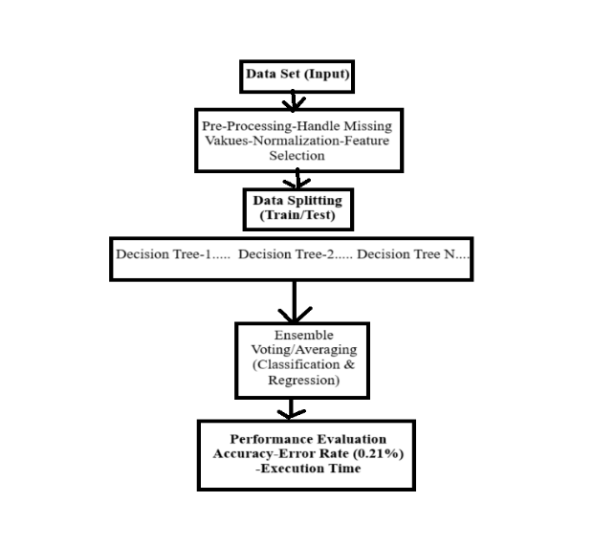
Fig: Proposed System

Slide 16
UML Diagram
Use Case Diagram
Class Diagram
Activity Diagram
Sequence Diagram
System Architecture

Slide 17
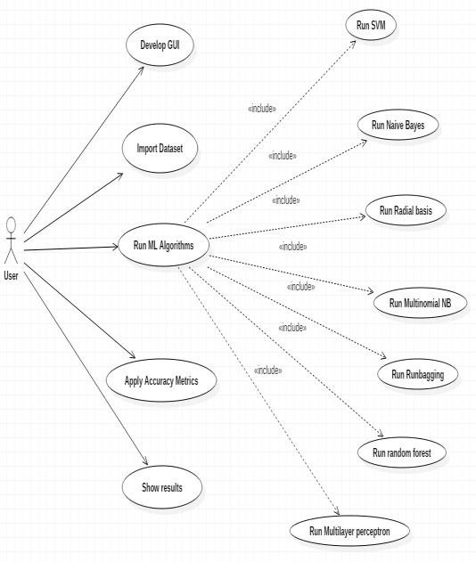
Use Case Diagram

Slide 18
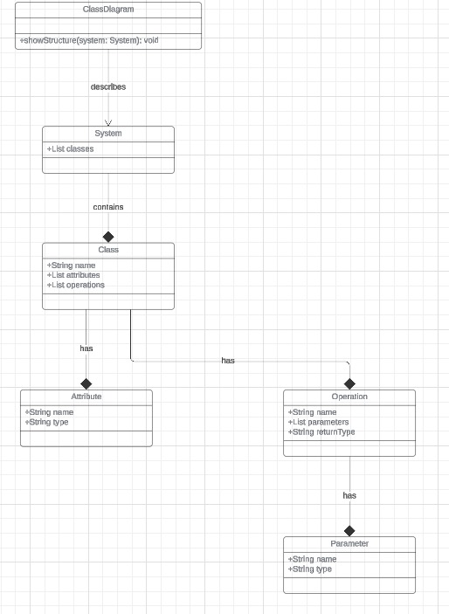
Class Diagram

Slide 19
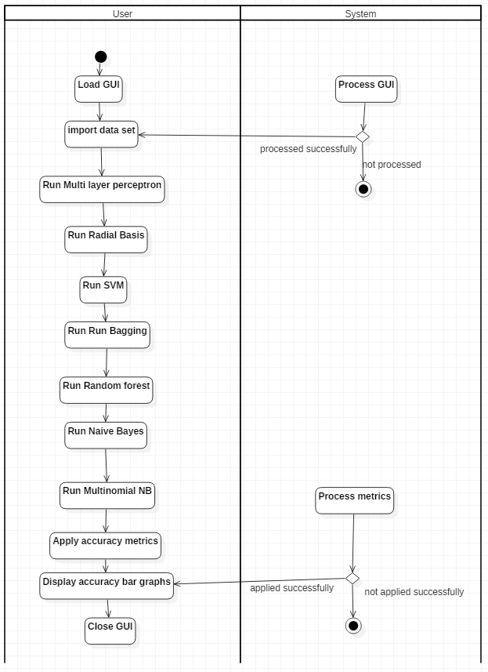
Activity Diagram

Slide 20
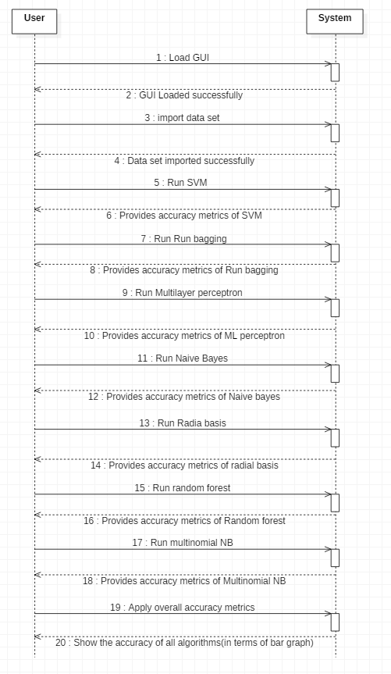
Sequence Diagram

Slide 21
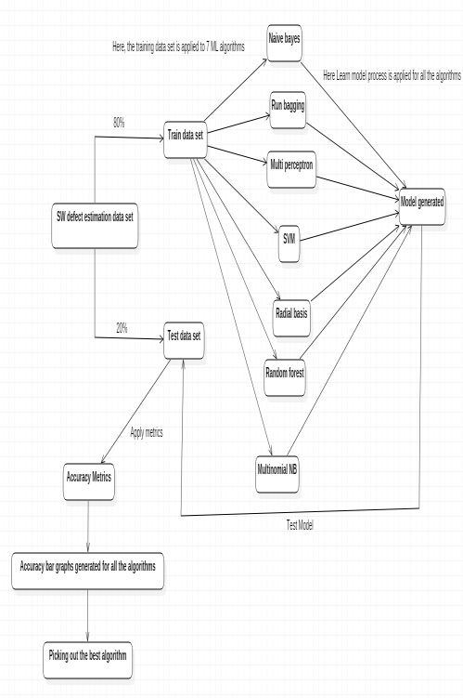
System Architecture

Slide 22
Implementation
MODULES:
Data Collection
Data Preparation
Model Selection
Analyse and Prediction

Slide 23
Data Collection :
This is the first real step towards the real development of a machine learning model, collecting data.
This is a critical step that will cascade in how good the model will be, the more and better data that we get, the better our model will perform.
There are several techniques to collect the data, like web scraping, manual interventions and etc.
Collecting data and set data
Data collecting from Kaggle web site

Slide 24
Data Preparation:
Data Preparation is a crucial step in any data analysis or machine learning workflow, as it involves transforming raw data into a format that is suitable for analysis or model building. This step typically includes data cleaning, data transformation, and data integration
Data preparation using Recursion technology a function calls itself directly or indirectly to solve a problem
What ever the data we are preparing means Training the data
By the using of data preparation it removes the null values

Slide 25
Model Selection :
The process involves evaluating different models and selecting the one that performs best according to predefined metrics, such as accuracy, precision, recall, or others. Here's an overview of model selection along with a block diagram the decision tree algorithm. Here, each friend makes a selection of the places he or she has visited so far.
We used Random Forest Classifier algorithm, We got a accuracy of 96.78% on test set so we implemented this algorithm.

Slide 26
algorithm work
It works in four steps:
1.Select random samples from a given dataset.
2.Construct a decision tree for each sample and get a prediction result from each decision tree.
3.Perform a vote for each predicted result.
4.Select the prediction result with the most votes as the final prediction.

Slide 27
Analyse and Prediction
For that purpose, different machine learning techniques are used to remove the unnecessary, erroneous data from the dataset.
Software defect prediction is seen as a highly important ability when planning a software project and much greater effort is needed to solve this complex problem using a software metrics and defect dataset. .
The primary goal of this survey paper is to understand the existing techniques for predicting software defect.
Results obtained states that the proposed approach works more efficiently in terms of accuracy as compared to other techniques like SVM, Naïve Bayes, and Decision Tree.
Accuracy on test set: We got a accuracy of 96.78% on test set.

Slide 28

Home page :

Slide 29
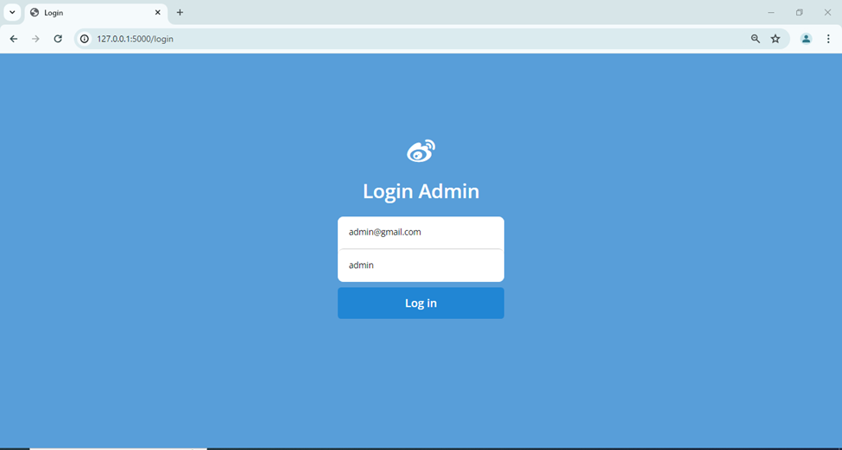
Lode page:

Slide 30
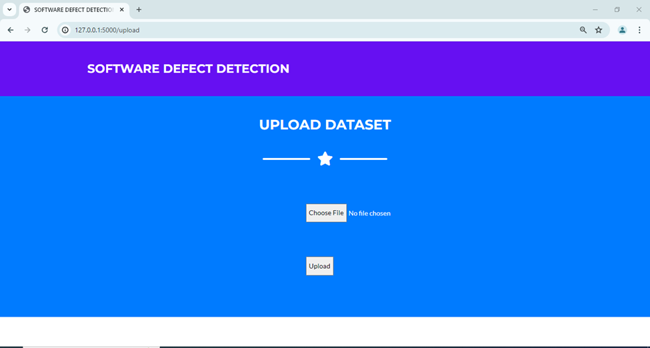
Upload Page:

Slide 31
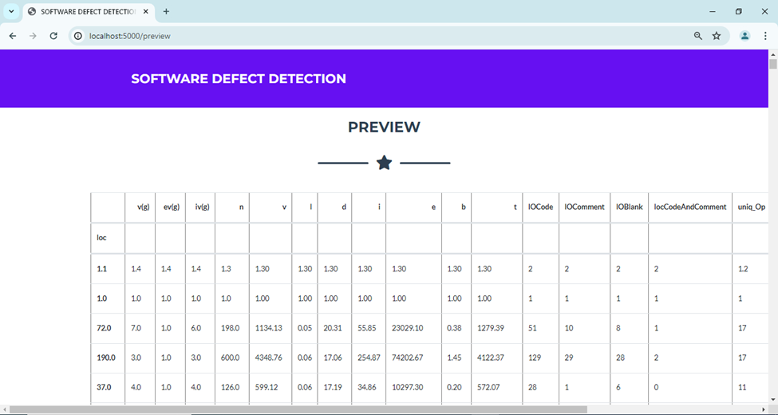
Preview Page:

Slide 32
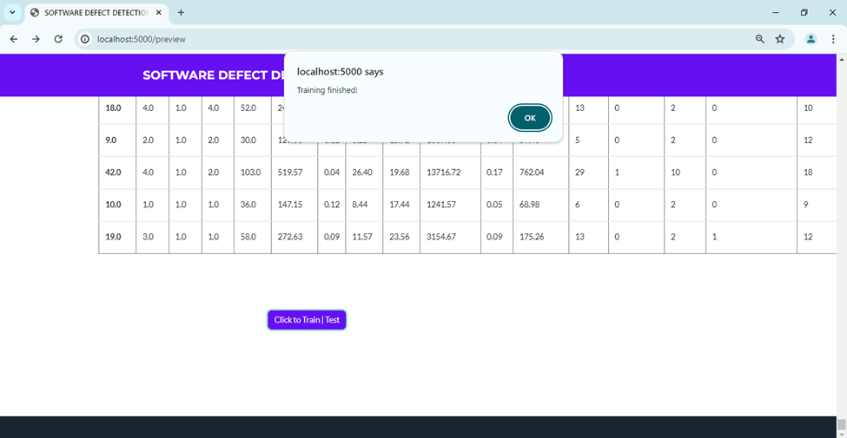

Slide 34

Predict Label Page

Slide 35
Conclusion
While it is impossible to completely prevent defects in software development, they can be greatly lessened with effective management. Delivering high-quality software requires an understanding of the causes of defects, their many kinds, and their lifespan.
By the process of modules it shows dataset of software .In that software we get the result there is defect or not

Slide 36
REFERENCE
1. B.W.Boehm and P.N.Papaccio (1988), Understanding and controlling software costs’, IEEE Tran, Software eng., vol. 14, pp. 1462-1477 .
2. 2. J. Zheng (2010), ’Cost-sensitive boosting neural networks for software defect prediction’, Expert Systems with Appl., vol.37, pp. 4537-4543.
3. L.C.Briand, K.E.Emam, et al (2000), ‘A Comprehensive Evaluation of Capture-Recapture Models for Estimating Software Defect Content’, IEEE Transactions on Software Engineering, Vol. 26, pp.518-540.
4. Lourdes Pelayo and Scott Dick (2007), ‘Applying Novel Resembling Strategies to Software Defect Prediction,’ in proc.North Amr.Fuzzy Inf. Processing Society, pp. 69 – 72.
5. Mingxia Liu, Linsong Miao et al (2014), ’TwoStage Cost-Sensitive Learning forSoftware Defect Prediction’, IEEE Trans. Reliability, Vol. 63, pp.679-684.

