Slide 1
Prahari
Web threat detection and protection
One scan API. Explainable decisions. A protected application.
AI Builders Hackathon · 2026
01

Slide 2
The problem and target users
Small application teams accept links, comments and API inputs every day.
Suspicious links and attack payloads need different checks, but one operational workflow.
Developers need to know what was detected, why it matters and whether the request reached their app.
02

Slide 3
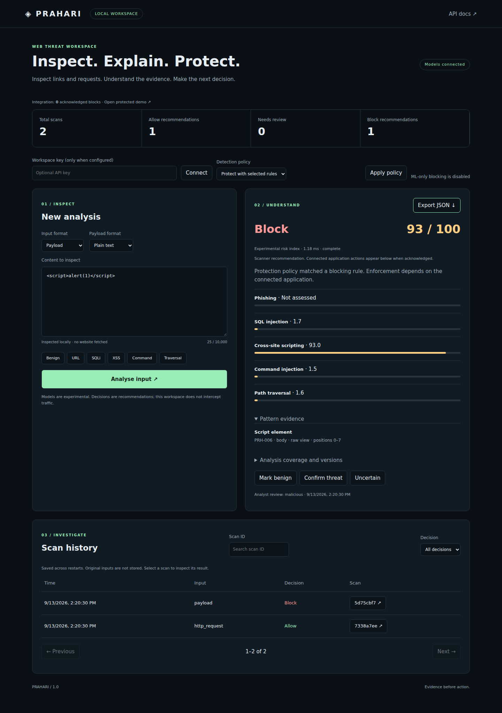
One shared analysis workspace
Scan URLs, requests and payloads
Five threat categories
ML and rule evidence kept separate
One risk index and decision
Persistent investigation history
03

Slide 4
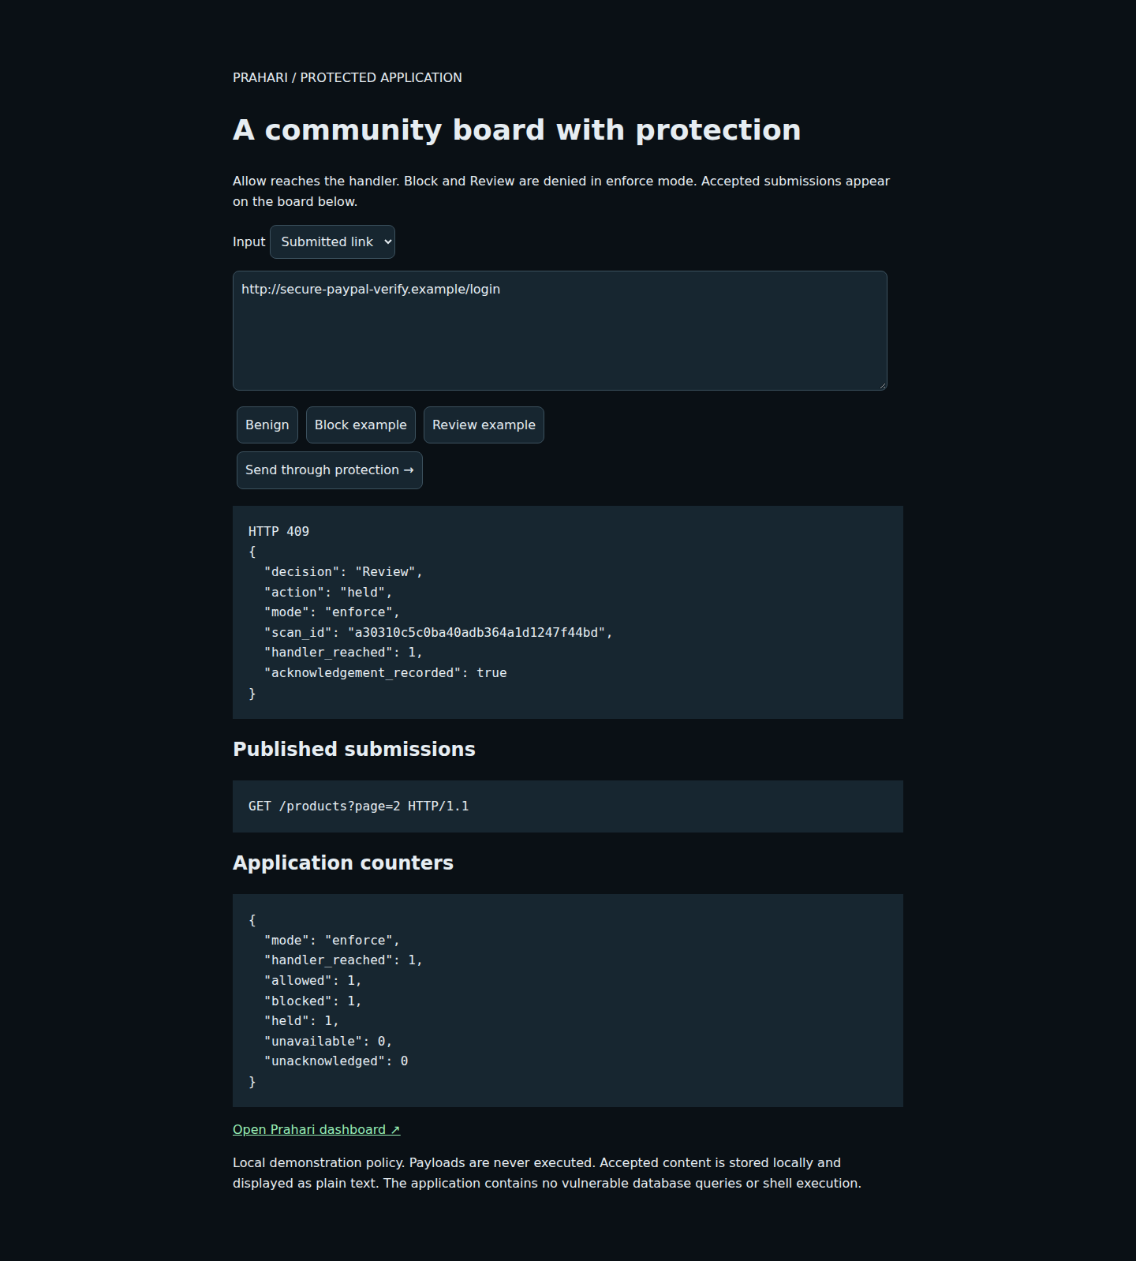
Protection in an application workflow
The community board uses the same scan API before publishing a submission.
Allow → publish
Block → HTTP 403
Review → HTTP 409
Scanner unavailable → HTTP 503
04

Slide 5
Technical architecture
Browser workspace and Node adapter → shared FastAPI contracts
Parser → phishing ML + request ML + multi-category rules
Policy → Allow / Review / Block with coverage and evidence
SQLite history + analyst labels + authenticated adapter acknowledgements
05

Slide 6
Where AI contributes
Phishing: 18 lexical features, Random Forest and sigmoid calibration.
Requests: character TF-IDF and Logistic Regression across five classes.
Rules supply localized evidence; models supply learned estimates.
ML-only blocking stays disabled until broader deployment validation.
06

Slide 7
Repairing a misleading phishing baseline
The original model confused ordinary subpages with phishing.
Fixed hostname, shortener and IPv6 feature handling.
Kept registered domains separate across train, calibration and test.
Added labelled synthetic benign path variants only within their partitions.
GitHub, Google search and Microsoft subpage regression checks now Allow.
07

Slide 8
Measured results and their limits
98.625%
Phishing accuracy on 8,000 original held-out rows
13 false positives · 97 false negatives
Single source; this is not a real-world performance guarantee.
26 authored request diagnostics: 16/16 attack examples held or blocked.
Protect also blocked 2/10 benign examples containing code or relative paths.
08
Notes:
Sources: evaluation/phishing_training.json and evaluation/request_diagnostics.json in the release. PhiUSIIL UCI dataset 967, CC BY 4.0: https://archive.ics.uci.edu/dataset/967/phiusiil+phishing+url+dataset . Request diagnostics include training-like cases; they are not independent traffic.

Slide 9
Value demonstrated in the working product
One integration connects detection to a real application action.
Evidence and saved decisions support repeatable investigation.
Denied requests do not reach the handler; actual acknowledgements are counted separately.
Browser, API and live integration checks are reproducible in the source package.
09

Slide 10
Roadmap and adoption
Try it locally: Python 3.12 + Node.js 22, one launcher.
Pilot in monitor mode; review false positives before enabling protection.
Next: independent traffic evaluation, route-specific policies and multi-user access.
Prahari is a working local product; production security claims require broader validation.
10

