Slide 1
Felodipine ER: everything we did, step by step
MBBE drug 2 · PK-Sim PBPK build, release-rate safe space, fed and dissolution gates, PBPK vs PopPK
PK-Sim, Julia BE simulation and Pumas PopPK

Slide 2
The whole project on one page
1
Set-up
CVs, shipped model checks, particle size dropped
Refit
Weibull refit, disposition check, colonic CYP3A4 = 50%
Rebuild
Rebuild after lost work, population, coarse 13-run cross
Safe space
27-run safe space, fed + dissolution gates, PopPK comparison
Write-up
Summary doc, Word export and this deck
27
4.37–5.23 h
0.79
−7% / −15%
PK-Sim population runs (100 subjects each)
ABE safe T50 at reference shape (×0.91–1.09)
Model Cmax vs observed (documented bias)
PopPK vs PBPK GMR boundaries
Bottom line: the fasted T50 × shape safe space is narrow and a diagonal band. Cmax decides BE. PopPK agrees with PBPK near the reference but diverges off-shape.

Slide 3
1 · Set-up and the model
Why felodipine, what the OSP model is, and the gates we set before any sweep

Slide 4
Why felodipine was chosen as MBBE drug 2
2
Only OSP library compound that meets all three criteria: free validated PBPK model, BCS II, and a real marketed ER product (Plendil ER)
Plendil ER has an FDA product-specific BE guidance, so the release-rate CQA carries over from metformin
Goal: repeat the 2-D T50 × shape safe space on a second, mechanistically opposite drug
Original extra goal: particle size and solubility CQAs (dropped, step 6)
 | Metformin XR | Felodipine ER
BCS class | III (high sol, low perm) | II (low sol, high perm)
Rate-limiting step | Permeability, upper-GI window | In-vivo dissolution
Clearance | Renal, transporters | Hepatic CYP3A4, high first pass
Oral bioavailability | ~50–60% | ~15%
Within-subject Cmax CV | ~12% | ~36%
Food effect | Modest | Large and erratic

Slide 5
The OSP felodipine whole-body PBPK model
3
Source: github.com/Open-Systems-Pharmacology/Felodipine-Model (Bergmann et al., Pharmaceutics 2022;14:1474)
Built as a CYP3A4 victim drug for DDI work, not for formulation work; validated at OSP's 2-fold level
Fitted to 13 studies (IV, solution, IR, ER) plus an itraconazole DDI
Structure: PK-Sim whole body; GI tract as a chain of segments; drug dissolves, crosses the gut wall, meets gut-wall CYP3A4, then the liver
Our risk: a DDI model can get AUC right but the absorption shape only roughly
Setting | Value | Origin
logP | 4.51 | Fitted (OSP)
Fraction unbound | 0.0036 | Ushimura 2010
Solubility FaSSIF pH 6.5 | 12 µg/mL | Söderlind 2010
CYP3A4 Michaelis–Menten | Km 2.81 µM; kcat 205 /min | Walsky 2004; kcat fitted
Unspecific hepatic CL | 12.8 /min | Fitted
Gut-wall P ("P mucosa") | 0.0892 cm/min | Fitted, sim-level override
Partitioning / permeability | Rodgers & Rowland / PK-Sim std | PK-Sim methods
ER tablet Weibull | T50 286.95 min, lag 18.68, shape 0.764 | Fitted
IR tablet Weibull | T50 46.5 min, lag 0, shape 0.888 | Fitted
Individual | European male 30 y, CYP3A4 t½ 36 h | OSP

Slide 6
Four acceptance gates were set before any CQA sweep
4
# | Gate (scope §3.9) | Final status | How it was closed
1 | Oral IR / solution profile reproduced | Partly | Solution AUC 1.03; IR AUC overpredicted 1.58× (one dataset)
2 | ER fasted Cmax and AUC within 1.25-fold | Accepted with bias | AUC 1.04; Cmax 0.79, disposition-driven, documented
3 | Fed arm shows direction and size of food effect | Failed → sensitivity | Model fed/fasted Cmax 0.96 vs 1.6–2.8 observed
4 | Reference Weibull traceable to real dissolution | Closed, approximate | Abrahamsson 1994 tablets A/B/C within 1.25-fold
Results from the sweep are therefore reported as a fasted claim with a documented Cmax bias and fed as a within-subject-variability sensitivity.

Slide 7
2 · First model checks
Variability inputs, the shipped model against data, and dropping the particle-size CQA

Slide 8
Within-subject CVs sourced from the MHRA public assessment report
5
Study (Delofine XL vs Plendil) | Cmax CV | AUC CV
10 mg fasting, 2×2 | 35.7% | 24.3% (AUC0–∞)
10 mg fed, 2×2 | 36.5% | 22.2% (AUC0–∞)
10 mg steady state, replicate | 21.6% | 14.9% (AUCτ)
2.5 mg fasting, 4-period replicate | 30.8% (CVwR ≈ 34%) | 28.9%
n = 54
ABE 2×2 fasted (Cmax CV 35.7%, GMR 0.95, 80% power)
n = 56
Fed design (Cmax CV 36.5%)
Source: UK MHRA PAR, Felodipine/Delofine XL (PL 20117/0397-0399); healthy males.
n = 24
RSABE / ABEL full replicate, CVwR 34%
Decision D1: ABE 2-way crossover is primary (FDA guidance); RSABE on Cmax is a sensitivity. Cmax is ~3× metformin's 12% CV; n = 48 is not reused.

Slide 9
The shipped model underpredicts ER Cmax by about 22%
6
ER 10 mg study (training) | Cmax p/o | AUC p/o
Edgar 1987 (n=12, 12 h) | 0.73 | 0.87
Bailey 1996 (n=12, 24 h) | 0.63 | 1.02
Gelal 2005 (n=10, serum) | 1.05 | 1.21
Bailey 2003 (n=8, 8 h) | 0.76 | 1.04
Geometric mean | 0.78 | 1.03
AUC passes our 1.25-fold criterion; Cmax fails. OSP's "validated" means within 2-fold, which is looser
IR check (Edgar 1987, n=12): Cmax 1.32×, AUC0–12 1.58× — overprediction from 2 h on, so likely disposition, not formulation
Snapshot formulations confirmed: ER T50 286.95 min / lag 18.68 / shape 0.764; IR 46.5 / 0 / 0.888; solubility 12 µg/mL

Slide 10
No particle radius fits the IR data better than the shipped Weibull
7
IR formulation | Cmax p/o | tmax (obs 1 h) | AUC0–12 p/o | Peaks | log-RMSE
Weibull (shipped) | 1.32 | 1.2 h | 1.58 | 1 | 0.58
0.5 µm | 2.69 | 0.65 h | 1.61 | 1 | 0.96
1 µm | 2.29 | 0.85 h | 1.70 | 1 | 0.85
2 µm | 1.68 | 1.05 h | 2.00 | 1 | 0.81
3 µm | 1.31 | 1.2 h | 2.24 | 2 | 0.89
5 µm | 1.23 | 5.75 h | 2.50 | 2 | 1.02
10 µm | 1.11 | 7.25 h | 2.42 | 1, late | 1.12
25 µm | 0.74 | 9.5 h | 1.57 | 1, late | 1.19
50 µm | 0.47 | 11.5 h | 0.96 | 1, late | 1.42
Why a double peak: to lower Cmax, dissolution must slow; undissolved drug reaches the colon, dissolves late and escapes gut CYP3A4, so AUC rises
Structural trade-off: no radius avoids both "Cmax too high" and "second peak"
PK-Sim 12.2 limit: Parameter Identification cannot fit particle radius; the "radius" entries it offers are physiology — never fit those

Slide 11
Particle size and solubility were dropped as felodipine CQAs
8
No public Plendil API particle size — the patent (US 4,803,081) says only "micronized"
Plendil ER is surfactant-solubilised: polyoxyl 40 hydrogenated castor oil in an HPMC gel matrix, so drug leaves in solution
Rat data run opposite to the model: smaller particles gave higher bioavailability (25 µm 173% vs 200 µm 100%)
# | Decision | Why
D1 | MHRA CVs; ABE primary, RSABE sensitivity | Only public originator ISCV source
D2 | No individual-subject exports yet | Wait for locked reference and population
D3 | Drop particle size and solubility | Structural trade-off; same lever (S/r); not a real-product CQA
D4 | Keep T50 × shape, high variability, food | What felodipine does best, with an FDA guidance
D5 | Particle-radius CQA needs another BCS II drug | Not yet screened
D6 | Next: refit the ER Weibull | ER Cmax 0.78; Cmax decides BE

Slide 12
Early export problems led to a checklist used for every export
9
What went wrong
Checklist from then on
The rad10 export was really the reference sim
rad5 duplicated rad25
A re-copied download "(1)" was taken for new results
Two batches ran to 24 h instead of 96 h
Configure → Administration: formulation matches the sim name
Output intervals end at 96 h and the chart reaches 96
Unique filename with radius/T50 and "96h"
All observed datasets on the chart; I check checksums, end time and parameter-vs-shape

Slide 13
Data audit: 34 datasets, no grapefruit arms, a train/test split
10
Group | Datasets in the OSP snapshot
ER 10 mg train (4) | Edgar 1987, Bailey 1996, Bailey 2003, Gelal 2005 (serum)
ER 10 mg test (6) | Dresser 2002/2017, Bailey 1998/2000, Lundahl 1997, Madsen 1996
ER, other | Multiple dose: Aberg 1997, Bailey 1995, Lundahl 1998, Blychert 1990; 5/2.5 mg: Goosen 2004, Dresser 2000, Jalava 1997; Guo 2007 (unattached)
IR | Edgar 1987, Smith 1987, Edgar 1992, Bailey 1993, Bratel 1989 (fed), Blychert 1990
Solution / IV | Edgar 1987, Blychert 1990 / Lundahl 1997
Bailey 1996/2003 and Gelal 2005 are control arms (observed Cmax 6.1–7.3 nM; an inhibitor arm would be 2–3× higher)
Correction: the 0.78 Cmax was on the 4 training studies; the 6 test studies sit in a separate sim; both shipped sims end at 24 h
Blychert 1990 has ER "market vs trial" tablets — a real BE-type comparison for later
No fed ER data in the snapshot; Bratel 1989 (IR 5 mg) is the only fed set

Slide 14
3 · Refit and reference lock
Weibull refit, disposition diagnosis, colonic CYP3A4, and the locked reference

Slide 15
Against all 10 fasted ER studies the profile is too flat
11
Set | Study | Cmax p/o | AUC0–tlast p/o
train | Edgar 1987 | 0.73 | 0.87
train | Bailey 1996 | 0.63 | 1.07
train | Bailey 2003 | 0.76 | 1.04
train | Gelal 2005 | 1.05 | 1.23
test | Lundahl 1997 | 0.83 | 1.16
test | Dresser 2017 | 0.76 | 0.90
test | Dresser 2002 | 1.00 | 1.32
test | Bailey 2000 | 0.89 | 1.23
test | Bailey 1998 | 0.49 | 0.81
test | Madsen 1996 | 0.94 | 1.43
GM | train / test / all | 0.78 / 0.80 / 0.79 | 1.04 / 1.12 / 1.09
Too much drug early, too little at the peak, too much in the tail — the signature of Weibull shape < 1
Predicted Cmax 4.60 nM at 3.0 h vs observed 4.4–9.4 nM at 2.5–5 h

Slide 16
The Weibull refit worked as a fit but did not fix Cmax
12
T50 296 ± 52 min
 | Cmax GM | AUC GM | 0–2 h | 2–6 h | 6–12 h | 12–24 h
train, shipped | 0.78 | 1.04 | 1.31 | 0.86 | 1.19 | 1.83
train, refit | 0.77 | 1.07 | 1.02 | 0.87 | 1.31 | 1.82
test, shipped | 0.80 | 1.12 | 1.18 | 0.92 | 1.24 | 4.60
test, refit | 0.79 | 1.14 | 0.91 | 0.94 | 1.36 | 4.74
95% CI ≈ 244–348; shipped 287 inside
Shape 0.89 ± 0.08
≈ 0.81–0.97; shipped 0.764 outside
The refit fixes the early phase, slightly worsens the tail and leaves Cmax at 0.77–0.79. Observed profiles peak higher and fall faster at the same AUC — a release change cannot do that, so the cause is disposition.
r = −0.53
T50–shape correlation: not confounded
PI on the 4 training studies, log scaling, Levenberg–Marquardt, 10 random starts, lag fixed; all starts reached total error 0.95.

Slide 17
IV and solution: disposition is off, oral AUC right by cancellation
13
IV 1.5 mg, Lundahl 1997 | Model | Observed | Ratio
AUC∞ (µmol·min/L) | 3.63 | 4.59 | 0.79
Cmax end of infusion (nM) | 22.3 | 30.0 | 0.74
CL (mL/min/kg) | 14.7 | 11.6 | 1.27
Vss (mL/kg) | 4985 | 3090 | 1.61
t½ (h) | 8.1 | 5.7 | 1.42
CL too high (×1.27) and F too high (×1.3) cancel in oral AUC
Excess Vss and t½ flatten slow-input profiles: low peak, high tail — most of the ER Cmax 0.79
ER tail excess (1.8–4.7) is bigger than IV or solution tails, so a second, ER-specific cause is likely: colonic absorption without gut first pass
Options considered
Oral solution 10 mg (Edgar 1987): AUC∞ 1.03, Cmax 1.24. Implied F: model 0.20 vs observed 0.15 (literature ~15%).
A — accept the documented Cmax bias, use only T/R ratios
B — recalibrate disposition (risks OSP's DDI validation)
C — colon-specific lever, then T50 refit (chosen)

Slide 18
Colonic CYP3A4 at 50% of the small intestine fixes the tail, not Cmax
14
Colonic CYP3A4 | F | Cmax GM | AUC GM | 12–24 h train / test
0 (shipped) | ~0.20 | 0.789 | 1.089 | 1.83 / 4.60
10% of SI (0.0073) | 0.200 | 0.789 | 1.068 | 1.49 / 3.93
25% of SI (0.018) | 0.186 | 0.788 | 1.054 | 1.27 / 3.48
50% of SI (0.036) | 0.176 | 0.787 | 1.042 | 1.12 / 3.14
Reference locked (decision)
Shipped ER Weibull: T50 286.95 min, lag 18.68 min, shape 0.764
Colonic CYP3A4 = 0.036 in all large-intestine segments
Second refit (step 5c) skipped
Cmax bias ≈ 0.79 documented as disposition-driven
Shipped model: CYP3A4 in liver and small-intestine segments (0.073) but none in the large intestine, while AADAC and P-gp do have colon entries.
Logged as a deviation from scope §3.9: gates #2–#4 not yet met, so sweep results were provisional until they closed.

Slide 19
Rebuild did not match, and the work was not saved
15
 | Colon-50 clone | New individual
Cmax | 4.59 nM @ 3.0 h | 4.72 nM @ 2.75 h
F | 0.176 | 0.159
Fraction absorbed | 0.981 | 0.959
CL (mL/min/kg) | 14.27 | 14.35
0–2 h p/o | 1.31 | 1.47
Stage 6a: new profile `CYP3A4 36 h colon50` and individual `European_colonCYP3A4_50`, sim switched via Configure — check failed
Suspected cause: OSP stores 27 simulation-level overrides that Configure may drop
Later finding: none of this PK-Sim work was saved (clones, profile, individual); only the xlsx exports survived
Rule since: always end a PK-Sim stage with File → Save

Slide 20
4 · Rebuild and population
The override hunt, the virtual population, BE code, and the coarse cross

Slide 21
Configure drops OSP's simulation overrides; Clone keeps them
16
Step | What we found | Result
9.8 | Original individual checked: LI CYP3A4 = 0, SI 0.07 | Clean
9.9 | First snapshot sent was the older particle-size project | Wrong file
9.10 | 22 P(int↔cell) = OSP fitted "P mucosa" 0.0892 cm/min | Not cosmetic
9.11 | Rebuild without re-entry = earlier failure to the digit | Overrides absent
9.12 | Screenshots: P mucosa survived Configure (User Defined) | Refuted for 22
9.13 | Snapshot diff: only Tablet time delay factor missing | Cause found
9.14 | v2 with delay factor 0.0695415108 re-entered | Match to 3.3e-5
The 27 OSP overrides (reference/ER_tablet_10mg_sim_overrides.csv)
22 × gut-wall P (interstitial↔intracellular) = 0.0891674187 cm/min
Tablet time delay factor = 0.0695415108
Water volume 3.5 mL/kg; Undefined Liver × 3
Configure → individual drops the delay factor. Configure → population also drops the 22 P mucosa values. Clone keeps everything.
Reference restored in Felodipine_ER_colon50.pksim5: Cmax 4.588 nM @ 3.0 h, AUC0–96 4.383 µM·min, F 0.1765, all-10 Cmax 0.787 / AUC 1.042.

Slide 22
One 100-subject population, reused for every formulation
17
Pop_felo_100 | Value
Base individual | European_colonCYP3A4_50
Size / sex | 100 subjects, 50 F / 50 M
Age | 18.2–54.7 y (requested 18–55)
Weight / BMI | 41–98 kg / 19–30 kg/m²
Dose | 10 mg ER, single dose, fasted
Run length | 0–96 h
Overrides | 23 re-entered by hand in Pop_ref
Pop_ref | Individual | Median | GM | Range | BSV CV
Cmax (nM) | 4.59 | 5.26 | 5.16 | 1.65–10.98 | 35%
tmax (h) | 3.0 | 2.75 | 2.71 | 1.9–3.75 | 15%
AUC0–96 (µM·min) | 4.38 | 5.18 | 5.16 | 1.39–12.98 | 39%
~1.15× above the individual, uniformly over time — fits the demographics (half lighter women, fixed dose); not the missing-delay signature (that is early up, late down)
Accepted as a correct build
100, not 24: trials need ~54 subjects and resampling from 24 physiologies duplicates heavily. Every sweep run is a clone of Pop_ref, so test and reference are paired.

Slide 23
be_utils.jl was refactored so one BE engine serves both drugs
18
Metformin API unchanged: all 5 metformin output CSVs byte-identical before and after
Added: DRUG_CONFIG, wsv_cv(drug, arm, endpoint), parse_formulation (T50, shape), drug-aware loader (venous blood rows only, errors on duplicates)
Added: power_abe_2x2 / sample_size_abe_2x2, full-replicate FDA RSABE (sWR ≥ 0.294) and EMA ABEL (cap at CVwR 50%)
21 tests pass (programs/julia/test_be_utils.jl)
Test | Result
n at CV 0.20 / 0.25 / 0.30 | 20 / 28 / 40 (PowerTOST)
Felodipine fasted Cmax CV 0.357 | n = 54
Felodipine fed Cmax CV 0.365 | n = 56
Loader reproduces T50 2.39 h GMR | 1.488
RSABE self-comparison, n = 24 | 97% pass
True GMR 1.25: ABE / RSABE pass | 4.6% / 20.8%
The 20.8% at GMR 1.25 is the known RSABE type I inflation — worth reporting.

Slide 24
Coarse cross (13 runs): Cmax moves with T50 and is U-shaped in shape
19
Joint ABE power ≥ 0.80 (n = 54) only inside T50 ×0.85–1.2; shape tolerates 0.764→1.0 but not 0.6 or 1.2. AUC passes almost everywhere. Every T50/shape was verified from the lumen fraction dissolved.

Slide 25
5 · The safe space
2-D fill, edge runs, and the 27-formulation result

Slide 26
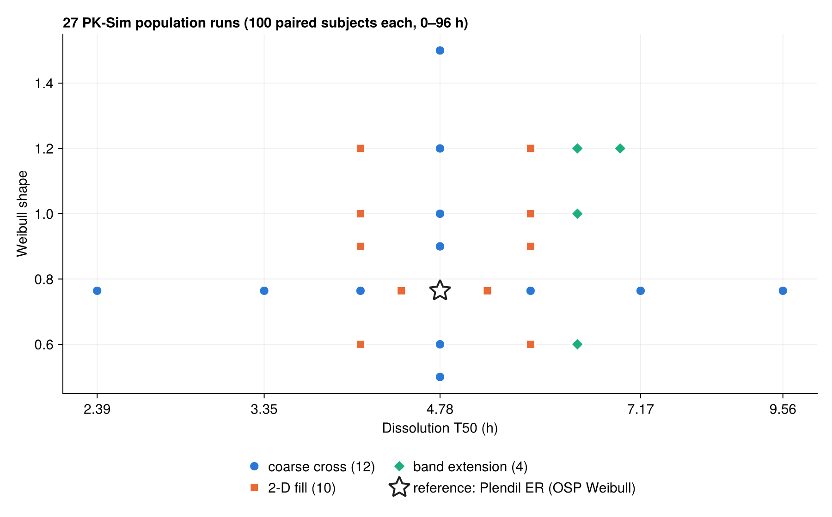
27 formulations were simulated in three rounds
20
Coarse cross (12 + ref): T50 axis and shape axis
2-D fill (10): T50 4.07 and 5.74 h × shapes 0.6–1.2, plus 4.42 and 5.26 h at 0.764
Band extension (4): 6.31 h × 0.6/1.0/1.2 and 6.88 h × 1.2
Upload checks caught: a missing PK-Analyses file (re-exported) and "5.7 h" files that were really 344 min (renamed 5.74 h)

Slide 27
Matrix sweep results, runs 1–14: relative BA and power
21
T50 h (min) | Shape | BA Cmax GMR | BA AUC0–t GMR | ABE Cmax | ABE AUC | ABE joint | RSABE | ABEL
2.39 (143) | 0.764 | 1.488 | 1.040 | 0.00 | 0.99 | 0.00 | 0.00 | 0.00
3.35 (201) | 0.764 | 1.229 | 1.026 | 0.10 | 1.00 | 0.08 | 0.29 | 0.20
4.07 (244) | 0.6 | 1.189 | 0.970 | 0.19 | 0.99 | 0.18 | 0.45 | 0.33
4.07 (244) | 0.764 | 1.099 | 1.013 | 0.62 | 1.00 | 0.59 | 0.81 | 0.73
4.07 (244) | 0.9 | 1.116 | 1.032 | 0.52 | 0.99 | 0.49 | 0.75 | 0.66
4.07 (244) | 1.0 | 1.149 | 1.040 | 0.35 | 0.99 | 0.32 | 0.62 | 0.52
4.07 (244) | 1.2 | 1.243 | 1.050 | 0.07 | 0.98 | 0.06 | 0.25 | 0.14
4.42 (265) | 0.764 | 1.047 | 1.007 | 0.84 | 1.00 | 0.83 | 0.94 | 0.91
4.78 (287) | 0.5 | 1.229 | 0.904 | 0.10 | 0.80 | 0.06 | 0.29 | 0.19
4.78 (287) | 0.6 | 1.094 | 0.951 | 0.64 | 0.97 | 0.61 | 0.82 | 0.74
4.78 (287) ref | 0.764 | 1.000 | 1.000 | 0.90 | 1.00 | 0.90 | 0.97 | 0.95
4.78 (287) | 0.9 | 1.010 | 1.022 | 0.89 | 1.00 | 0.89 | 0.97 | 0.94
4.78 (287) | 1.0 | 1.037 | 1.032 | 0.86 | 0.99 | 0.85 | 0.95 | 0.92
4.78 (287) | 1.2 | 1.119 | 1.045 | 0.50 | 0.98 | 0.46 | 0.74 | 0.65
BA = paired test/reference geometric-mean ratio in 100 subjects. Power = share of 1000 simulated trials passing: ABE 2×2 n = 54 (CV Cmax 35.7%, AUC0–t 25.3%); RSABE / ABEL on Cmax, n = 24, CVwR 34%. Shaded: joint power ≥ 0.80.

Slide 28
Matrix sweep results, runs 15–27: relative BA and power
22
T50 h (min) | Shape | BA Cmax GMR | BA AUC0–t GMR | ABE Cmax | ABE AUC | ABE joint | RSABE | ABEL
4.78 (287) | 1.5 | 1.269 | 1.055 | 0.03 | 0.97 | 0.03 | 0.17 | 0.10
5.26 (316) | 0.764 | 0.946 | 0.991 | 0.79 | 1.00 | 0.79 | 0.91 | 0.87
5.74 (344) | 0.6 | 0.996 | 0.927 | 0.90 | 0.91 | 0.82 | 0.97 | 0.94
5.74 (344) | 0.764 | 0.898 | 0.981 | 0.52 | 1.00 | 0.54 | 0.76 | 0.67
5.74 (344) | 0.9 | 0.901 | 1.008 | 0.53 | 1.00 | 0.55 | 0.76 | 0.68
5.74 (344) | 1.0 | 0.922 | 1.020 | 0.67 | 1.00 | 0.67 | 0.85 | 0.79
5.74 (344) | 1.2 | 0.990 | 1.036 | 0.90 | 0.99 | 0.88 | 0.97 | 0.94
6.31 (379) | 0.6 | 0.947 | 0.913 | 0.79 | 0.85 | 0.69 | 0.92 | 0.88
6.31 (379) | 1.0 | 0.865 | 1.012 | 0.30 | 1.00 | 0.31 | 0.58 | 0.44
6.31 (379) | 1.2 | 0.927 | 1.030 | 0.70 | 0.99 | 0.70 | 0.88 | 0.81
6.88 (413) | 1.2 | 0.873 | 1.023 | 0.35 | 1.00 | 0.36 | 0.62 | 0.49
7.17 (430) | 0.764 | 0.786 | 0.952 | 0.03 | 0.97 | 0.03 | 0.14 | 0.09
9.56 (574) | 0.764 | 0.659 | 0.904 | 0.00 | 0.81 | 0.00 | 0.00 | 0.00
AUC0–t power is ≥ 0.85 everywhere except 4.78 h / shape 0.5 and 9.56 h (0.80–0.81): Cmax is the binding metric. Scripts felo_02_be_sweep.jl → output_sweep_2d/.

Slide 29
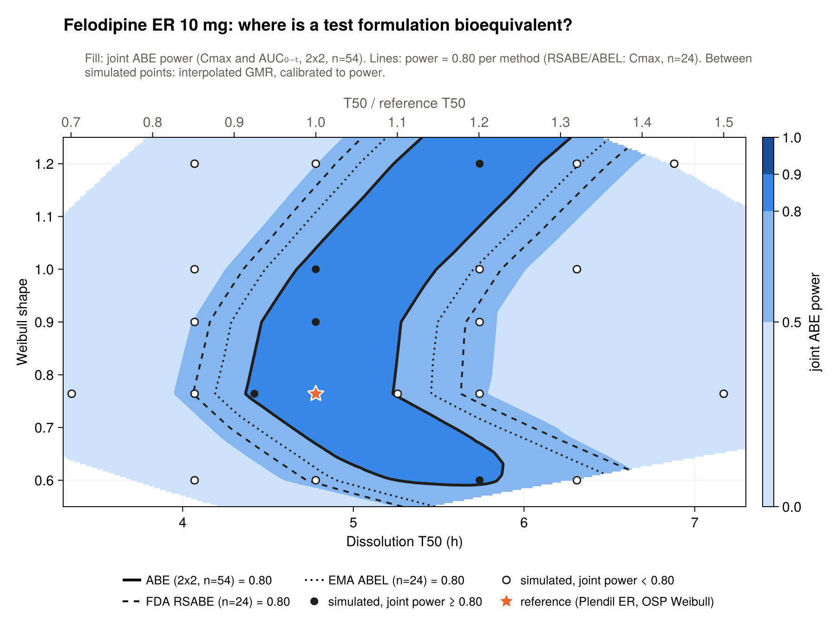
The safe space is a diagonal band, not a box
23
Shape | ABE n=54 | RSABE n=24 | ABEL n=24
0.6 | 5.25–5.84 | 4.73–≥6.31 | 4.90–≥6.31
0.764 | 4.37–5.23 | 4.07–5.63 | 4.19–5.46
0.9 | 4.47–5.28 | 4.16–5.66 | 4.29–5.49
1.0 | 4.67–5.49 | 4.36–5.87 | 4.49–5.70
1.2 | 5.24–6.10 | 4.90–6.50 | 5.04–6.33
T50 range (h) with joint power ≥ 0.80
At fixed T50, Cmax is lowest near shape 0.8, so a slower T50 is offset by moving shape either way
Method: log GMR interpolated on a Delaunay mesh, isotonic calibration to power (within 0.036 of all 27 runs)

Slide 30
6 · Fed and dissolution gates
Gate #3 food effect and gate #4 in-vitro link

Slide 31
Fed literature sets the target: Cmax up 1.6–2.8×, AUC unchanged
24
Source | Fed / fasted Cmax | Note
Sandoz CA monograph (Plendil arm) | ×2.77 | AUC∞ ×1.09; tmax 4.5 h both
US Plendil label | ≈ +60% | AUC unchanged
Weitschies 2005 (n=6) | ×1.63 | Bursts from proximal stomach
Apotex CA monograph | ×3.54 | Different subjects; not used
1.6–2.8
Target Cmax fed/fasted
1.0–1.1
Target AUC fed/fasted
Profiles: Kim 2014 PLoS One figs (digitisable, < 8 h); Abrahamsson 1993 Pharm Res (paywalled). Registered fed BE trials (NCT02311530, NCT01630902) posted no results. Full write-up: reference/fed-arm-literature.md.
0.81 / 0.89
Fasted model vs Sandoz Plendil: Cmax / AUC∞

Slide 32
The model cannot produce the food effect, so fed became a sensitivity
25
0.96
1.01
Why it fails: the Weibull release is a fixed function of time, so the meal only slows gastric emptying — Cmax falls slightly
What really happens: the tablet sits in the proximal stomach, released drug empties in bursts and more escapes gut-wall extraction (Weitschies 2005, Bergstrand 2009)
PK-Sim's meal event has neither mechanism
Decision (option A): claim the fasted safe space only; fed = within-subject-variability sensitivity (scope §10)
Cmax fed/fasted (target 1.6–2.8)
AUC∞ fed/fasted (target ≈ 1.0–1.1)
2.75 → 5.0 h
Unchanged
Median tmax (observed unchanged at 4.5 h)
Safe space with fed CV 36.5%, n = 56
Pop_fed_ref = clone of Pop_ref + high-fat breakfast event at t = 0; Configure kept the P mucosa values this time. The meal template used was not recorded.

Slide 33
Dissolution link: the in-vivo Weibull fails USP Test 1 at 10 h
26
USP Felodipine ER Test 1 | 2 h | 6 h | 10 h
Limits (App. 2, 50 rpm, pH 6.5 + 1% SLS) | 10–30% | 42–68% | ≥ 75%
Reference in-vivo Weibull, read as in vitro | 26.9% | 54.7% | 69.6% — fails
Proposal that followed
Fit Weibulls to the paper's in-vivo dissolution for tablets A, B and C
Run each as a clone of Pop_ref in PK-Sim
Compare Cmax levels and Cmax ratios with the observed mean curves
Use it as an external check of the model's Cmax sensitivity to release rate
Real Plendil passes USP, so in vitro and in vivo differ in shape, not just timescale; a 1:1 map is wrong
Abrahamsson 1994 (Pharm Res): tablets A/B/C on the same HPMC platform, n = 16, IVIVC r² 0.94–0.97
Its SLS 50 rpm row = USP Test 1: reference MDT 9.4 h sits inside the USP-implied 4.5–12.9 h — consistent, but a weak constraint
Vetchy 2007 (no basket) cannot be chained to the correlation

Slide 34
Tablets A/B/C: three real formulations reproduced within 1.25-fold
27
Ratio | Model | Observed | Difference
Cmax B/C | 2.31 | 2.17 | +6%
Cmax A/B | 2.36 | 1.90 | +24%
AUC C/B | 0.80 | 0.93 | slow tablet under-absorbed
Slow side right (+6%); fast side overstated ~25%, so the band's short-T50 edge is conservative
Gate #4 closed as "consistent, approximate, with a documented fast-side conservatism"
Caveats: Weibulls from deconvolution, digitised by eye; observed are young Swedish men, n = 16
Model / observed: A 1.20, B 0.96, C 0.91.

Slide 35
7 · PBPK vs PopPK
Same pipeline as metformin: fit PopPK to simulated studies and compare BE decisions

Slide 36
PopPK set-up: per-arm fits on rich simulated studies
28
01 dataset
PBPK subjects → 18 samples (0.5–96 h), 15% proportional error; 27 arms × 100
2-cmt + Weibull was unidentifiable (Q or Vp hit bounds), so 1-cmt + Weibull, lag 0.3113 h, IIV on alpha, CL, Vc
Two likelihood basins: release-limited (flip-flop) and disposition-limited (Vc ≈ 4000 L, t½ ≈ 9 h)
23 arms disposition-limited, 4 release-limited; σ 0.16–0.24 vs true 0.15
PopPK release parameters do not map onto PK-Sim T50, unlike metformin
Run: julia -J pumas.so --project=julia-env
1
02 fit
Per-arm FOCE, both basin starts, keep higher LL; NCA on 0.05 h IPRED grid
2
03 collect
Copy to poppk/output_rich/ in PK-Sim format so felo_02/03 run unchanged
3
04–06
Compare + type I (20k trials), diagnostics, design figure
4

Slide 37
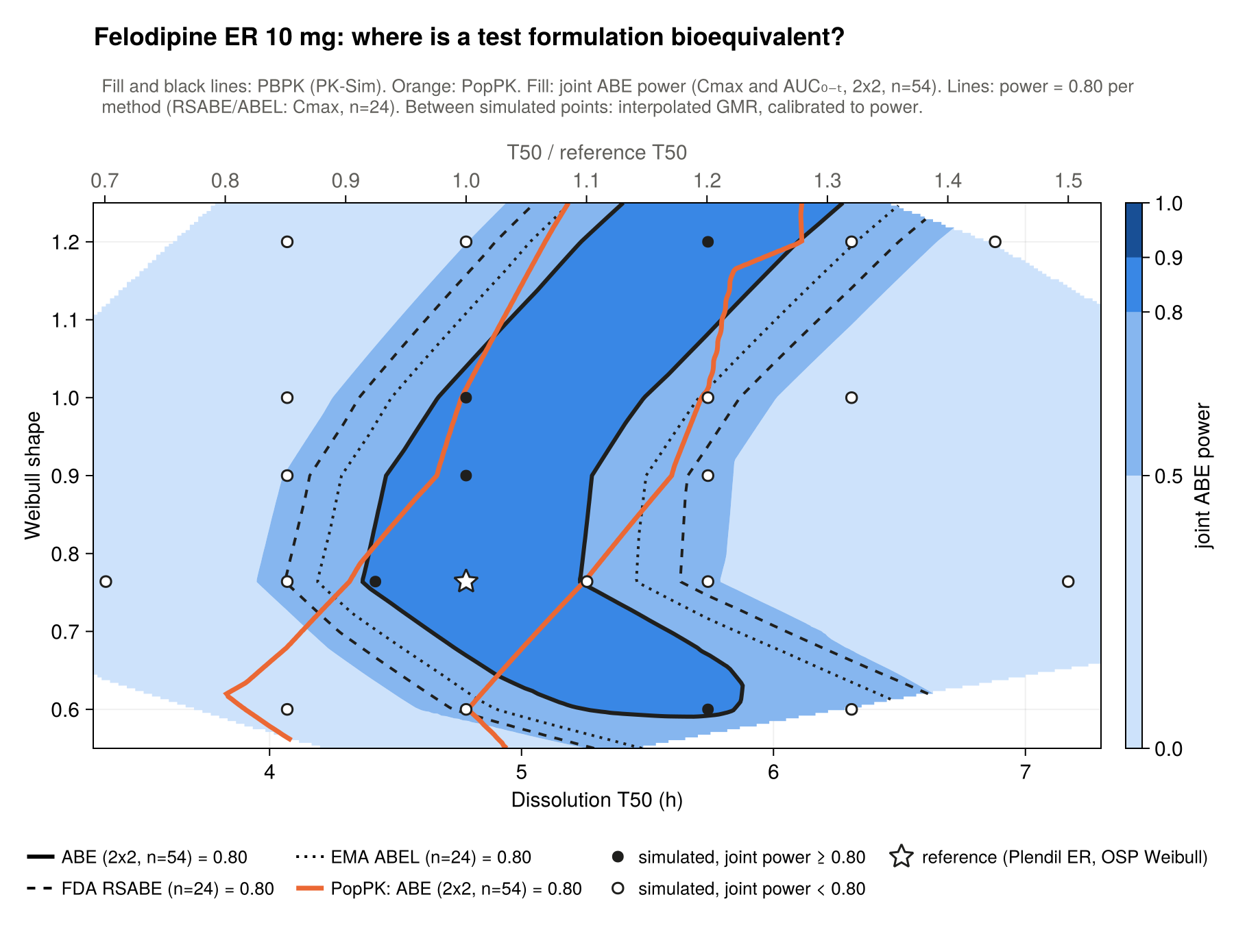
PopPK agrees near the reference but the band diverges off-shape
29
Shape | PopPK (h) | PBPK (h)
0.6 | 3.91–4.79 | 5.25–5.84 (no overlap)
0.764 | 4.32–5.25 | 4.37–5.23
0.9 | 4.67–5.60 | 4.47–5.28
1.0 | 4.77–5.71 | 4.67–5.49
1.2 | 5.10–6.11 | 5.24–6.10
Per subject: AUC0–t within ±3% in every arm; Cmax 0.87 (shape 0.5) to 1.135; ref 1.089
Bias does not cancel in T/R: shape 0.5 Cmax GMR 1.229 PBPK vs 0.984 PopPK
1-D T50 axis agrees within 0.08 h (4.38–5.21 vs 4.31–5.21)

Slide 38
Type I error: both are calibrated, but PopPK moves the GMR boundaries
30
T50 axis | PBPK | PopPK | Shift | True GMR there / truth passes
Fast side (GMR 1.25) | 3.25 h | 2.78 h | −15% | 1.37 / 0.2% (n=54), 0.5% (n=24)
Slow side (GMR 0.80) | 6.96 h | 6.45 h | −7% | 0.84 / 15.8% (n=54), 8.2% (n=24)
−1.1% / −6.8%
Metformin PopPK vs PBPK boundaries
−7% / −15%
Calibrated at their own boundary: 4.5–5.1% for Cmax and joint at n = 54; TOST control 4.96%
Fast side anti-conservative, slow side conservative
Shape axis: PBPK reaches GMR 1.25 at 1.46; PopPK never does
RSABE / ABEL at the ABE boundary (n=24): 20–22% / 13–14% for both
Felodipine PopPK vs PBPK boundaries
PopPK–PBPK decision agreement needs structural adequacy; for felodipine it fails off-reference even with rich sampling.
Discussion deck (18 slides): docs/Discussion-deck_PBPK-vs-PopPK_offline.html · scripts felo_04 (compare, type I), felo_05 (diagnostics), felo_06 (design).

Slide 39
8 · Wrap-up
Lessons, where everything lives, and what is still open

Slide 40
PK-Sim gotchas we learned the hard way
31
Model handling
Working remotely
Configure drops OSP sim-level overrides; Clone keeps them — re-enter from the overrides CSV
Overrides show under Parameters → User Defined (+ Find box); neighbourhoods in the detailed tree
Do not "update from building block" on colon clones — it resets colonic CYP3A4 to 0
PI cannot fit particle radius; never fit the physiology "radius" entries
Always File → Save at the end of each stage (a full day of work was lost once)
Verify every export: checksums, 96 h end, observed data, parameter vs curve
Ask for a screenshot instead of guessing a UI label
Ask for a project snapshot JSON — and check it is the current project

Slide 41
Where everything is saved
32
Item | Location (Felodipine-BCSII/ unless stated)
PK-Sim project (local installation) | Felodipine_ER_colon50.pksim5 (baseline Felodipine_original.pksim5 untouched)
Project notes, all decisions | project notes (not included) · scope: planning notes (not included)
PK-Sim exports | pksim-particle-size-pk/ · pksim-releaserate-cqa-er/ (matrix_Sweep_td50_shape/, 16Oct2026sims/, fed-sims/, tablets-1994/)
Sweep results | output_sweep_coarse/ · output_sweep_2d/ · output_sweep_2d_fedcv/ · output_tablets1994/
PopPK | poppk/ (src, scripts, output_rich/, output_sweep_2d_poppk/) · fits in poppk-fits/
Analysis scripts | scripts/felo_02 … felo_06 (run from programs, julia --project=.) · scripts/score.py, xl.py
References | reference/: OSP snapshot JSON, overrides CSV, fed + dissolution literature, digitised/
Decks | Explainer v14: docs/Explainer-deck_PKSim-model-fix_offline.html · Discussion: docs/Discussion-deck_PBPK-vs-PopPK_offline.html
Summary doc | docs/Felodipine-ER-PKSim-Work-Summary.docx · Word copy: Felodipine-ER-PKSim-Work-Summary.docx
This deck | slides/full-summary/Felodipine-ER-Full-Work-Summary.pptx and .html · generator scripts/build_full_deck.js

Slide 42
PK-Sim work is finished; these decisions are open
33
Proposed next steps
Open questions and loose ends
NCA on the sampled data (model-free comparator)
Joint PopPK model across arms (T50 and shape covariates)
Richer absorption model (transit or two-phase)
Sparse sampling (6 samples)
Felodipine write-up
Report the PopPK divergence as is, or improve PopPK first?
Literature: colon vs SI CYP3A4 ratio (supports 50%); Blychert 1990 market vs trial
Record the meal template used in Pop_fed_ref
Class B (particle size) CQA needs a different BCS II drug — not screened
Refresh the MBBE archive with the felodipine work when asked

