Slide 1

The "Big Hitters" – What Actually Predicts a Default?
Past Defaults Predict Risk
Previous defaults, such as bankruptcy, are strong indicators of a higher risk for future loan default.
Debt-to-Income Ratio
The debt-to-income ratio is the dominant factor influencing loan repayment risk and default likelihood.
Homeownership Indicates Stability
Homeowners tend to default less often on loans, showing greater financial stability compared to renters.
Proactive Loan Intent
Loans for ventures or education are safer than loans used as reactive financial fixes, showing lower default risk.
Notes:
Image source: Microsoft 365 content library Past defaults, such as bankruptcy, strongly indicate a higher risk of future loan default[cite: 415]. Debt-to-income ratio is the dominant risk factor for repayment[cite: 697]. Homeownership is a sign of financial stability, with homeowners defaulting less often than renters[cite: 9, 698]. Proactive loan intents—like ventures or education—are safer than reactive fixes[cite: 11, 699], while gender and education show little impact on repayment[cite: 7, 694].

Slide 2

The Model Engine
Generalised Linear Model Usage
A Generalised Linear Model with a binomial family was developed for predictive classification, enhancing decision-making accuracy.
High Model Accuracy
The model achieved an impressive accuracy rate of 87.9% on unseen datasets, demonstrating robust performance.
Balanced F1 Score
The F1 Score of approximately 71% highlights a strong balance between precision and recall in predictions.
Effective Non-Defaulter Identification
The engine reliably identified 93% of non-defaulters, ensuring trustworthy prediction results for risk assessment.
Notes:
Image source: Microsoft 365 content library We developed a Generalised Linear Model (GLM) using the binomial family for predictive classification. The model achieved a high accuracy rate of 87.9% when tested on unseen data. Additionally, the F1 Score was approximately 71%, reflecting strong balance between precision and recall. Reliable predictions were made, correctly identifying 93% of non-defaulters.

Slide 3
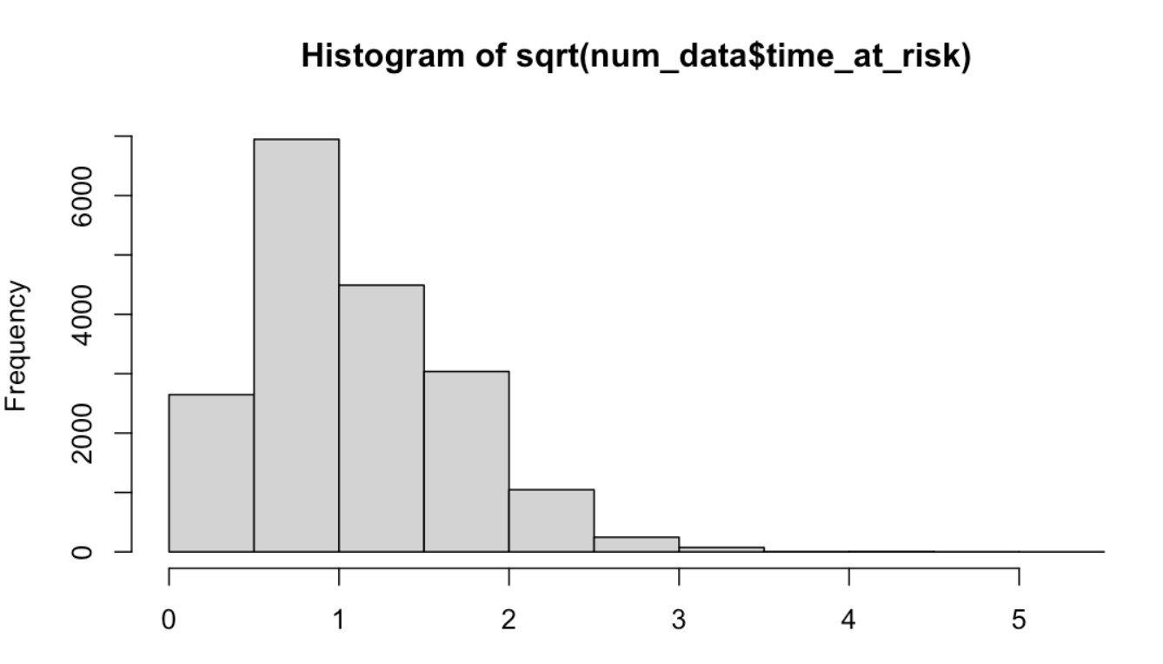
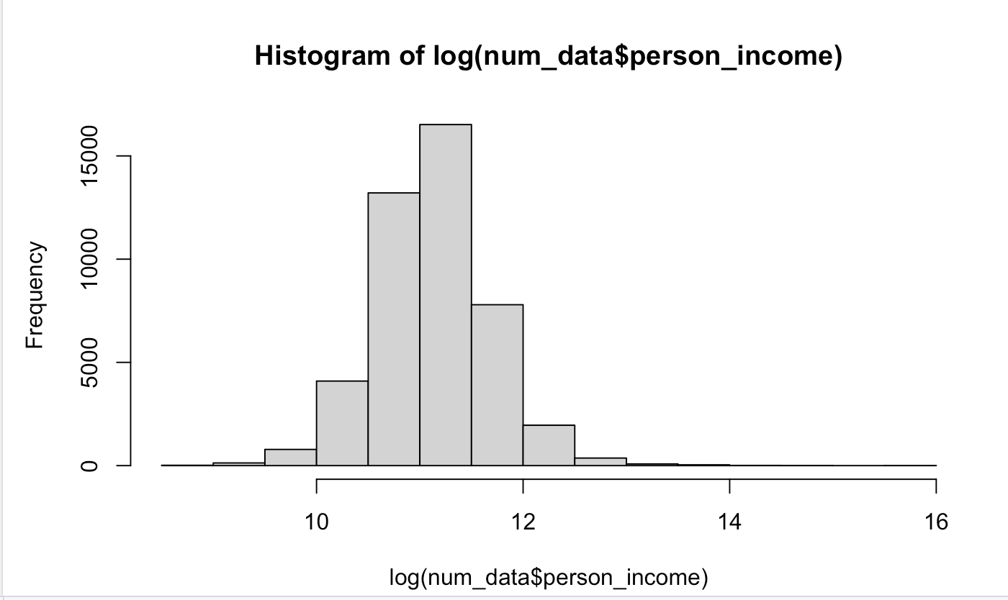
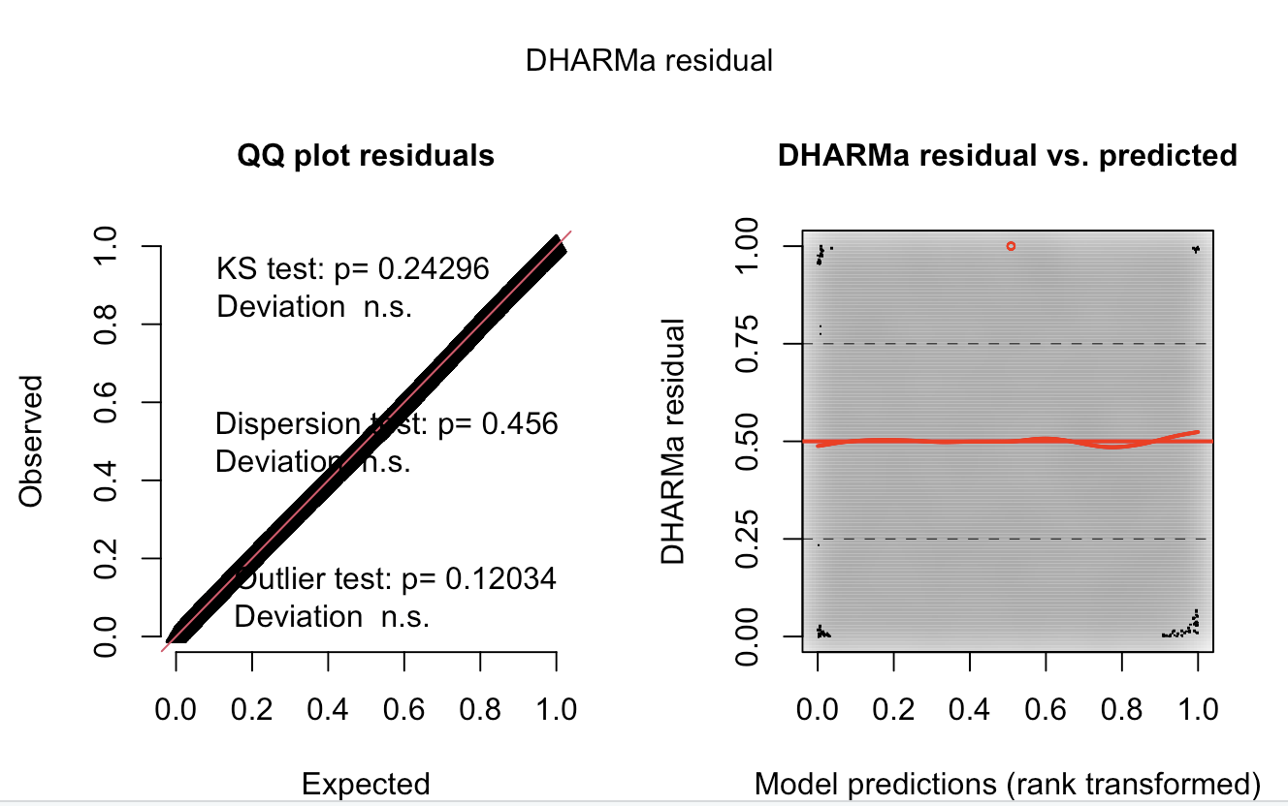
Checking Technical Assumptions
Data Normalisation Methods
Log and square root transformations were applied to handle skewness in income and risk factors, improving model reliability.
Principal Component Analysis
PCA combined age, credit history and employment history into principal components, capturing 92% of the data's variability efficiently.
Model Validation
DHARMa residual plots confirmed the model’s unbiased performance and sound mathematical foundation, supporting its integrity.
Category Independence Checks
Statistical tests verified that categories like home ownership and loan intent showed no excessive correlation.
Notes:
Image source: Microsoft 365 content library We normalised data using log and square root transformations to address skewness in income and risk factors. PCA merged age and credit history, capturing 92% of data variability. DHARMa residual plots validated the model's unbiased nature and mathematical soundness. Independence checks confirmed categories like home ownership and loan intent were not over-correlated.

Slide 4

Real-World Context – Project Limitations
Limited Data Insights
Static data from Kaggle offers fewer insights than real-time banking feeds, restricting understanding of changing borrower behaviour.
Incomplete Borrower Profiles
Mathematical models cannot accurately capture psychological factors or a borrower's true intentions behind financial decisions.
Bias from Historical Data
Relying on historical defaults might penalise borrowers who have since improved their financial stability, causing fairness concerns.
Notes:
Image source: Microsoft 365 content library Static data from Kaggle restricts insights compared to real-time banking feeds. Mathematical models cannot capture a borrower's true intent or psychological character. Data was cleaned by removing extreme anomalies, such as unusually old borrowers or extremely high incomes. Heavy reliance on historical defaults may unfairly penalise borrowers who have now improved their financial stability.

Slide 5

Presentation Overview
Key Financial Risk Markers
Bankruptcy history and debt-to-income ratios are vital indicators for forecasting financial failure and risk evaluation.
GLM Model Predictive Power
The GLM model improved data analysis, achieving 87.9% accuracy and a 71% F1 score in financial prediction.
Data Processing and Bias Minimisation
Techniques like PCA and data transformation reduced bias, but filtered data limitations should be acknowledged for effective results.
Notes:
Image source: Microsoft 365 content library Risk markers such as bankruptcy history and debt-to-income ratios proved crucial in predicting financial failure. The GLM model enhanced raw data into an accurate predictive tool, achieving 87.9% accuracy and a 71% F1 score. Rigorous methods like PCA and data transformations minimised bias, though filtered data limitations must be considered.

