Slide 1
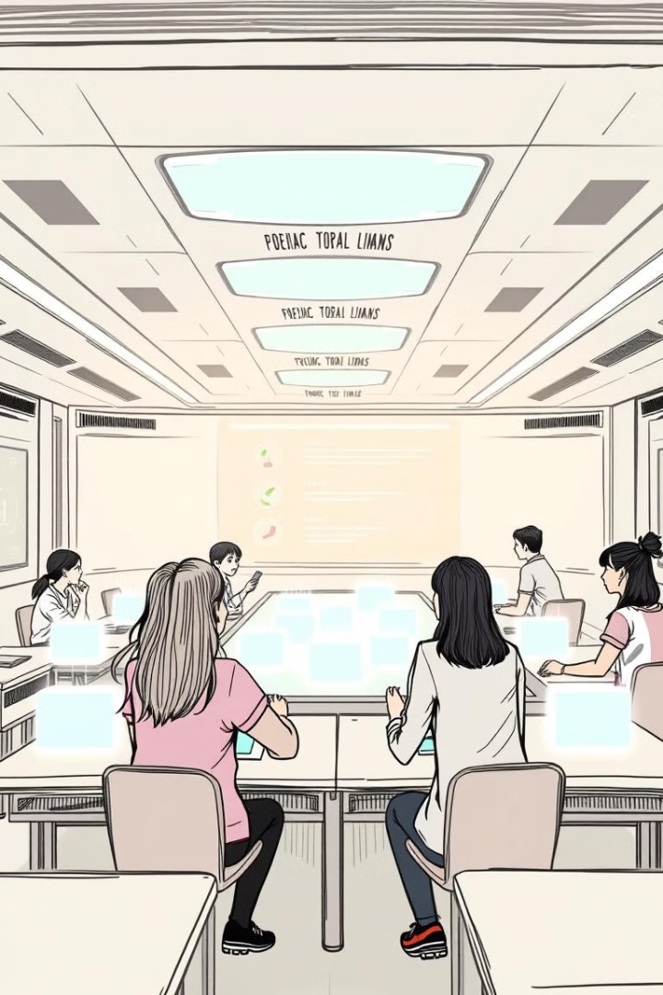
The Evolution and Future of E-Learning
Explore the exciting world of e-learning. Discover its transformative potential. Uncover how it shapes education's future. From its humble beginnings to innovative approaches. E-learning redefines education. Join us on this journey!

Slide 2
What is E-Learning? Defining Digital Education
Definition
Key Components
Scope
E-learning is education via digital resources.
It uses online platforms, multimedia, and interactive tools.
It includes online courses, virtual classrooms, and digital content.

Slide 3

Benefits of E-Learning: Accessibility and Flexibility
1
Accessibility
Learn from anywhere with an internet connection.
2
Flexibility
Study at your own pace and schedule.
3
Cost-Effective
Reduced costs compared to traditional education.
4
Wide Range
Access a vast array of courses and subjects.

Slide 4




Personalized Learning Paths: Tailoring Education to Individual Needs
Adaptive learning tailors content to skill level.
Individualized goals help learners focus.
Custom resources provide tailored support.

Slide 5

Accessibility & Inclusivity: E-Learning for Everyone
Assistive Tech
Global Reach
Tools for learners with disabilities.
Education opportunities for underserved communities.
Multilingual Support
Courses available in multiple languages.

Slide 6




Collaborative E-Learning: Fostering Interaction and Community
Forums
Discuss topics and share ideas.
Group Projects
Collaborate on assignments.
Peer Review
Provide feedback and learn from others.

Slide 7

Tech Innovations: AI, VR, and the Future of Learning Platforms
AI Tutors
1
Intelligent support for personalized learning.
2
VR Experiences
Immersive simulations for hands-on training.
Adaptive Platforms
3
Evolving content based on learner progress.

Slide 8



Blending E-Learning with Traditional Methods: A Hybrid Approach
2
In-Person Workshops
1
Online Modules
Virtual Mentoring
3
Hybrid learning combines the best of both worlds.
It offers flexibility with structured classroom learning.

Slide 9



Overcoming Challenges: Addressing Digital Divide & Engagement
Engagement
1
Keep learners motivated.
Training
2
Support effective use.
Access
3
Bridge digital divide.

Slide 10

Conclusion: The Transformative Potential of E-Learning
E-learning transforms education. It offers accessibility and personalized learning. It leverages innovative technologies. Embrace the future of e-learning. It empowers learners worldwide.

