Slide 1
SOLUTION OVERVIEW · ET HACKATHON 2026 · PROBLEM 8
IndusMind
The Unified Asset & Operations Intelligence Platform
Turning fragmented industrial knowledge into cited, governed, decision-ready answers.

Slide 2
EXECUTIVE SUMMARY
IndusMind converts an eroding knowledge base into a governed operating asset — with measurable results
1
The problem is structural
Technical staff lose ~35% of their time searching across 7–12 disconnected repositories, while an ageing expert workforce takes decades of know-how with it at retirement.
2
The solution is unified
One platform ingests and understands every document, links it with live operational data in a knowledge graph, and answers plain-language questions — every claim cited to its source and confidence-scored.
3
The results are verifiable
Time-to-answer falls from hours to under a minute; audit evidence assembles in minutes; a submitted shift log becomes citable knowledge immediately. Every claim can be reproduced in the demonstration environment.
IndusMind — Unified Asset & Operations Intelligence Platform

Slide 3
BUSINESS CONTEXT
A third of technical capacity is consumed by searching — and the knowledge itself is leaving
35%
7–12
30 yrs
of professional time spent locating information
disconnected repositories in a typical plant
of tacit expertise lost with each retirement
The operational consequences
Repeat failures — Problems solved years ago recur because the fix is unfindable
Extended downtime — Repairs wait while the right document hides on page 214
Audit exposure — Findings raised for evidence that exists but cannot be produced in time
Wasted payroll — Senior engineering hours spent searching rather than solving
IndusMind — Unified Asset & Operations Intelligence Platform

Slide 4
SOLUTION OVERVIEW
One platform that understands the documents, connects the operation, and answers with evidence
UNDERSTAND
ANSWER
ACT
Ingestion of documents of any age — OCR for scans, table parsing, entity extraction with human review — linked into a plant-wide knowledge graph
A conversational assistant grounded in retrieved evidence: every claim cited to its source page, confidence disclosed, answers in seconds
The same knowledge drives operations: risk indication, root-cause support, compliance gaps, audit evidence, and captured shift experience
• Document ingestion
• Knowledge assistant
• Condition-based risk
• Knowledge graph
• Global search
• Compliance & evidence
• Asset 360° views
• Role dashboards
• Shift logbook & lessons
IndusMind — Unified Asset & Operations Intelligence Platform

Slide 5
HOW IT WORKS
Every answer is retrieved, verified, and cited — never asserted
1
2
3
4
5
6
Ask
Authorise
Retrieve
Expand
Generate & verify
Deliver
plain-language question
identity, tenant, role checks
semantic + keyword, rank-fused
graph pulls linked records
evidence-only; citations checked
streamed, scored, sourced
EXAMPLE — AN ANSWER EXACTLY AS THE PLATFORM PRESENTS IT ON SCREEN
“Why does pump P-101 keep failing?”
Recurring failures trace to mechanical seal degradation in high-humidity months [1]. Three of four events fall within monsoon periods [2], consistent with the seal-storage caution in the pump’s vendor manual, section 6.4 [3]. Recommended action: inspect the seal chamber and verify nitrogen purge before June.
THE NUMBERED CITATIONS ARE THE PLATFORM’S OWN — EACH OPENS THE EXACT SOURCE PAGE INSIDE THE APPLICATION:
[1] Failure records of pump P-101
[2] Work-order history, 2023–25
[3] Vendor manual for P-101, page 214
Confidence: High
Answered in 38 seconds
Previous method: several hours of manual search
IndusMind — Unified Asset & Operations Intelligence Platform

Slide 6
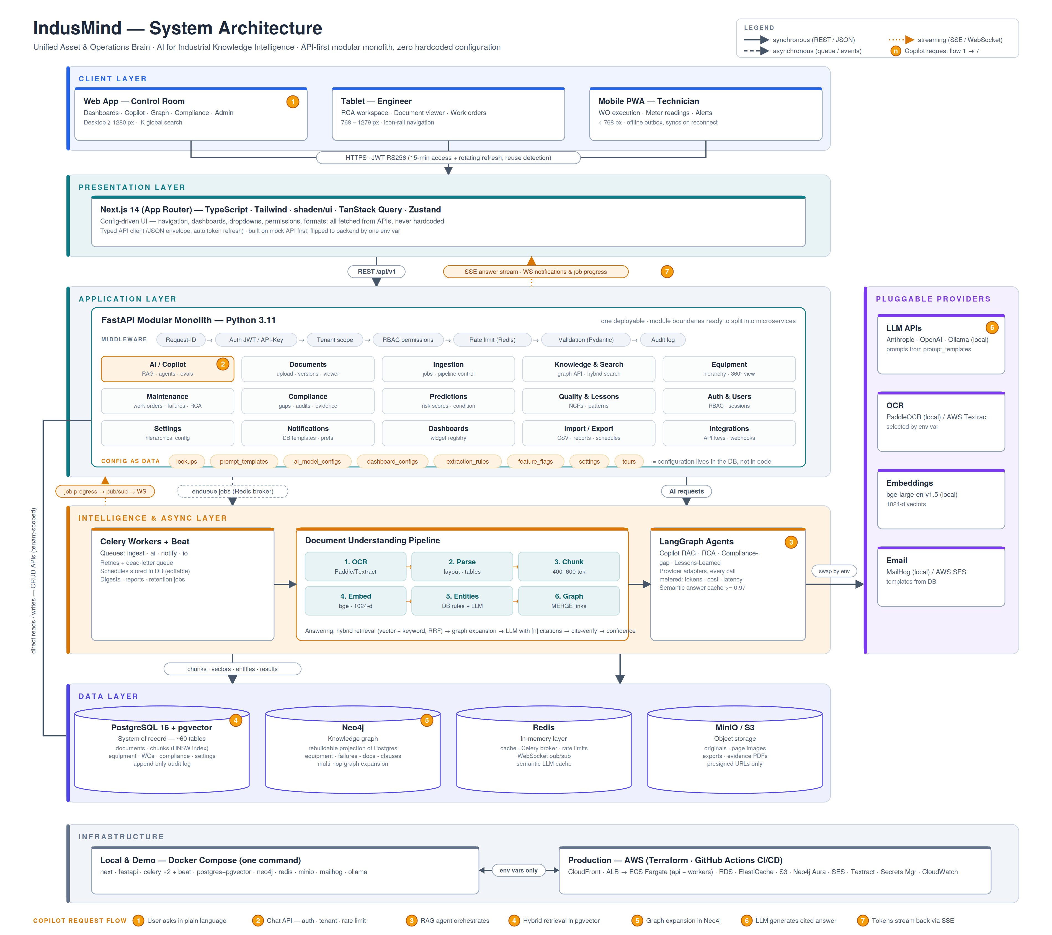
SOLUTION ARCHITECTURE
A layered, modular architecture — enterprise controls built in, no vendor lock-in
Modular application tier
One deployable, strictly bounded domain modules; uniform control chain (identity → tenant → role → limits → audit) on every request
Polyglot data tier
PostgreSQL as the single system of record with integrated vector search; the graph is a rebuildable projection — never a second source of truth
Asynchronous intelligence
All heavy work — OCR, embedding, extraction, generation — runs in queued workers with live progress to the user
Pluggable providers
Hosted or fully local AI models, OCR, and email behind adapters — selected by configuration, changed without code
Environment parity
One command runs everything on a laptop; the identical build deploys to cloud infrastructure defined as code
IndusMind — Unified Asset & Operations Intelligence Platform

Slide 7
SECURITY & GOVERNANCE
Isolation, authorisation, and accountability are foundational services — not features
Tenant isolation
Access control
Every record tenant-scoped by construction; isolation verified by dedicated automated tests
Eight business roles over fine-grained permission codes, enforced at every endpoint; full authorisation test matrix
Authentication
Accountability
Short-lived signed tokens, rotating refresh with reuse detection; per-user session visibility and revocation
Append-only audit trail — actor, action, subject, origin, before/after — available to authorised reviewers
Data protection
Data lifecycle
Encryption in transit and at rest; files via expiring signed URLs only; secrets in a managed vault
Administered retention policies per data class with archival and audited execution
IndusMind — Unified Asset & Operations Intelligence Platform

Slide 8
AI GOVERNANCE
The AI is designed to be supervised — grounded, measured, metered, and replaceable
01
Grounded by construction
02
Confidence disclosed
Generation sees only retrieved evidence and abstains when it is insufficient; an automated verifier checks every citation before display
Every answer carries an explicit confidence indication; weak answers say so and recommend human confirmation
03
Human accountability
04
Quality measured continuously
Uncertain extractions require confirmation; analytical suggestions are advisory — engineers decide
A curated benchmark scores answer quality on every change; user feedback flows into the same loop
05
Consumption fully metered
06
Provider-independent
Every model call records tokens, cost, latency, and cache use — spend visible by feature, model, and day
Prompts and model choices are versioned configuration; providers can be changed — or run fully on-premises — without code change
IndusMind — Unified Asset & Operations Intelligence Platform

Slide 9
BUSINESS VALUE
The value case is arithmetic: recovered time alone funds the platform many times over
Availability
Worked example — one plant
Early risk indication and instant procedures reduce repeats and repair time
Engineers
50
Loaded cost per engineer, per year
₹25 lakh
Compliance economics
Audit preparation compresses from weeks to hours; fewer findings
Time lost to information search
35%
Knowledge continuity
Share recovered (conservative)
50%
Logs, analyses, and lessons retained in citable form beyond individual tenure
≈ ₹2.2 crore / year
Threshold effect
One prevented day of unplanned downtime typically exceeds annual platform cost
productivity value alone, before any avoided downtime
IndusMind — Unified Asset & Operations Intelligence Platform

Slide 10
DELIVERY ROADMAP
Five phases from foundation to enterprise readiness — all demonstrated end-to-end today
1
2
3
4
5
Foundation
Intelligence
Operations
Assurance
Enterprise readiness
Identity, tenancy, RBAC, audit; asset registry; document intake
Ingestion pipeline; semantic search; knowledge graph; cited assistant
Work management; failures & root-cause; condition data & risk
Compliance mapping; gap analysis; audit evidence; lessons
Logbook; interchange & reporting; integrations; i18n; hardening
Planned next enhancements
• Trained predictive models, built on the condition data the platform accumulates in operation
• Federated single sign-on and multi-factor authentication (already designed into the product)
• Certified adapters for enterprise asset-management systems
• Expanded interface-language coverage
IndusMind — Unified Asset & Operations Intelligence Platform

Slide 11
CLOSING
Every claim in this presentation is verifiable in the demonstration environment — in minutes
Ask
“Why does pump P-101 keep failing?” — a cited, confidence-scored answer in under a minute
Hours → under a minute
Ingest
Upload a scanned manual — searchable and citable within minutes, progress visible throughout
Unreadable → citable
Assure
Open the compliance view — a gap identified against the standard, evidence package assembled on demand
Weeks → minutes
Capture
Submit a shift log — the assistant cites it moments later
Knowledge kept at source
Give your plant a memory. Everything shown here runs live, end-to-end, in the demonstration environment.
IndusMind — Unified Asset & Operations Intelligence Platform

Slide 12
IndusMind
Thank you.
Give your plant a memory.
IndusMind — every manual, every failure, and every fix, one question away.
NAME
CONTACT
QUESTIONS WELCOME
KOTA SRIRAMA MANISH
+91 93818 90654, manishcse2006@gmail.com
We are happy to walk through any part of the solution live

