Slide 1

MUSIC STORE DATA ANALYSIS IN SQL
You are hired as a data analyst at a music store, let’s call it "Spotify". You’re given access to a database with information about customers, singers, and more.
As you explore connections between the data, your manager shares exciting news: the company plans to launch a new product! They need insights from the data to guide their decision-making.
Your task is to analyse the database and provide answers to your manager’s problem statements

Slide 2

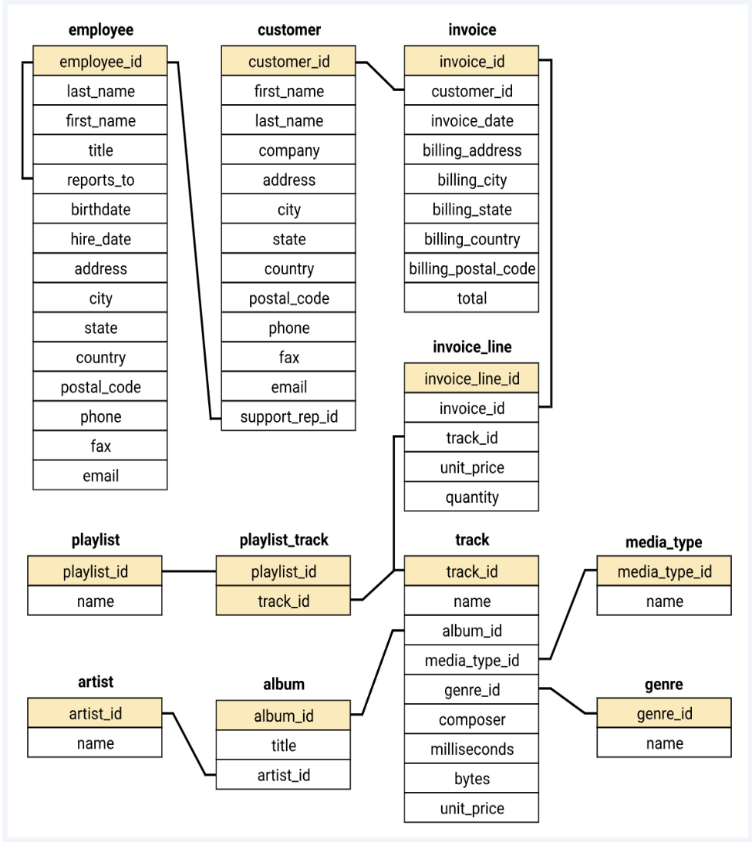
Database Schema:

Slide 3
Problem Statements
We want to assign an senior employee to lead that project. Who is the senior most employee based on job title?
Which county has most number of Invoices?
What is value of top 3 invoices ?
We would like to throw a promotional Music Festival in the city we made the most money. Which city has the best customers?
Who is the best customer? The customer who has spent the most money will be declared the best customer.
Details of customers who listens Rock music.
Let's invite the artists who have written the most rock music in our dataset.
We want to find out the most popular music Genre for each country.
We want to give gifts to top customer so Determine which customer has spent the most on music for each country.

Slide 4
Assignment
The company wanted to understand the spending habits of his customers on different artists. To uncover these insights, you have to ran a detailed analysis.
OR
Find how much amount spent by each customer on artists? Write a query to return customer name, artist name and total spent
After completing this Assignment share the SQL statement and Screen shot of the project at – doubts@theiscale.com

