Slide 1


NEXT GEN EMPLOYABILITY PROGRAM
CREATING A FUTURE-READY WORKFORCE
Student Name :
MANISH KUMAR NAVALE
Student ID :
STU5fd58a0a41ac21607830026
Mobile No:
7725023656
Mail ID:
NAVALE2580@GMAIL.COM
College Name :
University Institute of Technology, RGPV, Bhopal

Slide 2
CAPSTONE PROJECT SHOWCASE
Project Title
Power BI Enabled Comprehensive Analysis on Unicorn Businesses
Abstract | Problem Statement | Project Overview | Proposed Solution | Technology Used | Modelling & Results | Conclusion | Q&A

Slide 3
Abstract
1
1,074 unicorns across 15 industries have a total funding of $592.82 billion.
2
Fintech companies have received the most funding overall $108 billion.
JUUL Labs have largest individual funding round $14 billion.
3
Byte-dance has the highest valuation at $180B.
4
The number of unicorn companies has risen from 2020 to 2021.The highest is 520 unicorn companies in 2021.

Slide 4


Problem Statement
Which country has the highest number of unicorns?
Which company has the highest return on investment?
In which year did the highest number of companies become unicorns?
Which industry has most of the unicorns?
Who has funded the most unicorns among investors?
What is the average time it takes for companies to become unicorns?
How much total investment is invested in unicorns?

Slide 5

Project Overview
The data was collected from sources, and after the data collection, the data was cleaned and preprocessed.
Used the DAX function to find the year in which the company became a unicorn and its funding in $B.
Some basic visualizations were used, including slice charts
Summarized the data through visualization and formatted the visualizations, such as changing backgrounds and colors.

Slide 6
Proposed Solution
Used stacked bar chart to find which industry have most unicorn.
Used matrix for showing highest ROI.
Used stacked bar chart for investors who invested most of the unicorn.
Used stacked column chart for year companies become unicorn.

Slide 7
Technology used
Microsoft Power BI

Slide 8
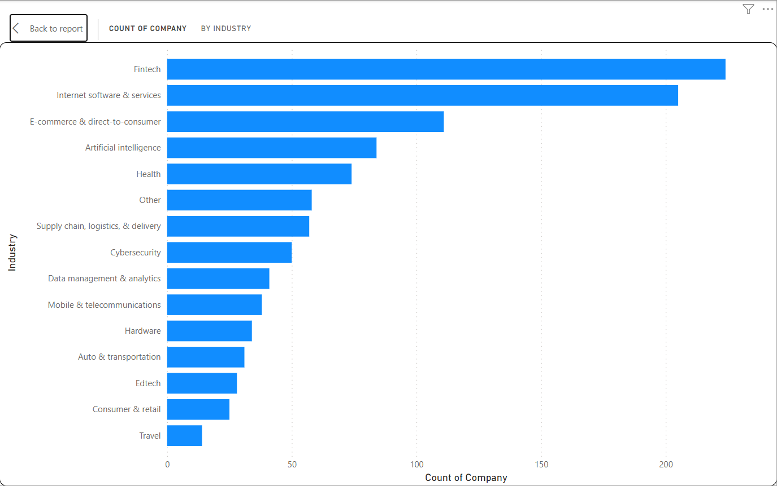
Modelling & Result

Slide 9
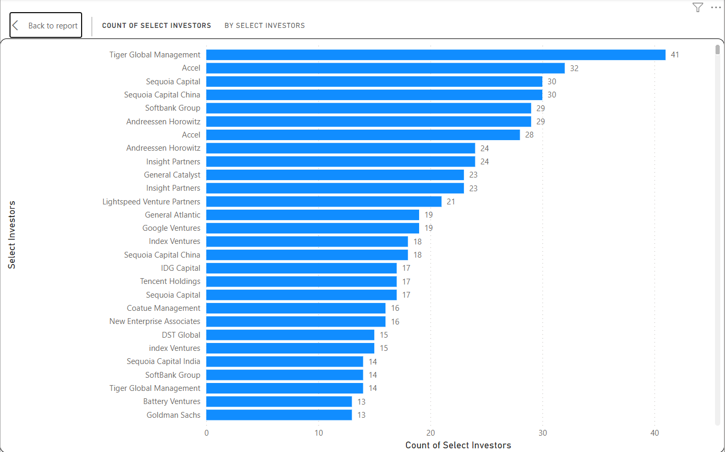
Modelling & Result

Slide 10
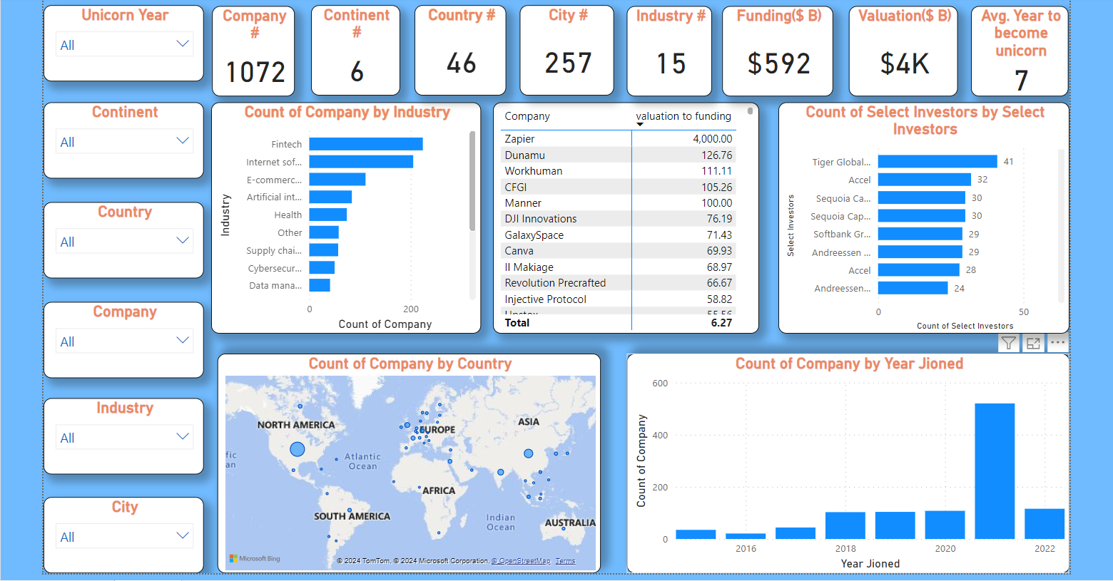
Modelling & Result

Slide 11

Conclusion
After finishing the project, I feel satisfied with the results. However, being my first project, I see areas for improvement, especially in enhancing the slicer. Although visually appealing, it could be more efficient, allowing for better comparisons over different time periods.

Slide 12


Notes:
Thank You !!

