Slide 1
How to perform data transformations in finance domain project ?

Slide 2
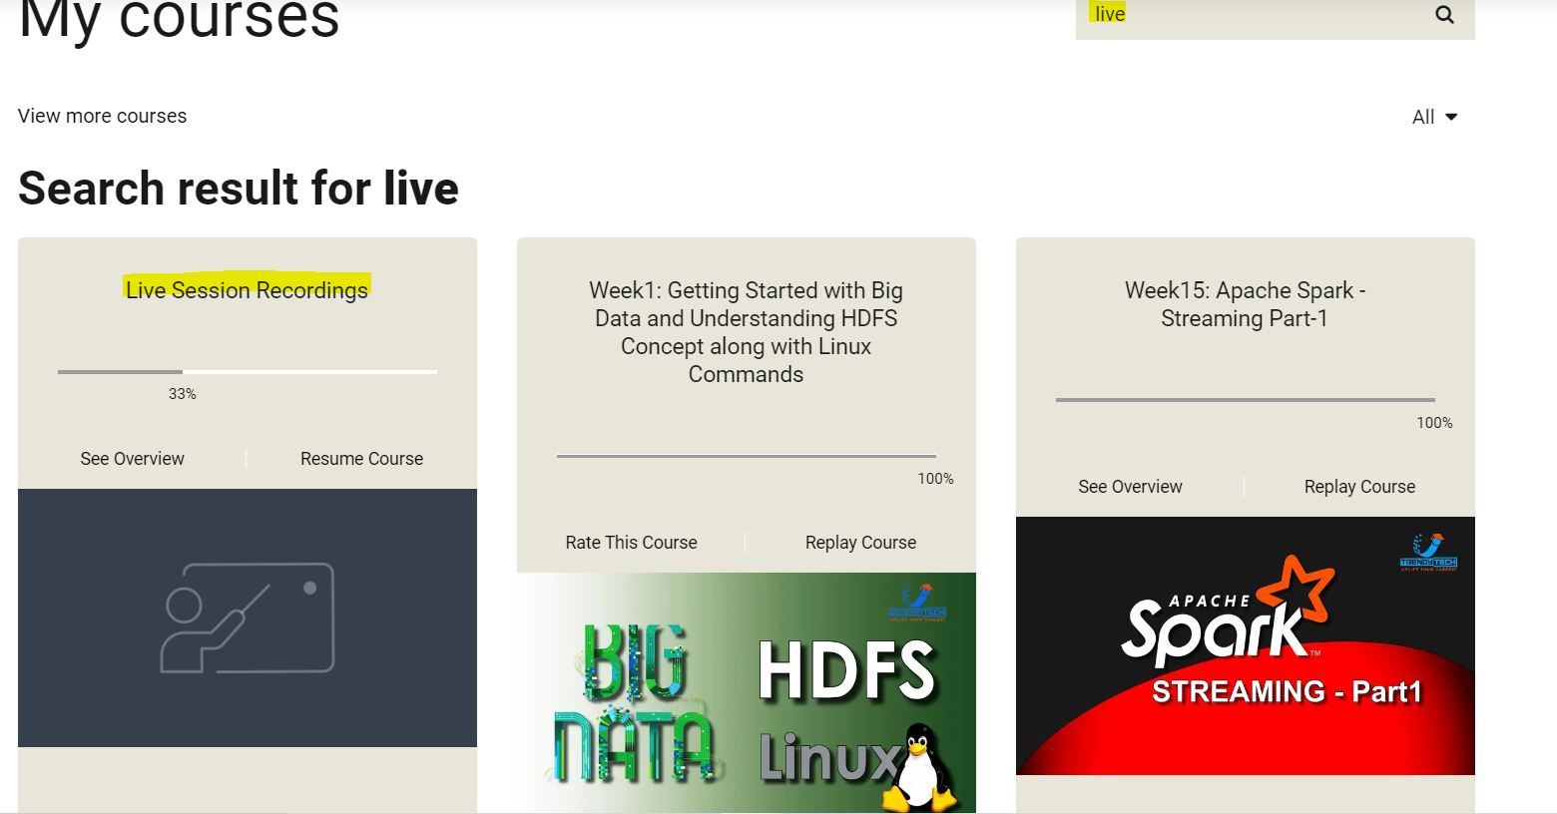
Mentoring Sessions Recording:

Slide 3
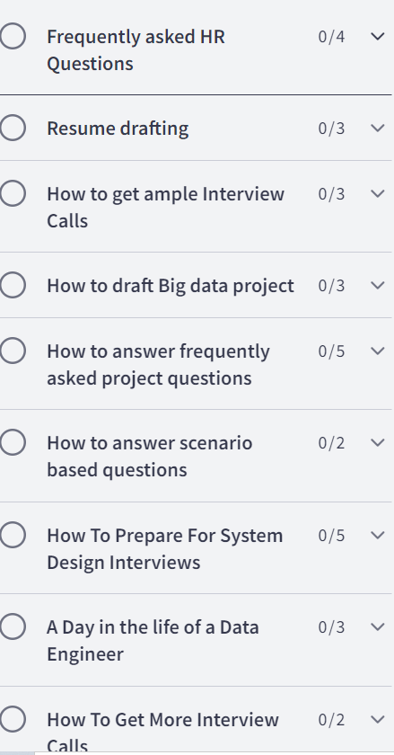
Mentoring Sessions Recording:

Slide 4
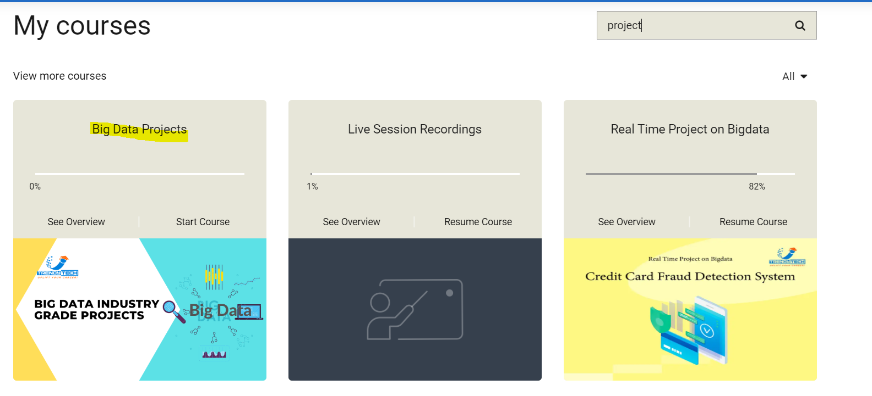
Big Data Projects:

Slide 5
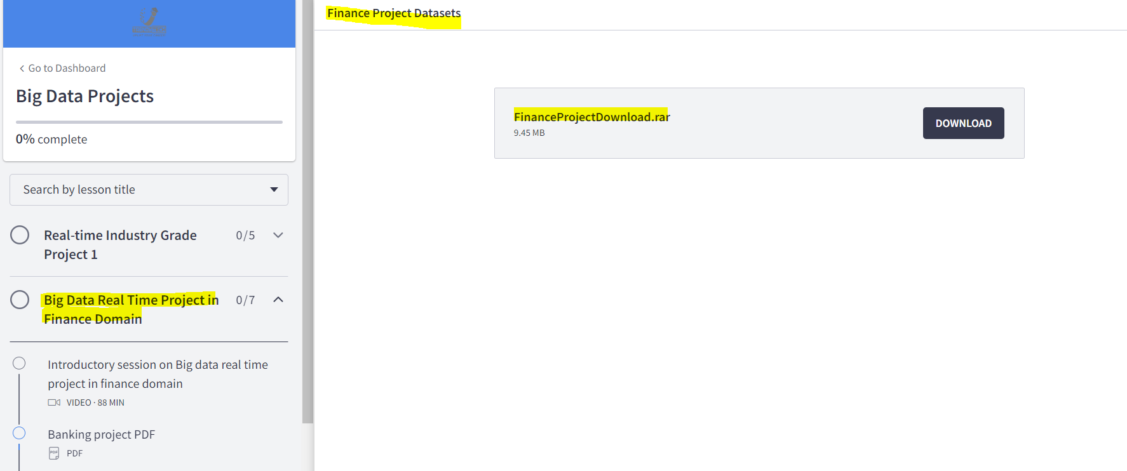
Project Sessions Code Base:

Slide 6
Agenda:
Root cause for pipeline failure.
2. Business context for loan score calculation
3. Data transformation logic
4. Architecture diagram of the project

Slide 7
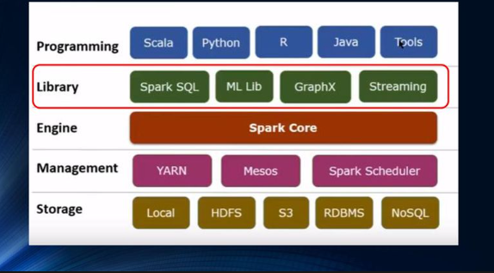
Spark Architecture Diagram:

Slide 8
SPARK SQL:
Metastore: Storage unit to store all the metadata information (file format, columns, column formats, location) of the data files in a data lake.
Hive Metastore is a component of Apache Hive that acts as a data catalog for Hive tables, partitions, and schemas. It stores metadata information about Hive tables and partitions in either databricks default or external source( relational database such as MySQL, PostgreSQL, or Oracle, or azure SQL).
Spark SQL
Databricks Default
Hive Metastore
External (Databases like MySQL, PostgreSQL), azure SQL
Azure Datalake Gen2

Slide 9
Spark Databases, tables, views :
Managed table: Both metadata and data are managed by spark
External Tables: Only metadata is managed by spark and underlying data is managed by us.
Managed VS External:
When tables were dropped, metadata &data gets deleted from managed tables. Only metadata is deleted from external tables
Views: Views built on top of tables and give the results based on underlying query.
Databricks Workspace
Databases
Tables
Views
Managed
External

Slide 10
Data Transformations

Slide 11
What are the factors considered in calculating loan score ?

Slide 12
Lending Score Calculation:
→The “loan score” is calculated by the lending loan firm against each borrower who avails for a personal credit which is funded by fellow lenders.
→The lending score acts as a first hand proof to know the borrower’s payment history, defaulters history, financial health which helps the lenders to mitigate the risk involved in lending the money to borrowers.
→This is the reason it is critical to calculate the lending score frequently to have the up-to-date status on the borrower’s financial history.
→It becomes a very important use case in the lending loan project which needs to be handled by the data engineering by performing data transformations on top of the cleaned data.
→We will consider various scenarios and use cases based on the lending loan data available to us and calculate the lending score and lending grade against each borrower.

Slide 13
Payment History

Slide 14
Factors considered for loan score calculation :
1.1 Payment History:
1.1.1 installment amount and last_payment_amount
1.1.2 total_payment_recorded and funded_amount_investor

Slide 15
Loan Defaulters

Slide 16
Factors considered for loan score calculation :
1.2 Loan Defaulters:
1.2.1 defaulters_2yrs
1.2.2 public_records
1.2.3 public_records_bankruptcies
1.2.4 enquiries_6mnths
1.2.5 hardship_flag

Slide 17
Financial Health

Slide 18
Lending Loan Architecture Flow

Slide 19
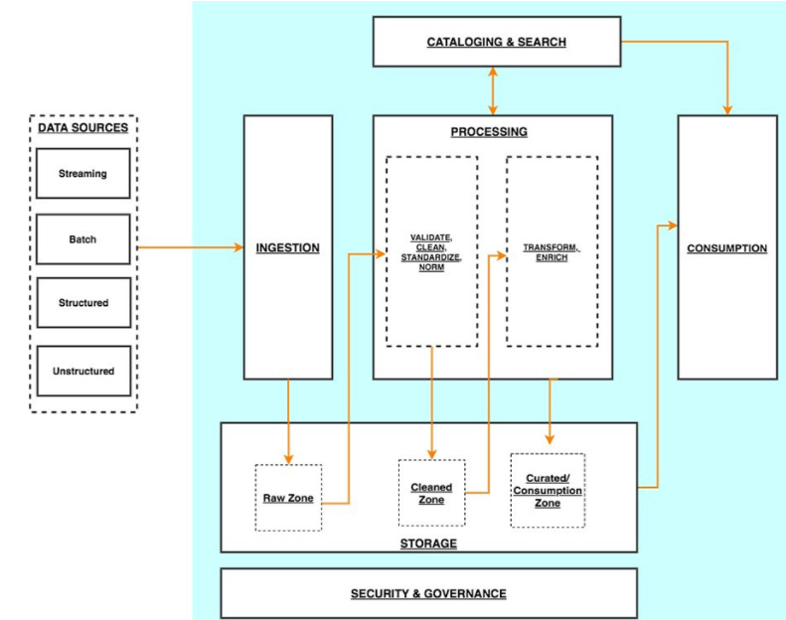

Slide 20




Project Flow Diagram
Lending Loan API
Data Ingestion
ADLS Raw Layer
Data Cleaning
ADLS Clean Layer
Data Transformation
Data Analytics
ADLS Processed Layer

Slide 21
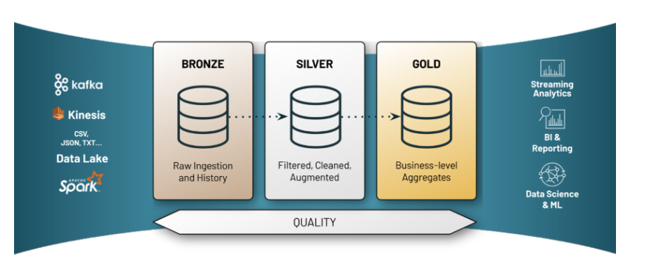
Lending Loan Architecture Flow

Slide 22
Factors considered for loan score calculation :
1.3 Financial Health:
1.3.1 loan_status
1.3.2 home_ownership
1.3.3 funded_amount and total_high_credit_limit
1.4.3 grade and sub_grade

Slide 23
References:
https://learn.microsoft.com/en-us/azure/databricks/sql/
https://spark.apache.org/docs/latest/sql-ref.html

Slide 24


