Slide 1





Mutual Fund Analytics Capstone Project
End-to-End Data Analytics Solution for Mutual Fund Performance, Investor Behaviour & Risk Analytics
Project Details
Submitted By: Manish Kumar
Team: 239FMBF
Internship: Data Analytics Internship – Bluestock.in
Tech Stack & Tools
build Python, Pandas, SQLite
bar_chartPower BI
code GitHub

Slide 2
Problem Statement & Objectives
Problem Statement
Mutual fund data is spread across multiple sources, making it difficult to evaluate fund performance, investor behaviour, and portfolio risk through a unified analytical framework.
Objectives
• Build an end-to-end ETL pipeline
• Perform exploratory data analysis
• Evaluate mutual fund performance
• Conduct advanced risk analytics
• Develop interactive Power BI dashboards
• Generate actionable investment insights

Slide 3
Data Sources
Datasets Used
• Fund Master Dataset (40 Schemes)
• Historical NAV Dataset (~46,000 Records)
• Investor Transactions Dataset (32,778 Records)
• Portfolio Holdings Dataset
Technologies
Python • Pandas • SQLite • Power BI • GitHub
• AUM Dataset
• SIP Inflow Dataset
• Category Inflow Dataset
• Benchmark Indices Dataset
• Live NAV Dataset (~19,792 Records)

Slide 4
ETL Architecture
Data Pipeline Workflow
Raw Data Sources
↓
Data Cleaning & Validation
↓
Feature Engineering
↓
SQLite Database
↓
Analytics Layer
↓
Power BI Dashboard
Key ETL Features
• Missing value handling
• Duplicate removal
• Data quality validation
• Live NAV integration
• Centralized database storage

Slide 5
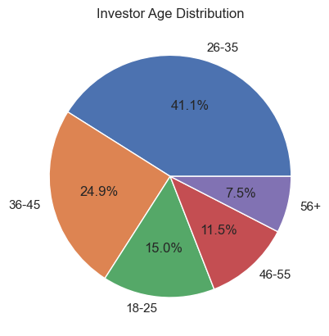
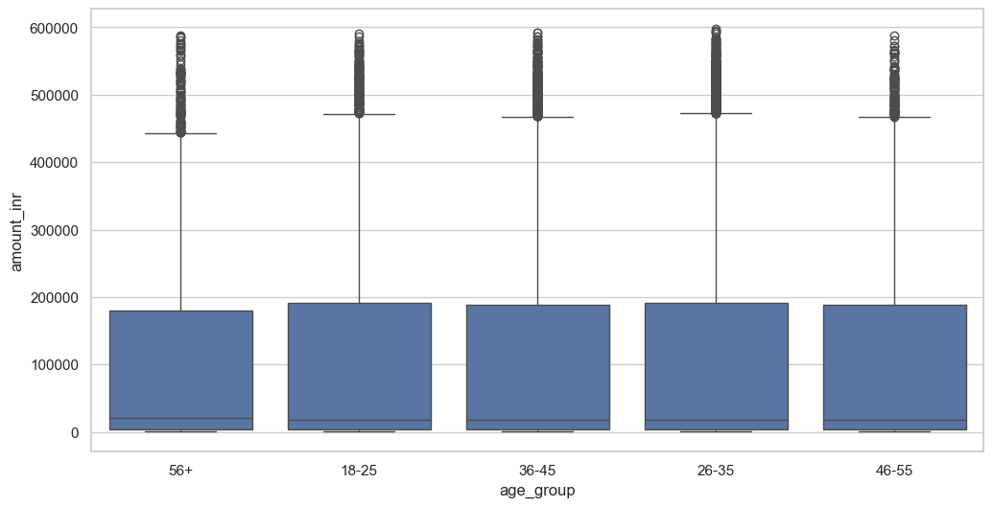
EDA Highlights (Investor Analysis)
Investor Demographic Analysis
• Investor Age Distribution
.
• Investment Amount by Age Group
Key Insights
• Working-age investors contributed the highest investment activity.
• Investment participation was concentrated in middle-age groups.
• Higher investment amounts were observed among established earning segments.

Slide 6
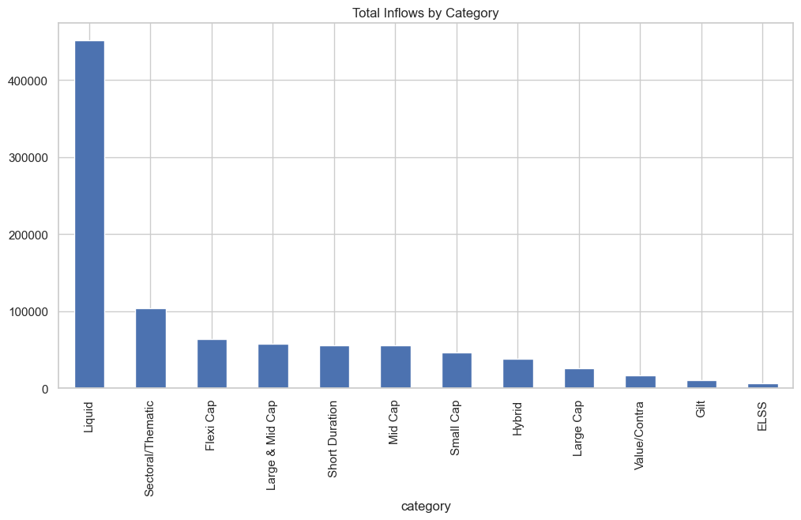
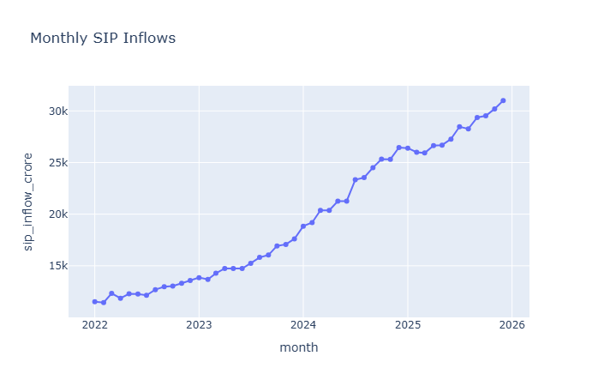
EDA Highlights (Fund Flow Analysis)
• Category Inflows
• Monthly SIP Trends
Key Insights
• Equity-oriented categories attracted the highest inflows.
• SIP contributions showed consistent growth patterns.
• Investors preferred long-term wealth creation products.

Slide 7
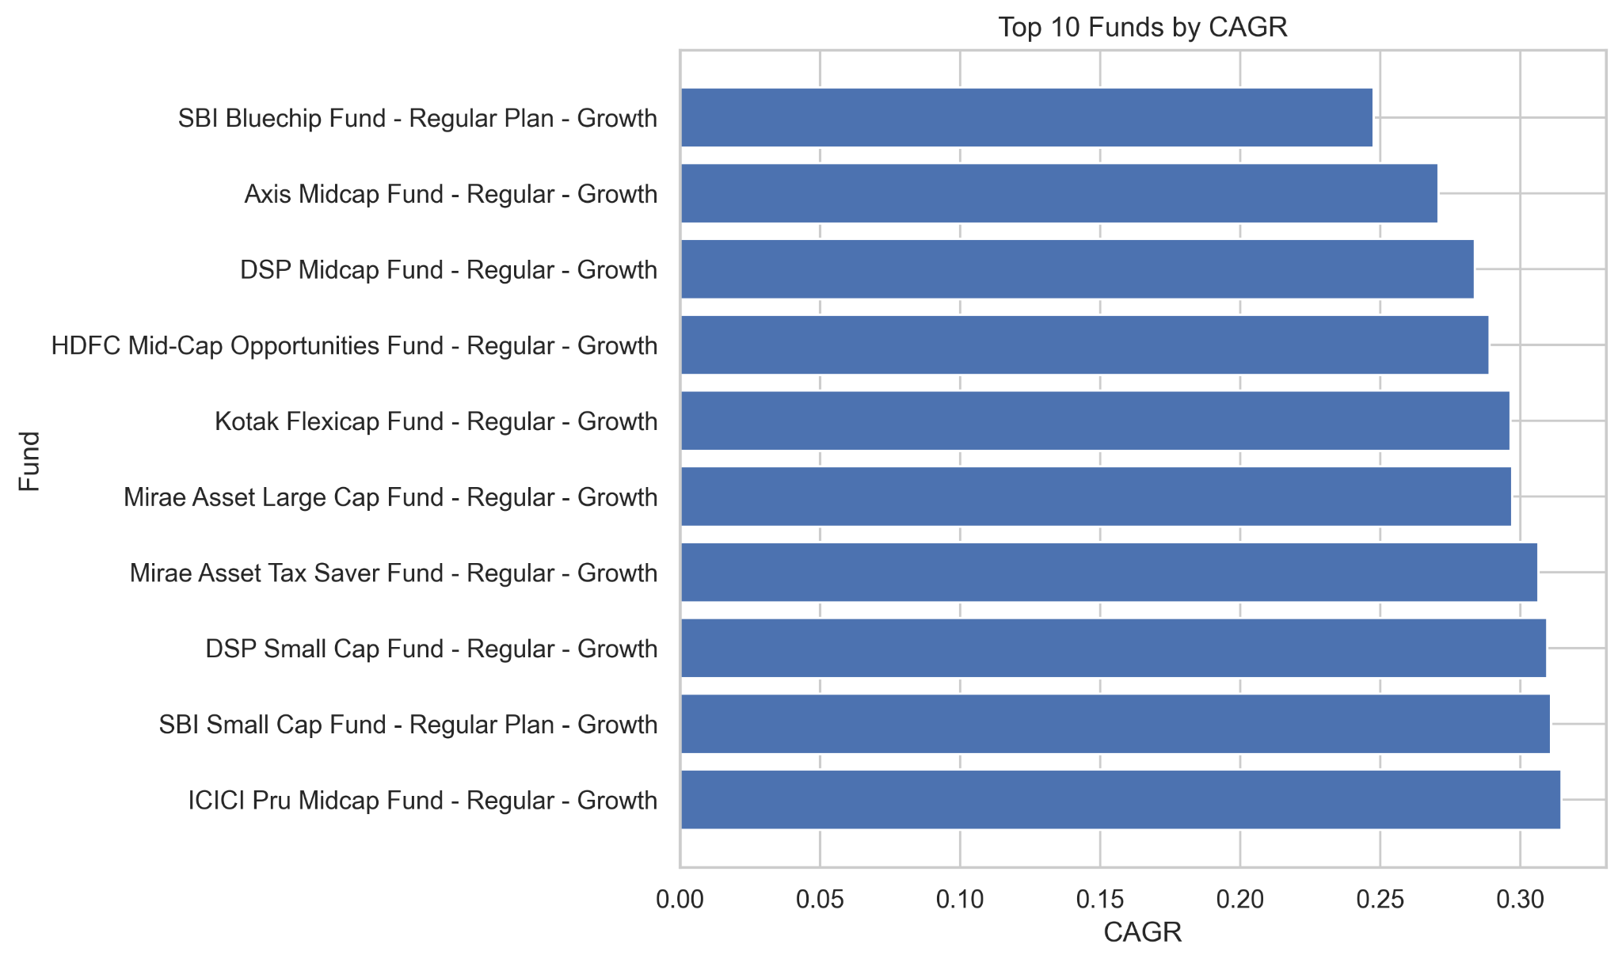
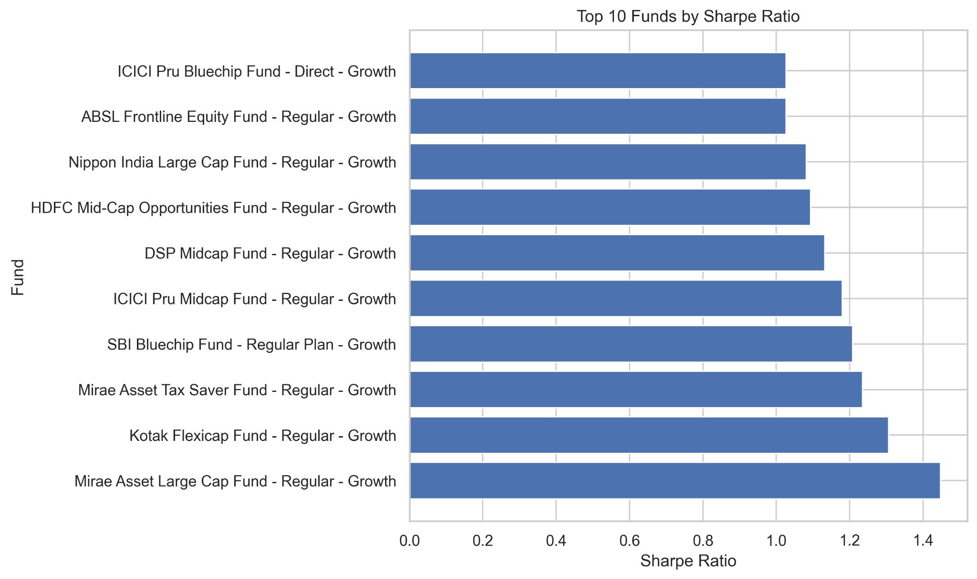
Performance Analytics
Metrics Calculated
• CAGR
• Sharpe Ratio
• Sortino Ratio
• Alpha
• Beta
• Maximum Drawdown
• Top Funds by CAGR
• Top Funds by Sharpe Ratio
Key Insight
Top-performing funds achieved superior risk-adjusted returns rather than simply higher returns.

Slide 8
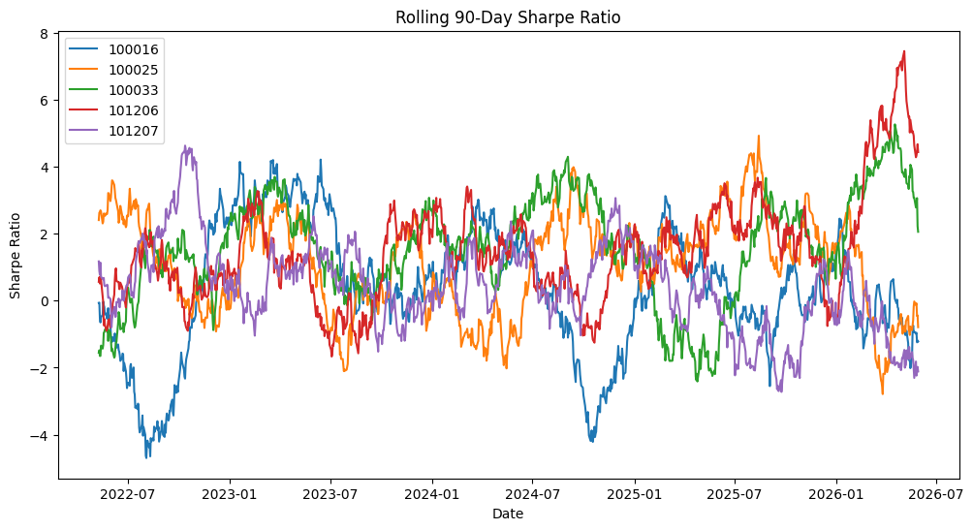
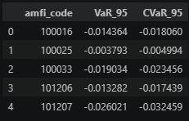
Advanced Risk Analytics
Risk Analytics Performed
• Value at Risk (VaR 95%)
• Conditional VaR (CVaR 95%)
• Rolling 90-Day Sharpe Ratio
Key Insight
Risk exposure varied significantly across schemes despite similar return profiles.
• Rolling Sharpe Ratio Trend
• VaR/CVaR Analysis

Slide 9
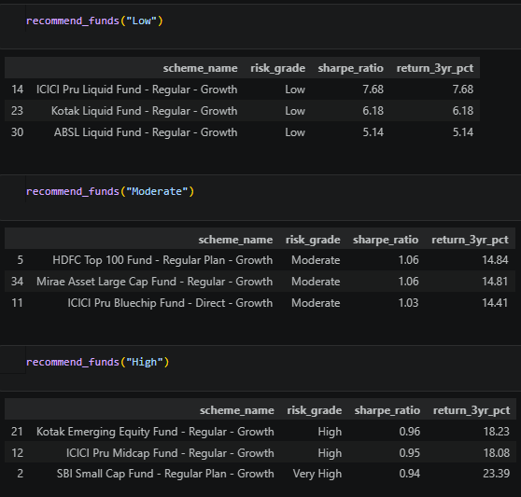
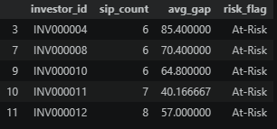
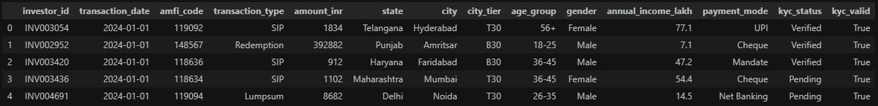
Advanced Analytics & Recommendation Engine
Key Insight
Recommendations were generated using risk grades and Sharpe Ratios to support investor suitability.
Advanced Analytics
• Investor Cohort Analysis
• SIP Continuity Analysis
• Portfolio Concentration (HHI)
• Fund Recommendation Engine

Slide 10
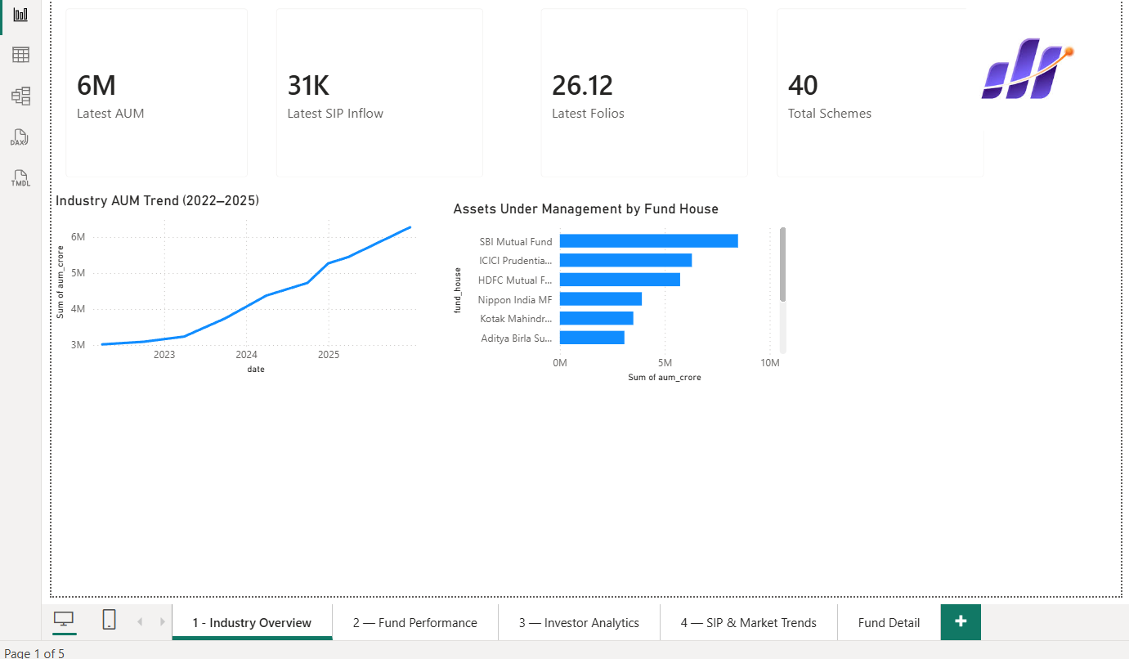
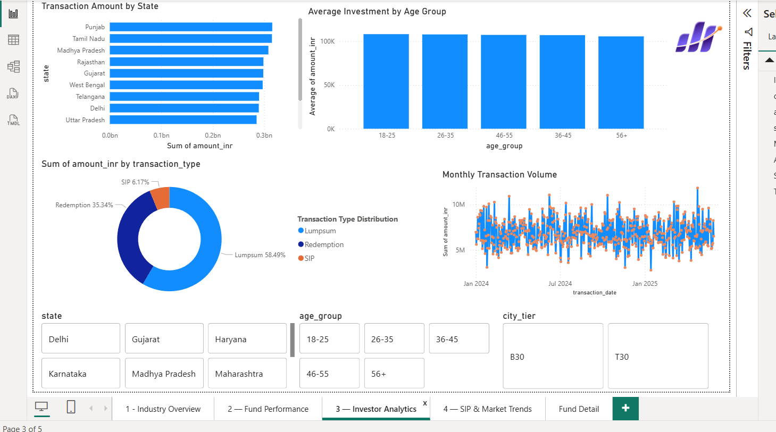
Dashboard Showcase
Power BI Dashboard
• Overview Dashboard
• Investor Analytics Dashboard
Features
• Interactive Filters
• Dynamic Analysis
• Investor Insights
• Performance Monitoring

Slide 11
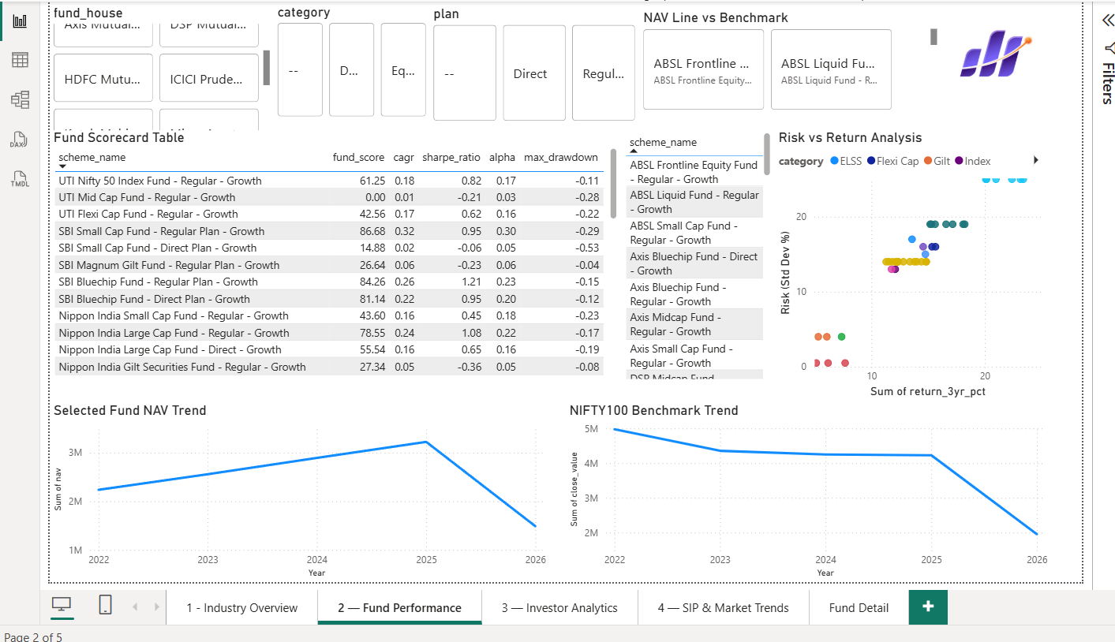
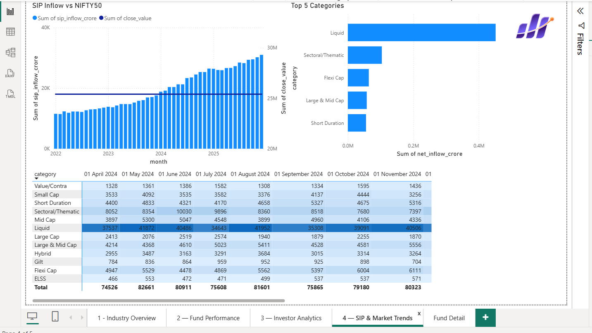
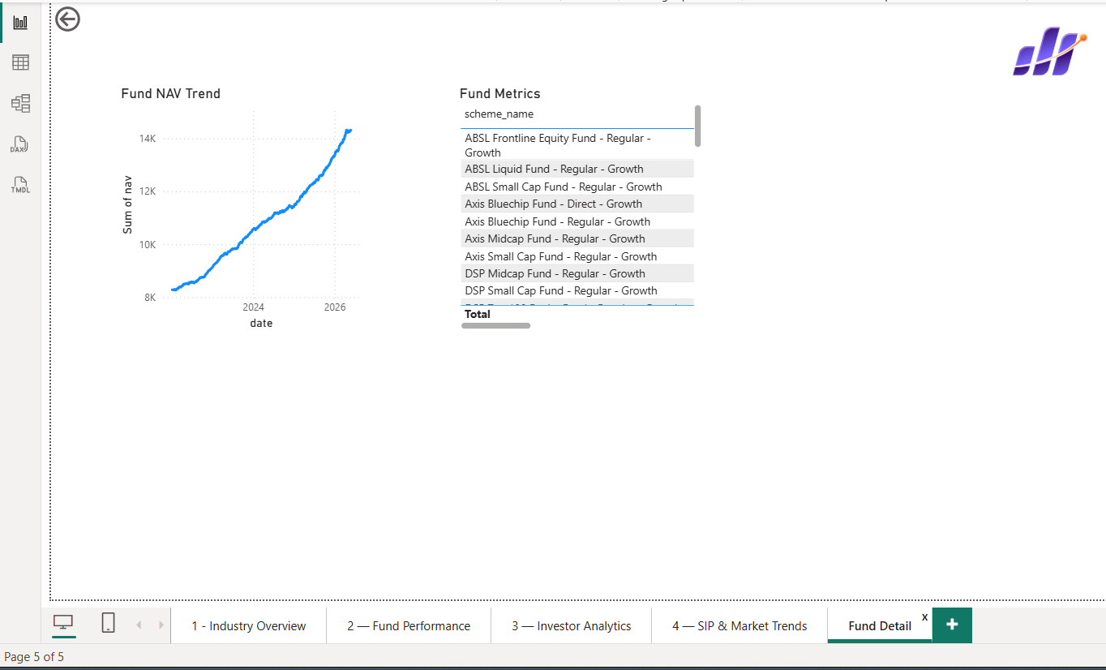
• Fund Flow Dashboard
• Risk Analytics Dashboard
• Fund Detail Dashboard
Features
• Drill-through Analysis
• Risk Evaluation
• Fund Comparison
• Category Insights

Slide 12
Key Findings
• Equity funds delivered the strongest long-term performance.
• SIP investments remained the dominant investment channel.
• Risk-adjusted returns varied significantly across schemes.
• Several funds outperformed benchmark returns.
• Portfolio concentration differed across equity funds.
• Recommendation engine supported informed investment decisions.

Slide 13
Thank You

