Slide 1

Sales Performance Analysis & Interactive BI Dashboard
Data Analytics Internship Report By : Manish Singh

Slide 2

Project Overview
An end-to-end analytics workflow — from raw transactional data to interactive business intelligence — covering cleaning, storage, analysis, and visualisation.
Excel Clean
SQL Store
Python Analysis
Power BI
Tools used: Microsoft Excel · SQL · Python · NumPy · Power BI · Jupyter Notebook · GitHub

Slide 3
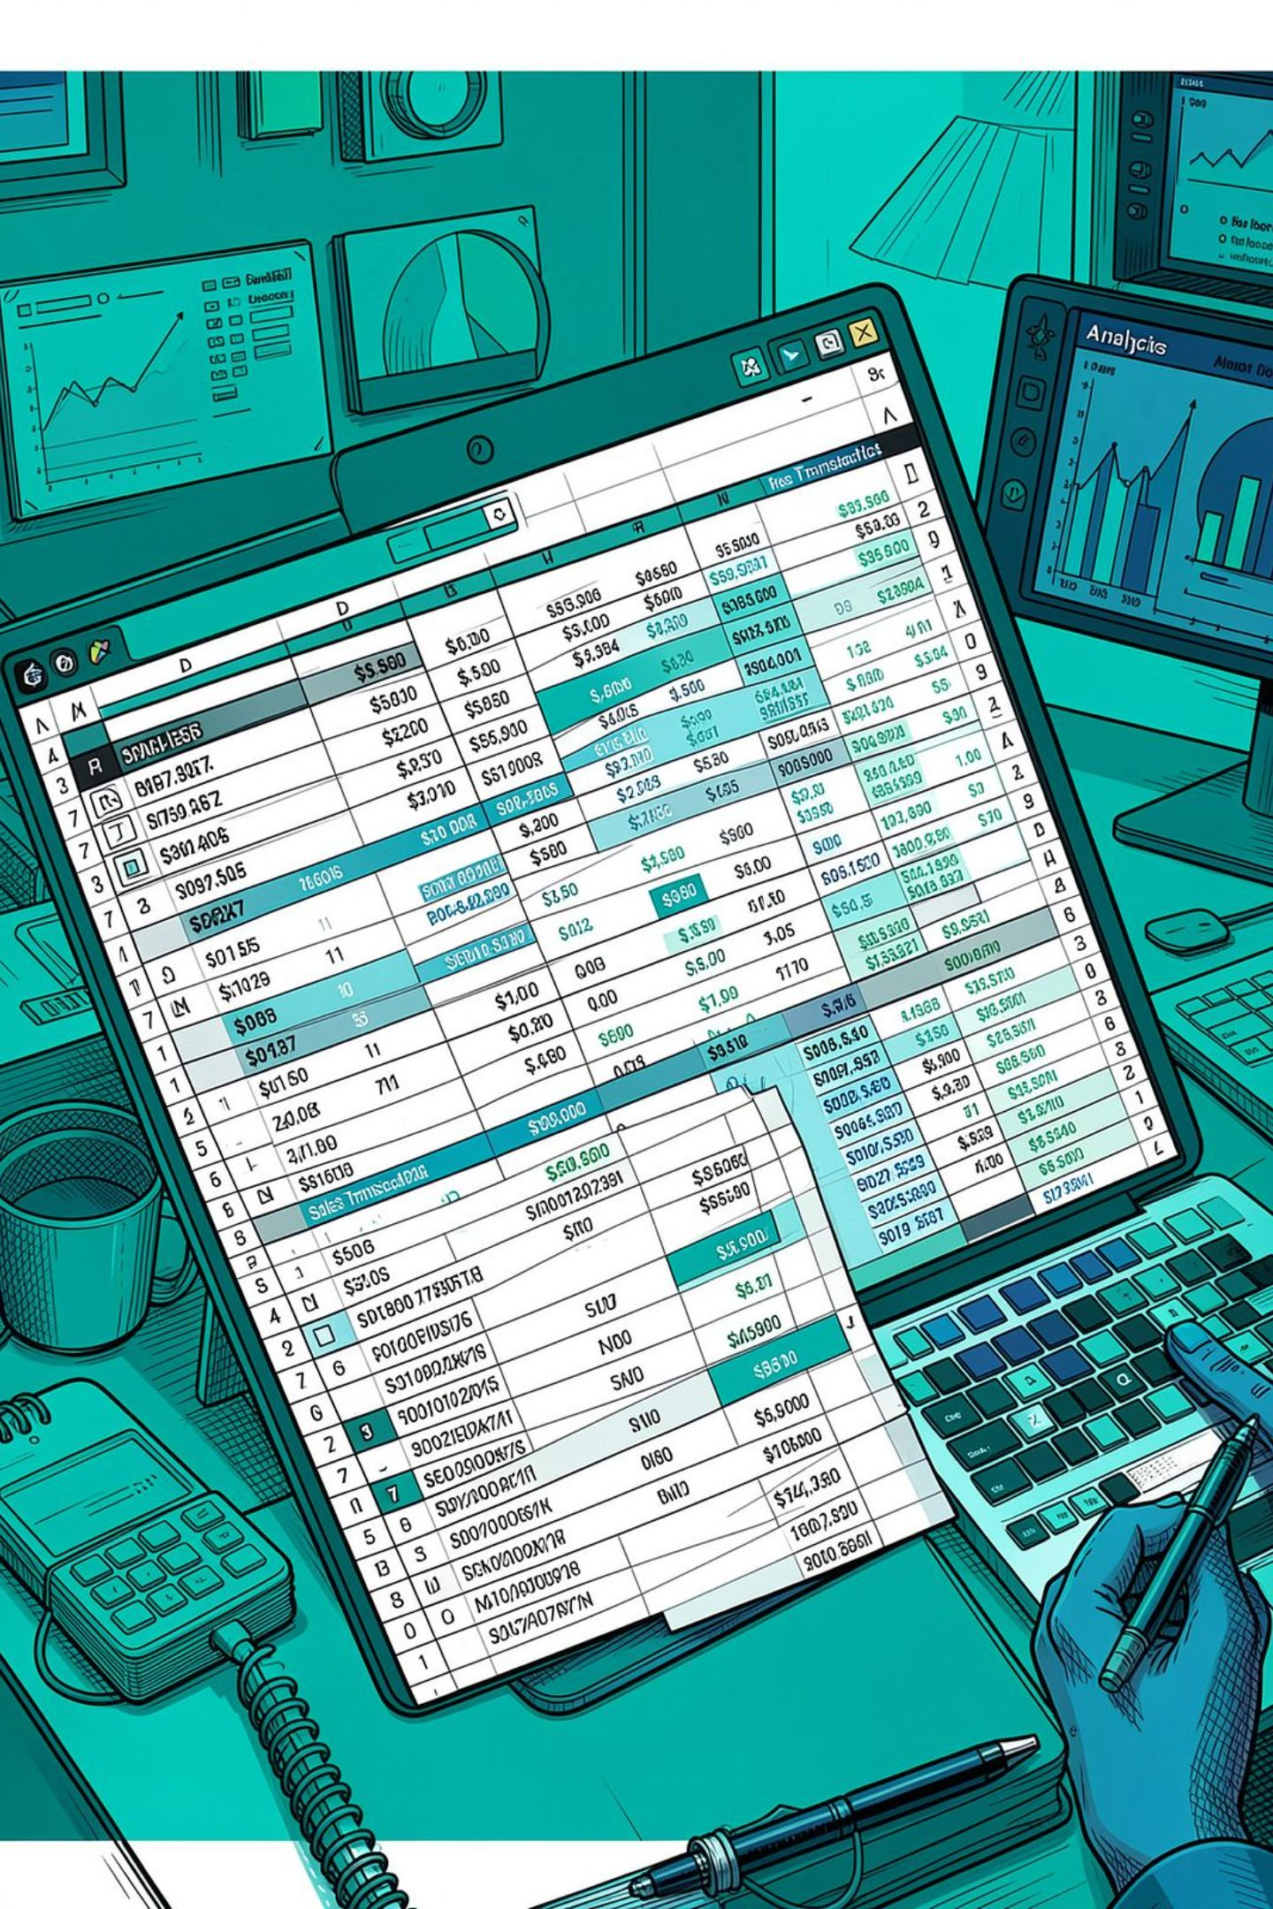
Dataset at a Glance
50K
Total Records
Transactional sales records
₹2.18B
Total Sales
Across all regions & categories
149K
Units Sold
Total quantity across 2023–2026
₹194M
Total Profit
Net profit from all transactions
5 regions · 5 categories · 15 product types · 6 payment methods · 3 sales channels

Slide 4




Tools & Technologies
Microsoft Excel
SQL
Data cleaning, preprocessing, Pivot Tables & initial exploratory analysis
Structured storage and retrieval of the cleaned dataset
Python & NumPy
Power BI
Numerical processing, descriptive statistics & data analysis
Interactive dashboard, KPI analysis & business visualisations

Slide 5

Data Cleaning & SQL Integration
Cleaning Workflow
SQL Database Layer
Inspect raw dataset for data-quality issues
Check duplicates and missing records
Validate date, numerical & categorical fields
Standardise inconsistent values and formats
Remove or correct invalid records
Validate cleaned dataset before analysis
Cleaned data stored in SQL for structured, persistent access — supporting future pipelines, scheduled refreshes, and analytical queries.
Pipeline: Raw Data → Excel Cleaning → SQL Database → Python / Power BI → Insights

Slide 6
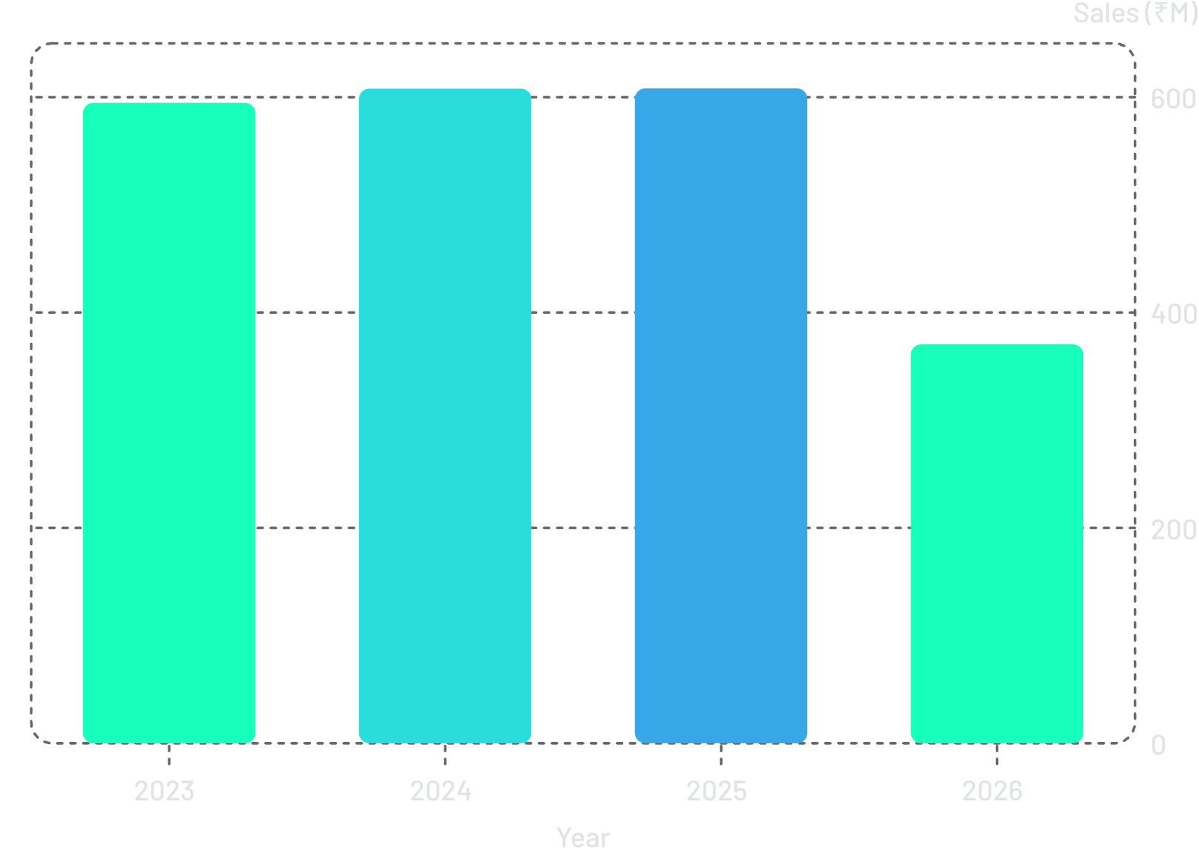
Yearly & Monthly Sales Trends
Key Observations
Sales grew steadily from 2023 to 2025, peaking at ₹608.13M. April recorded the highest monthly sales (₹210.30M) while September was the lowest (₹141.69M). Profit follows the same pattern — April ₹18.59M vs September ₹12.45M.
2026 represents a partial reporting period and should not be compared directly with complete years.

Slide 7
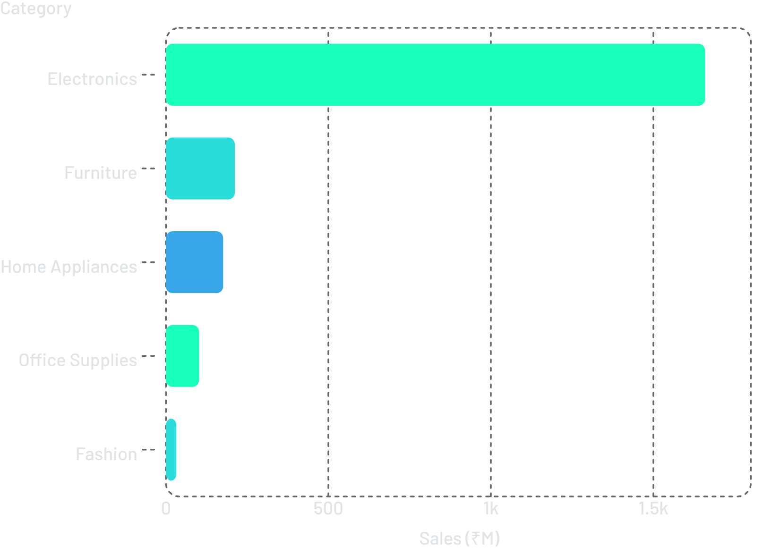
Category & Product Performance
Category Insights
Electronics dominates with ₹1.66B in sales and ₹128.33M profit across 17,992 orders — the clear priority for inventory and pricing strategy.
🏆 Laptops
📱 Mobiles
₹962.07M — top-selling product
₹657.26M — second highest

Slide 8
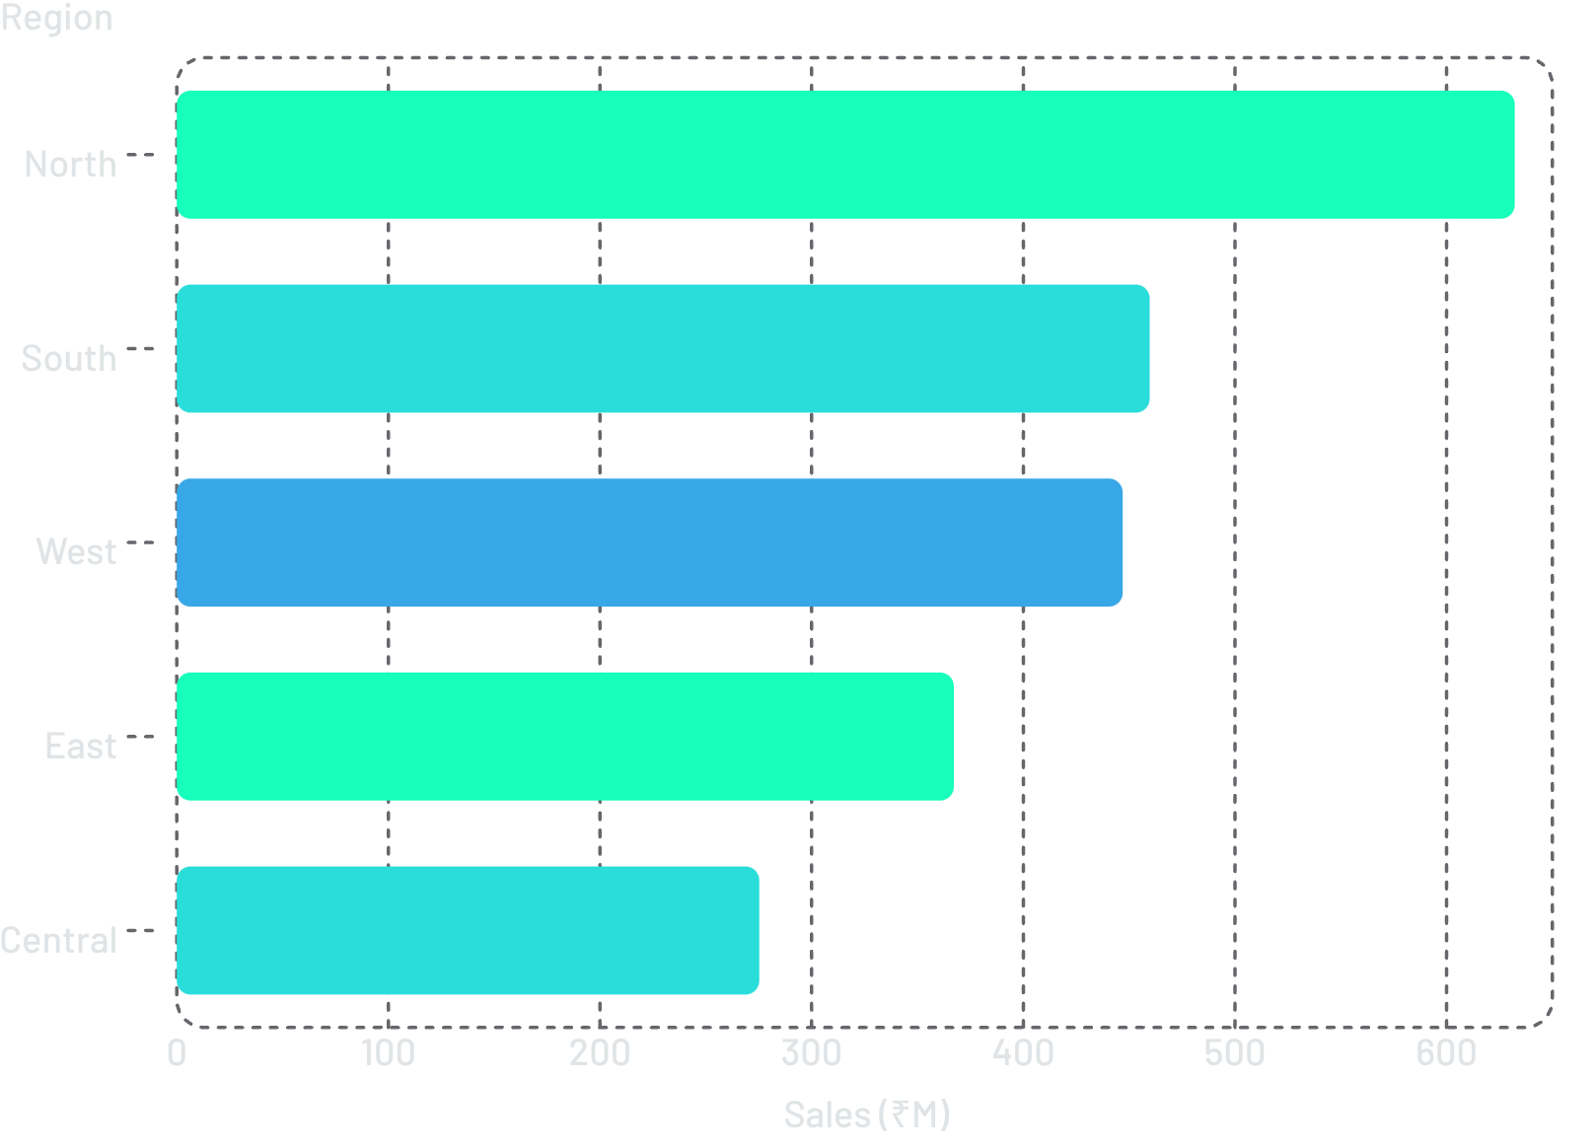
Regional Sales & Power BI Dashboard
Regional Highlights
North leads with ₹632.19M in sales and 14,399 orders. Central has the lowest volume — a key opportunity for growth.
Power BI Dashboard KPIs
Total Sales: ₹2,181.26M
Total Profit: ₹194.16M
Profit Margin: 10.88%
Total Quantity: 149.68K units
Visuals include monthly trends, regional comparisons, category breakdowns, and payment-method profit analysis.

Slide 9

Key Insights & Business Recommendations
Prioritise Electronics
Focus inventory on Laptops & Mobiles — ₹1.62B combined revenue.
Investigate Losses
Negative-profit transactions exist — review discounts, pricing & procurement costs.
Boost Sept–Dec Sales
Targeted promotions during weaker months to counter seasonal decline.
Leverage North Region
Use North's success as a benchmark to uplift lower-performing regions.

Slide 10

Learning Outcomes & Future Scope
What Was Learned
Future Roadmap
End-to-end data cleaning and preprocessing in Excel
SQL-based structured data storage and retrieval
Python & NumPy for numerical and statistical analysis
KPI-driven Power BI dashboard development
Converting analytical results into business recommendations
Automate SQL–Power BI pipeline with scheduled refreshes
Build sales and profit forecasting models
Customer segmentation and lifetime value analysis
Predictive models for sales and profitability
Automated alerts for unusual sales or profit movements
Deliverables On :https://github.com/Manish-singh74/Sales-Performance-Analysis-and-Interactive-Business-Intelligence-Dashboard
GitHub Repository :
Power BI Dashboard: SALES_DATA_POWER_BI
NumPy Notebook: CDA(File Name)

