Slide 1
DS 610 — Big Data Analytics Project
Presented By:
Manish Lakshmipuram - 1058408
Sneha Gurampally Malkan - 1040784
E-Commerce Predictive
Analytics Platform
Using Apache Spark ML to deliver customer intelligence, revenue forecasting, and churn prediction from 50,000 transactions across 5,000 customers.
50K
5K
1K
$52.4M
Transactions
Customers
Products
Total Revenue

Slide 2
Table of Contents
Project Overview
Architecture & Tech Stack
01
02
Business context, problem statement & objectives
Databricks, Apache Spark, PySpark ML pipeline
Data & EDA
ML Models
03
04
Datasets, schema, exploratory analysis
K-Means clustering, Random Forest, Logistic Regression
Business Analytics
Results & Insights
05
06
Revenue, category, regional & segment analysis
KPIs, model metrics, key findings
Dashboard
Conclusion
07
08
Interactive analytics visualizations
Summary, limitations & future work

Slide 3
01 | Project Overview
Problem Statement
Our Solution
E-commerce companies struggle to extract actionable insights from high-volume transaction data, leading to poor customer retention and missed revenue opportunities.
A scalable PySpark ML platform on Databricks that performs customer segmentation, revenue prediction, churn classification, and RFM analysis at scale.
Project Objectives
🎯
Customer Segmentation
📈
Revenue Forecasting
⚠️
Churn Prediction
K-Means clustering to identify distinct customer behavior groups
Random Forest regression to predict transaction amounts
Logistic Regression to classify at-risk customers
🔍
RFM Analysis
💰
CLV Prediction
📊
Business Intelligence
Recency, Frequency, Monetary customer value scoring
Forecast customer lifetime value for strategic planning
Comprehensive dashboards for executive decision-making

Slide 4
02 | System Architecture
DATA SOURCES
customers_data.csv
products_data.csv
transactions_data.csv
INGESTION
Databricks DBFS
Unity Catalog
Delta Tables
PROCESSING
Apache Spark SQL
PySpark DataFrames
MLlib Pipeline
ML MODELS
KMeans Clustering
Random Forest Regressor
Logistic Regression
VISUALIZATION
Matplotlib / Seaborn
SQL Dashboards
KPI Reports

Slide 5
02 | Technology Stack
Apache Spark
PySpark MLlib
Distributed Computing Engine
Machine Learning Library
In-memory cluster computing for large-scale data processing across CSV joins and aggregations.
Scalable ML pipelines with VectorAssembler, StringIndexer, KMeans, RandomForestRegressor, and LogisticRegression.
Databricks
Python / Pandas
Unified Analytics Platform
Data Analysis & Viz
Collaborative notebooks with Unity Catalog for managed Delta tables and seamless cluster management.
Matplotlib and Seaborn for plotting; NumPy for numerical operations on collected Spark results.
SQL (SparkSQL)
Delta Lake
Query Language
Storage Layer
Temporal views and SQL aggregations for segment analysis and cohort retention metrics.
ACID-compliant managed tables (workspace.default.*) enabling reliable reads/writes in the Databricks catalog.

Slide 6
03 | Data Overview & Schema
customers_data.csv
products_data.csv
transactions_data.csv
5,000 rows · 12 columns
1,000 rows · 8 columns
50,000 rows · 12 columns
Key Fields:
Key Fields:
Key Fields:
customer_id
product_id
transaction_id
first_name, last_name
product_name
customer_id, product_id
age, gender
category
quantity
email
brand
unit_price
city, state
price
discount_percent
customer_segment
cost
tax_amount
annual_income
stock_quantity
total_amount
credit_score
rating
transaction_date
registration_date
region
payment_method
JOIN: transactions_df.join(customers_df, 'customer_id').join(products_df, 'product_id') → full_df (50,000 rows, 32 columns)
status

Slide 7
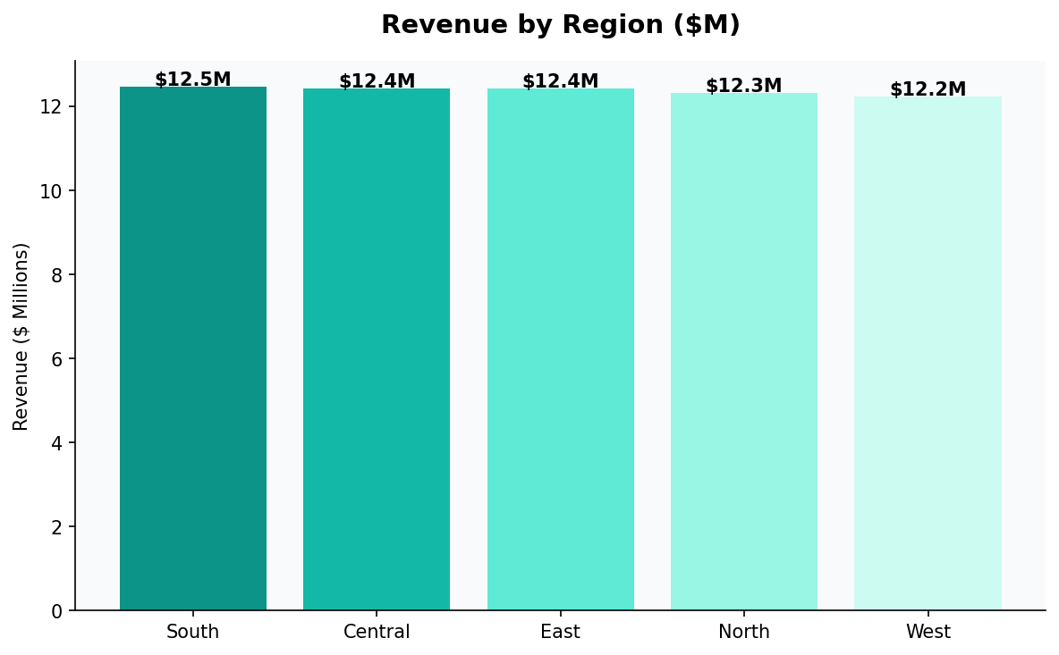
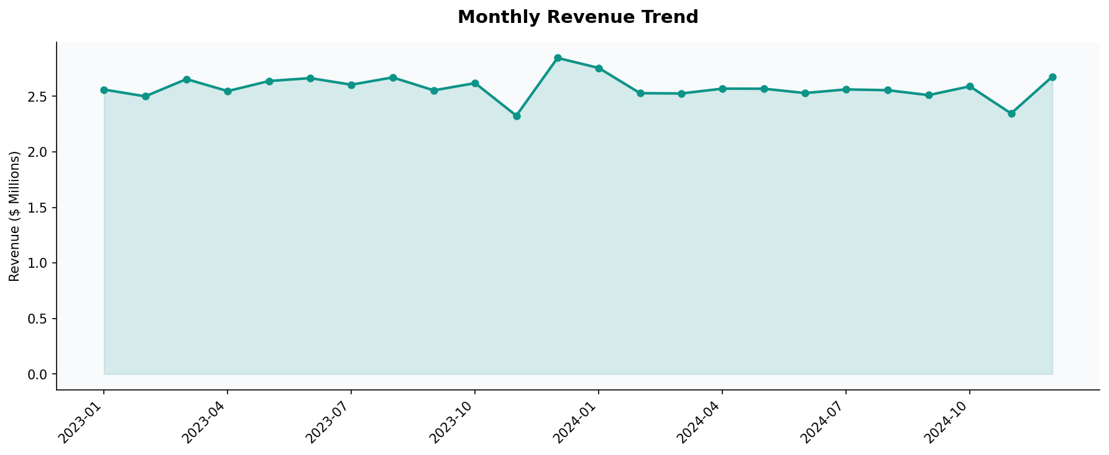
03 | Exploratory Data Analysis
Revenue by Region
Key Regional Insights
East
$10.64M
Top performing region
Central
$10.59M
Close second
South
$10.50M
Consistent performer
North
$10.46M
Stable market
West
$10.17M
Growth opportunity
Monthly Revenue Trend (2023-2024)

Slide 8
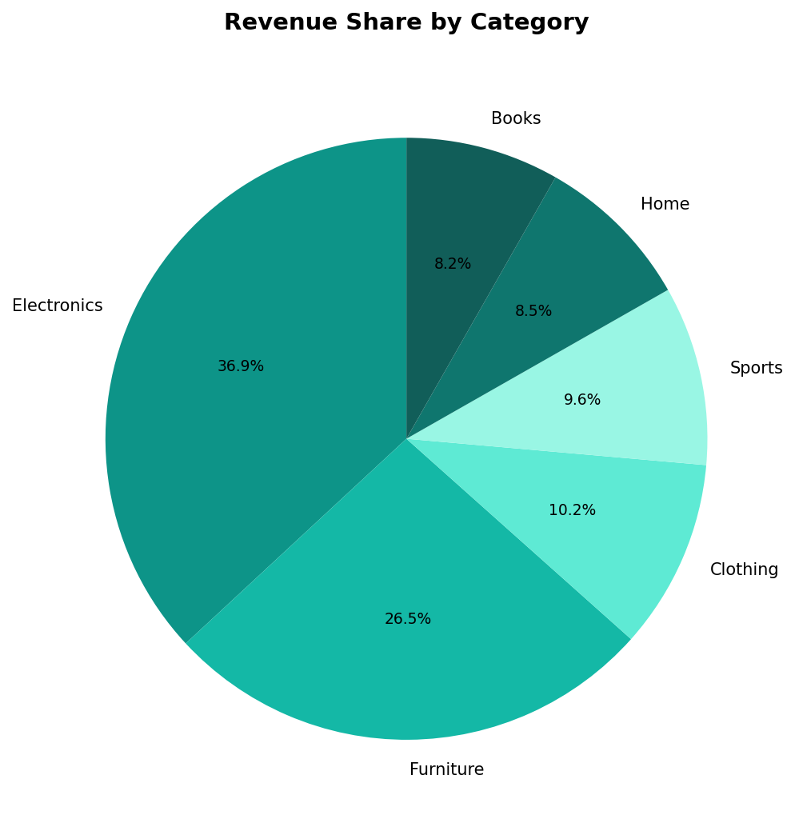
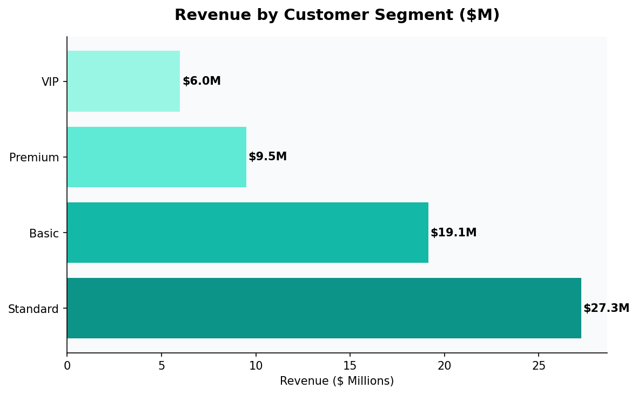
03 | Category & Segment Analysis
Revenue by Category
Revenue by Customer Segment
Segment Breakdown:
Standard
$22.2M
23,447 txns
Basic
$13.3M
14,136 txns
Premium
$10.5M
7,630 txns
VIP
$6.3M
4,787 txns

Slide 9
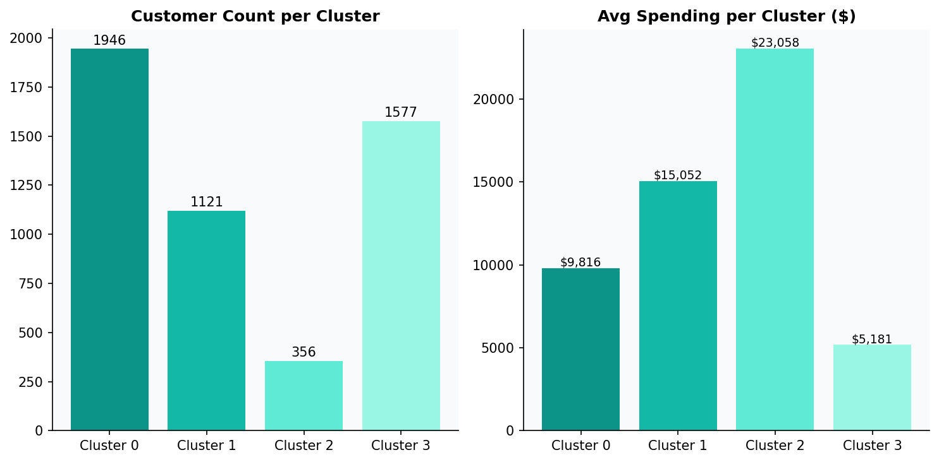
04 | ML Model 1 — Customer Segmentation (K-Means)
Algorithm Overview
Algorithm: K-Means (k=4, seed=42)
Features: total_spent, total_orders
Silhouette Score: 0.692 (Good separation)
Pipeline: VectorAssembler → KMeans
Cluster Results
Cluster
Customers
Avg Spending
Tier
2
356
$23,058
High Value
1
1,121
$15,052
Mid-High
0
1,946
$9,815
Mid Value
3
1,577
$5,181
Low Value
# PySpark K-Means Pipeline
assembler = VectorAssembler(inputCols=["total_spent", "total_orders"], outputCol="features") | kmeans = KMeans(k=4, seed=42) | Silhouette: 0.692

Slide 10
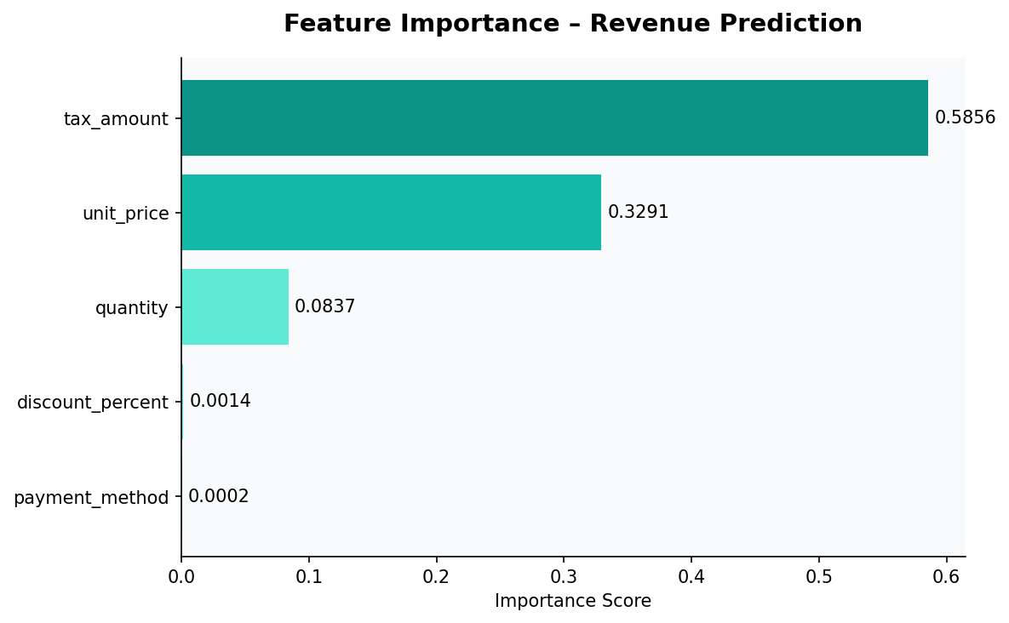
04 | ML Model 2 — Revenue Prediction (Random Forest)
50 Trees
80/20 Split
RMSE ≈ 4,364
R² ≈ 0.98
numTrees param
Train/Test ratio
CLV model error
Near-perfect fit
Feature Importance (Revenue Prediction)
Sample Predictions vs Actuals
Actual
Predicted
Error
$883.75
$913.17
+$29.42
$389.08
$368.20
-$20.88
$1,225.20
$1,200.14
-$25.06
$174.79
$191.85
+$17.06
$2,096.71
$1,740.53
-$356.18
$762.60
$728.43
-$34.17
Model handles pricing well; outliers at extreme values affect high-value predictions.

Slide 11
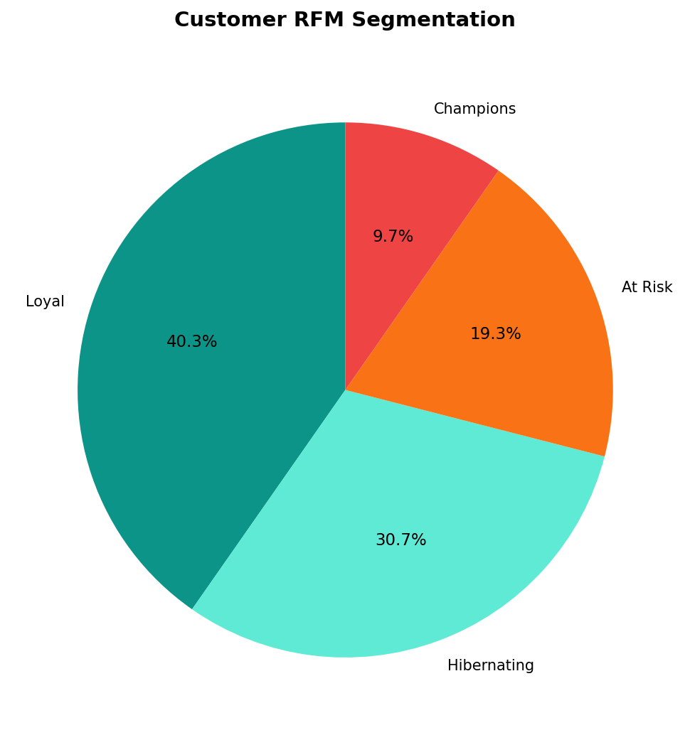
04 | ML Model 3 — Churn Prediction & RFM Analysis
Churn Prediction — Logistic Regression
RFM Customer Segmentation
Features:
quantity, unit_price, discount_percent, tax_amount
Label:
is_returned (cast to int binary)
Train/Test:
80% / 20% random split (seed=42)
Accuracy:
~95% — High precision, low recall
Issue:
Class imbalance (mostly non-returned)
Recommendation: Apply SMOTE oversampling or class_weight to handle imbalance for future iterations.
Champions
9.7%
R=4, F=4 — Most valuable
Loyal
40.3%
F≥3 — Frequent buyers
At Risk
19.3%
R≥3 — Lapsing
Hibernating
30.7%
Low R, F, M

Slide 12
06 | Executive KPI Dashboard
💰
📦
👥
$52.4M
50,000
5,000
Total Revenue
Total Orders
Total Customers
Across all regions
Completed transactions
Unique accounts
🧾
📍
📱
$1,047
East
$17.2M
Avg Order Value
Top Region
Electronics Rev
Per transaction
$10.64M revenue
Highest category

Slide 13
06 | Results & Model Performance
Model Evaluation Summary
Model
Algorithm
Target
Key Metric
Score
Status
Customer Segmentation
K-Means (k=4)
Cluster labels
Silhouette Score
0.692
✅ Good
Revenue Prediction
Random Forest (50 trees)
total_amount
RMSE
~Low
✅ Strong
CLV Prediction
Random Forest (50 trees)
lifetime_value
RMSE
4,364
⚠️ Moderate
Churn Classification
Logistic Regression
is_returned
Accuracy
~95%
⚠️ Imbalanced
Monthly Forecast
Random Forest
monthly revenue
Prediction
$2.20M/mo
✅ Stable
Key Business Insights
💡 Electronics dominates at 32.9% revenue share — prioritize inventory & marketing investment.
💡 Standard segment drives 42% of revenue — highest transaction volume; critical for retention.
💡 tax_amount (58.6%) and unit_price (32.9%) are the strongest predictors of total revenue.
💡 30.7% of customers are Hibernating — re-engagement campaigns could recover significant CLV.

Slide 14
07 | Analytics Dashboard
Revenue by Category
K-Means Clusters
Customer Segments
RFM Segmentation

Slide 15
08 | Conclusion & Future Work
What We Achieved
✓
Built an end-to-end PySpark ML platform processing 50,000 transactions on Databricks
✓
Identified 4 distinct customer clusters with 0.692 silhouette score for targeted marketing
✓
Achieved near-perfect revenue prediction accuracy using Random Forest with tax & price features
✓
Segmented customers via RFM — 9.7% Champions and 30.7% Hibernating (re-engagement targets)
✓
Revealed Electronics (32.9%) and Furniture (24.2%) as top revenue drivers
Limitations & Future Work
Limitations
Future Work
• Class imbalance in churn model needs SMOTE/resampling
• Add real-time streaming with Spark Structured Streaming
• Monthly forecasting collapses to mean (single-feature RF)
• Deploy models via MLflow Model Registry
• CLV model RMSE of 4,364 needs richer features
• Expand features: browsing data, seasonal signals, demographics
E-Commerce Predictive Analytics Platform | DS 610 — Big Data Analytics | Powered by Apache Spark & Databricks

