Slide 1


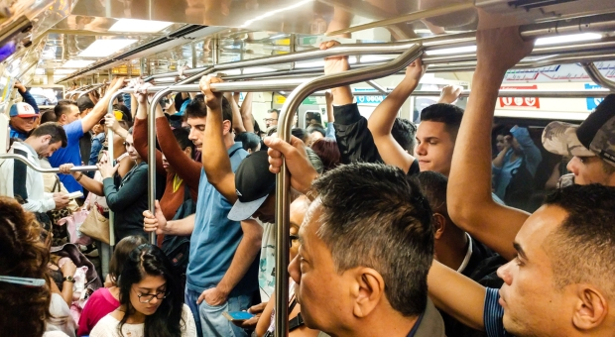
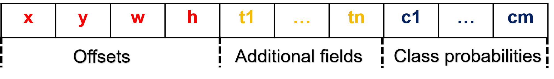

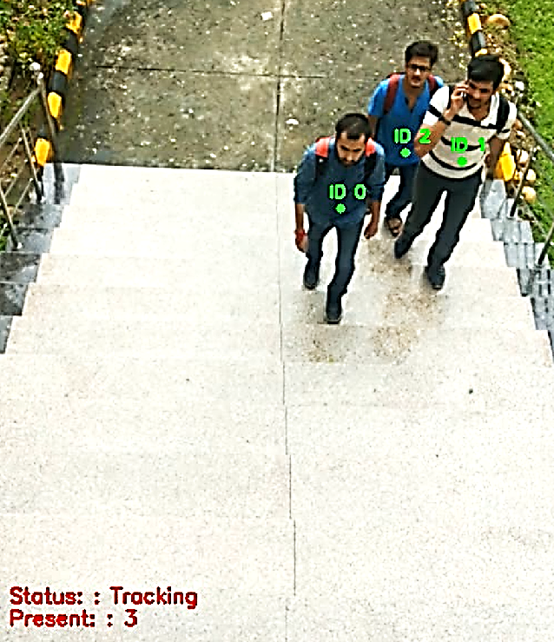
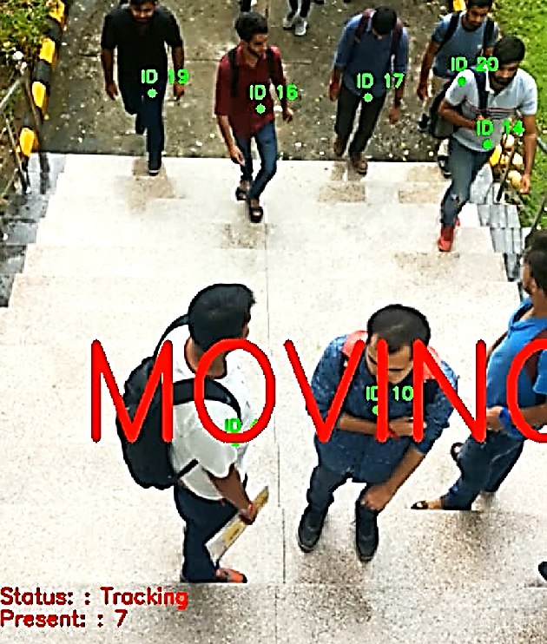
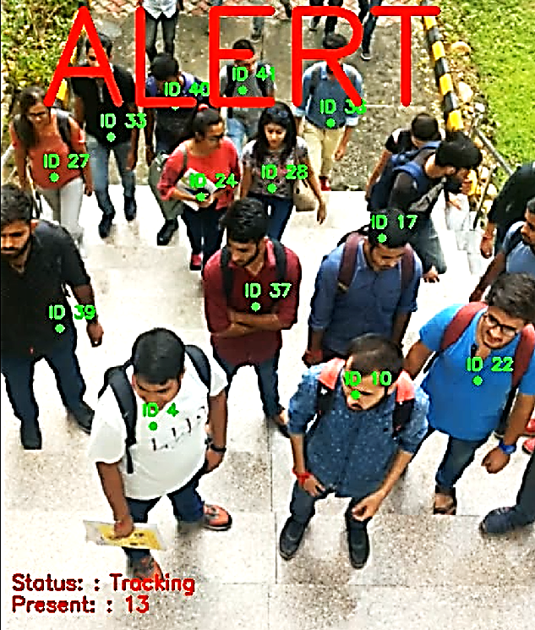

PRAGYASTRA - AI WEAPONIZE SYSTEM
EMAIL: 2022d1r003@mietjammu.in
PHONE: +919149843514
Abstract
Data Workflow
ChatGPT-based report generation is a novel approach that utilizes the capabilities of the ChatGPT language model to automate the process of generating reports. By leveraging natural language processing and generation techniques, this method allows for the seamless generation of comprehensive reports based on user interactions.The system interacts with student data, gathering relevant information and clarifying details as needed. It then processes and analyzes the input data to extract key insights, trends, and patterns. Using the synthesized knowledge, the ChatGPT model generates a well-structured and coherent report that presents the findings and conclusions in a concise and informative manner. This automated report generation approach holds great potential for streamlining report writing processes, reducing manual effort, and enabling efficient knowledge dissemination in various domains such as business, research, and data analysis.
INPUT VIDEO FEED
MOBILE NET SSD
Each feature map is
divided into cells with anchor boxes.
Each anchor box predicts offsets, additional fields, and class probabilities.
Innovation & Impact
FEATURE MAPS
INNOVATION:
This innovation improves productivity by eliminating repetitive tasks and enabling faster decision-making.
This innovation improves productivity by eliminating repetitive tasks involved in report writing, allowing users to focus on higher-value activities.
IMPACT:
ChatGPT-based report generation promotes efficiency and accuracy, reducing the chances of human errors or biases in the reporting process.
OUTPUT
Workflow
Open AI Workflow
Camera Lens
Performance Indices
Extra Curricular
Image Capturing/Processing
Academics
Projects
Co-Curricular
Object Tracking Module
Open AI Engine
Rendering Module
DISPLAY SCREEN
Automated Guidance via email
Language(s) | Technology Stack
LANGUAGES:
PYTHON
TECHNOLOGY STACK:
COMPUTER VISION
DEEP LEARNING
VIDEO ANALYSIS
API(S):
TWILLIO

