Slide 1
Laravel
Presentation About Basic Laravel

Slide 2
laravel
Laravel is a free and open source PHP web framework that is used to develop websites and web applications that follow the Model-View-Controller (MVC) pattern.
It is used in e-commerce, ticket and ordering systems, dashboards and admin backends for complex real-time applications.

Slide 3
Become a laravel developer he or she is responsible for:
Developing modern web applications and providing adequate maintenance and support
Writing clean and secure codes
Having profound knowledge of HTML, CSS, and JavaScript
Debugging and resolving technicalities whenever occurred while development
Create databases
Enhance different features and functionalities
Collaborate with other teammates
Conduct best practices

Slide 4
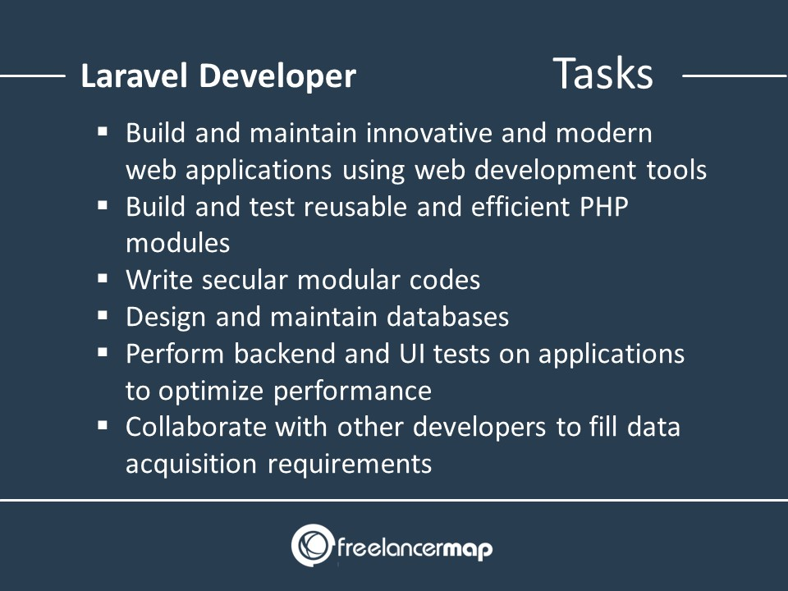
Tasks

Slide 5
Future Of laravel
Google, Yahoo, Rediff, Facebook, Intel, Digg, Flickr, Zynga, Borland, eBay, Nokia, Oracle, etc. based on PHP.

Slide 6
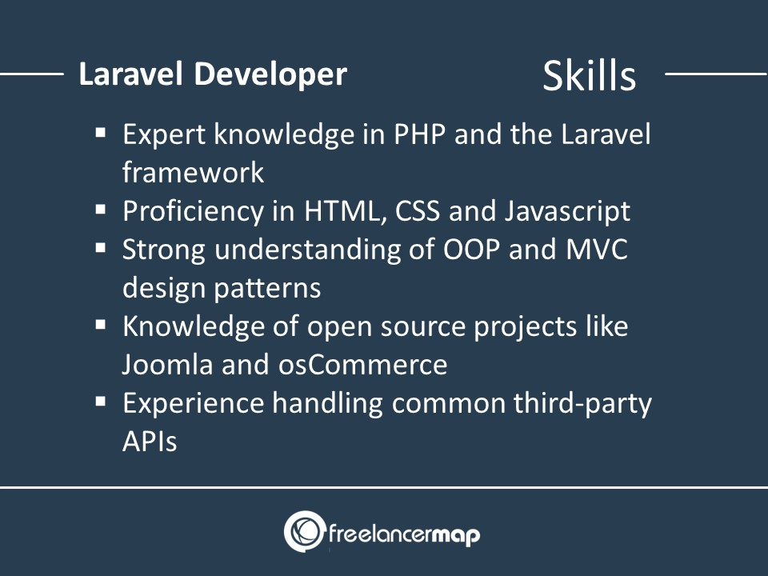
skills

Slide 7
Before learn Laravel
Basic HTML
Basic CSS
Basic Bootstrap
MySQL
PHP

Slide 8
Basic Html
HTML is a language for describing web pages.
HTML stands for Hyper Text Markup Language.
Hyper Text Markup Language (HTML) is the set of markup symbols or codes inserted into a file intended for display on the Internet.
"Hypertext" refers to the hyperlinks that an HTML page may contain.
"Markup language" refers to the way tags are used to define the page layout and elements within the page.
HTML is a markup language.
A markup language is a set of markup tags.
The tags describe document content
HTML documents contain HTML tags and plain text.
HTML documents are also called web pages

Slide 9
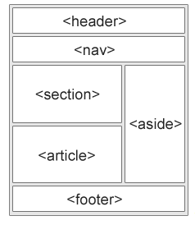
HTML Layout

Slide 10
Contd…
<header> - Defines a header for a document or a section
<nav> - Defines a set of navigation links
<section> - Defines a section in a document
<article> - Defines an independent, self-contained content
<aside> - Defines content aside from the content (like a sidebar)
<footer> - Defines a footer for a document or a section
<div> - The <div> tag defines a division or a section in an HTML document. By default, browsers always place a line break before and after the <div> element.
<details> - Defines additional details that the user can open and close on demand
<summary> - Defines a heading for the <details> element

Slide 11
Basic CSS
CSS stands for Cascading Style Sheet.
Typical CSS file is a text file with an extention .css and contains a series of commands or rules.
These rules tell the HTML how to display.

Slide 12
CSS Benefits
Separates structure from presentation
Provides advanced control of presentation
Easy maintenance of multiple pages
Faster page loading

Slide 13
HTML & CSS
HTML and CSS work together to produce beautiful and functional Web sites
HTML = structure
CSS = style

Slide 14
Attaching a Style Sheet
Attach a style sheet to a page by adding the code to the <head> section of the HTML page. There are 3 ways to attach CSS to a page:
External Style Sheet: Best used to control styling on multiple pages. <link rel=“stylesheet” type=“text/css” href=“css/styles.css” />
Internal Style Sheet: Best used to control styling on one page. <style type=“text/css”> h1 {color: red) </style>
Inline Style Sheet*: CSS is not attached in the <header> but is used directly within HTML tags. <p style=“color: red” >Some Text</p>

Slide 15
Css
1. Color
2. Background
background-color
background-image
background-repeat
background-attachment
background-position
background (shorthand property)
3. Borders
border-style
border-color
border-width
border-sides
border-shorthand

Slide 16
Contd…
4. Margin
5. Padding
6. Height/Width
Min-height
Max-height
Min-width
Max-width
7. Box model

Slide 17

Box model

Slide 18
css
8. Text
Color
Alignment
Decoration
text-decoration: underline red double 5px;
Transformation
text-transform: uppercase;
Spacing
1. text-indent
2. letter-spacing
3. Line-height
4. word-spacing
5. white-space

Slide 19
css
9. Icons – fontawesome icons
10. Links – style a tag
11. List
list-style-type: none, circle, square, upper-roman, lower-alpha
list-style-position: outside, inside
Display
Position
Z-index
12. Table
Borders
border-collapse: collapse;
Size
height, width
Alignment
text-align: center
Responsive
overflow-x: auto; to parent div tag of table

Slide 20
CSS Combinators
There are four different combinators in CSS:
descendant selector (space)
The descendant selector matches all elements that are descendants of a specified element.
The following example selects all <p> elements inside <div> elements:
div p { background-color: yellow; }
child selector (>)
The child selector selects all elements that are the children of a specified element.
The following example selects all <p> elements that are children of a <div> element:
div > p { background-color: yellow; }

Slide 21
Contd…
adjacent sibling selector (+)
The adjacent sibling selector is used to select an element that is directly after another specific element.
Sibling elements must have the same parent element, and "adjacent" means "immediately following".
The following example selects the first <p> element that are placed immediately after <div> elements:
div + p { background-color: yellow; }
general sibling selector (~)
The general sibling selector selects all elements that are next siblings of a specified element.
The following example selects all <p> elements that are next siblings of <div> elements:
div ~ p { background-color: yellow; }

Slide 22
Pseudo class
/* unvisited link */ a:link { color: #FF0000; } /* visited link */ a:visited { color: #00FF00; } /* mouse over link */ a:hover { color: #FF00FF; } /* selected link */ a:active { color: #0000FF; }
div:hover { background-color: blue; }
p:first-child { color: blue; }

Slide 23
Pseudo Element
The ::first-line Pseudo-element
The ::first-line pseudo-element is used to add a special style to the first line of a text.
The following example formats the first line of the text in all <p> elements:
p::first-line { color: #ff0000; }
The ::first-letter Pseudo-element
The ::first-letter pseudo-element is used to add a special style to the first letter of a text.
The following example formats the first letter of the text in all <p> elements:
p::first-letter { color: #ff0000; font-size: xx-large; }
CSS - The ::marker Pseudo-element
::marker { color: red; font-size: 23px; }

Slide 24
Contd..
::selection { color: red; background: yellow; }
@media only screen and (max-width: 600px) { body { background-color: lightblue; } }

Slide 25
Bootstrap
Bootstrap is a free front-end framework (HTML and CSS) for faster and easier web development.
Bootstrap is famous for being developed with components that have the ability to follow the property of responsive designs.
Responsive Design is about using CSS and HTML to resize, hide, shrink, enlarge, or move the content to make it look good on any screen.
Responsive Design allow your page works for computer, tablets and mobile phones.
In other words, bootstrap is a collection of CSS classes and JavaScript functions the you get ready to use and will not worry about write code
You will need to include three files:
• bootstrap.min.css
• jquery.min.js
• bootstrap.min.js
• Download and include in you page or use CDN links.
<meta name="viewport" content="width=device-width, initial-scale=1">

Slide 26
Bootstrap
 | Extra small <576px | Small ≥576px | Medium ≥768px | Large ≥992px | Extra Large ≥1200px | XXL ≥1400px
max-width | 100% | 540px | 720px | 960px | 1140px | 1320px

Slide 27

Container
Use the .container-fluid class to create a full width container, that will always span the entire width of the screen (width is always 100%):
The .container class provides a responsive fixed width container

Slide 28
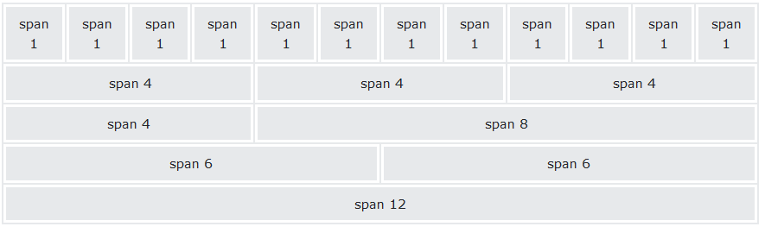
Bootstrap Grid System
Bootstrap's grid system is built with flexbox and allows up to 12 columns across the page.
If you do not want to use all 12 columns individually, you can group the columns together to create wider columns:

Slide 29
Grid Classes
.col- (extra small devices - screen width less than 576px)
.col-sm- (small devices - screen width equal to or greater than 576px)
.col-md- (medium devices - screen width equal to or greater than 768px)
.col-lg- (large devices - screen width equal to or greater than 992px)
.col-xl- (xlarge devices - screen width equal to or greater than 1200px)
.col-xxl- (xxlarge devices - screen width equal to or greater than 1400px)

Slide 30
Text Colors
The classes for text colors are: .text-muted, .text-primary, .text-success, .text-info, .text-warning, .text-danger, .text-secondary, .text-white, .text-dark, .text-body (default body color/often black) and .text-light:
Background Colors
The classes for background colors are: .bg-primary, .bg-success, .bg-info, .bg-warning, .bg-danger, .bg-secondary, .bg-dark and .bg-light.

Slide 31
Spacing
The classes are named using the format {property}{sides}-{size} for xs and {property}{sides}-{breakpoint}-{size} for sm, md, lg, xl, and xxl.
Where property is one of:
m - for classes that set margin
p - for classes that set padding
Where sides is one of:
t - for classes that set margin-top or padding-top
b - for classes that set margin-bottom or padding-bottom
s - (start) for classes that set margin-left or padding-left in LTR, margin-right or padding-right in RTL
e - (end) for classes that set margin-right or padding-right in LTR, margin-left or padding-left in RTL
x - for classes that set both *-left and *-right
y - for classes that set both *-top and *-bottom
blank - for classes that set a margin or padding on all 4 sides of the element

Slide 32
Contd…
Where size is one of:
0 - for classes that eliminate the margin or padding by setting it to 0
1 - (by default) for classes that set the margin or padding to 0.25rem i.e. 4px
2 - (by default) for classes that set the margin or padding to 0.5rem i.e. 8px
3 - (by default) for classes that set the margin or padding to 1rem i.e. 16px
4 - (by default) for classes that set the margin or padding to 1.5rem i.e. 24px
5 - (by default) for classes that set the margin or padding to $spacer * 3
auto - for classes that set the margin to auto

Slide 33
Why laravel
MVC Support and Object-Oriented Approach: It follows - Model, View, and Controller-based architectural pattern and it has an expressive beautiful syntax which makes it object-oriented.
Built-In Authentication and Authorization: Laravel provides an out-of-the-box configuration for the Authentication and Authorization system.
Packaging System: Laravel uses a composer as a dependency manager, which manages all the information needed to manage packages.
Multiple File System: Laravel also has a built-in support for the cloud storage system such as Amazon S3 and Rack space Cloud Storage and of course for local storage.
Artisan Console: Common uses of Artisan include publishing package assets, managing database migrations, seeding and generating boilerplate code for new controllers, models, and migrations.

Slide 34
Cont…

