Slide 1
Diabetic Retinopathy Detection
Using MobileNetV2
-Manish M
- MonishRaj S

Slide 2
Table of contents
Objectives
Methodology
01
02
Results analysis
Conclusions
03
04
Introduction/Main Objective of the project
Preprocessing, Model Working, Visualization
What exactly our model Analyse and predicts
Future enhancements and Conclusion

Slide 3
01
Objectives
Diabetes

Slide 4
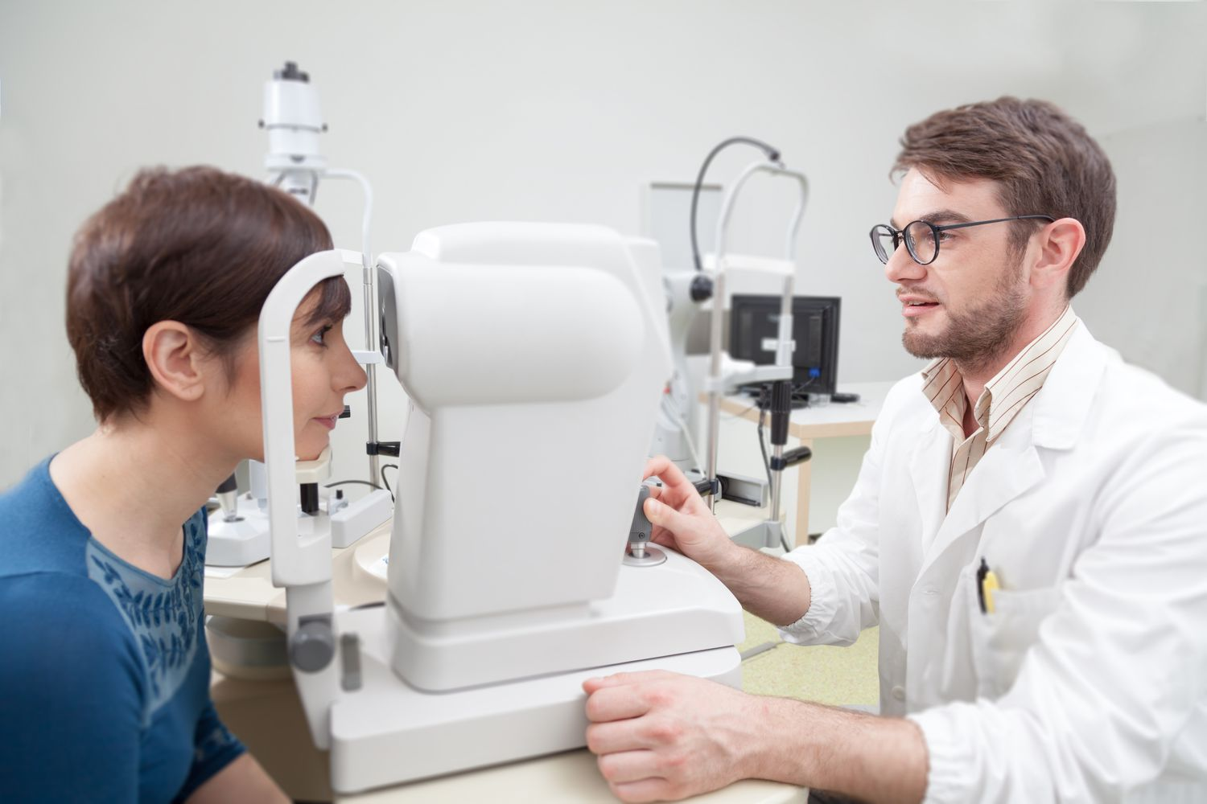
Introduction
Eye
Diabetes
Diabetic retinopathy is a potentially serious eye condition that affects individuals with diabetes, particularly those who have had diabetes for a long time.
It occurs when high blood sugar levels damage the blood vessels in the retina, the light-sensitive tissue at the back of the eye.
Diabetic retinopathy is a leading cause of vision loss and blindness in people with diabetes.

Slide 5
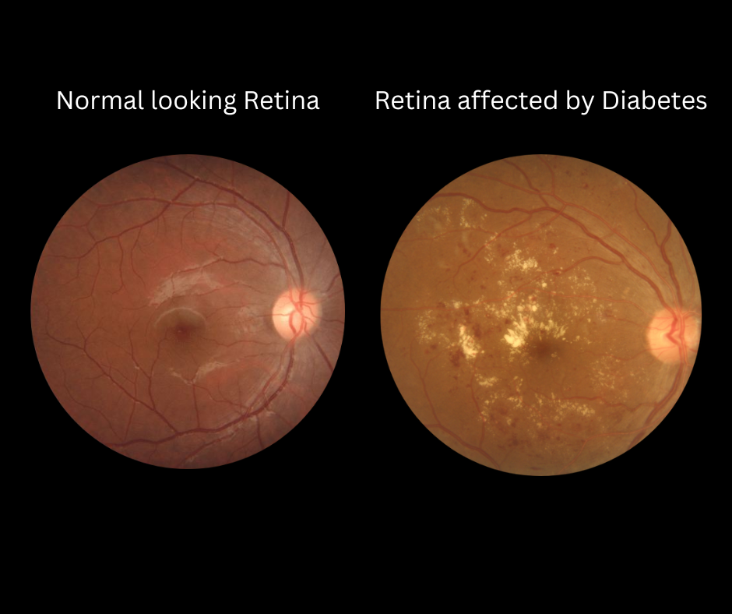
Introduction
Eye
Diabetes
Causes:
Elevated Blood Sugar
Duration of Diabetes
2. Stages:
Non-Proliferative Diabetic Retinopathy (NPDR)
Proliferative Diabetic Retinopathy (PDR)
3. Symptoms:
Blurred or distorted vision
Floaters (tiny specks or dark spots in the field of vision)
Difficulty seeing at night
Sudden vision loss (a sign of advanced disease)

Slide 6
Objective :
N0 DR(0)
MILD(1)
MODERATE(2)
SEVERE(3)
PROLIFERATIVE DR(4)
Objective
The main objective of this project is create an automated analysis system capable of assigning a score based on the following classification.

Slide 7
Objective :
Image Classification :
Risk Assessment :
Scalability :
Western blot
Develop a machine learning model capable of accurately classifying retinal images into different categories or stages of diabetic retinopathy, such as "No Diabetic Retinopathy," "Mild," "Moderate," "Severe," and "Proliferative."
Provide risk assessment by estimating the severity of diabetic retinopathy in each image, allowing healthcare professionals to prioritize patients for further evaluation and intervention.
Design the system to handle a large number of retinal images efficiently, enabling its use in real-world clinical settings.

Slide 8
02
Methodology
Diabetes

Slide 9
Procedure
4.
Load the data set.
2.
Train the model using the data.
Process the images.
5.
3.
Validate.
Classify based on scores

Slide 10
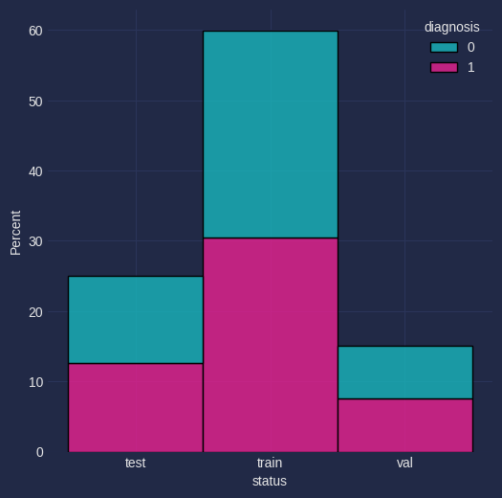
Test/Train/Validation data Classification:
Data :
Test data - 916
Train data - 2196
Validation data - 550
Input Type :
Image
Output :
Accuracy
Loss
The given data is balanced data with 3662 files with 50% DR data and other is No DR data
Dataset : https://www.kaggle.com/datasets/sovitrath/diabetic-retinopathy-224x224-gaussian-filtered/data

Slide 11
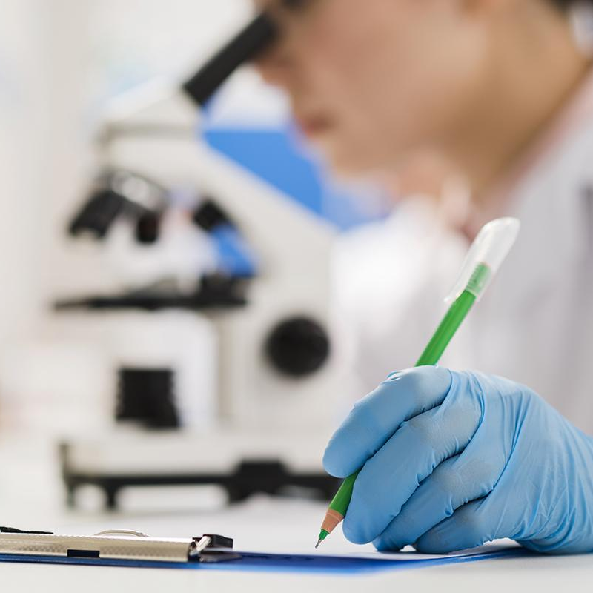
Description :
MobilenetV2(frozen MobileNet-based model) model is used.
Some of the advantages of using MobilenetV2 are as follows :
Image Preprocessing :
The code also uses the preprocess_input function from MobileNetV2 to preprocess the input images.
This preprocessing step is important as it applies the required transformations to the input images to match the preprocessing used during the original training of MobileNetV2.
It ensures that the input data is in a format that the pre-trained model expects.

Slide 12
Description :
Generalization :
Deep learning models like MobileNetV2 can generalize better to unseen data, thanks to their ability to capture intricate patterns and features.
Traditional machine learning models may not generalize as effectively, especially on complex data.
Fine-Tuning :
The base model is set to be non-trainable (base_model.trainable = False), which means that the weights of MobileNetV2 will not be updated during training.
This is common when you want to use the pre-trained features and fine-tune the model for your specific task.
Fine-tuning involves training the new layers added on top of the pre-trained model while keeping the base model's weights fixed.

Slide 13
Libraries :
Os - To perform system operations, like file creation, copying images, etc,..
Pandas - For data representation.
PIL - For image display.
Sklearn, Tensorflow - For training the model.
Multiprocessing - For performing multiprocessing.
Imagehash - For analyzing duplicate images.
Matplotlib - For plotting the graph.
Warning - To display some warnings.

Slide 14
Measures :
Accuracy
accuracy represents the overall correctness of predictions in a classification task.
Recall
recall assesses the ability to capture all positives
Precision
Precision measures the accuracy of positive predictions

Slide 15
ReLU (Rectified Linear Unit) :
ReLU is an activation function that's used in neural networks. It's like a switch that turns on if the input is positive and off if the input is negative.
In other words, if the input is greater than zero, it lets the information flow as is; if it's less than zero, it blocks the information. It's like saying "if something is there, keep it; if it's not there, throw it away."

Slide 16
Sigmoid :
Sigmoid is another activation function used in neural networks, especially in binary classification tasks. It takes any input value and "squashes" it into a range between 0 and 1. This is often used to represent probabilities. If the input is very negative, the sigmoid output is close to 0, and if the input is very positive, the output is close to 1. It's like mapping any number to a probability value between 0% and 100%.

Slide 17
03
Result Analysis
Diabetes

Slide 18
Test Results :
85.04%
34.8%
Accuracy
Loss
Venus is the second planet from the Sun
Despite being red, Mars is a cold place

Slide 19
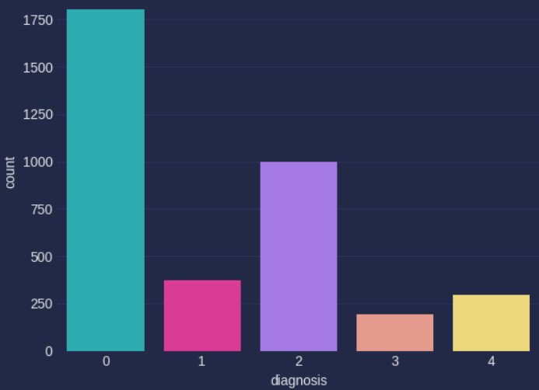
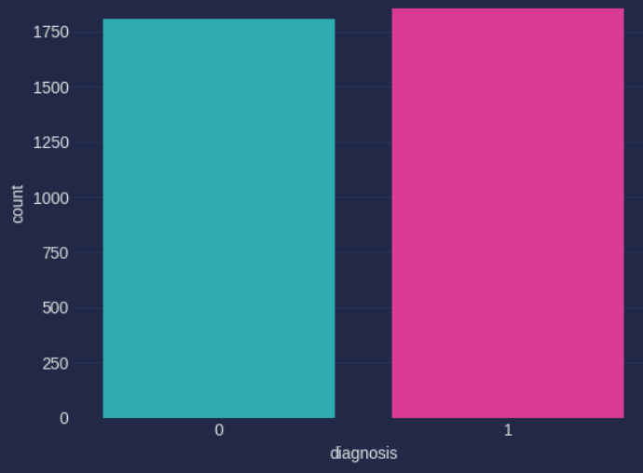
Results Visualization :
5 Class Classification
2 Class Classification

Slide 20
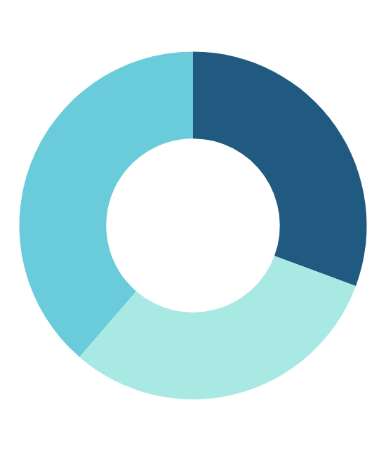
Results
Experiment A
Outcome
 | 0 | 1
Test | 12.5% | 12.5%
Train | 29.5% | 29.5%
Validation | 7.5% | 7.5%

Slide 21
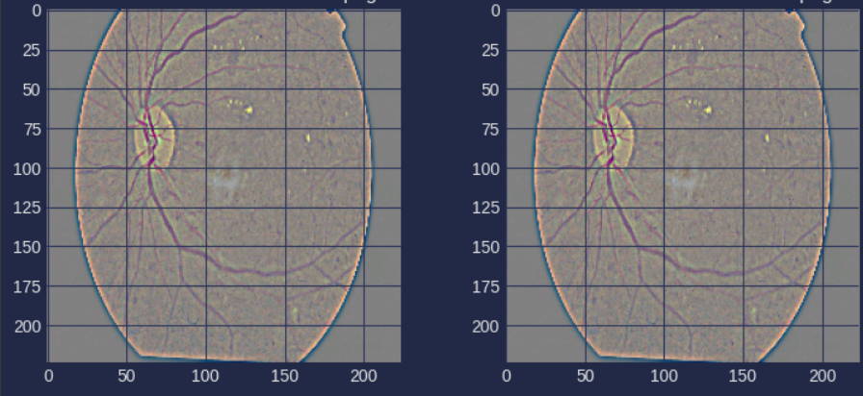
Sample Output :

Slide 22
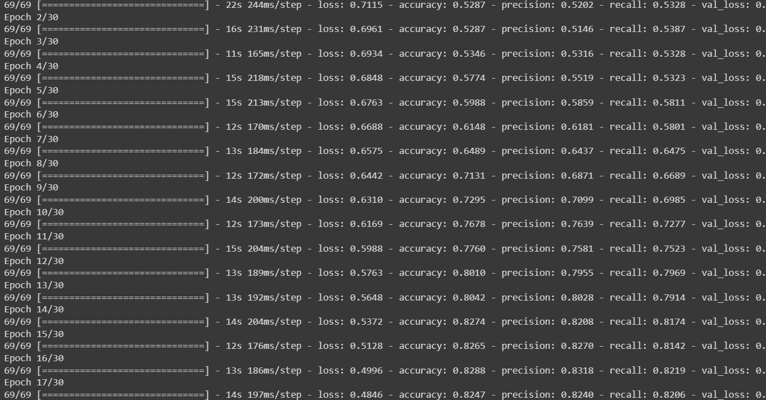

Slide 23
04
Conclusions
Diabetes

Slide 24
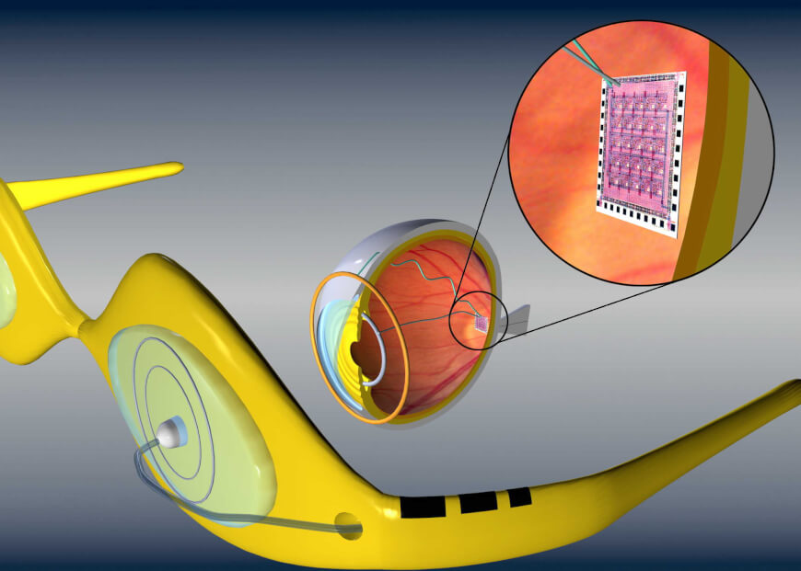
FUTURE SCOPE
In conclusion, the development of an automated analysis system for score assignment holds significant promise across various domains. This project objective focuses on enhancing efficiency, consistency, and objectivity in decision-making processes. By harnessing machine learning and classification techniques, we can achieve accurate and reliable score assignments. As we move forward, we aim to create user-friendly, adaptable systems that continually improve and address the unique needs of diverse applications.

Slide 25
Research Resources
https://www.nei.nih.gov/learn-about-eye-health/eye-conditions-and-diseases/diabetic-retinopathy
https://www.youtube.com/watch?v=YxQYvhap3kE
https://www.nei.nih.gov/learn-about-eye-health/eye-conditions-and-diseases/diabetic-retinopathy

Slide 26
Thanks!

