Slide 1

Exploratory data analysis on movies
Exploratory Data analysis on Movies

Slide 2
Introduction
Dataset contains various features -year, cast, actor, director, runtime, ratings and revenue of movies released between year 2006-2016.
We will analyze relationship between various features and derive insights to enable better decision making.
We will be exploring factors which play a major role in making a successful movie and what changes need to be done for business growth.

Slide 3
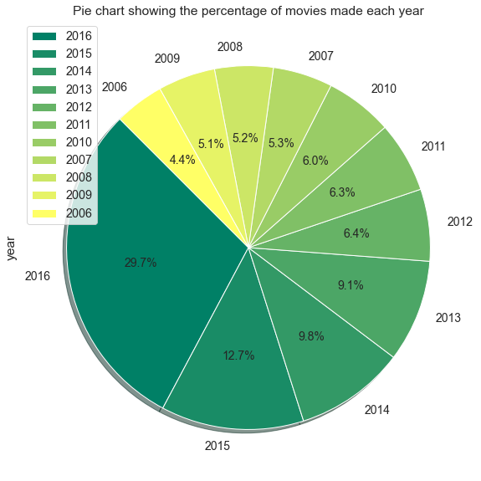
In which year maximum movies were made?
Maximum movies were produced in 2016 followed by 2015 and 2014

Slide 4
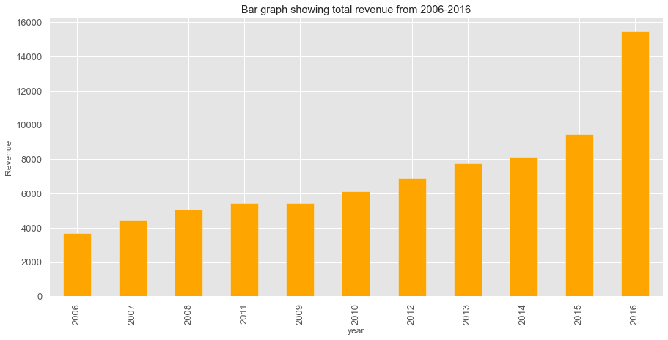
Which year contributed to maximum revenue?
2016 has maximum revenue

Slide 5
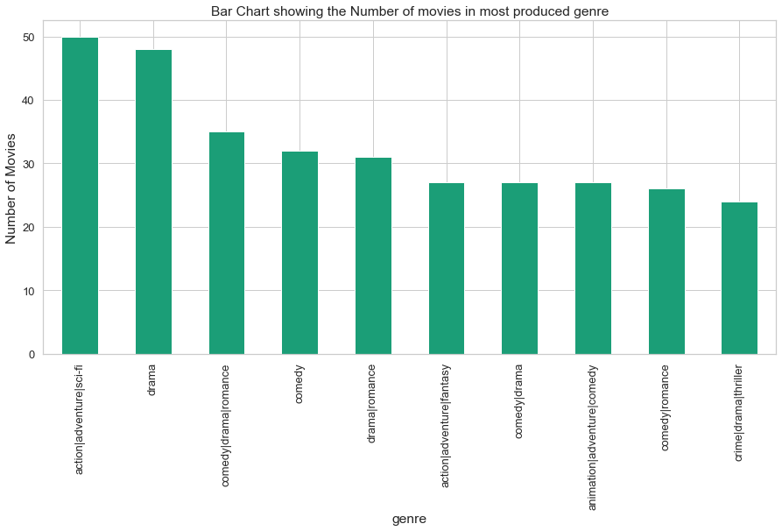
Which is the most produced genre?
Action | Adventure| Sci-fi is the most produced genre followed by drama and comedy.

Slide 6
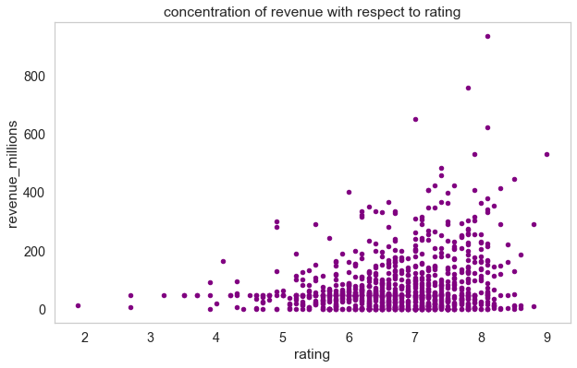
Relation between rating and revenue
Movies making highest revenue are rated between 7 to 8

Slide 7
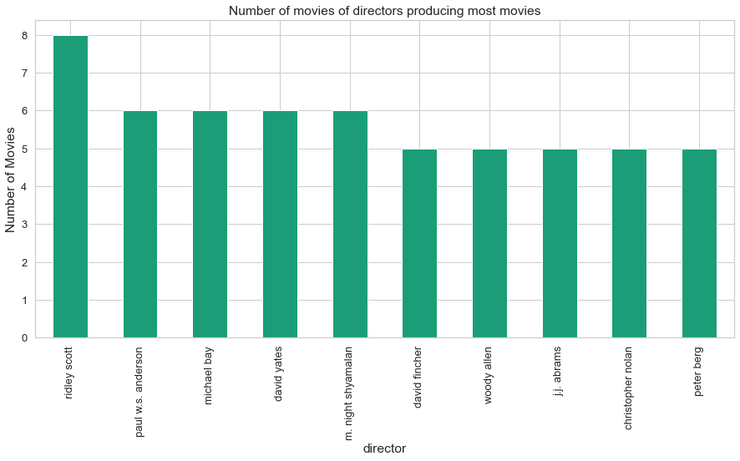
Which director has made maximum movies over the years?
Ridley scott has directed maximum movies (8) followed by Paul anderson , Michael bay , and David yates with 6 movies each.

Slide 8
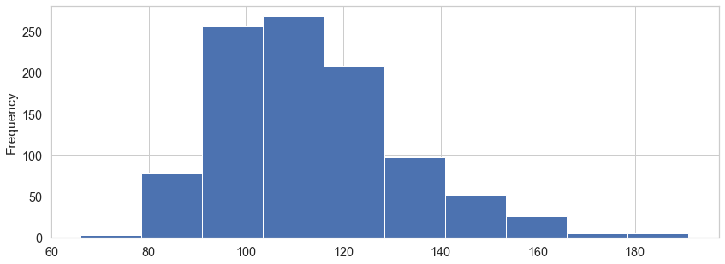
What is the runtime of movies?
Runtime of most of the movies is between 100 to 130 minutes

Slide 9
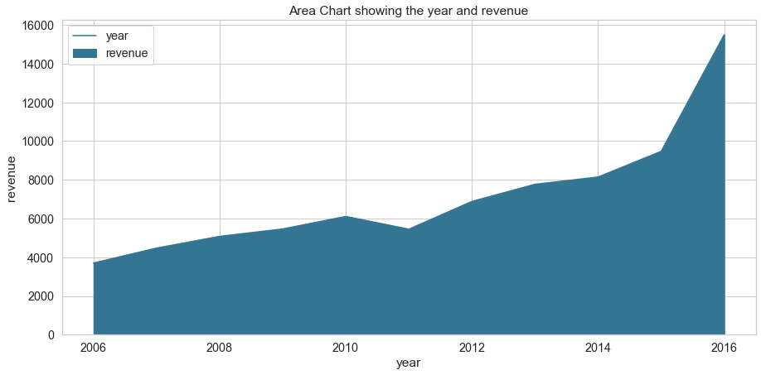
Growth of revenue over the years
Revenue is constantly growing taking a slight plunge in 2011 and reaching its peak in 2016

Slide 10
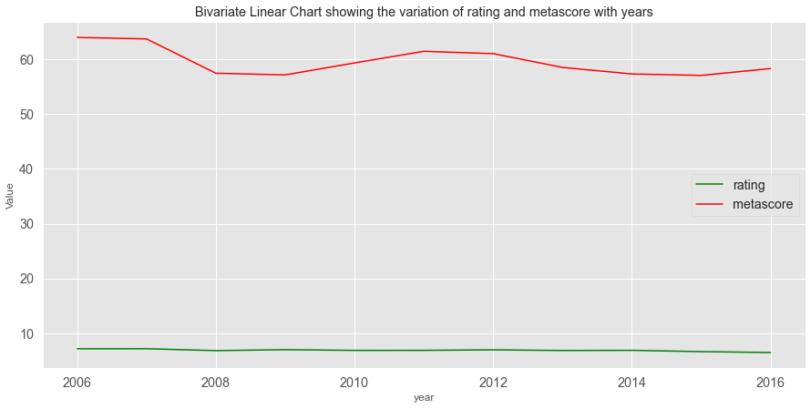
Relation between rating and metascore
While rating is stagnant over the years , Metascore is showing constant variation.

Slide 11
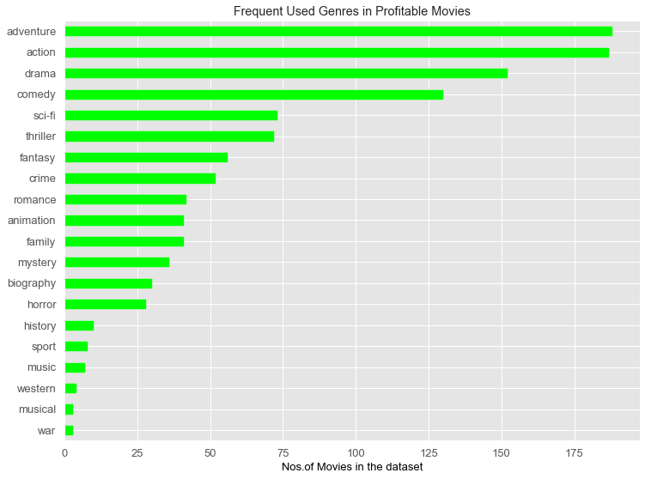
What is the most used genre in movies grossing over 50 million USD
Movies grossing over 50 million USD have used action & adventure genre followed by drama and comedy

Slide 12
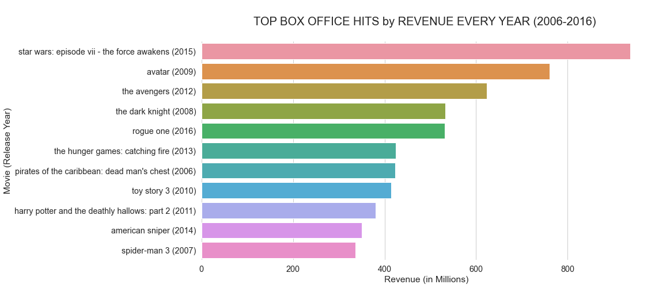
Highest profit making movie each year
Above are the movies which made highest revenue each year from 2006 to 2016 most of which are in franchise format

Slide 13
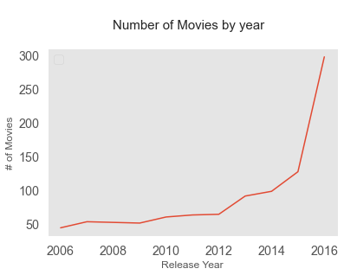
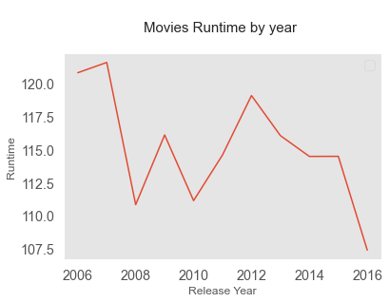
Number of movies vs runtime over the years
While the number of movies have grown significantly from 2006-2016 , run time has come down steeply from 2012 to 2016

Slide 14
Conclusion
The number of movies are growing every year leading to higher revenue growth.
Runtime of movies has gone down from 2006 to 2016.
The most profitable genres are action,adventure,comedy and drama.
Movies having renowned directors and actors tend to earn more at box office.
Ratings have a huge impact on success and profit of any movie.
franchise movies have higher likelihood of making big numbers at box office.

Slide 15
Actionable insights
More Movies must be made in action, adventure, comedy and drama genres.
More movies must be made in franchise format.
Runtime must be capped between 100-130 minutes.
With the advent of OTT platforms like Netflix and prime video ,Movies can be released in theatres and OTT simultaneously.
A regular survey about audience choices and preferences must be done in order to make movies accordingly.
Based on historical data of any person, appropriate predictions must be made to target right audience.

