Slide 1


Swami Keshvanand Institute of Technology, Management & Gramothan, Jaipur
(An Autonomous Institute Affiliated to Rajasthan Technical University, Kota)
Industrial Training
Presentation
TOPIC: Moraa jewels
Submitted To:
Name:- Mrs. Meenakshi Nawal
Submitted By:
Name:- Manish Kumar
Roll No.:- 24ESKCS601

Slide 2
Index
Company Introduction
Certificate
Technology Used
Goal of Training
Project Overview
Working Project
Future Scope
Q&A
SKIT, JAIPUR www.skit.ac.in

Slide 3
Company Introduction
GIT Infosys Pvt. Ltd. is a Jaipur-based information technology company established in 2010. The company specializes in providing innovative and customer-focused IT solutions, including web development, mobile application development, custom software development, digital marketing, UI/UX design, e-commerce solutions, and IT consulting. With a commitment to quality, innovation, and client satisfaction, GIT Infosys serves businesses across India and internationally, helping them achieve digital transformation and sustainable growth through advanced technology solutions.
SKIT, JAIPUR www.skit.ac.in

Slide 4
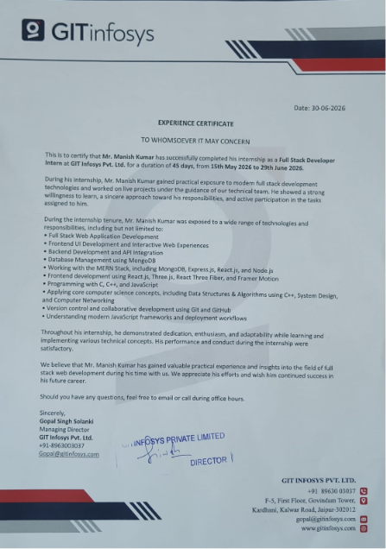

Slide 5









Technology Stack Used
SKIT, JAIPUR www.skit.ac.in

Slide 6
SECTION 01
Goal of Training
The primary goal of my internship at GIT Infosys Pvt. Ltd. was to gain practical experience in Full Stack Web Development by working on real-world projects and applying the concepts learned during my academic studies. The internship helped me understand industry-standard development practices and improve both my technical and professional skills. During the internship, I worked with the MERN Stack (MongoDB, Express.js, React.js, and Node.js), developed responsive user interfaces using React.js, and gained exposure to technologies such as Three.js, React Three Fiber, and Framer Motion. I also learned backend development, API integration, database management, and version control using Git and GitHub. In addition to technical knowledge, the internship enhanced my problem-solving, teamwork, communication, and time management skills. Overall, it provided valuable hands-on experience and prepared me for a successful career in the software development industry.
Adapt the objectives below to reflect your own training program's stated outcomes before presenting.
MORAA JEWELS
03

Slide 7
SECTION 02
Project Overview
Moraa Jewels is a responsive online jewelry store offering product browsing, user authentication, an admin-managed catalog, and cloud-based image delivery. A React single-page frontend pairs with a Node/Express backend and MongoDB persistence, deployed on Vercel.
KEY FACTS
Type
Full-stack web application
Frontend
React SPA
Backend
Node.js / Express
Database
MongoDB
Media
Cloudinary
Hosting
Vercel
Domain
moraajewles.com
MORAA JEWELS
04

Slide 8
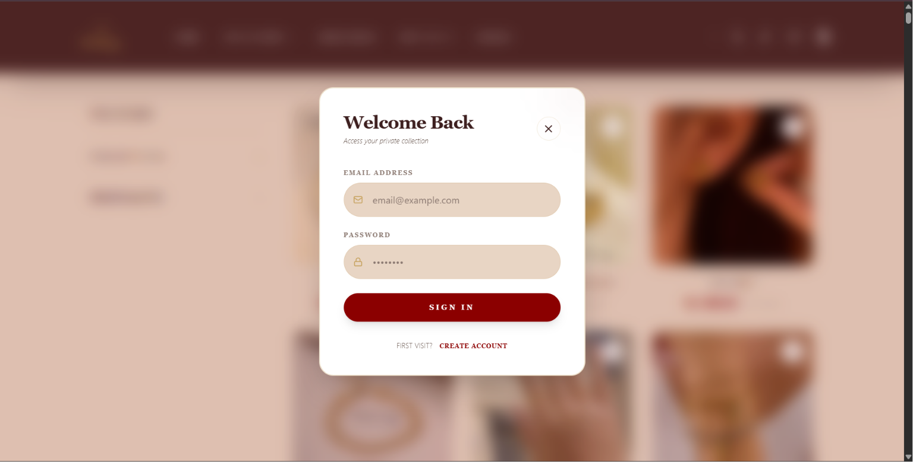
Login SECTION

Slide 9
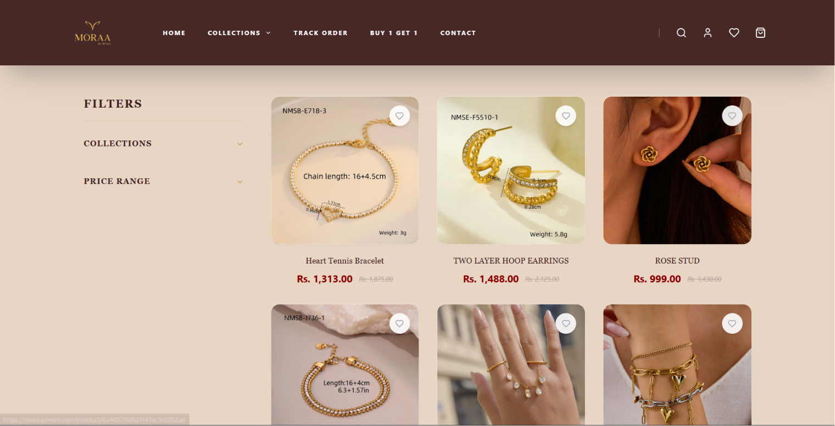
HOME SECTION

Slide 10
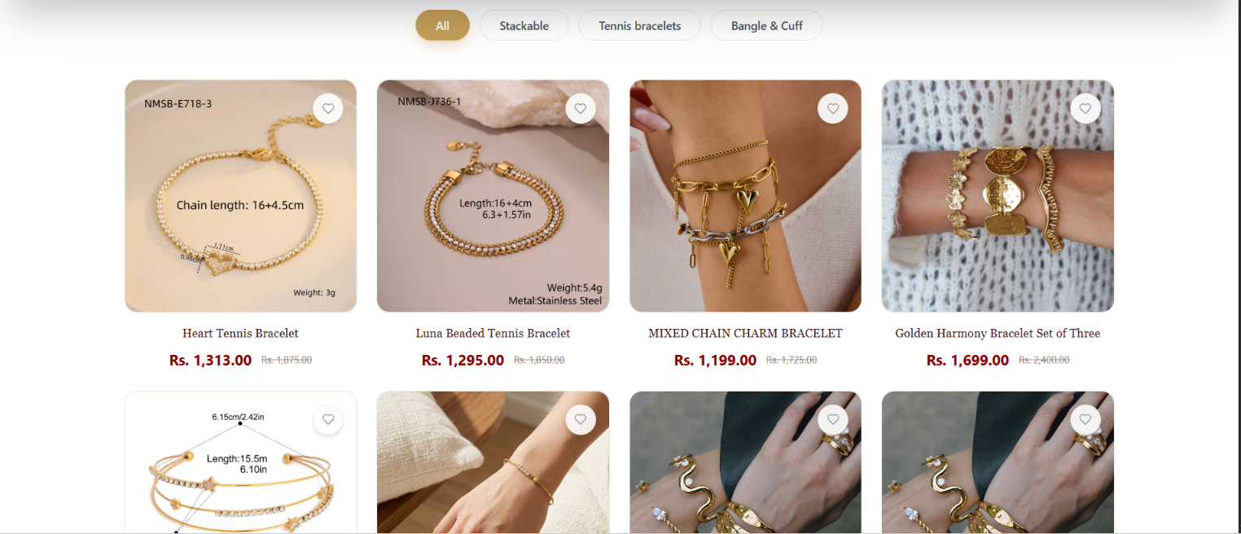
PRODUCT SECTION

Slide 11
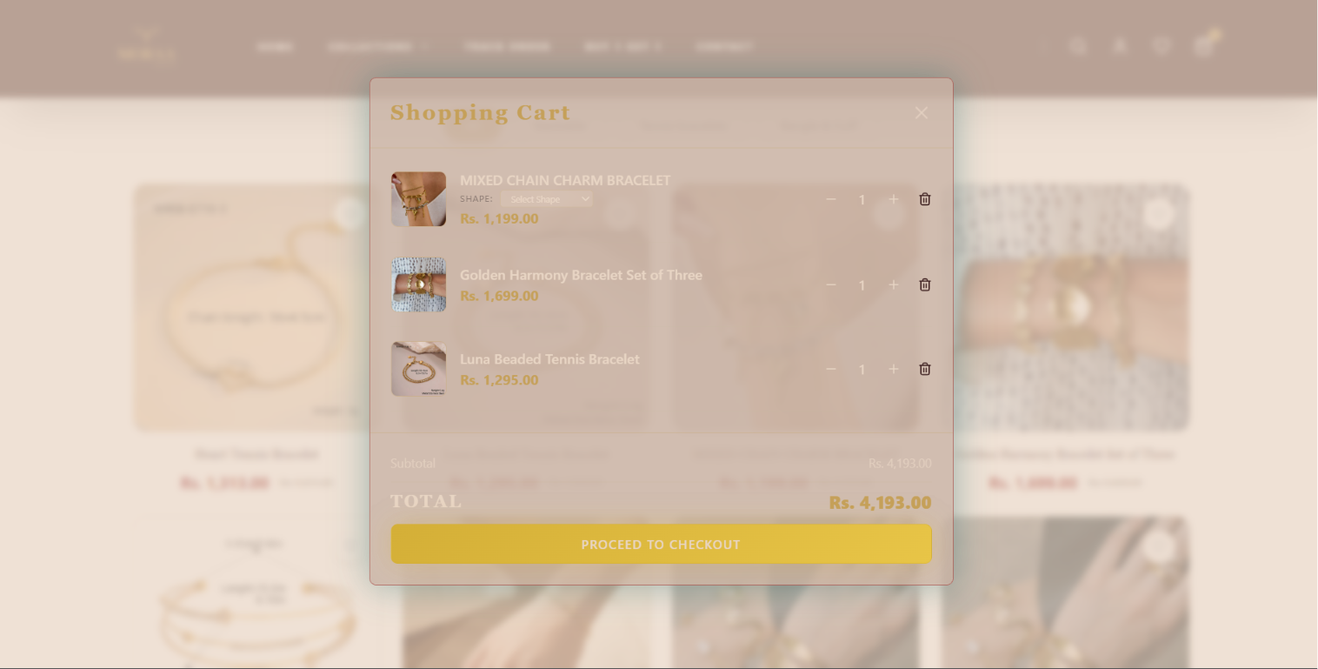
CArT section

Slide 12
SECTION 03 · TECHNOLOGY USED
The Stack, Layer by Layer
FRONTEND
React 18 · TypeScript · Vite · Tailwind CSS · React Router
BACKEND
Node.js · Express (independent /server sub-project)
DATA & MEDIA
MongoDB · Mongoose · Cloudinary
AUTH & SECURITY
JWT sessions · bcryptjs password hashing
TOOLING & DEPLOYMENT
ESLint · PostCSS/Autoprefixer · Vercel
MORAA JEWELS
06

Slide 13
SECTION 03 · TECHNOLOGY USED
Frontend
React 18
TypeScript
Component-driven UI and application state
Type safety across components and API calls
Vite
Tailwind CSS
Fast dev server and optimized production build
Utility-first, mobile-responsive styling
React Router
lucide-react
Client-side routing between pages
Consistent icon set across the UI
Axios
HTTP client for talking to the API
MORAA JEWELS
07

Slide 14
SECTION 03 · TECHNOLOGY USED
Backend, Auth & Media
SERVER
DATA
Node.js + Express, kept in its own /server sub-project
Independent dependencies and start script
MongoDB as the primary datastore
Mongoose ODM for schema modeling
AUTH
MEDIA
JWT for stateless session tokens
bcryptjs for password hashing
Cloudinary for product image upload and hosting
MORAA JEWELS
08

Slide 15
SECTION 06 · WORKING PROJECT
Admin & Content Management
1
Bootstrap the admin
A seeding script creates the first admin account before launch.
2
Admin login
The same auth flow, gated to an elevated role.
3
Manage products
Create, edit and remove catalog listings from the admin view.
4
Upload to Cloudinary
Product photography uploads directly to cloud storage.
5
Catalog updates live
Changes reach the storefront without a redeploy.
MORAA JEWELS
12

Slide 16
SECTION 08
Security Measures
Password hashing
Stateless authentication
Secrets kept out of source control
Passwords are never stored in plain text — bcrypt hashes each one before it reaches the database.
JWT-based sessions verify each request without server-side session storage.
API keys, database URI and Cloudinary credentials live in environment variables, guided by .env.example and enforced by .gitignore.
MORAA JEWELS
14

Slide 17
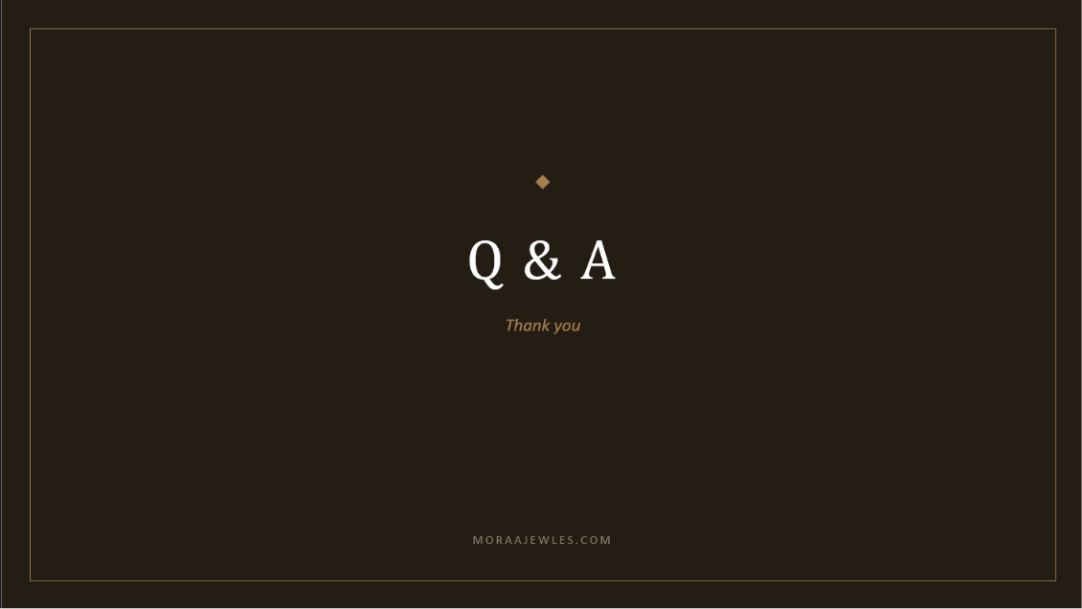
Q & A
Thank you
MORAAJEWLES.COM

