Slide 1


Swami Keshvanand Institute of Technology, Management & Gramothan, Jaipur
(An Autonomous Institute Affiliated to Rajasthan Technical University, Kota)
Industrial Training
Presentation
TOPIC: FedE²LoRA: Entropy-Guided Heterogeneous Low-Rank Adaptation for Non-IID Federated Learning
Submitted To:
Name:- Ms. Meenakshi Nawal
Assistant Professor
Submitted By:
Name:- Harshit Singh Hada
Roll No.:- 24ESKCS145

Slide 2
Index
  Company Introduction
  Certificate
  Technology Used
  Goal of Training
  Project Overview
  Working Project
  Future Scope
  Q&A
SKIT, JAIPUR www.skit.ac.in

Slide 3

Company Introduction
Malaviya National Institute of Technology Jaipur (MNIT or NIT Jaipur) is a public technical university established by an act of Parliament of India and is located in Jaipur, India with an emphasis on engineering whereas programmes in science and management are also offered.
Founded in 1963, and formerly known as Malaviya Regional Engineering College (MREC) Jaipur.
MNIT is 3rd ranked NIT according to research ranking of NIRF ranking and 50th overall.
MNIT have three center for research
SKIT, JAIPUR www.skit.ac.in

Slide 4
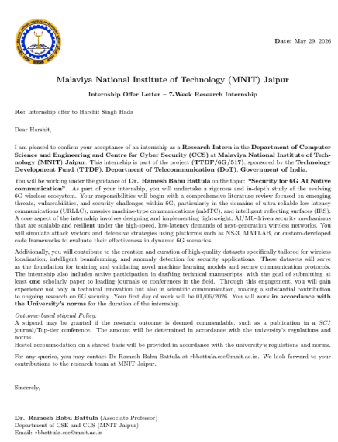

Slide 5

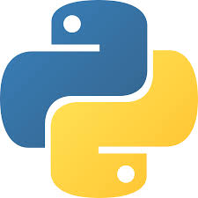


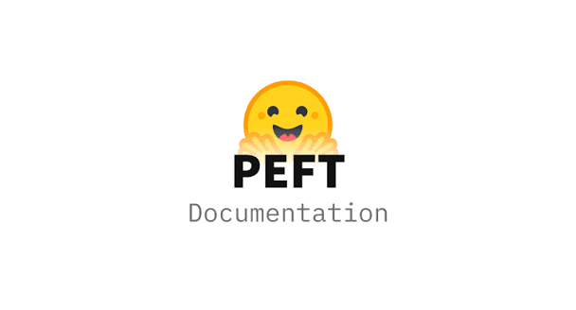


Technology Stack Used
SKIT, JAIPUR www.skit.ac.in

Slide 6
Goal Of Training
  To conduct research on Federated Fine-Tuning of Large Language Models (LLMs) and Small Language Models (SLMs).
  To study and implement PEFT techniques such as LoRA and its variants for efficient model adaptation.
  To explore communication-efficient aggregation algorithms for federated learning.
  To evaluate federated learning methods under IID and non-IID data distributions.
  To develop research skills through algorithm implementation, experimentation, and result analysis.
SKIT, JAIPUR www.skit.ac.in

Slide 7
Research Overview
The project focuses on Federated Fine-Tuning of Large Language Models (LLMs) and Small Language Models (SLMs) to enable privacy-preserving and communication-efficient distributed learning. It explores Parameter-Efficient Fine-Tuning (PEFT) methods such as LoRA and E²LoRA, along with efficient aggregation algorithms for heterogeneous client updates. The research evaluates these methods under different federated learning settings using PyTorch and Hugging Face Transformers, aiming to improve the scalability and efficiency of fine-tuning modern language models.
SKIT, JAIPUR www.skit.ac.in

Slide 8
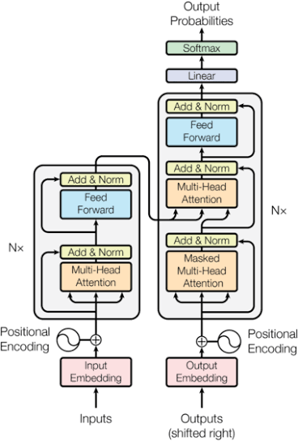
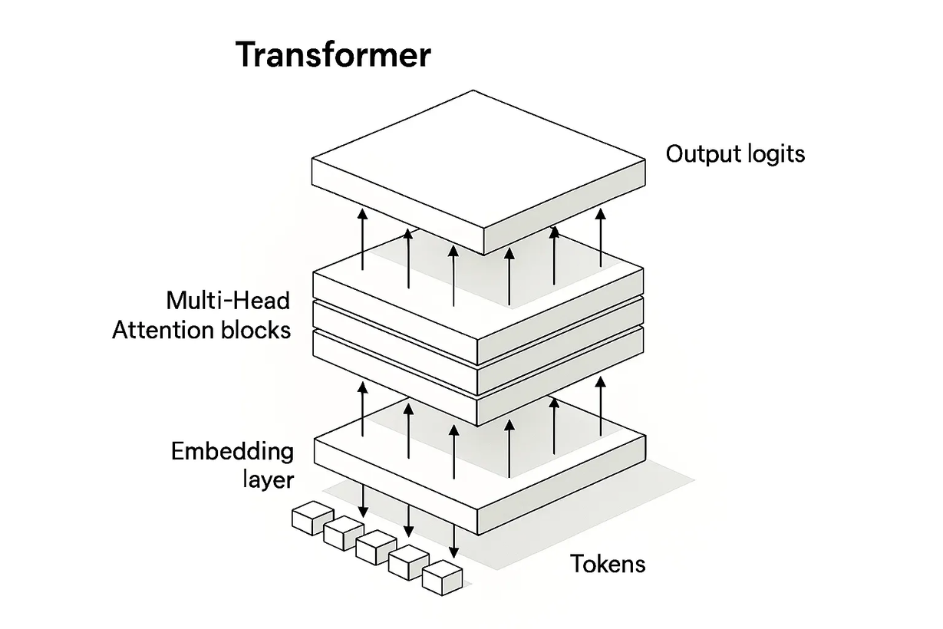
transformer model

Slide 9
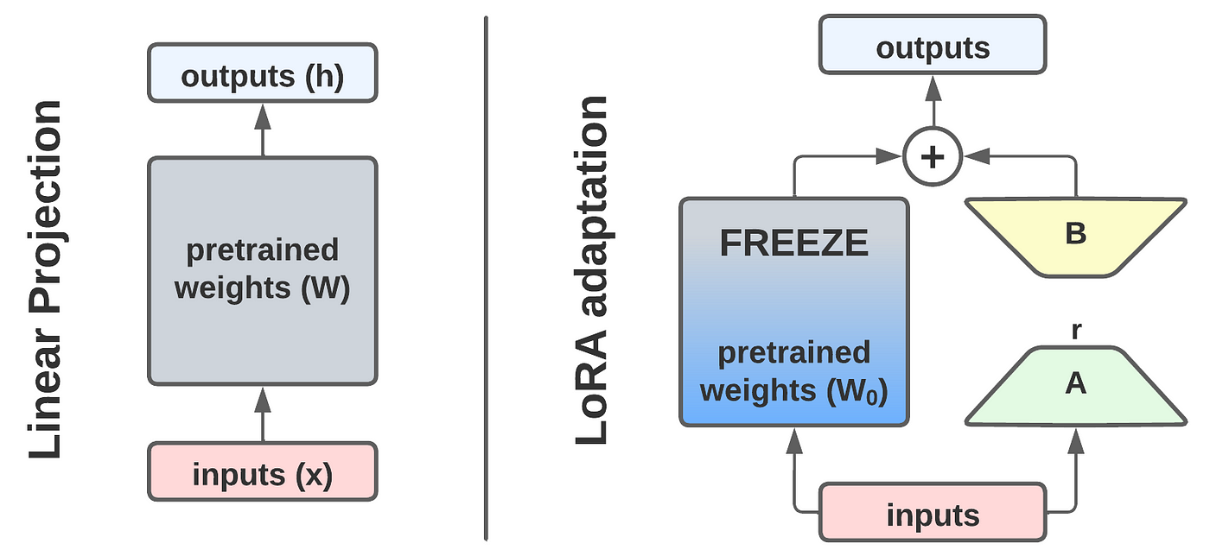
Lora finetuning

Slide 10
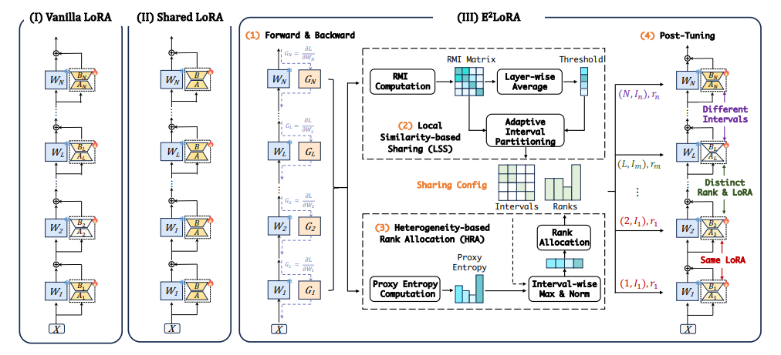
e2 lora architecture

Slide 11
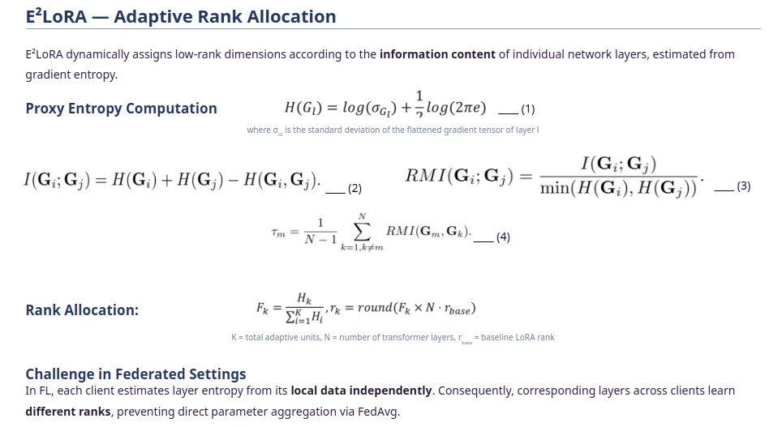
E2 lora intution

Slide 12
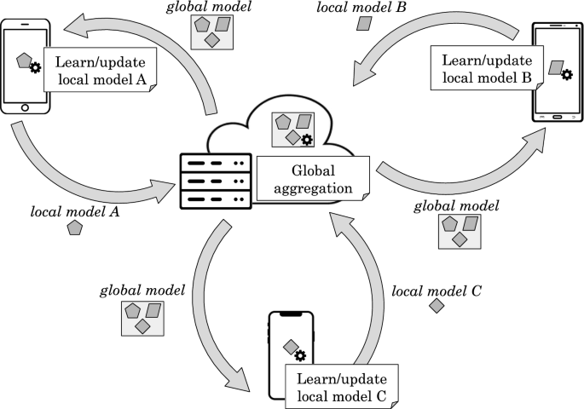
federated learning

Slide 13
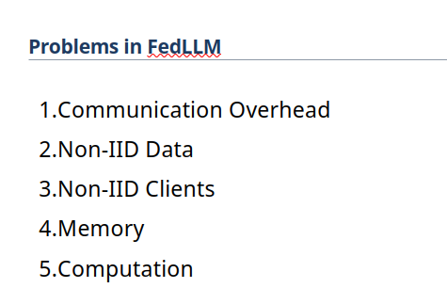
Problem in federated learning

Slide 14
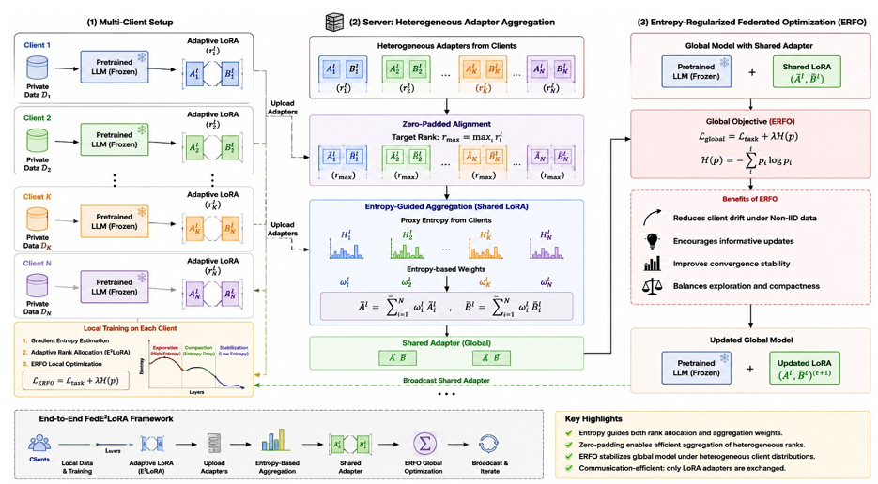
architecture FedE2lora

Slide 15
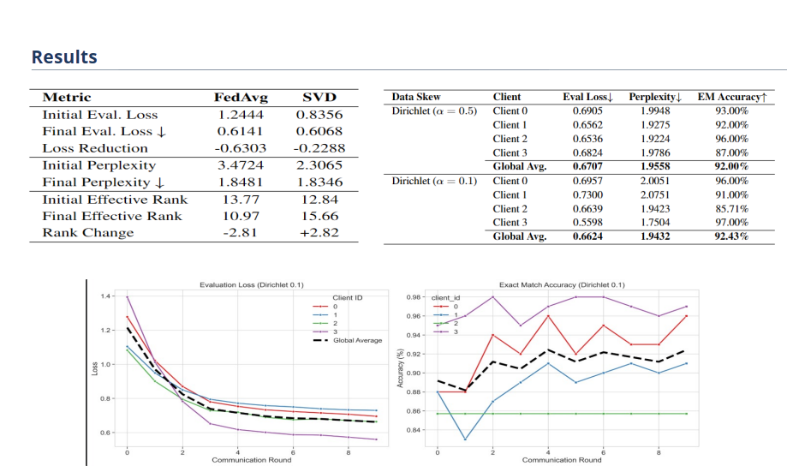
Results

Slide 16
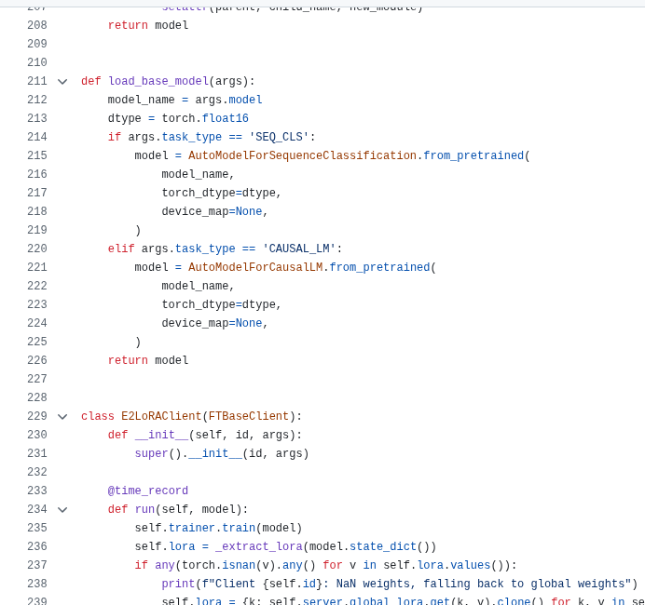
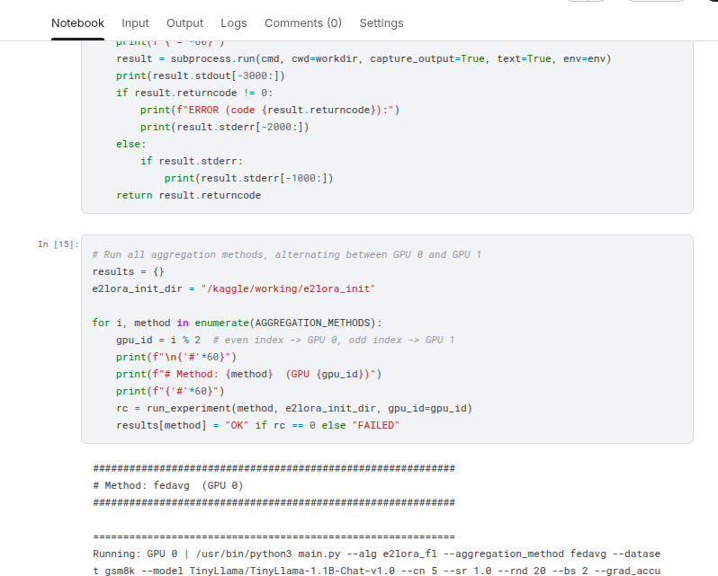
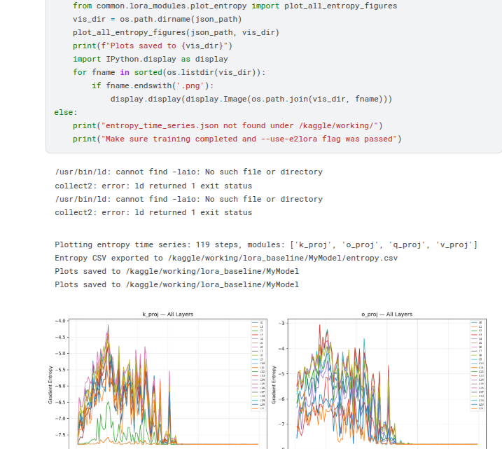
Code

Slide 17
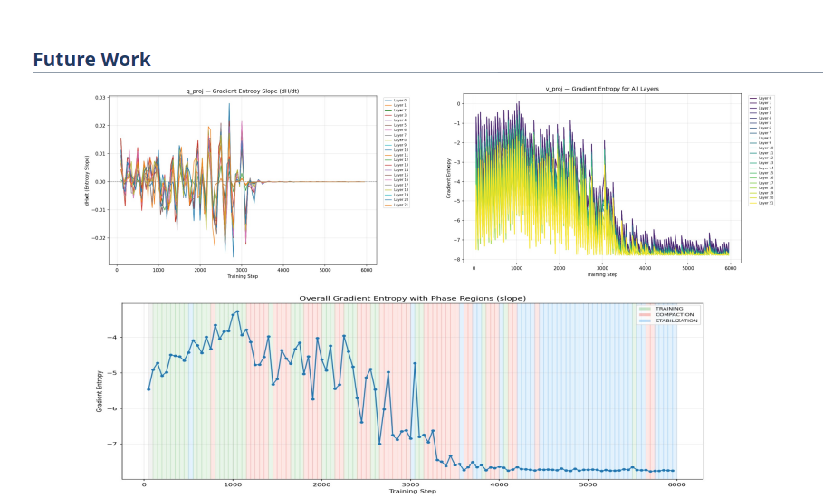

Slide 18
Future Scope
  Communication-Efficient Federated Fine-Tuning
  Advanced PEFT Techniques for Federated Learning
  Adaptive Entropy-Based Aggregation Algorithms
  Personalized Federated Fine-Tuning
  Scalable Federated Learning for Large Language Models
SKIT, JAIPUR www.skit.ac.in

Slide 19
Q & A
SKIT, JAIPUR www.skit.ac.in

Slide 20
Thank You
SKIT, JAIPUR www.skit.ac.in

