Slide 1
Covid-19: Response and Containment Measures

Slide 2
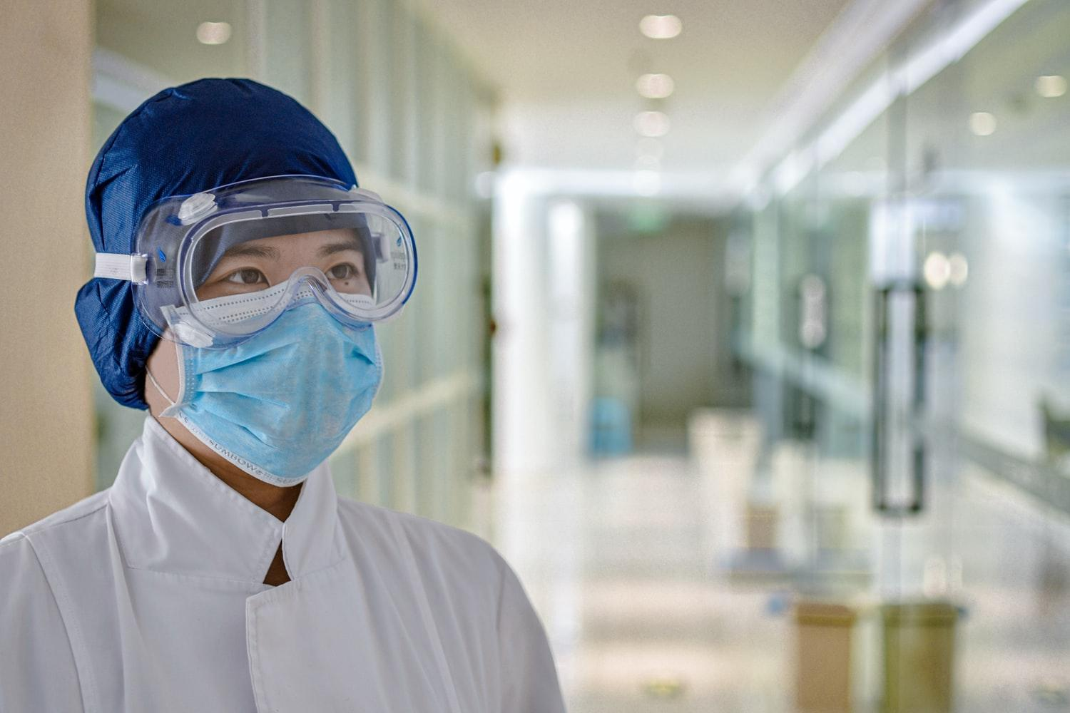
HELLO!
I am Sakshi Gupta
Roll Number: 2k20/TM/70

Slide 3
Introduction
1
Let’s get a brief introduction to Covid-19.

Slide 4
Coronavirus disease (COVID-19) is an infectious disease caused by the SARS-CoV-2 virus.

Slide 5
Response
2
What was world’s response to this outbreak?

Slide 6
Do gaj ki doori Mask hai zaroori
-Campaign led by Indian Govt.

Slide 7
Response
Wearing a mask at public places is mandatory
Keeping good hygiene
Keeping physical distance of 1 meter in public places.
Getting vaccinated as soon as it is your turn

Slide 8
Containment Measures
2
How to contain Covid-19?

Slide 9
Containment Measures
Clean your hands frequently with alcohol-based hand rub or soap and water
If you develop symptoms or test positive for COVID-19, self-isolate until you recover
Make your environment safer and healthier

Slide 10
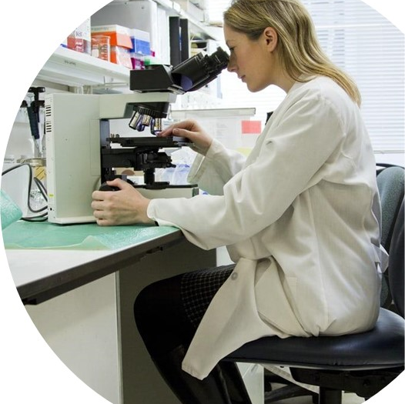
THANKS!
Any questions?
Thank you for your patient listening

