Slide 1

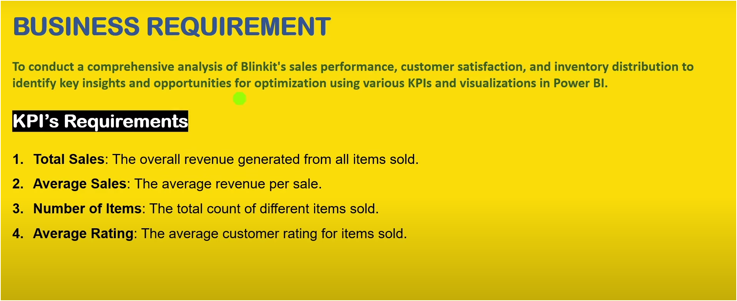
Blinkit Analysis

Slide 2
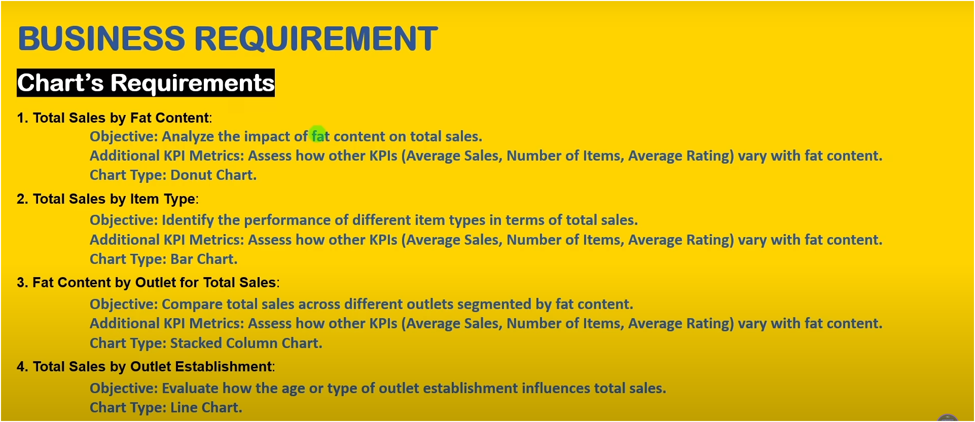
Blinkit Analysis

Slide 3
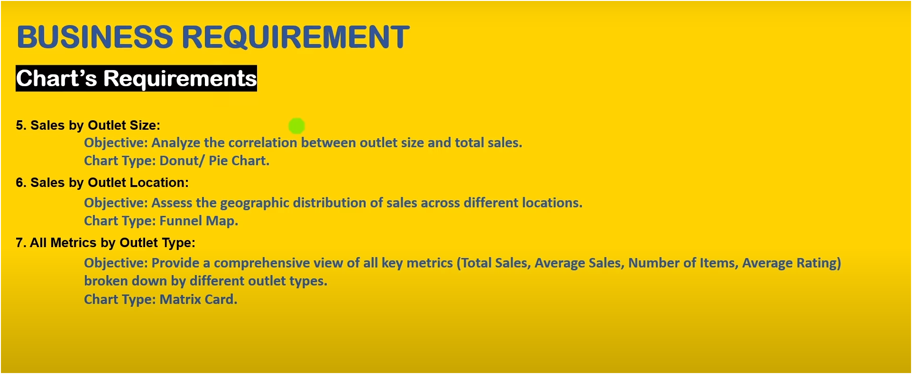
Blinkit Analysis

Slide 4
Blinkit Analysis
Thank You
Manish Gupta

