Slide 1
Back End Engineering Project
Title :
EduSphere
Team Details :
Manish Kaushik , 2310992060
Krish Malik , 2310992044
Kushagra Pandey , 2310990639
Laksh Garg , 2310992049
Faculty Coordinator :
Mrs . Vijaita Kashyap
:
Chitkara University Institute of Engineering and Technology,
Chitkara University, Punjab

Slide 2

INTRODUCTION
What is the Purpose of Our E-Learning Platform?
To provide an easy-to-use platform that simplifies online learning and makes it accessible to everyone.
To offer a seamless learning experience with a user-friendly interface and efficient data management on the backend.

Slide 3

KEY FEATURES
Key Features Implemented:
Homepage : A simple, attractive layout with navigation options.
Registration System : Allows users to create accounts by entering their details.
Backend Integration : Captures and stores user data in a JSON file.

Slide 4

TECHNICAL DETAILS
Frontend:
HTML : Structure of the website.
CSS : Styling for the webpage elements.
JavaScript : Adds interactivity to the homepage and registration page.
Backend:
Node.js for handling user input and requests.
Database:
JSON file used for storing user data entered during registration.

Slide 5
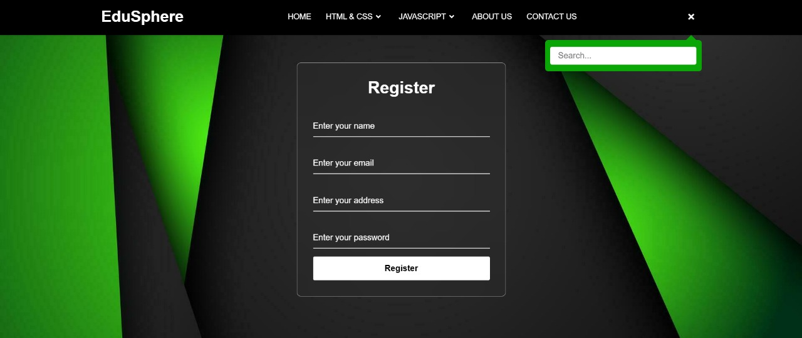
PROJECT HIGHLIGHTS

Slide 6
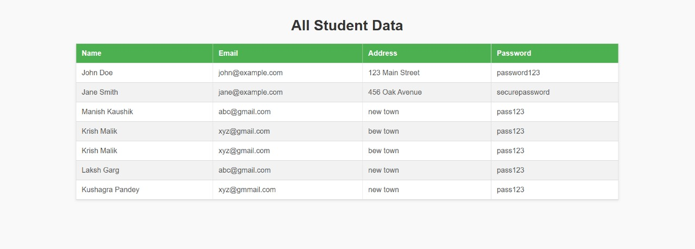
PROJECT HIGHLIGHTS

Slide 7

CONCLUSION
The online learning platform includes:
A functional homepage.
A registration system for users to create accounts.
Backend data storage and dynamic display of user information.
Functionality :
Users register by entering their details, which are stored and displayed dynamically.
Demonstrates the core feature of user registration, crucial for online platforms.

Slide 8


FUTURE SCOPE
Add more pages for courses and user profiles.
Use a proper database like MySQL for scalability.
Include user login and progress tracking.
Add interactive features like quizzes and video
Discussion Forums and Peer Interaction
Feedback and Suggestion Form

Slide 9


