Slide 1





CODENEXUS HACKATHON 2025
FinoTalk
PROBLEM STATEMENT TITLE – FINOTALK - Financial Literacy Chatbot
TEAM NAME - AI BASHERS
TEAM LEADER NAME - Manish Ram
COLLEGE NAME - Centurion University Of Management And Technology

Slide 2



PROBLEM & SOLUTION
Problem:
76% of Indian adults lack basic financial literacy.
Difficulty in understanding complex financial concepts and investment strategies.
Misinformation and lack of easy-to-access financial advisory services.
Solution:
AI-powered chatbot providing accurate, real-time answers to financial queries.
Simplifies economic terms, tax laws, and investment options in an easy-to-understand format.
Offers AI-driven personalized investment insights based on user financial behaviour.

Slide 3

TECHNOLOGY IMPLEMENTATION
Tech Stack :
Python Modules: OS, Tkinter, message box, PIL (ImageTk), mysql.connector, google.generativeai, auto-py-to-exe
MySQL: Database integration for user data storage .
API Key: Gemini API (gemini-1.5-flash) .
Methodology :
Tkinter-based UI: User-friendly graphical interface for interaction .
Database Connectivity: Storing and retrieving user data via MySQL .
AI Integration: Google Gemini API for intelligent responses .
Standalone Executable: Convert the project into an .exe file using auto-py-to-exe .
What makes it unique?
AI-powered Financial Insights: Provides real-time, AI-driven financial guidance
Interactive UI: Engaging user experience with Tkinter-based design
Secure Database Storage: MySQL ensures reliable data management
Text Input: Supports multiple input formats for better user interaction
Easy Deployment: Convert the app to an executable file for distribution

Slide 4

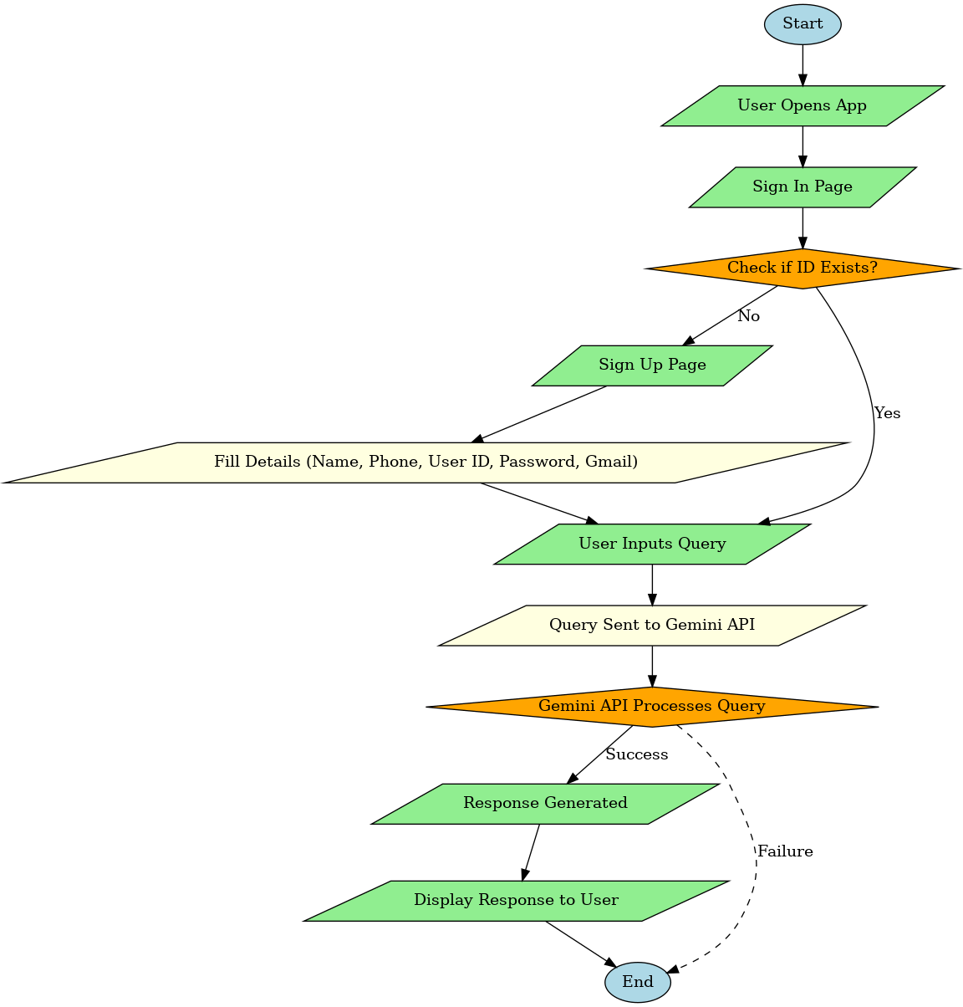
FLOWCHART

Slide 5

IMPACT & BENEFITS
Impact on Users:
Improves financial decision-making for individuals and small business owners.
Empowers millions with essential financial knowledge, reducing misinformation.
Bridges the knowledge gap, enabling financial independence across all demographics.
Benefits:
Social: Encourages financial inclusion and literacy for all socio-economic groups.
Scalability: Future expansion into taxation, stock market predictions, and automated investment advisory.
Economic: Promotes smart financial habits, reduces debt traps, and boosts savings.

Slide 6
FEASIBILITY & CHALLENGES
Feasibility:
AI-driven financial advisory is cost-effective and scalable.
Cloud-based infrastructure ensures smooth deployment and updates.
API integrations with real-time financial data providers enhance accuracy.
Challenges & Solution:
User Trust: Implement verified financial data from SEBI, RBI, and government sources.
Regulatory Compliance: Adhere to financial regulations and privacy policies.
Language Barrier: Leverage AI translation tools for seamless multilingual support.
User Engagement: Gamification and interactive learning modules for better adoption.

