Slide 1
Model Compression using Pruning, Quantization and Distillation on AG News Dataset
Assignment 5 Presentation
Prepared by: Manish Raj

Slide 2
Problem Statement and Motivation
Transformer models provide outstanding accuracy in NLP tasks but require significant computational and memory resources.
To enable deployment on low-resource devices, compression techniques are used to make models smaller and faster.
This study applies pruning, quantization, and knowledge distillation on transformer models.
The goal is to analyze performance trade-offs between size reduction, accuracy, and inference time.

Slide 3
Methodology / Workflow
Dataset: AG News (1,000 samples used for experimentation)
Model: DistilBERT transformer fine-tuned on AG News
Compression Techniques:
– Pruning: Global L1 Unstructured Pruning (30%)
– Quantization: Dynamic INT8 Quantization for CPU inference
– Knowledge Distillation: Training a smaller student model from a teacher
Evaluation Metrics:
– Model Size (MB)
– Validation Accuracy (%)
– Inference Time per Batch (s)

Slide 4
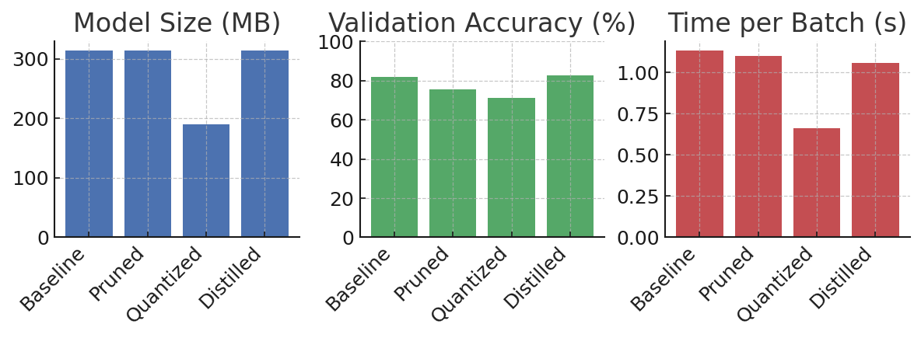
Results and Performance Metrics
Model | Size (MB) | Accuracy (%) | Time/Batch (s)
Baseline | 313.30 | 82.0 | 1.1326
Pruned | 313.30 | 75.5 | 1.1033
Quantized | 190.13 | 71.0 | 0.6613
Distilled | 313.30 | 82.5 | 1.0591

Slide 5
Observations and Lessons Learned
Quantization provided the highest size reduction and fastest inference speed.
Pruning showed moderate improvements but minimal file-size gain due to serialization format.
Distillation retained accuracy similar to the baseline while offering potential for smaller student architectures.
Trade-offs were observed between accuracy and speed – quantized models favored speed, distilled models favored accuracy.
Compression is crucial for deploying models on low-power devices efficiently.

Slide 6
Conclusion
Model compression techniques help in optimizing deep learning models for real-world applications.
Quantization provides immediate benefits in memory and inference time with small accuracy loss.
Pruning enhances model sparsity, preparing it for further optimization.
Knowledge distillation maintains competitive accuracy while reducing complexity.
Together, these techniques make transformer models viable for edge and mobile deployment.
Prepared by: Manish Raj

