Slide 1
Atliq Mart Supply Chain Insights
Data-Driven Analysis for FMCG Supply Chain Performance

Slide 2
Agenda
• Project Overview
• Problem Statement
• Objectives
• Data & Methodology
• Key Metrics
• Insights
• Recommendations
• Conclusion

Slide 3
Project Overview
Atliq Mart, a fast-growing FMCG manufacturer headquartered in Gujarat, operates in Ahmedabad, Surat, and Vadodara.
This project analyzes daily delivery data across customers, products, and cities:
• Identify supply chain gaps
• Improve delivery efficiency
• Support expansion strategy into Tier-1 and Metro cities

Slide 4
Problem Statement
Key customers have not extended annual contracts due to:
Late deliveries
Incomplete deliveries
Management requires daily tracking of OT %, IF %, and OTIF % to quickly resolve issues.

Slide 5
Project Objectives
1. Track Key Metrics on daily basis: OT %, IF %, OTIF %, LIFR %, VOFR %
2. Evaluate Metrics Against Customer Targets cities
3. Analyze Metrics based on City-Level Performance
4 Product-wise Analysis

Slide 6
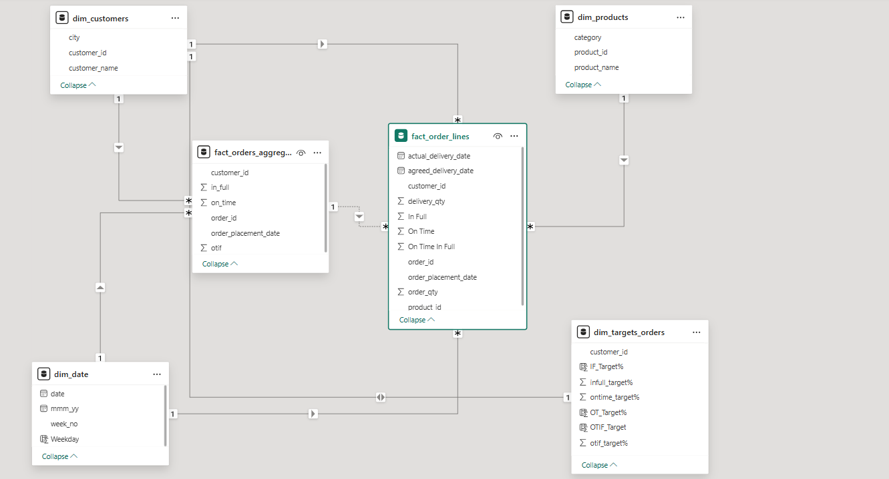
Data & Methodology
• Data Source: CSV files
• Data Model: Star schema
Tools: Power BI
Skills: Data Modelling, DAX, Data Visualization & KPI

Slide 7
Key Metrics Defined
Line Fill Rate (LIFR %): % of order lines shipped vs. total lines ordered.
Volume Fill Rate (VOFR %): % of quantity shipped vs. ordered.
In-Full Delivery (IF %): Order delivered only if all items match requested quantities.
On-Time Delivery (OT %): Order delivered only if all items arrive by the agreed time.
On-Time In-Full (OTIF %): Order delivered both on-time and in-full.

Slide 8
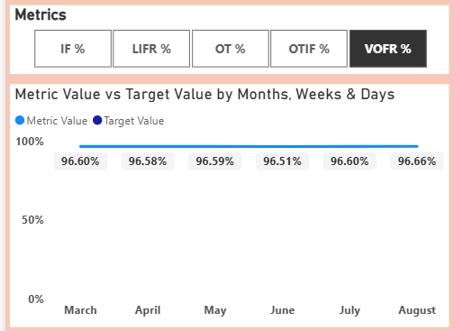
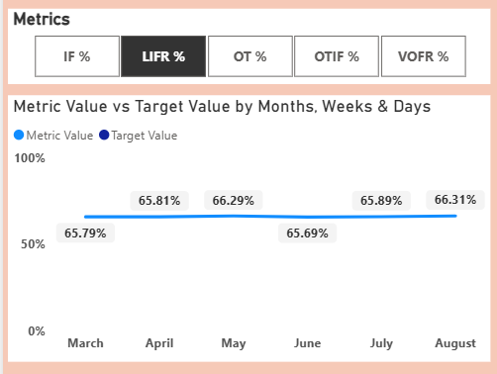
Insights Summary : Track Key Delivery Metrics
• VOFR remains strong (~96.6%) and stable, reflecting consistent fulfilment performance.
• LIFR moderate (~66%), showing improvement with higher Volume items delivered, confirming interdependence.

Slide 9
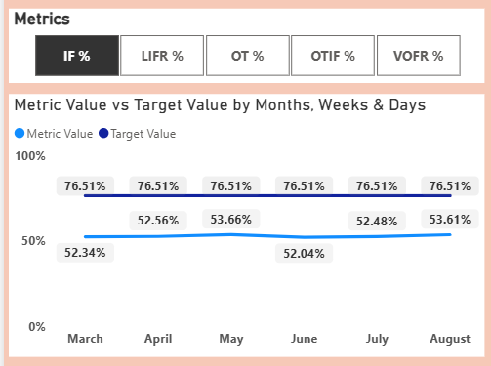
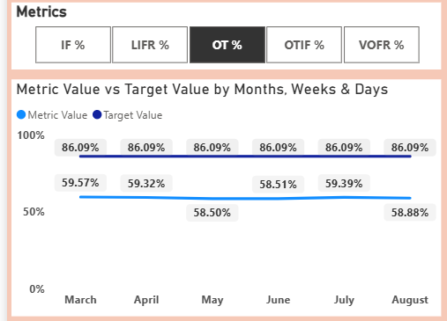
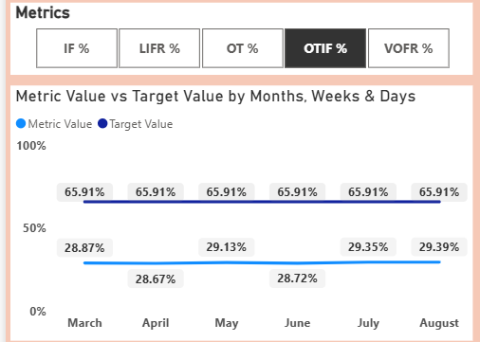
IF (~53%) underperforms, 23.7 pts below target, reflecting systemic fulfilment gaps.
OT (~59%) underperforms, 27 pts below target, highlighting fulfilment & on-time delivery gaps.
OTIF very low (~29%), 36.9 pts below target, reflecting systemic gaps in On-Time & In-Full delivery.

Slide 10
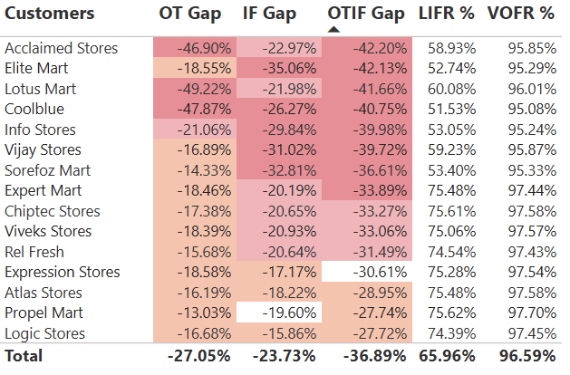
Evaluate Metrics Against Their Target for Customers
VOFR% remains strong at 95–98%, indicating high fulfillment of customer orders.
LIFR% varies significantly (52–76%), highlighting challenges in fulfilling complete line items per order.
All customers fall below target for OT %, IF % and OTIF % indicating systemic issues in timeliness and completeness of orders.
Top Performers: Logic Stores, Propel Mart, Atlas Stores, Expression Stores, Rel Fresh.
OTIF%: Gap –27.7% to –31.5%
OT%: Gap –13.0% to –18.6%
IF%: Gap –15.9% to –20.6%
Bottom Performers: Acclaimed Stores, Elite Mart, Lotus Mart, Coolblue, Info Stores.
OTIF%: Gap –40.0% to –42.2%
OT%: Gap –18.6% to –49.22%
IF%: Gap –22.0% to 35.06%

Slide 11
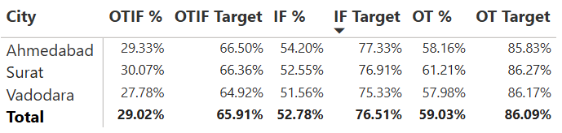
Analyse Metrics Against Their Target for City
Lower IF% across cities is primarily driven by weaker VOFR% and LIFR%, highlighting incomplete order fulfillment.
Lower OT% across cities is tied to weaker LIFR%, indicating order lines were not fully ready for dispatch on the agreed delivery date.
Lower OTIF% is directly impacted by gaps in VOFR%, LIFR%, IF%, and OT%, resulting in incomplete and delayed deliveries.

Slide 12
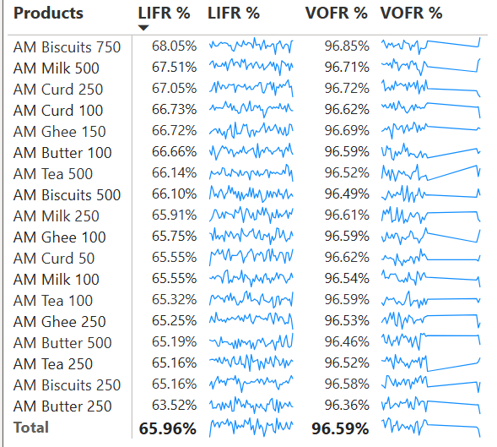
Product-Wise Metric Check
Highest performing products (AM Biscuits 750, AM Curd 250, AM Milk 500, AM Ghee 150, AM Curd 100) show VOFR% of 96.6–96.9% as more volume is fulfilled, more line items are successfully delivered.
Lowest performing products (AM Butter 250, AM Butter 500, AM Biscuits 500, AM Tea 500, AM Tea 250) show VOFR% of 96.3–96.5%; lower VOFR% corresponds to lower LIFR%, highlighting fulfilment and delivery gaps.

Slide 13
Recommendations
• Strengthen supplier agreements
• Improve inventory planning
• Enhance dispatch & workforce scheduling to reduce delays
• Balance ERP/WMS rules
• Benchmark top-performing customers

Slide 14
Conclusion
Systemic issues in OT %, IF %, and OTIF % must be addressed before expansion.
Focus on end-to-end improvements across supply, inventory, and logistics to enhance customer satisfaction.

Slide 15
Created BY Manish Bherunani
Thank You

