Slide 1




QUIZ
GAME
Interactive Quiz Game Application

Slide 2

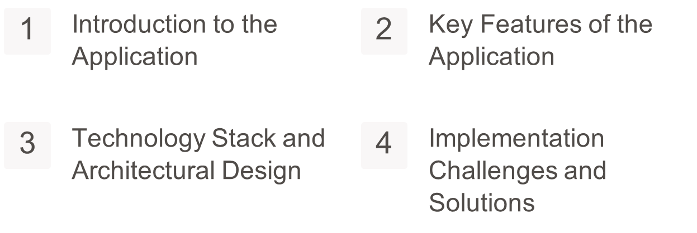
Table Of
CONTENT

Slide 3
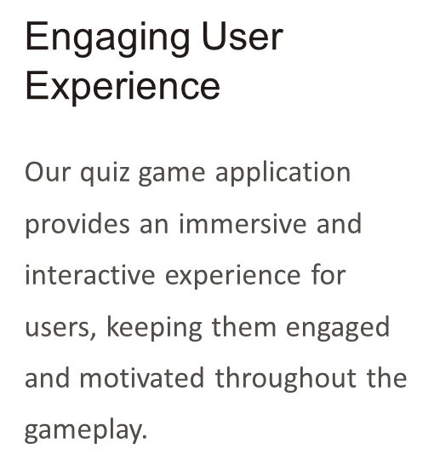

Introduction to the Application

Slide 4
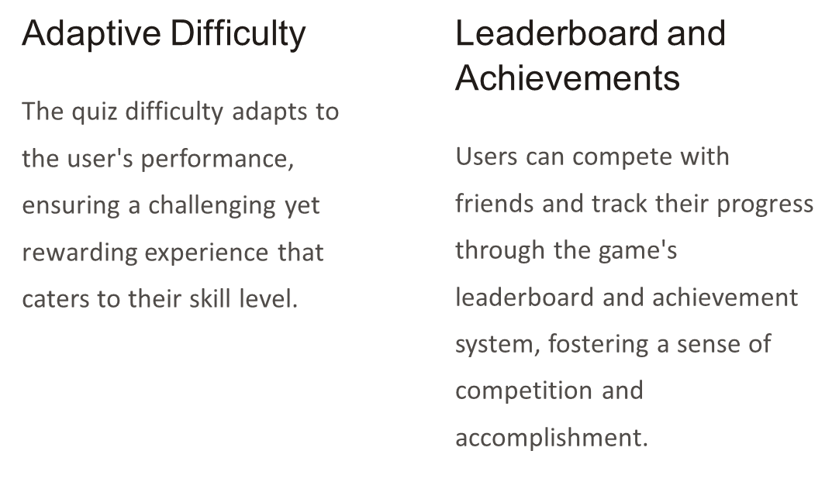

Slide 5




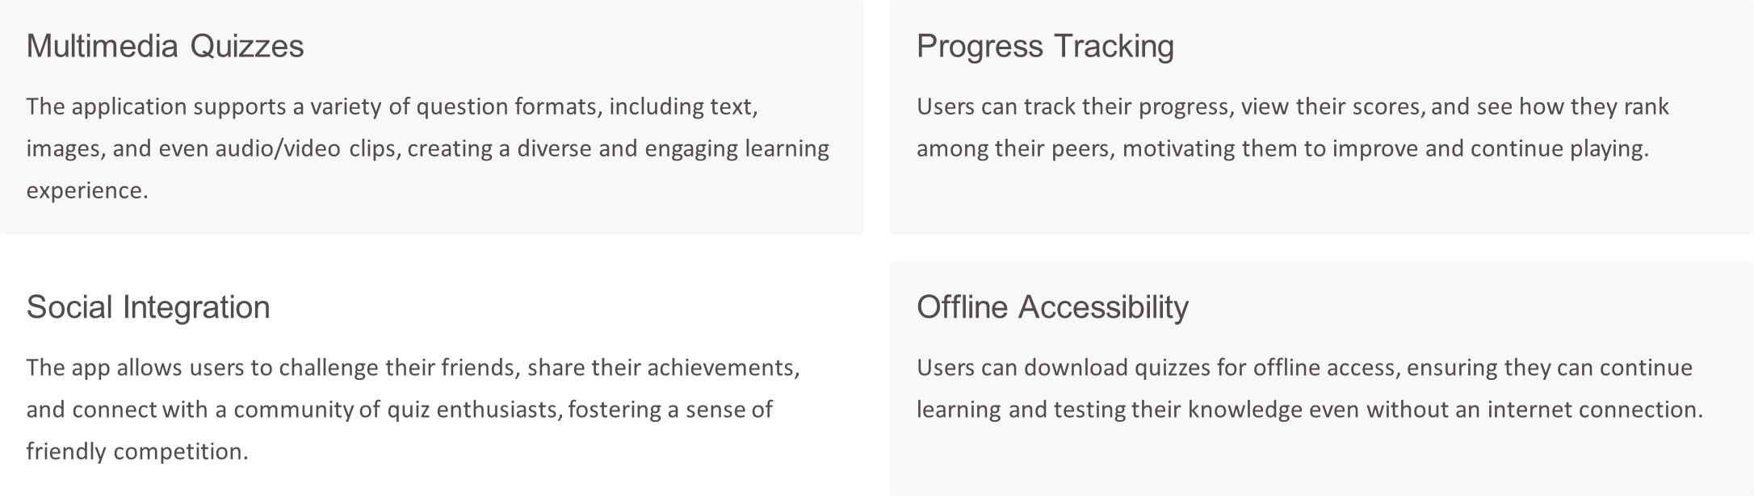
Key Features of
THE APPLICATION

Slide 6
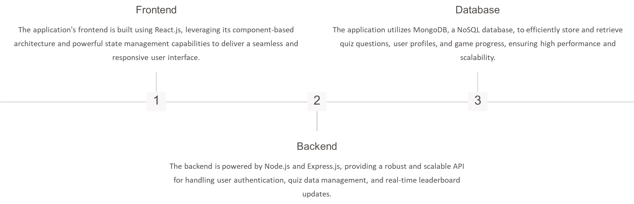
TECHNOLOGY STACK AND ARCHITECTURAL DESIGN
TECHNOLOGY STACK AND ARCHITECTURAL DESIGN

Slide 7
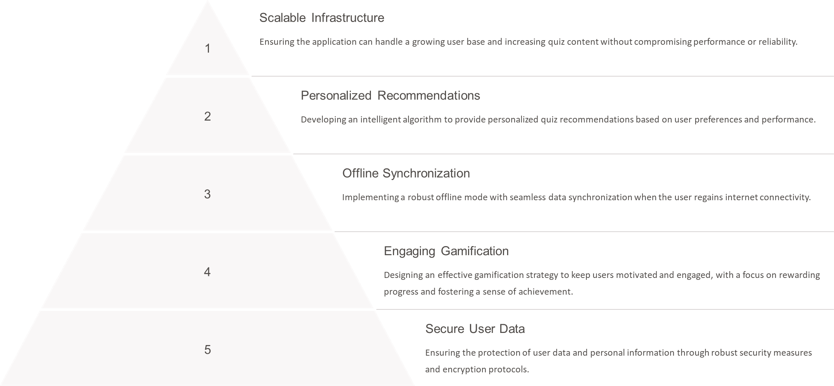
Implementation Challenges and Solutions

Slide 8

Future Enhancements and Conclusion
Users
Quizzes
100K+
10K+
In conclusion, our Interactive Quiz Game Application has been designed to provide an engaging, educational, and personalized experience for users of all ages. With its robust technology stack, innovative features, and ongoing development, we are confident that this application will continue to grow and evolve, meeting the needs of an ever-expanding user base.
5
4.9/5
Languages
User Rating

Slide 9
Thank You
FOR PLAYING!

