Slide 1
A Block Chain Platform with Equipment ID for Industrial Internet

Slide 2
ABSTRACT
This study develops a blockchain-based and Internet of Things-based strategy for industrial equipment traceability. The primary data that is recorded in the internal traceability solution of the blockchain is the digital summary of the detailed traceability data and the important traceability data of industrial equipment. The detailed industrial equipment traceability information and digital summaries produced by the traceability information are mostly recorded by the traceability solution outside of the blockchain. The suggested traceability mechanism in this study guarantees the accuracy of all traceable data and prevents the issue of blockchain data explosion.

Slide 3
INTRODUCTION
The development of industrial intelligence is supported by the Industrial Internet, a crucial infrastructure that links the entire industrial system, the entire industrial chain, and the entire value chain. A new generation of manufacturing technology and information technology were deeply integrated to create this emergent business and application paradigm. The relationship between factories and consumers has been further increased by the emergence of mobile communication. Wired and wireless networks are typically included in industrial internet. Industrial wired networks are able to guarantee very dependable communication when controlling and watching over physical equipment. However, as Industry 4.0 takes hold, the industrial manufacturing sector tends to advance wisely. The number of machines, sensors, robots, and other pieces of equipment has increased.

Slide 4
EXISTING SYSTEM
The blockchain system can be broken down into data layer, network layer, consensus layer, etc., according to the study that has already been done. To guarantee the security and privacy of data information, the data layer is utilised. Key technologies used primarily by the data layer include the encryption method, Merkle tree, chain structure, and timestamp. The network layer, which primarily consists of P2P networks, data distribution, and verification procedures, is the structural foundation of decentralised storage. The blockchain distributed network's smooth operation is made possible by the consensus layer. Commonly used consensus algorithms include the PBFT method, Kafka algorithm, Raft algorithm, PoW (Proof of Work), PoS (Proof of Stack), and DPoS (Proof of Stack Delegation).

Slide 5
DISADVANTAGES OF EXISTING SYSTEM:
1. All currently used methods involved gathering and storing data across wired or wireless connections, which were then placed on centralised (single node) servers where the data could be manipulated by hackers if the server was compromised.
2. There are security threats, such as data manipulation and forgery, and this cannot ensure the security and privacy of shared data.

Slide 6
PROPOSED SYSTEM
This article suggests a blockchain- and Internet of Things-based physical device identification system approach. The OID identifying system is the foundation of the solution. It achieves the global unique identification of physical equipment using the OID encoding method, which is compatible with other identification systems, and prevents the ambiguity of traceable objects in the traceability process. Then, the traceability information is selectively kept inside and outside the blockchain, and the internal and external traceability of the blockchain is built in accordance with the importance of the traceability information of physical equipment and the importance of the amount of data.

Slide 7
ADVANTAGES
The traceability solution suggested in this study prevents the problem of blockchain data explosion and protects the legitimacy of all traceable information.
To guarantee the effectiveness of traceability information, the key and authentication mechanism, and the authority management are all included in the system's security design.

Slide 8
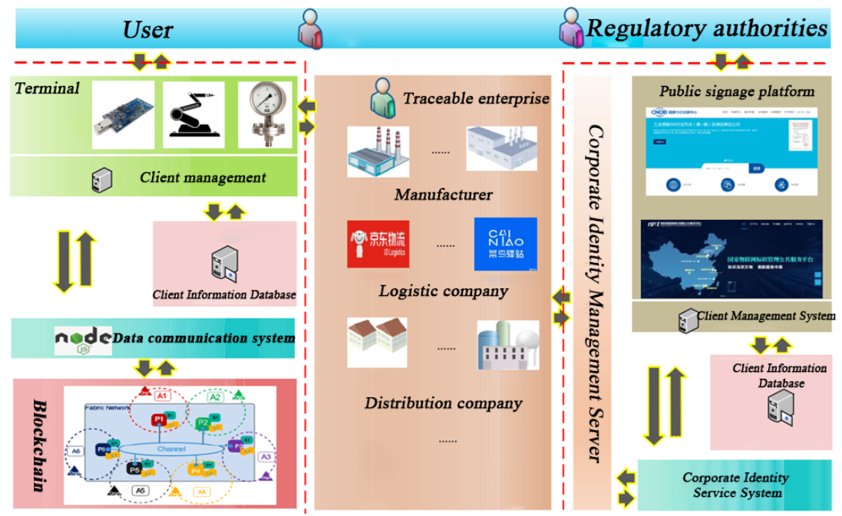
SYSTEM ARCHITECTURE

Slide 9
MODULES
Production Login, Supervision Login, Distribution Login and Circulation Login: This four users may login to application by using username and password as ‘Production or Supervision or Distribution or Circulation. After login they will perform below operations
Production Module: this user will provide unique code to each product and add other product details such as Batch number, production date, product name and image and al this details will be saved in Blockchain
Circulation Module: using this module user can add Logistic details such as location of product out for delivery
Distribution Module: using this module user can add equipment sold to which distributor or retailer
Supervision Module: using this module user will add defect found in the equipment so that product will be sent to production for alteration.
View Details: using this module all users may track different details such as product details, location, defect etc.

Slide 10
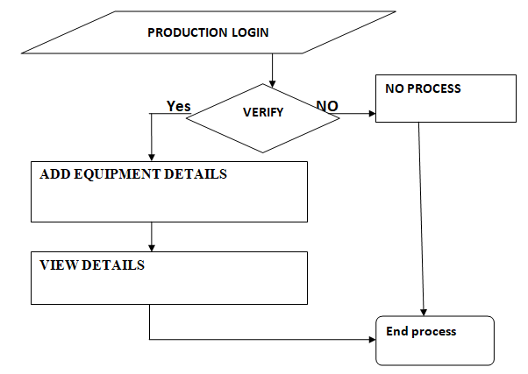
DATAFLOW DIAGRAM

Slide 11
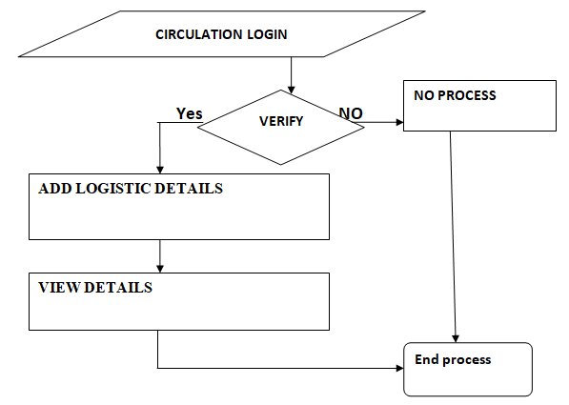
DATAFLOW DIAGRAM

Slide 12
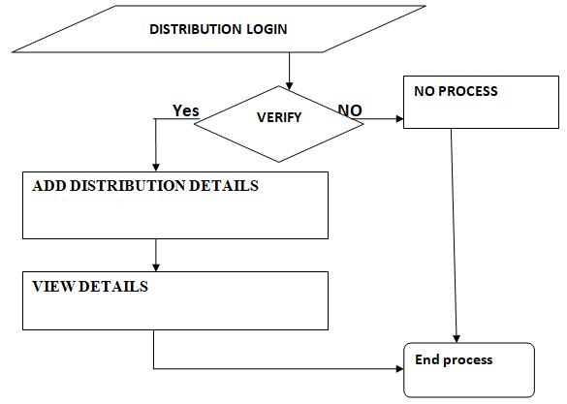
DATAFLOW DIAGRAM

Slide 13
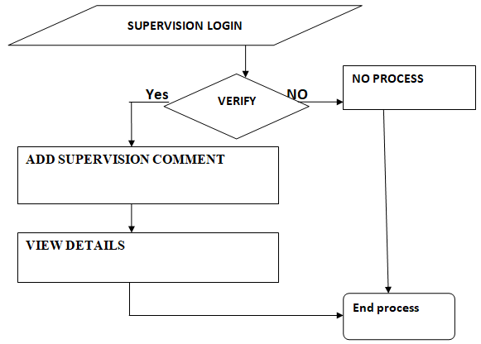
DATAFLOW DIAGRAM

Slide 14
SYSTEM DESIGN-UML DIAGRAMS

Slide 15
USECASE DIAGRAM

Slide 16
CLASS DIAGRAM

Slide 17
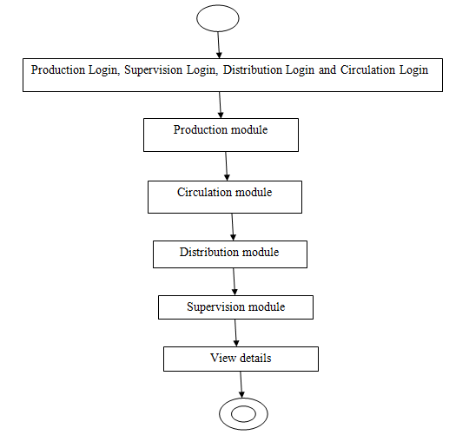
ARCHITECTURE DIAGRAM

Slide 18
SEQUENCE DIAGRAM

Slide 19
COLLABORATION DIAGRAM

Slide 20
COMPONENT DIAGRAM

Slide 21
DEPLOYMENT DIAGRAM

Slide 22
CONCLUSION
This article focuses on the use of blockchain technology and device identification in the traceability system, as well as how these technologies are applied to it. The overall scheme design and system security design of the traceability system based on blockchain and identity are proposed on the basis of research into these technologies in the traceability system. A blockchain internal traceability solution and a blockchain external traceability solution have been developed as part of the overall plan to address the issue of the explosion of blockchain data and to ensure the tamper-proof and traceability of all information related to consumer electronics products throughout the various supply chain processes.

Slide 23
REFERENCES
[1] N. Zhang, N. Cheng, A. T. Gamage, K. Zhang, J. W. Mark and X. Shen, “Cloud assisted HetNets toward 5G wireless networks,“ in IEEE Communications Magazine, vol. 53, no. 6, pp. 59-65, June 2015
[2] Y. Wu, B. Rong, K. Salehian and G. Gagnon, “Cloud Transmission: A New Spectrum-Reuse Friendly Digital Terrestrial Broadcasting Transmission System,“ IEEE Transactions on Broadcasting, vol. 58, no. 3, pp. 329-337, Sept. 2012.
[3] B. Rong, Y. Qian, K. Lu, H. Chen and M. Guizani, “Call Admission Control Optimization in WiMAX Networks,“ IEEE Transactions on Vehicular Technology, vol. 57, no. 4, pp. 2509-2522, July 2008.
[4] N. Chen, B. Rong, X. Zhang and M. Kadoch, “Scalable and Flexible Massive MIMO Precoding for 5G H-CRAN,“ in IEEE Wireless Communications, vol. 24, no. 1, pp. 46-52, February 2017.
[5] B. Rong, Y. Qian and K. Lu, “Integrated Downlink Resource Management for Multiservice WiMAX Networks,“ in IEEE Transactions on Mobile Computing, vol. 6, no. 6, pp. 621-632, June 2007.

