Slide 1
Amazon
ML engineer Hiring Problem
Name: Manish M. Dalvi
Contact: md2077@gmail.com(Hackerearth Id)
manishdalvim@gmail.com(Professional Id)
+919483629493

Slide 2
Problem statement
Predict the customer category.
Based on Customer category recommend correct products.
Problem Type: Binary Classification Problem
Performance Metric: Macro Precision score

Slide 3
Business Objective
No low latency requirement.
Error not very critical but should be in respectable limit.
Interpretability is important on why a person was classified into a category based on which features.
Recommend Products based on the predicted category of the customer.

Slide 4
Given Dataset
Dataset with 10 features and 1 output
customer_visit_score | A score based on how regularly the customer visits the website
customer_product_search_score | Quality or price range of product that the customer searches for. For ex: a customer Searching for a laptop will have more weightage than someone looking for a book
customer_ctr_score | How many of the searched links does the customer click
customer_stay_score | A score based on the time spent on an avg. by the customer
customer_frequency_score | A score based on how many times in a day the customer visit the website
customer_product_variation_score | A score based on how many varieties of products does a customer search for, for ex. electronics, apparels, etc.
customer_order_score | Score based on the no. of orders that has been successfully delivered and not returned
customer_affinity_score | An internal overall score calculated which signifies the affinity of the customer towards the website
customer_category | The cluster/group to which the customer should belong to
customer_active_segment | The categorization of the customers based on their activity
X_1 | Anonymized feature based on loyalty of the customer

Slide 5
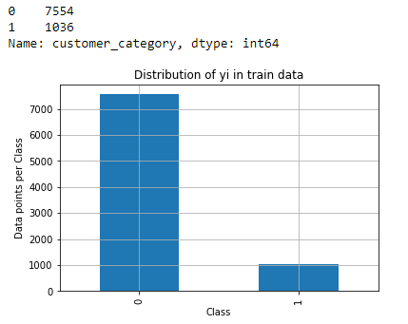
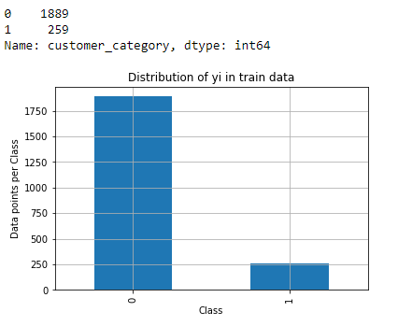
Dataset Distribution
Since the test dataset did not have the output category, the train data is split into train and cross validation data in the 80:20 ratio.
Training Dataset
Cross Validation Dataset
Clearly, the given dataset is an imbalanced dataset.

Slide 6
Feature Engineering
From the given dataset which features are important and why?

Slide 7
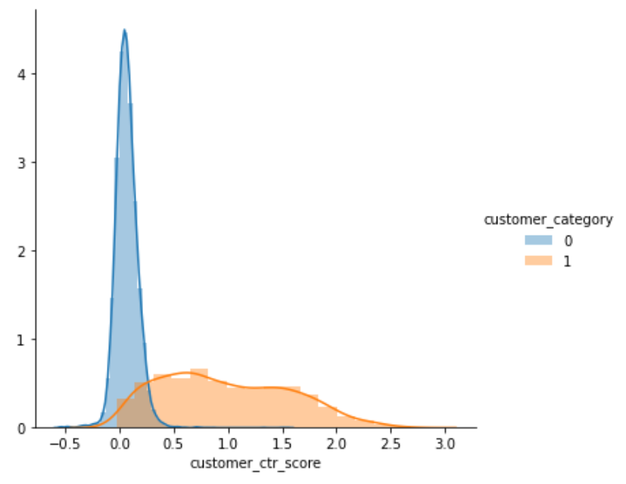
Customer CTR score – Most important Feature
Higher the ratio of click to search, the customer is categorized into category “1”.
The graph distribution of the two categories has very less overlap due to which this feature is very important.

Slide 8
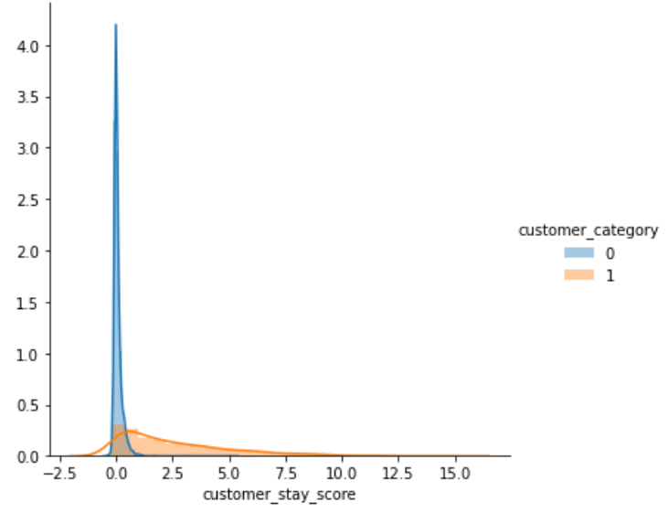
Customer Stay Score – 2nd Most important feature
The more the time spent by the customer on the website, the more likely the customer is categorized into category “1”.
This graph too has less overlap between the two categories which helps in classification.

Slide 9
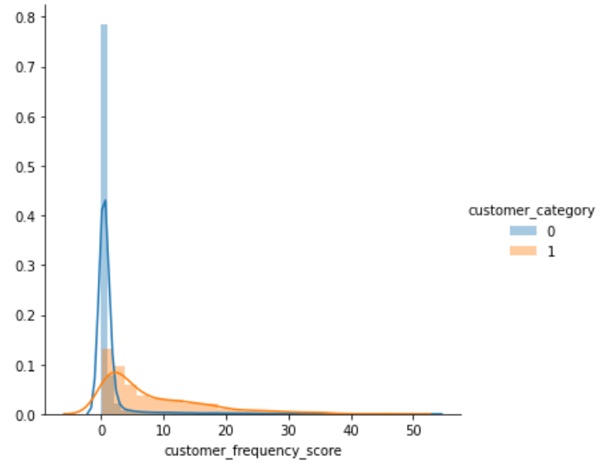
Customer Frequency Score – 3rd most important feature
Customer who visited the website more in a day will be categorized into category “1”.
This graph too has a fair amount of non overlapping areas (after 5) which helps in categorizing the customer.

Slide 10
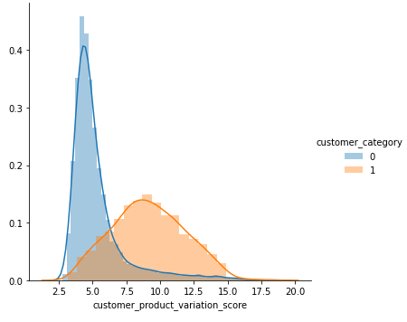
Customer Visit Score – 4th Most important feature
The customer who visited more variety of products is more likely in category “1”.
This graph has considerable amount of overlap and due to which, there is difficulty in using this feature alone for deciding the category of the customer.

Slide 11
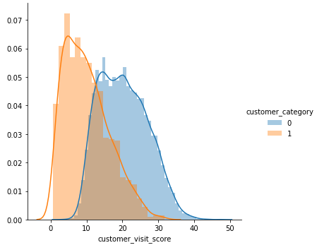
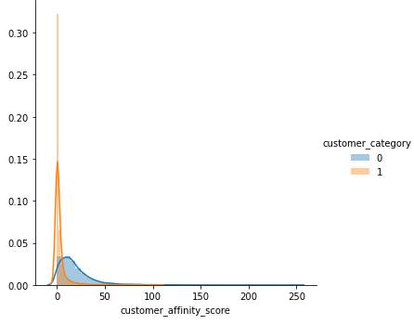
Other Features
The Remaining numerical features tend to have overlapped distributions due to which it is difficult to decide the category.
Among the other features: Customer visit score and customer affinity score tend to have more importance since their distributions has lesser overlaps.

Slide 12
Categorical Features
Customer Active Segment – Just by using this feature we obtained a 71% precision score.
Which means that this feature is an important contributor.
X1 Feature - Anonymized feature based on loyalty of the customer.
The precision by this feature was not great hence this feature is not relevant in deciding the customer category.

Slide 13
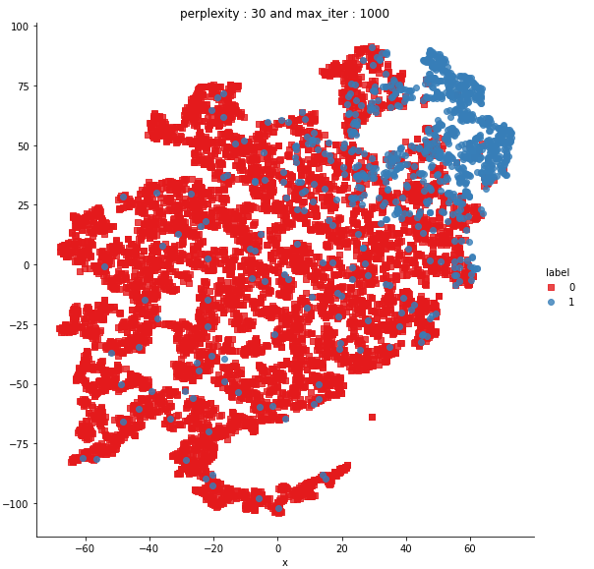
T-SNE
TSNE can be used to visualize N dimensional data in 2 dimensional .
It helps in knowing how separable is the data.
The blue data of category “1” seems quite separable from the red points of category “0”.
However, there are several blue points overlapping in the red regions where some algorithms like KNN will not work well.

Slide 14
ML algorithms and their Precision Scores
Decision Tree based algorithms, SVM were used since they handle Imbalanced dataset well.
Train dataset split into Train and Cross validation dataset in ration 80:20.
ML Algorithm | Precision
Decision Tree | 93.54
XG boosting DT | 94.35
SVC (balanced class weight, rbf) | 87.68
Other ML algorithms which can be tuned to handle such datasets.
ML algorithms
KNN (N=10) | 95.69
Logistic Regression | 94.71
Stacking Classifier (KNN, DT, XGB, meta=Logistic Regression) | 95.69

Slide 15
Deciding on the Best Algorithm
XGBoost and KNN provided good results during Cross validation stage.
They were chosen to be trained over the entire dataset.
XGBoost provided the best results at 92.16268.
Algorithm | Macro Precision Score
XGBoost DT | 92.16268
KNN (N=10) | 91.81054

Slide 16
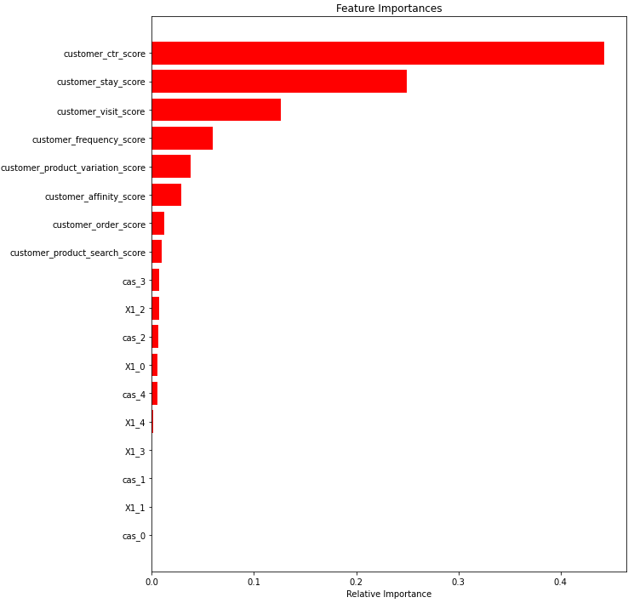
Feature Importance with XGBoost
From the graph we see that,
Customer Ctr score, Customer Stay Score and Customer Visit score are top 3 important features
We had also seen the same during analysis of the distributions of the graphs during the exploratory data analysis.
The important features tend to have visually separable distributions for each category.
Among the categorical feature – Customer Activity score when added up is higher

Slide 17
Key points
Customer belongs to category “1” if,
The customer had a higher ratio of click to search for searched links.
The customer stayed on the website for more time.
The customer visits the website frequently in a day.
The more categories the customer explores.
The customer has lesser returns to delivered ratio.

Slide 18
Analysis of the Customer and category
Category 1 of customers are more likely an experienced buyer and checks the reviews, searches alternate products, more in-depth analysis before purchase.
Since the research about the product is in depth before purchase, Category 1 are less likely to return the products on delivery
Category 0 customers are the ones who buy the product with less time spent on it, lesser analysis and quicker buying decision.
Reason the Category 0 customers have higher “return to delivered” ratio is due to fact that lesser time is spent on the website which means improper analysis of reviews before making a purchase decision.

Slide 19
Pros and Cons of the Recommendation
Pros:
2 Simple Categories.
Recommend Similar Products as being searched by customer.
Quicker recommendations and less processing for categorizing customer.
Advertise on other website so that customer visits frequently and chance of purchase increases
Cons:
Not very in-depth recommendation system since very few features in analysis.
May recommend products to category “0” customers that are not having good ratings due to which higher returns done by the category “0” person.
Small number of categories, can be increased based on customer preferences.
Recommend different kind of products rather than similar products.

Slide 20
Proposed Architecture
Recommend best products of the current searched item using Content Based Filtering.
Recommend other products, which similar users like the one under observation using Collaborative Filtering.
Recommend quality products with better ratings and reviews to both categories to avoid higher return to delivered ratio.
Perform Text analysis over reviews of the product for recommendations.
Instead of using 2 class classification recommendation system. Use User-User Matrix to recommend Products which provides more vast recommendations.
Use Features like User Geography, Previous purchases, Quality of products purchased, Income, Preferred brand in the category.
Based on User Product Search, recommend what similar users would have preferred.

