Slide 1


Analyzing the role of machine learning models in customer segmentation and churn prediction

Slide 2

INTRODUCTION
The dataset used in this project is available in the KAGGLE and contains 19 columns (Independent variables) that indicate the characteristics of the clients of a fictional telecommunications corporations. The churn column (Response variable) indicates whether the customer departed within the last month or not. The Class No includes the clients that did not leave the company last month, while the class Yes contains the clients that decided to terminate their relationship with the company. The objective of the analysis is to obtain the relationship between the customer’s characteristics and the churn.

Slide 3

PROBLEM STATEMENT
Predicting customer churn is critical for telecommunication companies to be able to effectively retain customers. It is more costly to acquire new customers than to retain existing ones.
The problem statement involves selection of the appropriate machine learning techniques that can handle large amount of datasets to identify different types of customer behaviours.
The challenge is to develop models that can effectively analyse and make sense of the vast amounts of customer data generated by telecom service providers.
The objective is to obtain a data-driven solution that will allow us to reduce customer churn rates and as a consequence, to increase customer satisfaction and corporation revenue.

Slide 4
Data Overview
The dataset used in this project is available in KAGGLE.
In contains 19 (Independent variables) with 7043 rows that indicate the characteristics of the clients.
The churn column (Response variable) indicates whether the customer departed within the last month or not.
The class No includes the clients that did not leave the company last month, while the Class Yes contains the clients that decided to terminate their relations with the company.
The objective of the analysis is to obtain the relation between the customers' characteristics and the churn.

Slide 5
Data Preprocessing
Data Cleaning and exploratory data analysis
The data Contains 19 independent variables, which can be classified into 3 categories
Dealing with missing values
Remove Customer ID, Total charges Columns
Internet service, Device protection, Streaming TV and movies, Online backup, Online security, Tech support, Multiple lines, Phone : Services provided by company
Customer tenure, Payment method, Monthly charges, Paperless billing, Total charges : Customer's behavioral information
If customer has partner and dependent, gender, Senior citizen : Customer's Demographic information
Data Visualization
Pivot Tables
Bar Charts
Count plots (Churn values separated)
Clustered Columns Stacked columns

Slide 6

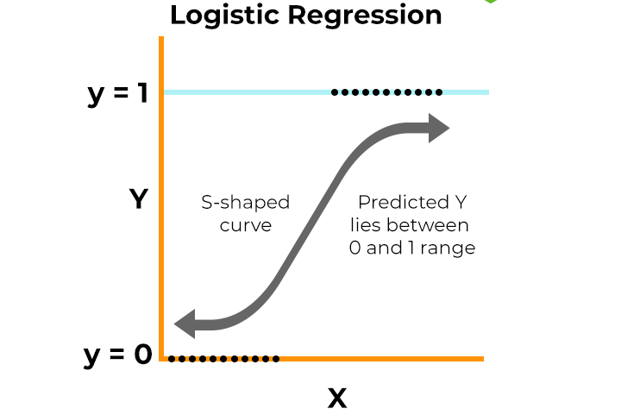
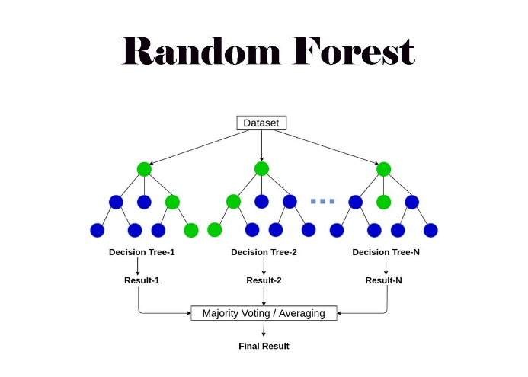
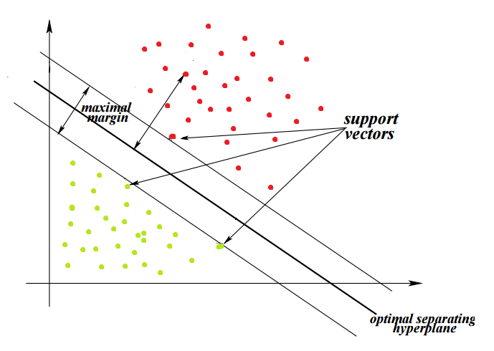
Accessing Multiple algorithm
We have prepared 4 different algorithms
Decision tree classifier are used in customer churn prediction because they create straightforward "If-then" tree to predict churn, making it interpretable and suitable for understanding customer behavior.
Random forest classifier are used in customer churn prediction because they combine multiple decision trees reducing overfitting and improving accuracy by considering various aspects of customer behaviour for robust predictions.
Logistic regression is used in customer churn prediction because it's a suitable statistical technique for predicting binary outcomes providing probabilities for each class, like whether a customer will churn or stay.
Support vector machines is used in customer churn prediction because it finds the boundary between Churn and Non-churn customers, making it effective for binary classification task.

Slide 7
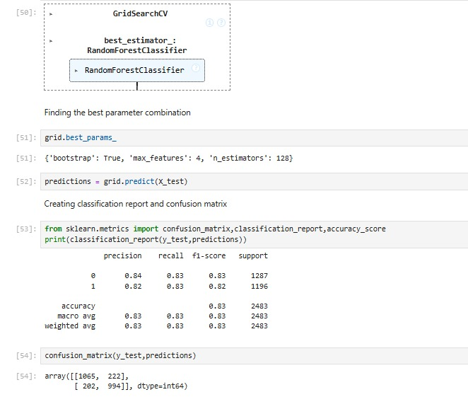
Random Forest Classifier
Hyper parameters used:
Results
n_estimators: No of decision trees to produce in modelling
max_features : No. of features to use for each decision tree
bootstrap : Whether to use bootstrapping or not

Slide 8
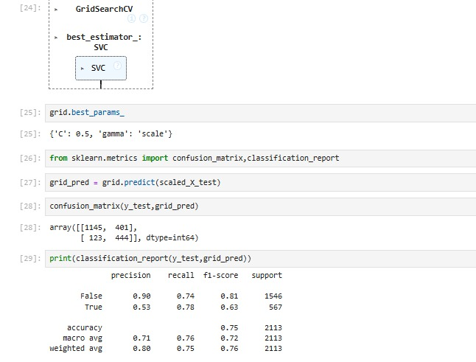
Support Vector Machines
Hyper parameters used:
Results
C value : Soft margin adjustment
Gamma : Weighing parameter

Slide 9
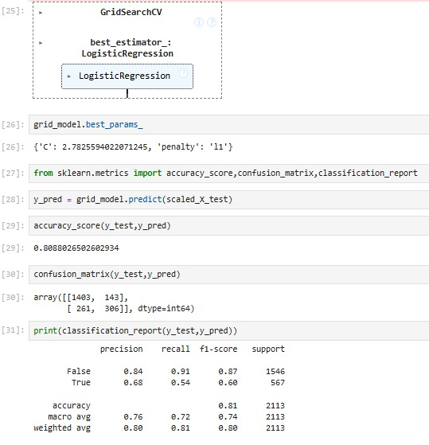
Logistic regression
Results
Regularization methods
Ridge Regression
Lasso Regression
Hyper parameters used:
C : Regularization strength
Penalty: Regularization Type

Slide 10
Model deployment
Steps for model Deployment
Select the best performing model
Fit the model with the dataset
Dump and save the model with Joblib
Provide inputs to the model.

Slide 11
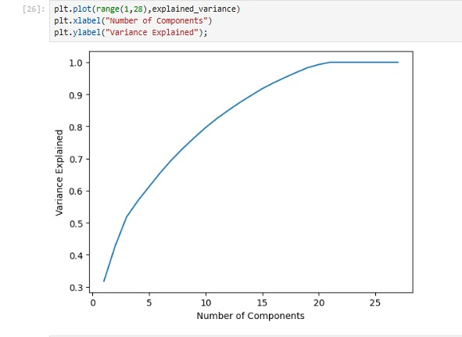
PCA Analysis
No. of components Vs. variance explained
Advantages:
1. Helps in reducing the curse of dimensionality.
2. Transforms high-dimensional data into a lower-dimensional.
3. Helps in customer segmentation

Slide 12
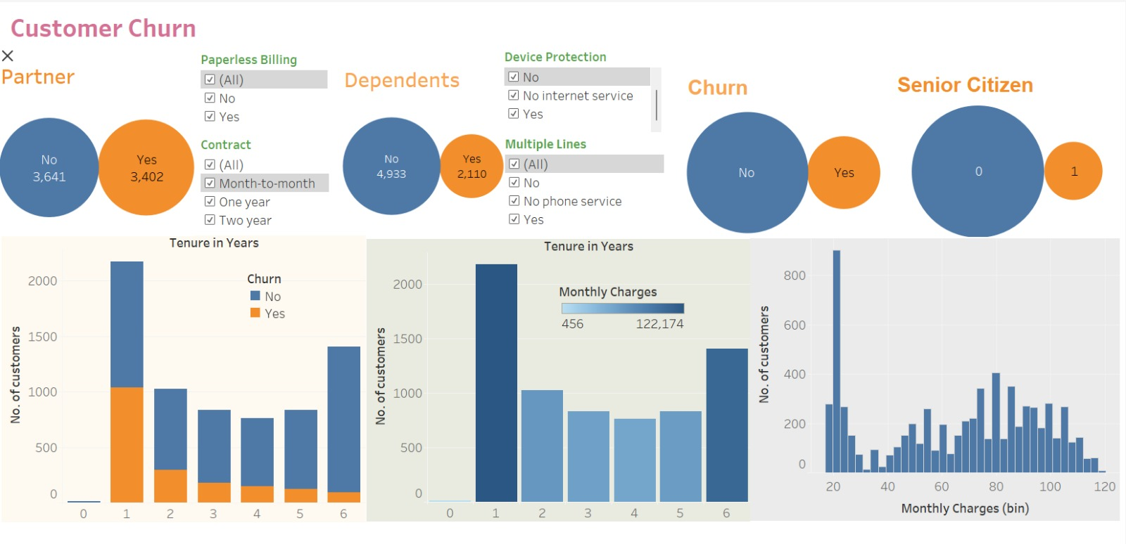
Creating a Dashboard
Advantages
Enhanced decision-making
Real-time data access
Improved visibility into key performance indicators (KPIs)
Other benefits
Customization
Performance measurement
Data integration
Better business intelligence

Slide 13
Resource Requirements
Software Requirements
Jupyter Notebook
Tableau
Libraries and its uses
Pandas >> Importing and exporting datasets
Scikit-learn >> data mining and data analysis
Matplotlib >> Equipped with data visualization
Imblearn >> Used to balance datasets that highly skewed to one category
Making a Dashboard

Slide 14
Risks and Mitigations
Imbalanced datasets: mitigated by using oversampling and under sampling techniques
High dimensionality: Dimensionality reduction techniques such as principal component analysis (PCA)
Variability in customer behaviour: Visualisation techniques can be used to identify patterns
Issues
Resolutions
Poor quality data (noise, missing values, and inconsistencies)
Data Representation (Choosing the right features and representing data)
Data Bias
Data pre-processing, mean/median imputation, forward/backward fill, or interpolation methods.
Performing Exploratory data analysis
Cross-validation, Ensemble methods

Slide 15
Conclusions
The churn prediction is a critical task for businesses looking to improve customer retention and reduce the impact of churn on their bottom line. Churn prediction enables businesses to proactively identify and retain customers at risk of leaving, leading to improved customer retention, reduced acquisition costs, and sustained business growth.
A successful churn prediction project requires careful data collection, preprocessing, feature engineering, model selection, hyperparameter tuning, model evaluation, and deployment. By following these steps, businesses can build accurate and effective churn prediction models that can be used to identify at-risk customers and take targeted actions to reduce churn.
Churn prediction provides insights into customer behaviour and preferences, allowing businesses to make more informed decisions about product development, marketing, and customer service. Overall, churn prediction is an essential tool for businesses looking to improve customer retention, reduce churn, and maximize revenue. By leveraging advanced analytics techniques and machine learning algorithms, businesses can stay ahead of the competition and achieve long-term success.

Slide 16


