Slide 1

Multi Camera Tracking Project
Summer 2025 –Biweekly progress, 10 July, 2025

Slide 2
Agenda
Recap
Creation of new ReID split(v2) based on the Hierarchical Categorization.
Overview of Trace-1573 ReID v2 dataset and CLIP-ReID Experiments
Current Progress
Conducted Experiments with OSNet model using Trace-1573 v2 and scaled up with Market-1501 dataset.
Performed ablation studies with various augmentations during training and test time , applied k-reciprocal re-ranking .
Explored feature aggregation across different augmentations of query images.
Investigated the impact of various body parts on ReID performance
Conclusion
Next steps

Slide 3
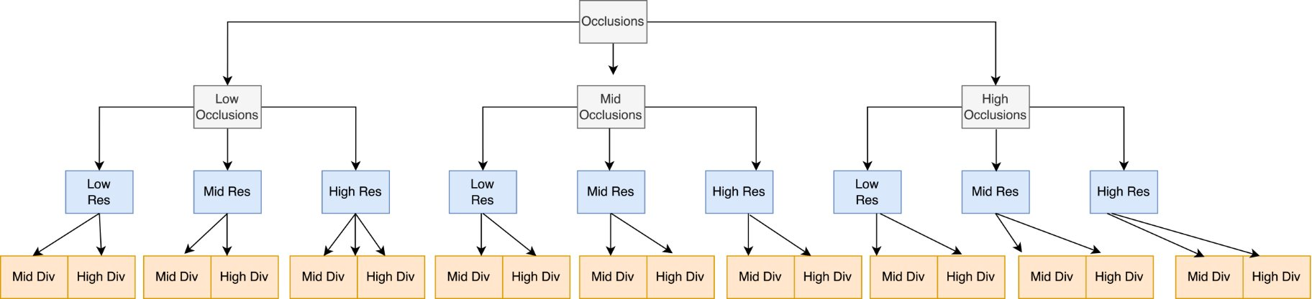
Hierarchical Data Categorization
Each person ID is routed through the following decision tree:
Occlusion Level - Based on Average keypoint confidence score.
Low : < 0.33 ; Mid : (0.33-0.66) ;High: >0.66
2. Resolution Level - Based on average image resolution
Low: <100px ; Medium: 100-200px ; High >=200px
3. Pose Diversity – Based on co variance score of Normalized
2D key points
Low ; Mid ;High ;None
Each leaf node contains a non-overlapping set of person IDs.

Slide 4
ReID Dataset – Train/Val/Test Strategy
After routing each person ID into a leaf node of 3-level decision tree
Stratified person-ID Split – For each leaf
Train set – 50 %
Val set – 15%
Test set – 35%
Note : val/ test sets should have only multi camera person Ids.
Randomly sample images for each person ID
Train person ID – Select upto 20 images
Val/ Test person ID – 15 in case of Gallery , 5 in case of Query(probe)
Question : Why are we doing Stratified by Tree Node ?
Ensures each split contains:
Low - > high occluded cases , resolutions
diverse pose examples
Prevents training on only easy examples (a risk with uniform sampling)

Slide 5
New ReID Dataset Overview
Total person Ids : 1001 --- 637 Single Cam ; 364 Multi Cam
Total Camera : 45
Train Set consists of both multi-camera(79) and single camera(637) person IDs
Val/Test Set has only multi camera person Ids
Split | IDs | Images | Cameras
Train | 716 | 12321 | 39
Val | 121 | 2408 | 40
Test | 164 | 3280 | 43

Slide 6
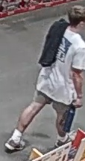
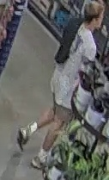
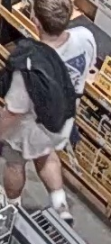

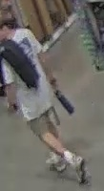
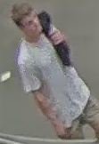

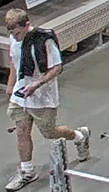
Examples of New ReID Dataset
PID : 23474412-12082
Appearing across multiple scenes and 5 different cameras
Toolworld cam1
Toolworld cam4
Toolworld cam2
Diverse views with :
low subject resolutions
occlusions
pose variations
TermFrontEnd
ToolworldPTZ

Slide 7
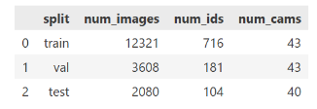
Experimental Results on Trace-ReID-V2
Method | Training data | Evaluation | mAP | Top-1 Acc
CLIP-ReID | Train set | Val set | 46.5 | 57.8
 | Train set | Test set | 53.6 | 68.9
 | Train+val set | Test set | 67.5 | 80.6
Data distribution
Val |  | Test
Query | Gallery | Query | Gallery
905 | 2703 | 520 | 1560
By expanding the train set multi camera person Ids(79---> 260) improves performance by 26% in mAP , 17% in rank-1 accuracy.

Slide 8
Experimental Results on Trace-ReID-V2 combined with Market-1501
Trace-ReID v2
Market-1501 + Trace-ReID v2
Method | Training data | Inference | mAP | Top-1 Acc
CLIP-ReID | Train set | Val set | 46.5 | 57.8
 | Train set | Test set | 53.6 | 68.9
 | Train+val set | Test set | 67.5 | 80.6
Method | Training data | Inference | mAP | Top-1 Acc
CLIP-ReID | Train set | Val set | 52.1 | 63.6
 | Train set | Test set | 56.6 | 71.1
 | Train+val set | Test set | 70.6 | 83.8
Increase in data diversity helps generalization !!!

Slide 9
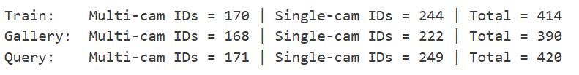
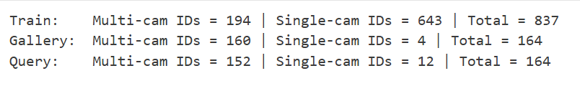
Trace-1573-ReID Datasets V1 vs V2
Split | IDs | Images | Cameras
Train | 414 | 12720 | 45
Query | 420 | 4099 | 43
Gallery | 390 | 14976 | 43
Split | IDs | Images | Cameras
Train | 837 | 12321 | 39
Query | 164 | 820 | 40
Gallery | 164 | 2460 | 43
Method | Training data | mAP | Top-1 Acc
CLIP-ReID | Train set | 63.3 | 80.8
Method | Training data | mAP | Top-1 Acc
CLIP-ReID | Train set | 62.0 | 78.2

Slide 10
Test Time Basic Augmentations
Augmentation | mAP | Top-1 Acc
Resize | 45.5 | 64.8
Resize+Normalize | 62.0 | 78.2
Resize +Normalize +Horizontal Flip | 62.1 | 78.8
Resize +Normalize Random Crop | 62.0 | 78.2
Resize +Normalize Color jitter | 46.9 | 69.2
Resize +Normalize +Random Rotate | 35.7 | 56.1
Resize+ Random Rotate | 21.0 | 37.7
All | 62.2 | 78.8
Base line
Normalization improves performance.
Random crop , horizantal flip , color jitter does not have any effect
Random Rotation has poor performance.

Slide 11
Experiments with Basic Augmentations
Augmentation | mAP | Top-1 Acc
Strong Aug | 62.5 | 78.2
Res+Norm+ Color Jitter | 58.2 | 77.3
Res+Norm+Affine | 62.6 | 80.8
Res+Norm+Horizontal Flip | 60.9 | 77.8
Res+Norm+Random Crop | 59.9 | 77.2
Res+Norm+Random Erasing | 60.2 | 77.2
Resize + Normalize
Horizantal Flip
Random Crop
Color Jitter
Affine Transform
(Rot , Translate , sheer , scale)
Random Erasing
Strong Augmentation : Resize + Horizontal Filp + Pad + Random Crop + Normalize + Random Erasing

Slide 12
Current Progress
Experiments with OSNeT method on Trace-1573-v2
Feature Aggregation with various augmentations and probe only , gallery only augmentations
Low subject resolution Analysis of CLIP-ReID predictions on Trace-ReID v2 data
Effect of person body parts in CLIP-ReID evaluation
Face
Lower body
Upper body
Face & Upper body
Upper & lower body

Slide 13
Experimental Results on Trace-ReID-V2 with OSNeT
Method | Training data | Evaluation | mAP | Top-1 Acc
OSNeT | Train set | Val set
 | Train set | Test set
 | Train+val set | Test set
Data distribution
Val |  | Test
Query | Gallery | Query | Gallery
905 | 2703 | 520 | 1560

Slide 14
Feature Aggregation on Query images
Apply basic augmentations horizantal flip , rotate , Affine transform and get the CLIP-REID features along with the raw original features.
Get the average embedding of all the augmentations.
Perform similarity matching with gallery features.

Slide 15
Feature Aggregation : CLIP-ReID results

Slide 16
Qualitative Examples of Feature Aggregation
Add Qualitative examples

Slide 17
Qualitative Examples of Feature Aggregation
Add Qualitative examples

Slide 18
Analysis of Image resolution on CLIP-ReID predictions

Slide 19
Effect of various body parts in CLIP-ReID evaluation
Body Parts | Total Query samples | mAP | Top-1 Acc
Face | 738 | 17.6 | 22.8
Lower body | 738 | 43.1 | 58.4
Upper body | 738 | 49.3 | 66.5
Face + upper body | 738 | 53.9 | 70.8
Upper + lower body | 738 | 59.6 | 77.1
Full body | 738 | 62.1 | 78.1
Baseline without filtering | 820 | 62.6 | 80.8

Slide 20
Effect of various body parts in ReID evaluation
Qualitative Examples

Slide 21
Effect of various body parts in ReID evaluation
Qualitative Examples

Slide 22
Key takeaways
Update this based on all the experiments

Slide 23
Next Steps

