Slide 1

Multi Camera Tracking Project
Spring 2025 – Biweekly progress, 3 April, 2025

Slide 2
Agenda
Objective
Recap , Progress Overview
Trace-1573 ReID Dataset and Experiments
Normal and cross dataset settings
Various sampling
Combination of Various proportions Market-1501 dataset
Arc-Face loss instead of Triplet loss
Offline Multi Camera Tracking with OSNet and CLIP-ReID.
Conclusion and Discussion
Next steps

Slide 3
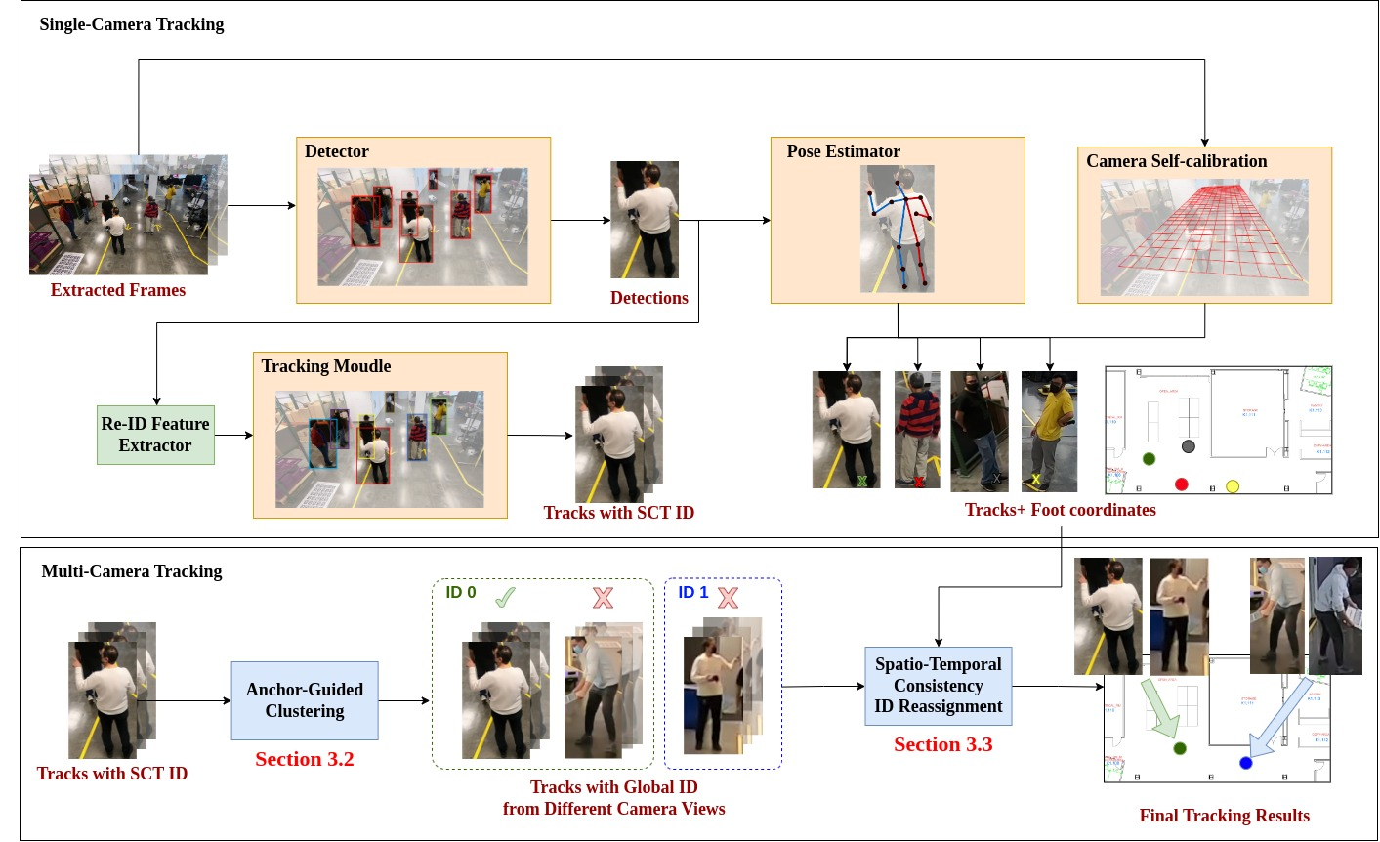
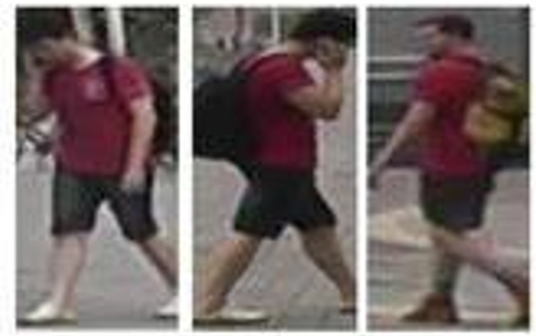
Objective
Develop a robust multi-camera tracking model with a focus on person re-identification (Re-ID).
Focus
Re-ID Module

Slide 4
Recap
Explored recent re-identification approaches such as CLIP-ReID, CLIP-SCGI and multi view video generation approach such as Pippo.
Despite few limitations with existing Lowe's ReID dataset, experimental results shows that CLIP-ReID is better than OSNET.
Performed detailed analysis on Trace-1573 multi camera dataset.
Trace-1573 ReID Dataset Curation
To demonstrate the effectiveness of curated ReID dataset, conducted various experiments with CLIP-ReID and OSNET.

Slide 5

ReID Dataset pipeline
Based on person ID add to train/test split
Discard the frame
For each
yes
No
Randomly divide train, test set person Ids
Extract frames from raw video
Based on the MOT label crop frames
Check frame for person existence using Yolov8
50: 50
confidence = 0.5 IOU = 0.2
Create query / gallery split from test

Slide 6
Trace-1573 ReId data set statistics
This dataset consists of 834 person identities.
All persons does not appear across all the cameras.
​​
Split | IDs | Images | Cameras
Train | 414 | 12720 | 45
Query | 420 | 4099 | 43
Gallery | 390 | 14976 | 43
Test set
Person 10 images in train and 15 in test (12 gallery , 3 query)
Notes:
594 previous IDS

Slide 7
Experimental Results
Method | Train data | Test data | MAP(%) | Top-1 Accuracy(%)
OSNeT | Market-1501 | Market-1501 | 78.3 | 93.8
CLIP-ReID | Market-1501 | Market-1501 | 89.8 (14.6 % ) | 95.3(1.6 % )
OSNET | Trace-1573 ReID | Trace-1573 ReID | 35.5 | 64.2
CLIP-ReID | Trace-1573 ReID | Trace-1573 ReID | 63.5 (78.8 % ) | 78.6 (18.3 % )
OSNET | Trace-1573 ReID (full data) | Trace-1573 ReID(full data) | 35.7 | 69.2
CLIP-ReID | Trace-1573 ReID(full data) | Trace-1573 ReID(full data) | 63.3 (77.3 % ) | 80.8 (16.7 % )
OSNET | Market-1501 | Trace-1573 ReID | 7.5 | 25.4
CLIP-ReID | Market-1501 | Trace-1573 ReID | 40.1 (434 % ) | 61.7(36.3 % )
Strong generalization
Results of CLIP-ReID , OSNET in same dataset setting(Top 6 rows ) and cross dataset(bottom 2 rows) setting evaluations using Market-1501 , Trace-1573 ReID datasets

Slide 8
Progress
Investigation of Cosine distance vs Euclidean distance in ReID clustering
Re-ID Dataset Creation
Creation of Trace-1573 ReID Dataset across all scenes
ReID Experiments
Evaluated CLIP-ReID and OSNeT on Trace-1573 under normal and cross-dataset settings.
Conducted experiments with more robust & combined data (Market-1501 and Trace-1573 ReID data).
Arc-Face loss instead of Triplet loss
Offline Multi Camera Tracking

Slide 9
ReID Clustering : Cosine distance vs Euclidean Distance
Euclidean distance measures absolute distance
Preserves Absolute differences ensuring meaning full margin separation.
Effective in case of hard mining Triplet loss.
Cosine distance measures angle similarity
Focuses on Angle not on magnitude
Harder to define margins in Angle space
Better for ranking tasks

Slide 10
ReID Triplet Loss : Cosine vs Euclidean distance
Training Objective : Triplet hard mining loss
During Inference , Euclidean distance is used as similarity metric.
Method | Metric | Train data | Test data | MAP(%) | Top-1 Accuracy(%)
CLIP-ReID | Euclidean | Market-1501 | Market-1501 | 89.8 | 95.3
CLIP-ReID | Cosine | Market-1501 | Market-1501 | 86.8 | 93.9
CLIP-ReID | Euclidean | Trace-1573 | Trace-1573 | 63.8 | 80.0
CLIP-ReID | Cosine | Trace-1573 | Trace-1573 | 57.9 | 77.2
Euclidean distance provides better clustering of person IDs compared to cosine distance.
Notes:
Euclidean distance forms clusters based on absolute positioning, making it more effective when featurerepresentations are well-distributed.
Cosine distance may place different identities closer together if they share similar directional features buthave different magnitudes, leading to less distinct clustering.

Slide 11
ReID evaluation : Cosine vs Euclidean similarity
In the experiments , models are trained on Euclidean distance and
Method | Distance | Train data | Test data | MAP(%) | Top-1 Accuracy(%)
OSNET | Euclidean | Market-1501 | Market-1501 | 80.4 | 93.4
OSNET | Cosine | Market-1501 | Market-1501 | 82.7 | 94.1
Method | Distance | Train data | Test data | MAP(%) | Top-1 Accuracy(%)
CLIP-ReID | Euclidean | Market-1501 | Market-1501
CLIP-ReID | Cosine | Market-1501 | Market-1501

Slide 12
Experimental Results : Different Samples per person ID
No of Samples per person ID per Camera | Method | Train data | Test data | MAP(%) | Top-1 Accuracy(%)
Train Set : 10 Gallery Set : 12 Query Set : 3 | OSNET | Trace-1573 ReID | Trace-1573 ReID | 34.2 | 68.4
 | CLIP-ReID | Trace-1573 ReID | Trace-1573 ReID | 63.3 | 80.8
Train Set : 30 Gallery Set : 30 Query Set : 5 | OSNET | Trace-1573 ReID | Trace-1573 ReID | 41.2 | 80.3
 | CLIP-ReID | Trace-1573 ReID | Trace-1573 ReID | 62.5 | 83.0
Observation :
In traditional CNN models, performance improves as the amount of data increases.
However, for foundational models like CLIP-ReID, only a few samples are sufficient for learning, but adding too many samples can reduce generalizability.

Slide 13
Experimental Results: Market+Trace 1573 ReID Data
Method | Train data | Test data | MAP(%) | Top-1 Accuracy(%)
OSNET | Market-1501 | Market-1501 | 78.3 | 93.8
OSNET | Market-1501+ Trace-1573 | Market-1501 | 82.5 | 93.9
OSNET | Trace-1573 | Trace-1573 | 35.7 | 69.2
OSNET | Market-1501+ Trace-1573 | Trace-1573 | 36.9 | 68.2
Method | Train data | Test data | MAP(%) | Top-1 Accuracy(%)
CLIP-REID | Market-1501 | Market-1501 | 89.8 | 95.3
CLIP-REID | Market-1501+ Trace-1573 | Market-1501 | 88.9 | 95.0
CLIP-REID | Trace-1573 | Trace-1573 | 63.5 | 78.6
CLIP-REID | Market-1501+ Trace-1573 | Trace-1573 | 65.5 | 81.2

Slide 14
Experimental Results: Market+Trace 1573 ReID Data
Combine various proportions of market-1501 data with Trace 1573

Slide 15
Experimental Results: Ablation study on Loss Function
ARC Face loss and Triplet loss on CLIP ReID / OSNeT

Slide 16
Conclusion
Trace-1573 ReID data consists of 834 person IDs
Train : 12720 images
Query : 4099 images
Gallery : 14976 images
Performed experiments with CLIP-ReID , OSNeT using both Market-1501 , Trace-1573 data and combination of both datasets. CLIP-ReID outperfroms OSNET in both normal and cross dataset settings. Rephrase and shorten verbose.
Euclidean distance is better distance metric than Cosine distance.
Scaling up the samples per person is more effective in case of OSNET than CLIP-ReID
Will points based on arc face loss vs triplet loss
Will points data mixture
When Trace-1573 is combined with Market-1501 data , the results are comparable on OSNET but on CLIP-ReID the performance of Trace-1573 improves by 3.1% , 3.3% mAP , Top-1 accuracy respectively.

Slide 17
Next steps
Conduct End-to-End offline Multi tracking using CLIP-ReID features
Synthetic Data Exploration
Rotational augmentations to existing single view camera to create multi-view data.
Pippo’s synthetic multi-view generation to enhance Re-ID performance.

