Slide 1

Multi Camera Tracking Project
Spring 2025 – Biweekly progress

Slide 2
Agenda
Objective
Recap
Current progress
Dataset description
Results
Concluson
Next steps

Slide 3
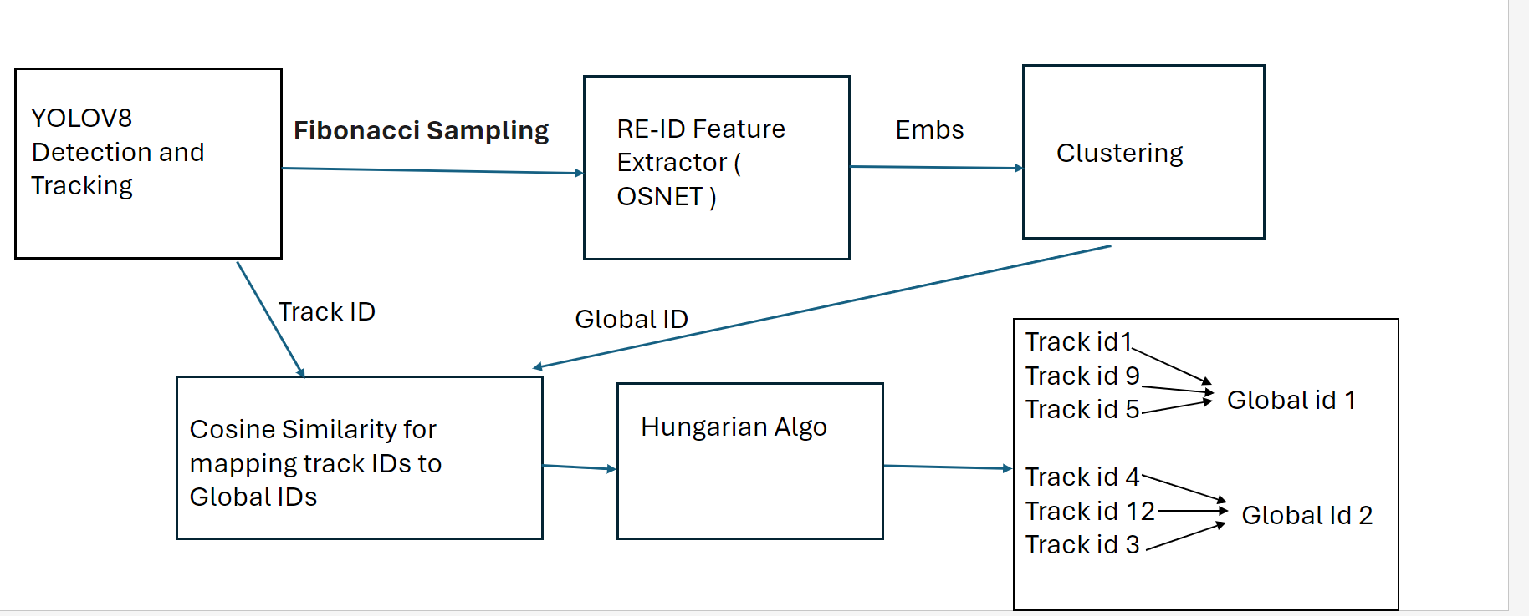
Objective
Project Goal : Developing a robust foundational Mutli camera tracking model , with a focus on person re-identification(Re-ID) tasks for this semester.

Slide 4
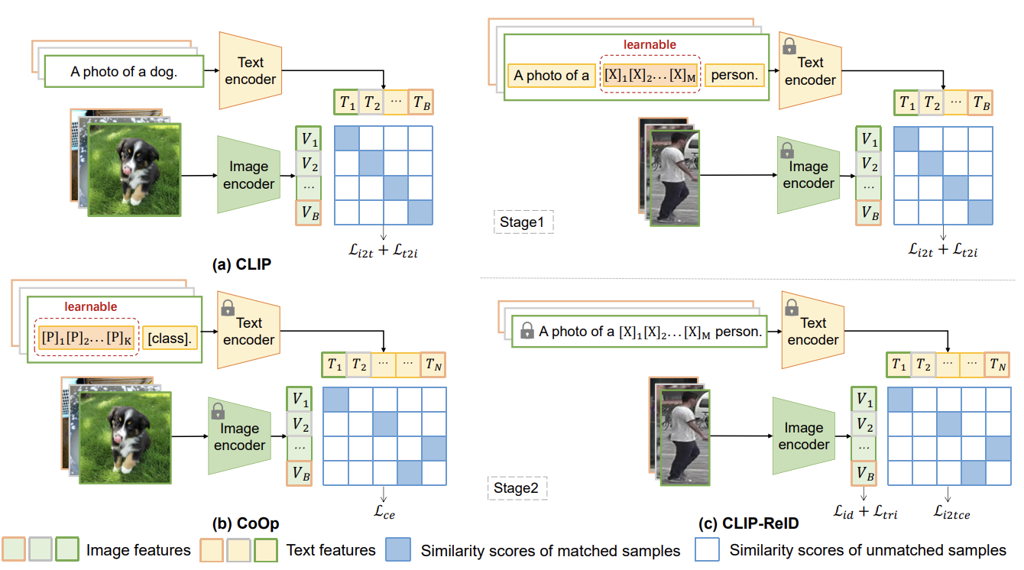
Recap – Literature Review on CLIP-ReID
Stage 1: Learnable Text Token Optimization
Fixed image and text encoders
Optimization of learnable text tokens
Contrastive loss similar to CLIP
Stage 2: Image Encoder Fine-tuning
Fixed text tokens and text encoder
Fine-tuning of image encoder
ID loss and triplet loss
Cross-modality image-to-text cross-entropy loss

Slide 5
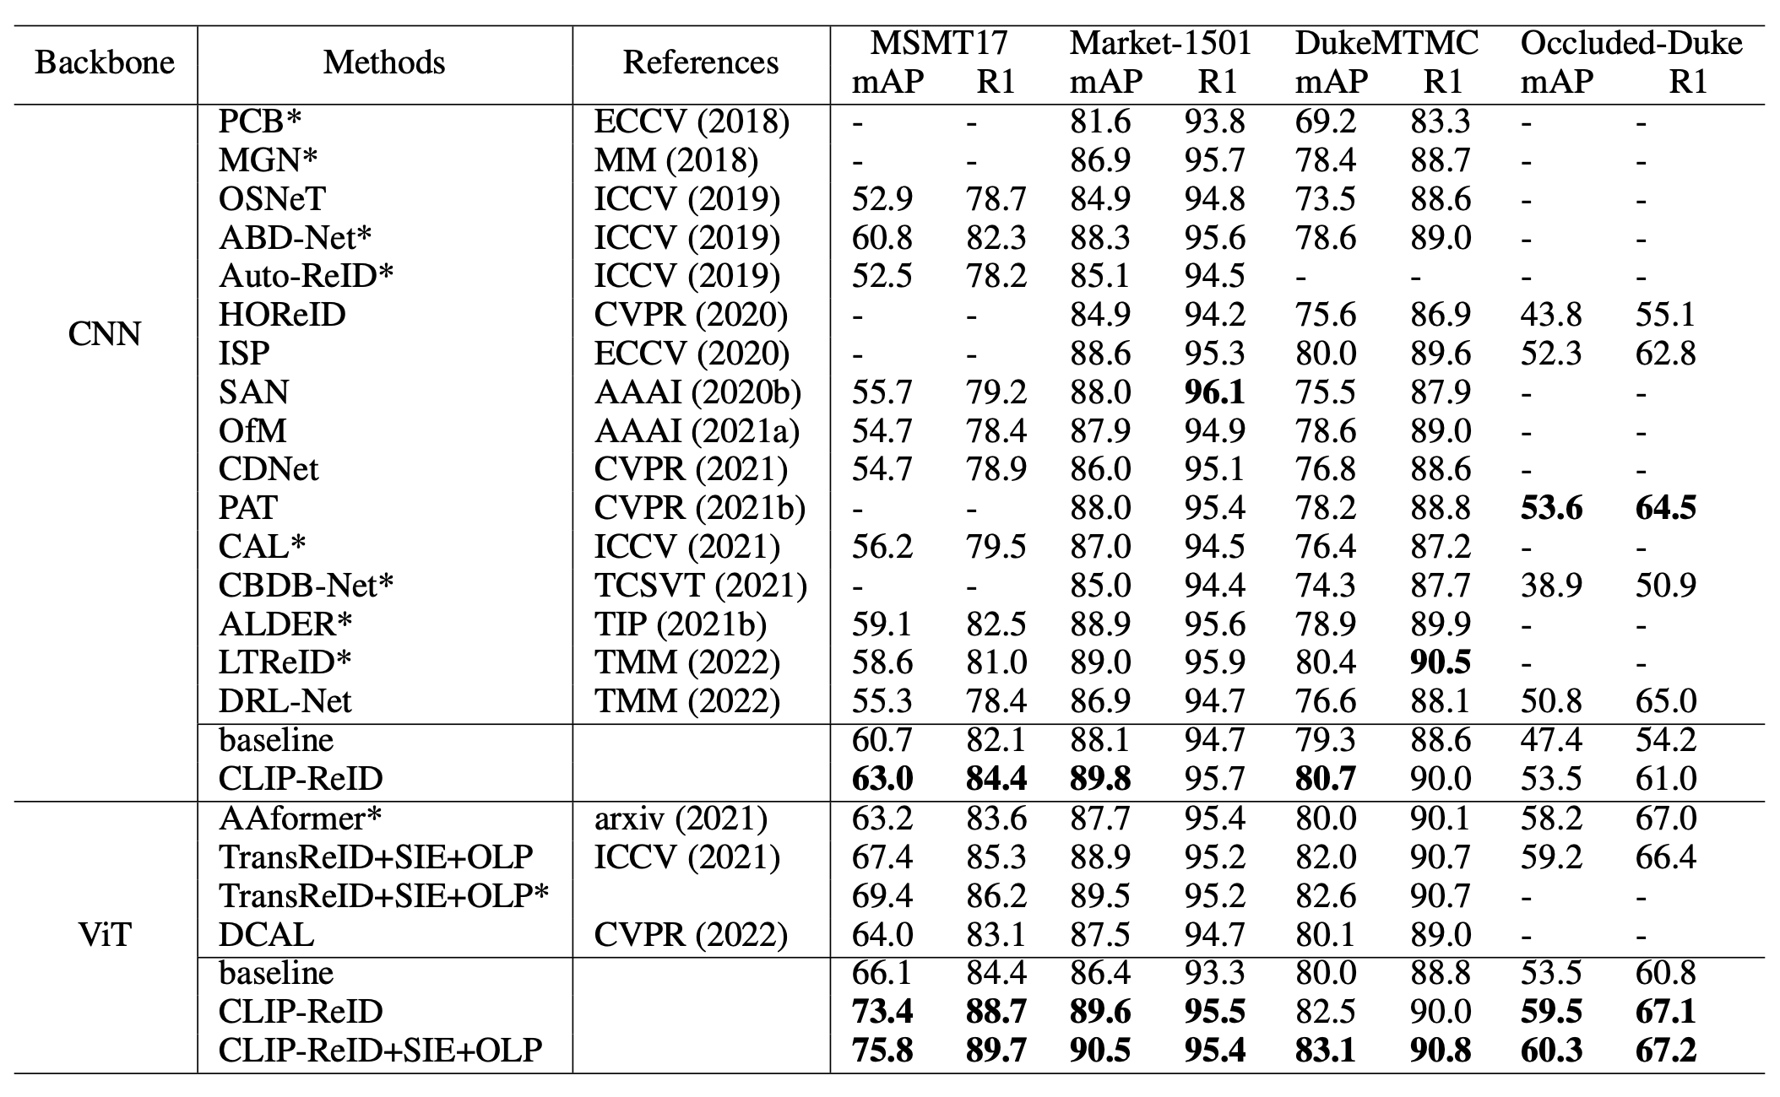
CLIP-ReID – State of the art comparison
43% in mAP
14% R1(rank1 accuracy)

Slide 6
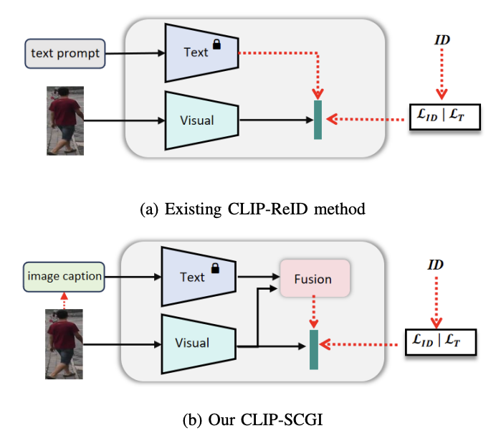
Recap – Literature Review on CLIP-SCGI
Problem: CLIP-ReID uses predefined ID tokens along with simple text prompts.
Absence of concrete descriptions that capture key semantic attributes such as gender, clothing, and age. Solution :
Leverage existing image captioning models(LLaVA) to generate pseudo captions for person images, to boost person re-identification using Vision language models (CLIP)
Introduce Caption guided inversion and Fusion module
CLIP-ReID
CLIP-SCGI
Notes:
One of recent CLIP based method (CLIP-SCGI) has shown using synthetic captions instead of static text to all the person ID.
CLIP-SCGI uses image captioner LLaVA (A large language vision model) to generate person specific captions.

Slide 7
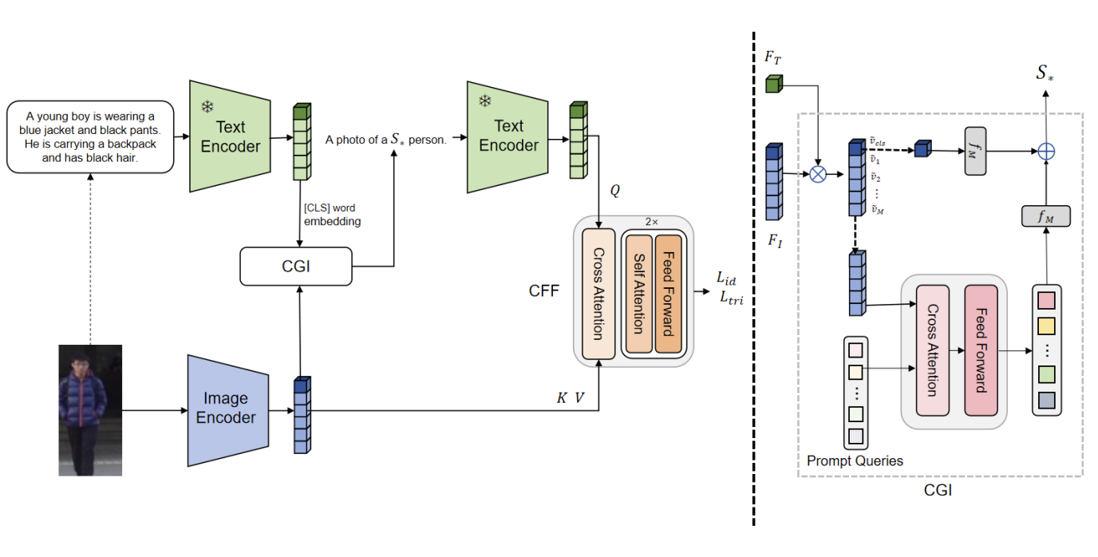
CLIP-SGCI :Methodology
On top of CLIP-ReID , CLIP-SCGI uses Caption Guided inversion(CGI) and Cross Feature Fusion(CFF) module
In Caption Guided Inversion , semantic attributes from images are converted into pseudo-word tokens guided through text descriptions.
The objective function remains same as CLIP-ReID (ID loss + Triplet loss + contrastive loss)

Slide 8
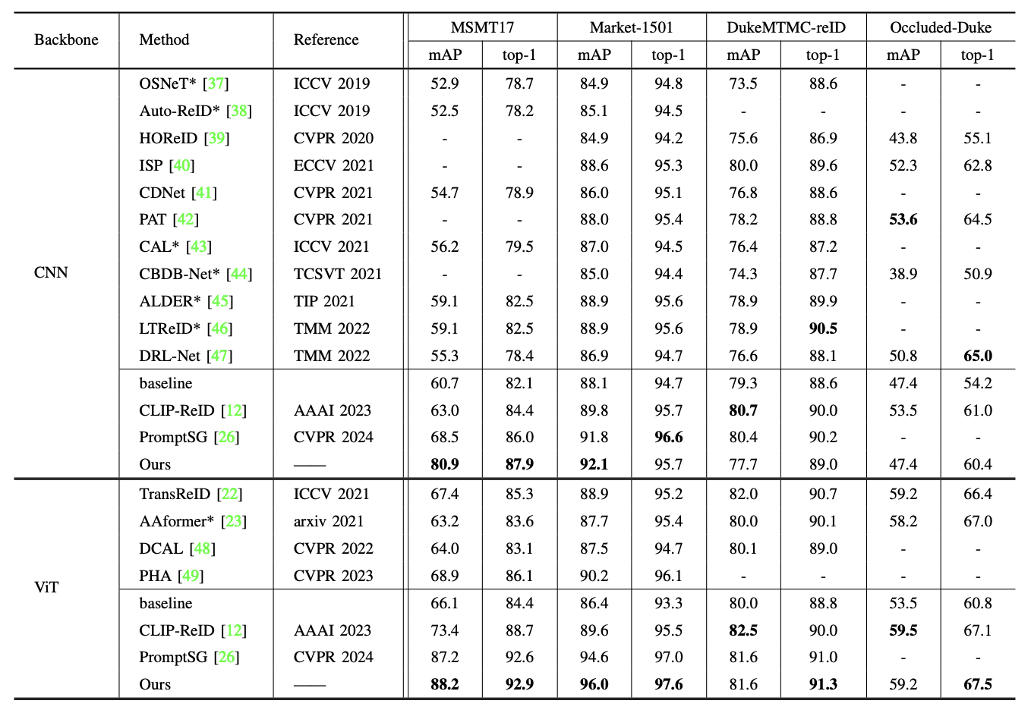
CLIP-SCGI –Comparison to State-of-the-Art
CLIP-SCGI has 26% higher parameters than CLIP-ReID
No increase in training time for one-stage approach compared to the two-stage CLIP-ReID.
Recap – Literature Review on CLIP-SCGI​

Slide 9
CLIP-SCGI
Challenges :
Open-source implementation is not available
Develop the modules from scratch which is time consuming .
Overhead of extracting synthetic captions using Large language models.

Slide 10
Current Progress
Setup of CLIP-ReID codebase
Training of CLIP-ReID and OSNeT on :
Market-1501
Lowes in-house ReID dataset
Qualitative and Quantitative Comparsion of CLIP-ReID and OsNeT on both datasets.
Resolved CLIP-ReID issues including model downloads and system dependencies(Turtle GUI)

Slide 11
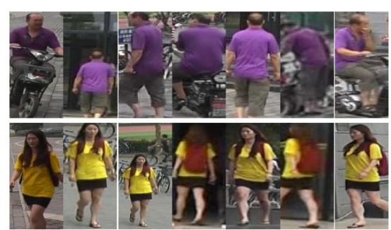
Dataset overview : Market-1501
A Large-scale public benchmark dataset for person re-identification tasks
This dataset consists of 1501 identities.
Split | IDs | Images | Cameras
Train | 751 | 12936 | 6
Query | 750 | 3368 | 6
Gallery | 751 | 15913 | 6
Test set
Dataset statistics
Each identity is present in atleast 2 cameras

Slide 12
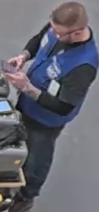
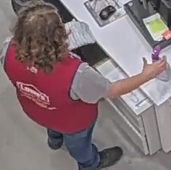
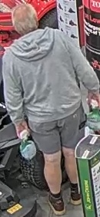
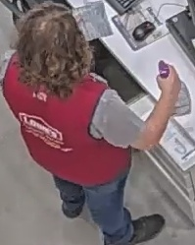
Dataset overview : Lowe's ReID Data
Train set examples
This dataset consists of 1022 identities.
Split | IDs | Images | Cameras
Train | 688 | 13615 | 1
Query | 466 | 3612 | 1
Gallery | 680 | 13625 | 1
Test set examples​
Test set
Dataset statistics
Each identity is across only one camera.

Slide 13
Experimental Results : ReID Evaluation workflow
Extract features for all the query and gallery images.
Apply L2 Normalization to feature vector.
Compute Euclidean distance between query and gallery features.
Generate a distance matrix ; Rank gallery images in ascending order.
Evalutation metrics :
CMC curve Assess matching probabilty at various ranks(Rank-1 Accuracy)
Mean Average Precision measures the retrival performance
Note : for each query identity, its gallery images from the same camera view are discarded

Slide 14
Experiments : Quantitative Results
Performance comparison of CLIP-ReID & OsNeT on Market-1501 Dataset
Method | Epochs | mAP | Top-1 Accuracy
OSNeT | 60 | 78.3 | 93.8%
OSNeT | 250 | 85.3% | 93.8%
CLIP-ReID | 60 | 89.8% | 95.3%
CLIP-ReID+SIE+OLP | 60 | 96.6% | 99.9%
13.2% mAP ,
6.5% Top-1 Accuracy

Slide 15
Experiments: Quantitative Results
Performance comparison of CLIP-ReID & OsNeT on Lowe's Dataset ​
Method | Epochs | mAP | Top-1 Accuracy
OsNET | 50 | 95.8% | 98.3%
CLIP-ReID | 60 | 96.6% | 98.3%
CLIP-ReID+SIE+OLP | 60 | 96.6% | 98.2%
Both methods perform in similar for the below reasons :
Unlike Market-1501 , Lowe's data has common identities in both train and test split.
This dataset lacks multi camera and multi view samples.
In Traditional ReID evaluations , Gallery samples from same person and camera are not considered. However , we evaluate on same samples.

Slide 16

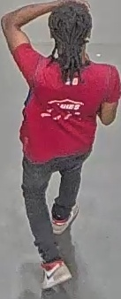
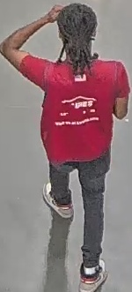
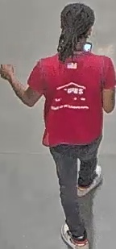



Lowe's Data : Query & Gallery Examples
Query:
Train sample :
Train set and Test set has Similar Identities
No Multi camera samples
Gallery:

Slide 17







Lowe's Data : Query & Gallery Examples
Query:
Train samples :
Train set and Test set has Similar Identities
No Multi camera samples
Gallery:
As the Query is similar to Gallery images , their Feature Norms are closer and Hence, Always Rank as Top-1.

Slide 18






Market –1501 : Query & Gallery Examples
Query:
Train spilt does not contain this sample
Cross Camera sample between Query and Gallery samples
​
Gallery:

Slide 19
CLIP-ReID– Takeaways
Quantivative results on Market-1501 suggest that CLIP-ReID is better than OSNet.
CLIP-ReID requires less training than OSNeT(in terms of epochs) due to CLIP's pretraining.
Unlike to this trend , performance on Lowe's data is almost similar due to below limitations. So irrespective of the method , unless the dataset is diverse the performance remains same.
Limitations :
Query and Gallery images are from same camera
Train and Test split has common images
Lack of multi camera image samples.

Slide 20
Conclusion
Goal : To Enhance person re-identification task of Multi camera tracking framework.
Explored state-of-the-art person Re-ID methods CLIP-ReID , CLIP-SCGI
Conducted experiments on Market-1501 , Lowe's datasets using CLIP-ReID, OSNeT.
CLIP-ReID outperforms OSNeT(our baseline) by 13.2% , 6% in mAP , rank-1 accuracy respectively on Market-1501.
In Contrast to Market-1501 data, both appraches demostrate similar perfomance on Lowe's data due to several dataset limitations.

Slide 21
Next Steps
​
Evaluate CLIP-ReID on Lowe's data which contains multi camera data.
Extract CLIP-ReID features and replace them with the OSNeT features in existing Multi camera tracking pipeline
Perform end-to-end tracking after replacing CLIP-ReID component.
Conduct literature study on recent multi camera tracking approach
BEV-SUSHI: Multi-Target Multi-Camera 3D Detection and Tracking in Bird’s-Eye View from Nvidia ​

